Slide 1
Distant or close cousins: Connectedness between cryptocurrencies and traditional currencies volatilities
Andrada-Félix, Fernandez-Perez, Sosvilla-Rivero (2020)
<number> /

Slide 2
Objectives
Provide insights on the extent and the nature of interdependencies and spillovers between four highly capitalized cryptocurrencies and four major exchange rates
Capture connectedness within both groups or blocks of currencies
Evaluate net directional connectedness for each currency
Analyze the potential drivers of the detected, dynamic volatility connectedness
<number> /

Slide 3
Data
Both types of currencies are considered against USD.
Traditional (daily exchange rates):
  EUR, AUD, JPY and GBP (a, b, c, d)
Cryptocurrencies (daily data):
  Bitcoin-XBT, Ripple-XRP, Litecoin-XLT and Dash-XDS
  (e, f, g, h)
February 2014 to September 2018 (1160 observations)
<number> /
Notes:
I would like to present the data first, in order to make the methods a bit more concrete.
The authors used a normalized-GARCH(1,1) to estimate the variance of the series at a particular point in time.

Slide 4
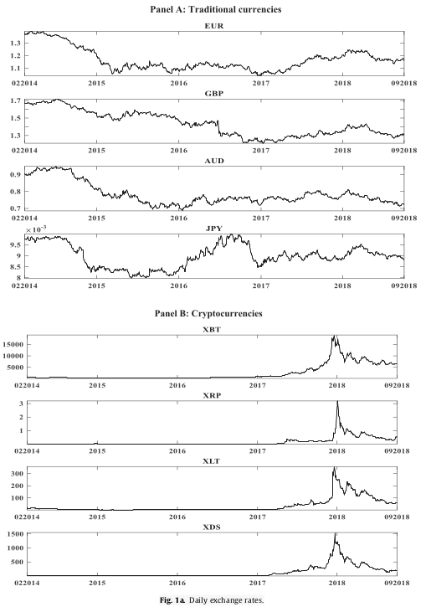
Data
<number> /
Notes:
The traditional currencies do not vary as abruptly as the cryptocurrencies, which have a clear spike at the end of 2017 / beginning of 2018.

Slide 5
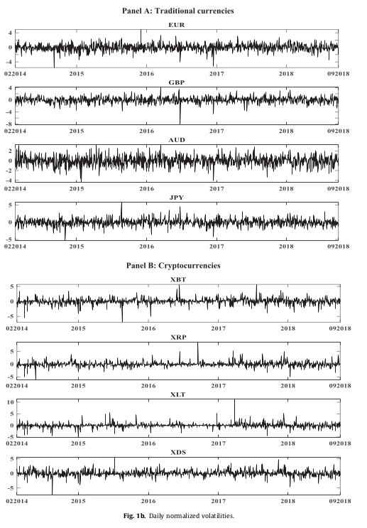
Data
<number> /
Notes:
We can see volatility clustering and that the volatility of the cryptocurrencies is generally larger than the volatility in the traditional currencies.

Slide 6
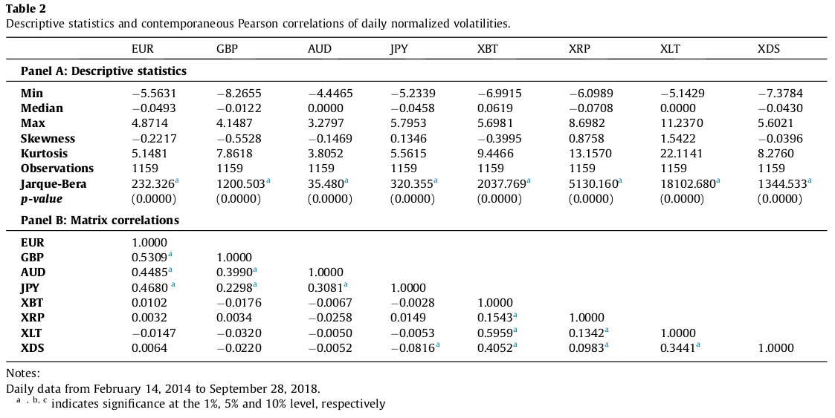
Descriptive Statistics
<number> /
Notes:
We can see from the pairwise correlations that are reported that there are a lot of significant correlation between currencies in the same blocks (i.e. between traditional currencies and between cryptocurrencies), but only one significant (negative) correlation between JPY and XDS, which is a correlation across the blocks. This already indicates that the two blocks might be disconnected.

Slide 7
Notes on Cryptocurrencies
Intention:
  Store of value
  Medium of exchange
  Unit of account
Not issued by central banks
Decentralized: Transferred without involvement of central authority
Rely only on cryptographic integrity, where traditional currencies rely on political and legal mechanisms
<number> /
Notes:
Unit of account means: A unit of measurement of the market value of goods, services and other transactions.
The insights described in the Objectives are used to test if cruptocurrencies may be used as another medium of exchange. The study of volatility connectedness between the two blocks of currencies is used to explore how volatility has been transmitted between (and within the blocks), in order to analyze to which degree cryptocurrencies provide diversification benefits.

Slide 8
Results
34.43% of the forecast’ errors total variance is explained by shocks across the eight examined currencies, indicating that 65.57% of the variation is due to idiosyncratic (individual) shocks
Volatility connectedness varies over time; increasing in periods of increasing economic and financial instability
The blocks are mostly disconnected with periods of mild net volatility spillover
<number> /

Slide 9
Results (Cont.)
Financial market variables are the main drivers of connectedness between traditional currencies
Cryptocurrency-specific variables are the main drivers of connectedness between cryptocurrencies
A combination of the two types of variables explains the connectedness between both blocks
<number> /

Slide 10
Econometric Methodology
Forecast error variance decomposition
Connectedness measures
Generalized connectedness measures
Dynamic connectedness
<number> /
Notes:
The first connectedness measures are used to quantify connectedness between simple components. These are extended into the generalized connectedness measures, in order to quantify connectedness not only between components, but also between components within specific markets and between specific markets. i.e. we can capture connectedness between subgroups of components and/or blocks at the same time.
Point 4 generalizes the frameworks shown in the first 3 points to a time varying model, which means that we can look at dynamic connectedness (similar to the rolling window predictions we talked about in class). The earlier models only allowed us to look at static connectedness.

Slide 11

Forecast error variance decomposition
Fit a reduced-form vector autoregressive (VAR) model to the series [VAR(1)]
Establish H-period-ahead forecast
Decompose variance of the forecast for each component w.r.t. shocks from the same or other components at time t
→ This decomposition is the key to the connectedness measures defined later
<number> /
Notes:
A VAR is a generalization of AR-models, allowing the use of multivariate time series. In our case, the vector will have 8 components; one for each type of currency.
The model fitted here models the current time series vector (at time t) with the observations going back one time (at time t-1) (Known as VAR(1)).
Forecast H-period ahead means to forecast until time t + H.
The key in the methodology used in the paper is that the variance of the forecast can be decomposed into parts that stem from each component in the vector, i.e. the variance in the forecast will be decomposed into 8 parts, each stemming from one of the 8 currencies they have analyzed. Note that I do not know HOW it can be decomposed this way, but it is possible.

Slide 12
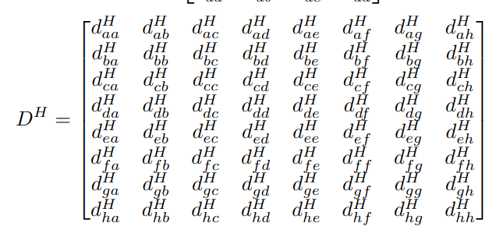

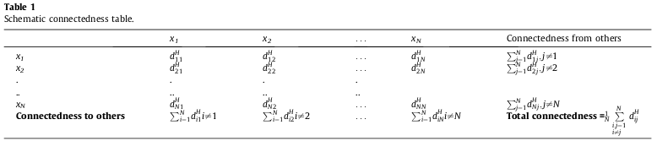
Connectedness measures
<number> /
Notes:
The main ideas are summarized in Table 1.
First some notation:
D^H is the “connectedness matrix” (the upper left part of table 1). Each component of this matrix denotes the fraction of currency i’s H-step forecast variance due to shocks in currency j).
In addition to this matrix, Table 1 contains the row-sums (to the right) and the column-sums (below) as well as the grand average of all off-diagonal elements in D^H. Said loosely: The row-sums show the total variance x_i gets from shocks in the other currencies (from) and the column-sums show the total shock x_i “gives” to other currencies (to).
This table will be shown with the corresponding estimated numbers from the data, which gives some of the results in the paper.

Slide 13






Connectedness measures (Cont.)
Gross pairwise directional connectedness:
Net pairwise directional connectedness
(from j to i) :
Total directional connectedness
  From others to i:
  To others from j:
Net total directional connectedness:
Total connectedness:
<number> /
Notes:
Several connectedness measures are proposed (most of them are given in table 1). All the connectedness measures are based on the non-diagonal terms in the connectedness matrix. i.e. connectedness is measured based on the decomposition of the forecast variance of the VAR-model into each component (each currency).

Slide 14
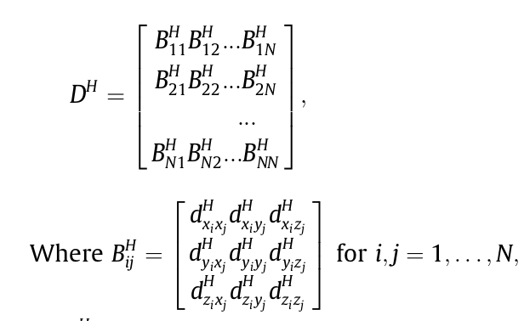
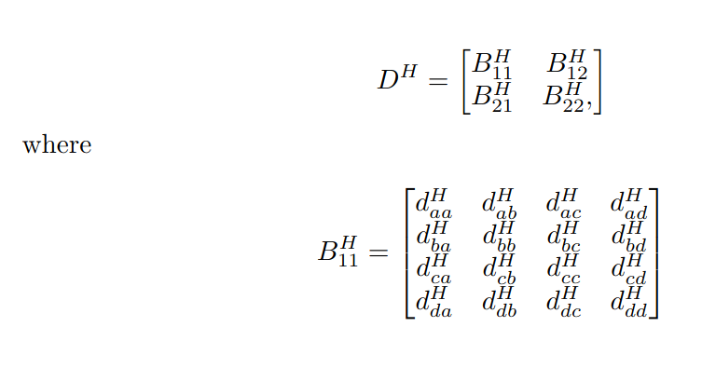
Generalized connectedness measures
Measure spillovers among blocks (here: traditional currencies vs. cryptocurrencies)
Block aggregation of the connectedness matrix
Example below (left) is for m = 3 variables in each market, for a total of N markets
<number> /
Notes:
Remember that the connectedness measures given earlier can only be used to calculate pairwise connectedness between two currencies (and sums of these pairwise connectedness measures).
In the example of the aggregated connectedness matrix, we suppose each block has 3 variables (x, y and z), which is why the matrices B are 3x3. Here we also assume that there are N blocks in total. In our case we would set m = 4 (4 currencies in each block) and N = 2 (2 types of currencies).
Our goal here is to measure the connectedness among the N blocks in a combined manner that encompasses all m currencies in each market.
We say that the diagonal blocks in the matrix collect all the “within-market effects” for block i, while the off-diagonal blocks (B_ij) collect all “spillover effects” from block j to block i.

Slide 15


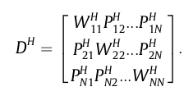
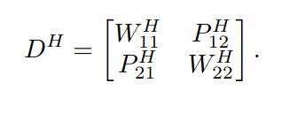
Generalized connectedness measures (Cont.)
  Total within market forecast error variance:
  Total pairwise directional spillover:
  Aggregated connectedness matrix:
<number> /
Notes:
Note that the expression shown for total within market forecast variance essentially is a grand sum of all the elements in the matrix B_ii^H. In this sum we have all the common-currency effects in the forecast variance and the cross-currency effects, within the given market.
Also note that the total pairwise directional spillover is from market j to market i (similar use of indices as normal).
Thus, note that the “aggregated connectedness matrix” is made up of the sums of each of the blocks shown for the connectedness matrix in block form shown in the previous slide (each element is such a sum of the corresponding block).
With this matrix the computations become as easy as before. In our case: this matrix would be 2x2.

Slide 16


Generalized connectedness measures (Cont.)
  Total directional spillover
    Aggregate from connectedness:
    Aggregate to connectedness:
  Net total directional spillover:
  Aggregate between-market spillover:
  Aggregate within-market effect:
<number> /
Notes:
By “aggregate from connectedness” we mean the total spillover from all other markets to market i.
By “aggregate to connectedness” we mean the total spillover from market i to all other markets.

Slide 17
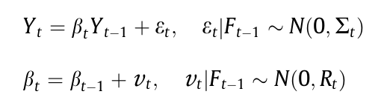
Dynamic Connectedness
Recall VAR(1):
Now: Time-Varying Parameter Vector Autoregressive (TVP-VAR) model
TVP-VAR(1):
<number> /
Notes:
Notice that the connectedness we have been discussing thus far has been static; the VAR model is estimated once at time t, before forecasting. Now we are extending this model to allow for dynamic connectedness. After extending the model, the connectedness matrices (and all the other quantities shown earlier) can be calculated similarly at each time step.
With TVP-VAR we have different coefficients to estimate at each time step. Moreover, each error term in the model has a different covariance-matrix, where F_{t-1} means is the given information in time t-1. From this model, the variance of the H-step forecast error can be decomposed w.r.t. shocks from the same or other components. Then, the rest of the framework is exactly the same as before.
Now we get one of each of the two connectedness matrices shown earlier, at each time step.

Slide 18
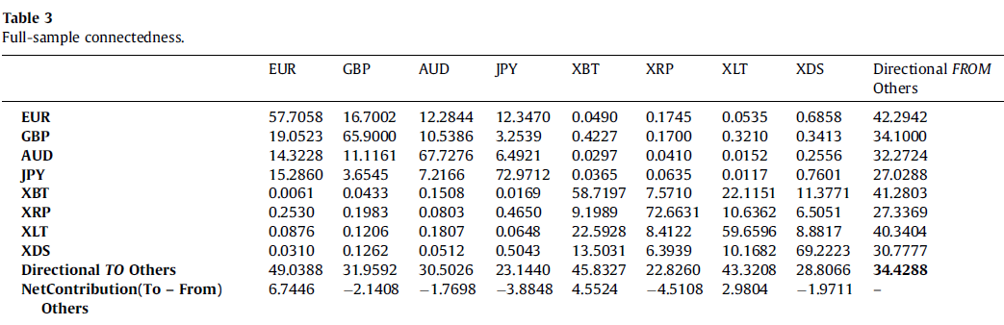
Empirical results
Static (full-sample, unconditional) analysis for all currencies
Notes:
In Table 3, we report the full-sample connectedness table where the off-diagonal elements measure the connectedness between the normalized volatility series.
The diagonal elements (own connectedness) are the largest elements in the table. And the own connectedness is higher than any total directional connectedness FROM and TO others, reflecting how these volatilities are independent of each other. Also, the total connectedness of the eight currency volatilities under study is 34.43% (indicating that the remaining 65.57% of the variation is due to idiosyncratic shocks).
Regarding to the net (TO minus FROM) contribution, our results suggest that the Euro, XBT(Bitcoin) and XLT(Nexalt) are net volatility triggers, while the others are net receivers of volatility.

Slide 19
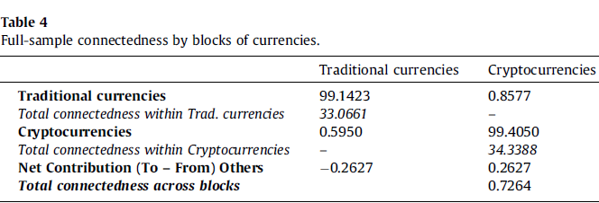
Empirical results
Static (full-sample, unconditional) analysis for all currencies
Notes:
Table 4 Reports the static connectedness table by blocks of currencies using the generalization suggested by Greenwood-Nimmo. The own connectedness of each block, traditional currencies and cryptocurrencies, represents almost 100% of the volatility with only a negligent 0.26% net connectedness from cryptocurrencies to traditional currencies. This result clearly reflects that both blocks are highly intra-connected but highly disconnected to each other, being the total connectedness across blocks of merely 0.73%.
This shows how shocks that come from traditional currencies do not spill over cryptocurrencies, and vice versa. This result is in line with the literature where cryptocurrencies have shown low correlation, and accordingly, good diversification benefits with traditional assets.
Finally, the estimated total connectedness within the traditional currencies is 33.07% and within cryptocurrencies is 34.34%.

Slide 20
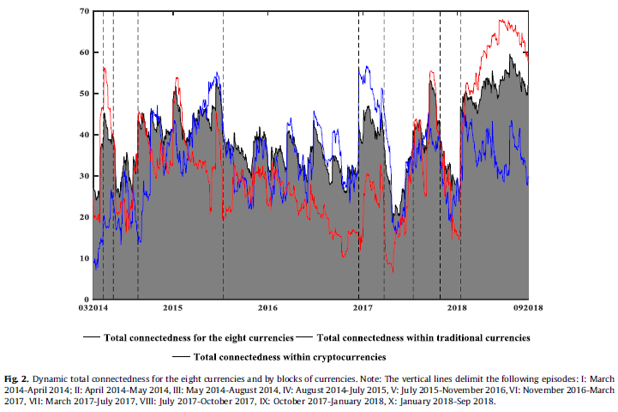
Empirical results
Dynamic connectedness analysis
Notes:
While the previous subsection provides a snapshot of the ‘‘unconditional,” or full-sample, connectedness measure between the volatility of cryptocurrencies and traditional currencies.
Now we’ll see the dynamics of the connectedness measures on the TVP-VAR approach.
In Fig. 2, we report the evolution of the total connectedness between the volatility of the eight traditional currencies and cryptocurrencies under study (shaded grey area).
The Fig. 2 highlights several cycles of connectedness where the total connectedness is around the full sample average (34.43%), suggesting that connectedness between cryptocurrencies and traditional currencies volatilities are time dependent.
We can observe different spikes:
(1) from August 2014 we can see an initial increase due to the divergences in monetary policy expectations followed by some period of relative calm coming from a calmer financial market after the EU bailout agreement with Greece and the stabilization of the Chinese stock market;
(2) until March 2017 we have some turbulence due to political uncertainty about US economic policy and the announcement by the British government of BREXIT;
(3) from the beginning of 2018 until the end of the sample, we have come increase since cryptocurrencies become more popular as the investors remained very sensitive to any changes in central banks’ messages.
We can find the lowest in connectedness in (4) April 2017 (in a context of positive tone in economic data).
Fig. 2 also displays the differentiated behaviour of the total connectedness by blocks of currencies:
1) the volatilities of the four traditional currencies (blue line), and
2) those of the four cryptocurrencies (red line).
The connectedness indexes by blocks of currencies show a similar time- varying pattern over the vertical lines. However, we observe several idiosyncratic spikes in the evolution of the total connectedness by blocks of currencies.
The total connectedness index of the traditional currencies from an initial low value, registered a turbulent rise (in a context of reassessment in emerging market economies and strength in advance economies.
Note, the sudden increase and decrease in the total connectedness index of the cryptocurrencies’ block as the conflict in eastern Ukraine escalated in a context of the considerable uncertainty triggered by the crisis and the fall in energy prices.
After a period of relative stability around its full sample average from July 2015 to November 2016, the total connectedness between the volatilities of the four traditional currencies experienced a fast increase that it peaked at the beginning of 2017 after the United Kingdom formally begun negotiations to leave the European Union.
An episode of free falls of the total connectedness between the volatility of the four cryptocurrencies is detected from March 2017 following the US Securities and Exchange Commission twice denied requests for Bitcoin exchange-traded funds, reaching its full sample lowest value at the end of April 2017 and the connectedness index of the traditional currencies’ block at its lowest values since August 2014.
This last index was followed by an episode of renewed impulse until September 2017 where the former climbed a new spike (57.63%) and the values of the last one above its full sample average coinciding with terrorist attacks in Spain and some tension between USA and North Korea.
Finally, an abrupt increase in both of total connectedness indexes per blocks is found in the final days of January 2018 coinciding with a massive sell-off of most cryptocurrencies in a context of loosening of credit conditions and increase in risk in most asset classes.
One can note that the connectedness index of the volatilities of the cryptocurrencies’ block was increasing gradually along 2018 until reaching the full sample highest values (around 68%) in middle June 2018 as statements from regulators starting to reflect a deeper acknowledgement of the technology underlying cryptocurrencies and their future potential, slowly reversing this trend from that point in time.
Meanwhile, the total connectedness of the volatilities of the four traditional currencies’ block experienced with moderate fluctuations on a downward trend until the end of the sample in September 2018.
When cryptocurrencies collapsed 80% from their peak in January 2018 after report stating that Goldman Sachs was abandoning its plans to trade in cryptocurrencies.

Slide 21
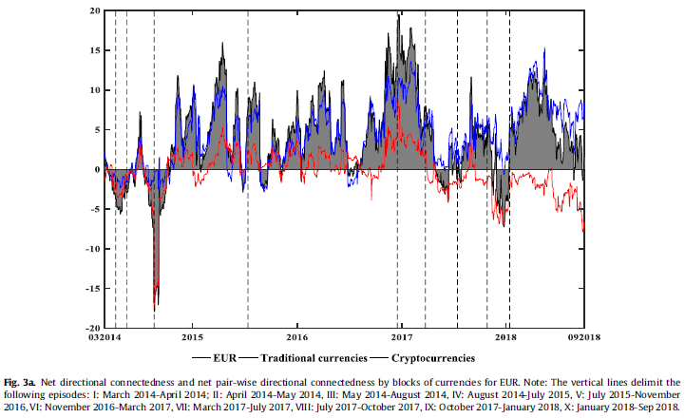
Empirical results
Net and dynamic net pair-wise directional volatility connectedness plots
Notes:
As can be seen in Fig. 3a, EUR is the net trigger of volatility in our sample. Indeed, 77.4% of the computed values in the net directional connectedness are positive, indicating that during most of the sample period EUR transmitted volatility, principally to the net pair-wise directional connectedness per blocks of the traditional currencies (blue line). Interesting, EUR is a net receiver of volatility from the net pair-wise directional connectedness of the cryptocurrencies’ block (red line) in August 2014 (when market participants started to look for further monetary stimulus).

Slide 22
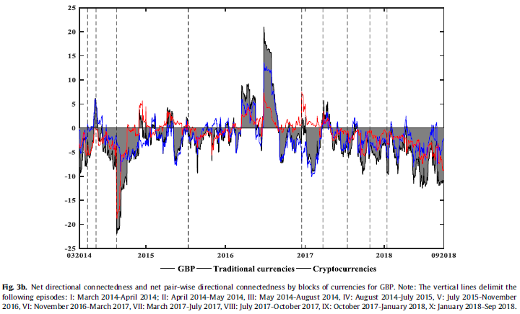
Empirical results
Net and dynamic net pair-wise directional volatility connectedness plots
Notes:
Fig 3b Regarding the GBP is a net receiver of volatility from the net pair-wise directional connectedness per blocks of the traditional currencies during much of the sample, being 79.3% of the computed values negatives. Nevertheless, it is worth noting a transmission of volatility received from the block of cryptocurrencies in August 2014 by both traditional currencies, it is strong in the case of GBP, being possibly partly driven by uncertainty related to the Scottish referendum.
The others are not discussed due to time matters.

Slide 23
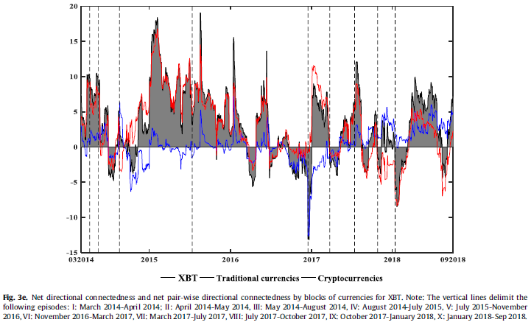
Empirical results
Net and dynamic net pair-wise directional volatility connectedness plots
Notes:
For the XBT(Bitcoin), in Fig. 3e we observe that it is a net generator of volatility in our sample. Indeed, 73.13% of the computed values in the net directional connectedness are positive, indicating that during most of the sample period XBT transmitted principally to the net pair-wise directional connectedness of the other cryptocurrencies. Interestingly, XBT is a net receiver of volatility from the net pair-wise directional connectedness of the other cryptocurrencies at the beginning of 2018, coinciding with the great cryptocurrency crash of January 2018.

Slide 24
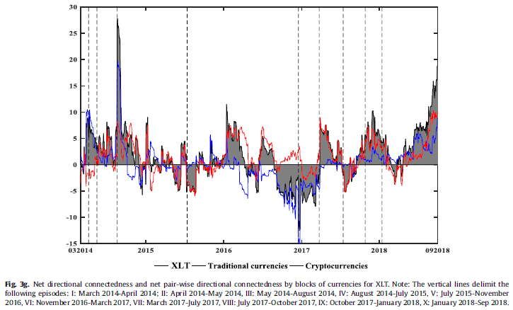
Empirical results
Net and dynamic net pair-wise directional volatility connectedness plots
Notes:
Concerning XLT, Fig. 3g shows a swing in the net directional connectedness where periods of a net generation of volatility are followed by periods where XLT is a net receiver of volatility. Moreover, XLT is a net absorber of volatility from the net pair-wise directional connectedness of the traditional currencies’ block from the second half of September 2016 to late December 2016.

Slide 25
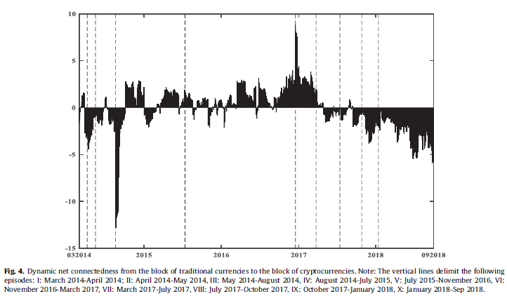
Empirical results
Net and dynamic net pair-wise directional volatility connectedness plots
Notes:
Fig. 4 plots the dynamic net connectedness from the block of traditional currencies to the block of cryptocurrencies. Although the static net connectedness from the block of traditional currencies to the block of cryptocurrencies shows that these two blocks are disconnected, the dynamic net connectedness shows a different picture, ranging the net connectedness from close to -14% (around mid-2014, in a context of widespread pessimism and negative investor sentiment in the cryptocurrency market trend) to 10% (late 2016 and early 2017, tensions about the implementation of the Greek adjustment programme, the UK Brexit vote and the surprise result of the US election). Remarkably, the block of cryptocurrencies is a net generator of volatility at the end of our sample, in a period characterized by a huge increase in trading activity and media coverage in cryptocurrencies.

Slide 26
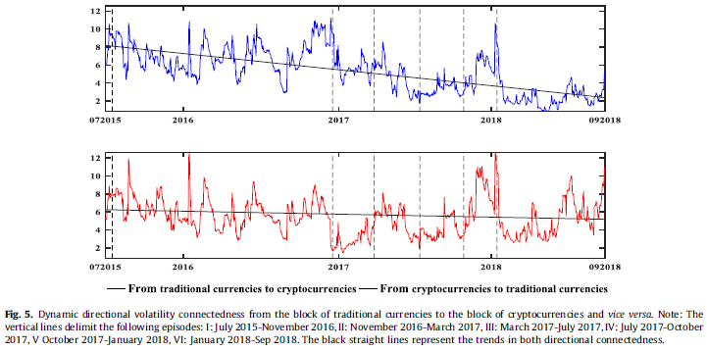
Empirical results
Net and dynamic net pair-wise directional volatility connectedness plots
Notes:
Fig. 5 plots the decomposition of the dynamic net connectedness into directional volatility connectedness from block of traditional currencies to the block of cryptocurrencies, and vice versa. We identify a negative trend in the directional volatility connectedness from the block of traditional currencies to the block of cryptocurrencies, indicating a gradual reduction in the exposures of traditional to digital currencies.
The analysis of this section shows that the unconditional or full-sample connectedness measure is not able to uncover all the dynamics of the connectedness between the different currencies’ volatilities. The dynamic net connectedness approach identifies substantially different interrelationship episodes, yielding more accurate and sensible indicators of the spread of market disturbances.

Slide 27
Determinants of the total and net dynamic connectedness

Slide 28
Concluding remarks

