Slide 1
Distant or close cousins: Connectedness between cryptocurrencies and traditional currencies volatilities
Andrada-Félix, Fernandez-Perez, Sosvilla-Rivero (2020)

Slide 2
Objectives
Provide insights on the extent and the nature of interdependencies and spillovers between four highly capitalized cryptocurrencies and four major exchange rates
Capture connectedness within both groups or blocks of currencies
Evaluate net directional connectedness for each currency
Analyze the potential drivers of the detected, dynamic volatility connectedness

Slide 3
Data
Both types of currencies are considered against USD.
Traditional (daily exchange rates):
  EUR, AUD, JPY and GBP
Cryptocurrencies (daily data):
  Bitcoin-XBT, Ripple-XRP, Litecoin-XLT and Dash-XDS
February 2014 to September 2018 (1160 observations)
Notes:
I would like to present the data first, in order to make the methods a bit more concrete.
The authors used a normalized-GARCH(1,1) to estimate the variance of the series at a particular point in time.

Slide 4
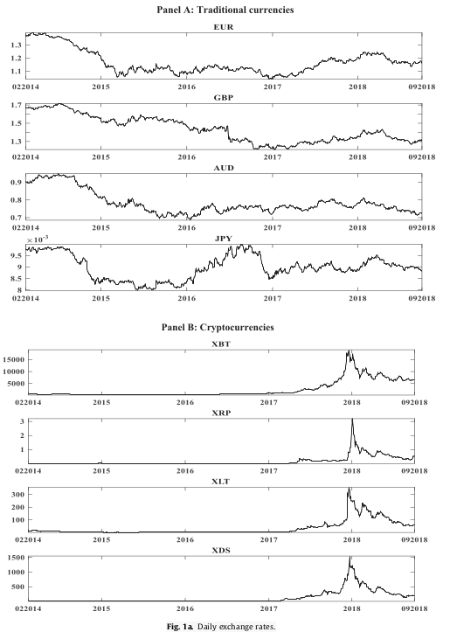
Data
Notes:
The traditional currencies do not vary as abruptly as the cryptocurrencies, which have a clear spike at the end of 2017 / beginning of 2018.

Slide 5
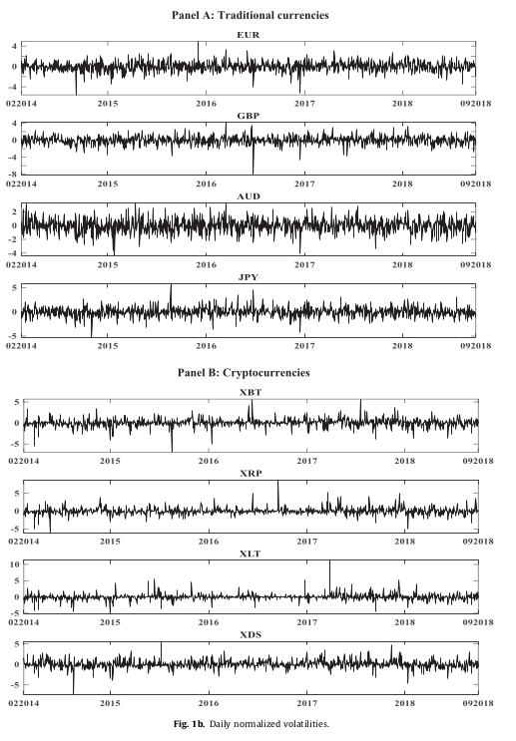
Data
Notes:
We can see volatility clustering and that the volatility of the cryptocurrencies is generally larger than the volatility in the traditional currencies.

Slide 6
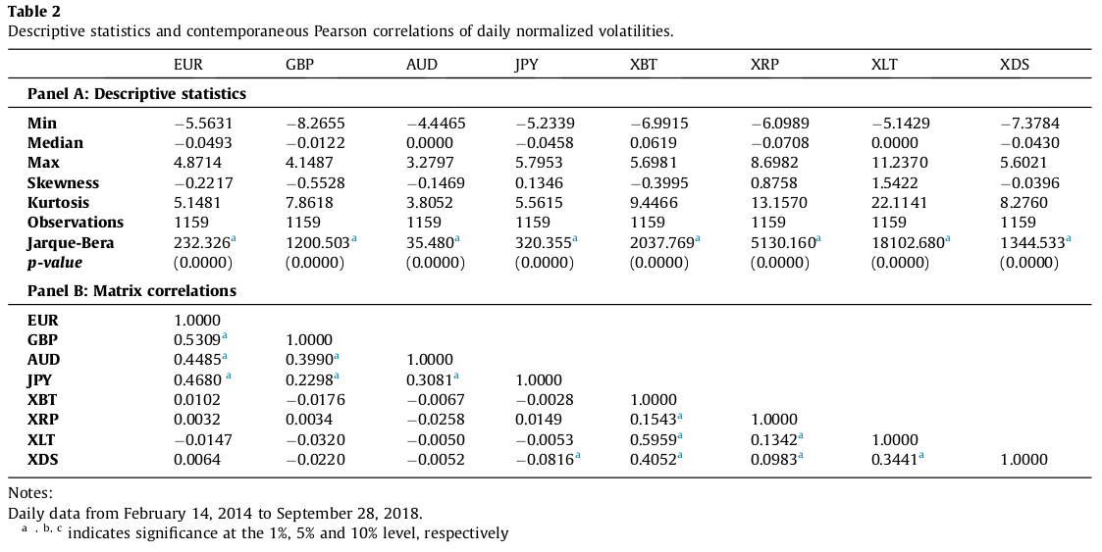
Descriptive Statistics
Notes:
We can see from the pairwise correlations that are reported that there are a lot of significant correlation between currencies in the same blocks (i.e. between traditional currencies and between cryptocurrencies), but only one significant (negative) correlation between JPY and XDS, which is a correlation across the blocks. This already indicates that the two blocks might be disconnected.

Slide 7
Notes on Cryptocurrencies
Intention:
  Store of value
  Medium of exchange
  Unit of account
Not issued by central banks
Decentralized: Transferred without involvement of central authority
Rely only on cryptographic integrity, where traditional currencies rely on political and legal mechanisms
Notes:
Unit of account means: A unit of measurement of the market value of goods, services and other transactions.
The insights described in the Objectives are used to test if cruptocurrencies may be used as another medium of exchange. The study of volatility connectedness between the two blocks of currencies is used to explore how volatility has been transmitted between (and within the blocks), in order to analyze to which degree cryptocurrencies provide diversification benefits.

Slide 8
Results
34.43% of the forecast’ errors total variance is explained by shocks across the eight examined currencies, indicating that 65.57% of the variation is due to idiosyncratic (individual) shocks
Volatility connectedness varies over time; increasing in periods of increasing economic and financial instability
The blocks are mostly disconnected with periods of mild net volatility spillover

Slide 9
Results (Cont.)
Financial market variables are the main drivers of connectedness between traditional currencies
Cryptocurrency-specific variables are the main drivers of connectedness between cryptocurrencies
A combination of the two types of variables explains the connectedness between both blocks

Slide 10
Econometric Methodology
Forecast error variance decomposition
Connectedness measures
Generalized connectedness measures
Dynamic connectedness
Notes:
The first connectedness measures are used to quantify connectedness between simple components. These are extended into the generalized connectedness measures, in order to quantify connectedness not only between components, but also between components within specific markets and between specific markets. i.e. we can capture connectedness between subgroups of components and/or blocks at the same time.
Point 4 generalizes the frameworks shown in the first 3 points to a time varying model, which means that we can look at dynamic connectedness (similar to the rolling window predictions we talked about in class). The earlier models only allowed us to look at static connectedness.

Slide 11
Forecast error variance decomposition
Fit a reduced-form vector autoregressive (VAR) model to the series [VAR(1)]
Establish H-period-ahead forecast
Decompose variance of the forecast for each component w.r.t. shocks from the same or other components at time t
→ This decomposition is the key to the connectedness measures defined later
Notes:
A VAR is a generalization of AR-models, allowing the use of multivariate time series. In our case, the vector will have 8 components; one for each type of currency.
The model fitted here models the current time series vector (at time t) with the observations going back one time (at time t-1) (Known as VAR(1)).
Forecast H-period ahead means to forecast until time t + H.
The key in the methodology used in the paper is that the variance of the forecast can be decomposed into parts that stem from each component in the vector, i.e. the variance in the forecast will be decomposed into 8 parts, each stemming from one of the 8 currencies they have analyzed. Note that I do not know HOW it can be decomposed this way, but it is possible.

Slide 12

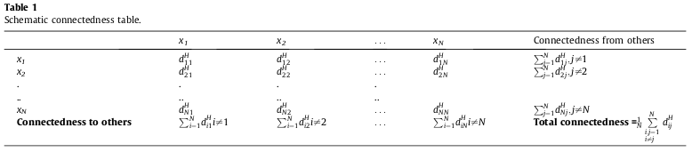
Connectedness measures
Notes:
The main ideas are summarized in Table 1.
First some notation:
D^H is the “connectedness matrix” (the upper left part of table 1). Each component of this matrix denotes the fraction of currency i’s H-step forecast variance due to shocks in currency j).
In addition to this matrix, Table 1 contains the row-sums (to the right) and the column-sums (below) as well as the grand average of all off-diagonal elements in D^H. Said loosely: The row-sums show the total variance x_i gets from shocks in the other currencies (from) and the column-sums show the total shock x_i “gives” to other currencies (to).
This table will be shown with the corresponding estimated numbers from the data, which gives some of the results in the paper.

Slide 13






Connectedness measures (Cont.)
Gross pairwise directional connectedness:
Net pairwise directional connectedness
(from j to i) :
Total directional connectedness
  From others to i:
  To others from j:
Net total directional connectedness:
Total connectedness:
Notes:
Several connectedness measures are proposed (most of them are given in table 1). All the connectedness measures are based on the non-diagonal terms in the connectedness matrix. i.e. connectedness is measured based on the decomposition of the forecast variance of the VAR-model into each component (each currency).

Slide 14
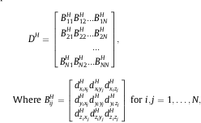
Generalized connectedness measures
Measure spillovers among blocks (here: traditional currencies vs. cryptocurrencies)
Block aggregation of the connectedness matrix
Example below is for m = 3 variables in each market, for a total of N markets
Notes:
Remember that the connectedness measures given earlier can only be used to calculate pairwise connectedness between two currencies (and sums of these pairwise connectedness measures).
In the example of the aggregated connectedness matrix, we suppose each block has 3 variables (x, y and z), which is why the matrices B are 3x3. Here we also assume that there are N blocks in total. In our case we would set m = 4 (4 currencies in each block) and N = 2 (2 types of currencies).
Our goal here is to measure the connectedness among the N blocks in a combined manner that encompasses all m currencies in each market.
We say that the diagonal blocks in the matrix collect all the “within-market effects” for block i, while the off-diagonal blocks (B_ij) collect all “spillover effects” from block j to block i.

Slide 15



Generalized connectedness measures (Cont.)
  Total within market forecast error variance:
  Total pairwise directional spillover:
  Aggregated connectedness matrix:
Notes:
Note that the expression shown for total within market forecast variance essentially is a grand sum of all the elements in the matrix B_ii^H. In this sum we have all the common-currency effects in the forecast variance and the cross-currency effects, within the given market.
Also note that the total pairwise directional spillover is from market j to market i (similar use of indices as normal).
Thus, note that the “aggregated connectedness matrix” is made up of the sums of each of the blocks shown for the connectedness matrix in block form shown in the previous slide (each element is such a sum of the corresponding block).
With this matrix the computations become as easy as before. In our case: this matrix would be 2x2.

Slide 16


Generalized connectedness measures (Cont.)
  Total directional spillover
    Aggregate from connectedness:
    Aggregate to connectedness:
  Net total directional spillover:
  Aggregate between-market spillover:
  Aggregate within-market effect:
Notes:
By “aggregate from connectedness” we mean the total spillover from all other markets to market i.
By “aggregate to connectedness” we mean the total spillover from market i to all other markets.

Slide 17

Dynamic Connectedness
Recall VAR(1):
Now: Time-Varying Parameter Vector Autoregressive (TVP-VAR) model
TVP-VAR(1):
Notes:
Notice that the connectedness we have been discussing thus far has been static; the VAR model is estimated once at time t, before forecasting. Now we are extending this model to allow for dynamic connectedness. After extending the model, the connectedness matrices (and all the other quantities shown earlier) can be calculated similarly at each time step.
With TVP-VAR we have different coefficients to estimate at each time step. Moreover, each error term in the model has a different covariance-matrix, where F_{t-1} means is the given information in time t-1. From this model, the variance of the H-step forecast error can be decomposed w.r.t. shocks from the same or other components. Then, the rest of the framework is exactly the same as before.
Now we get one of each of the two connectedness matrices shown earlier, at each time step.

