Slide 1
DBAP – Distance-based amplitude panning
Trond Lossius, BEK
Pascal Baltazar, GMEA
Théo de la Hogue, GMEA

Slide 2
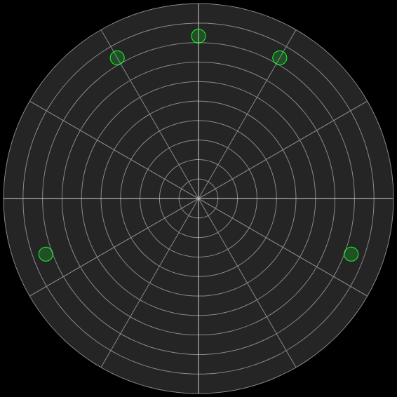
ITU 5.1 Surround

Slide 3
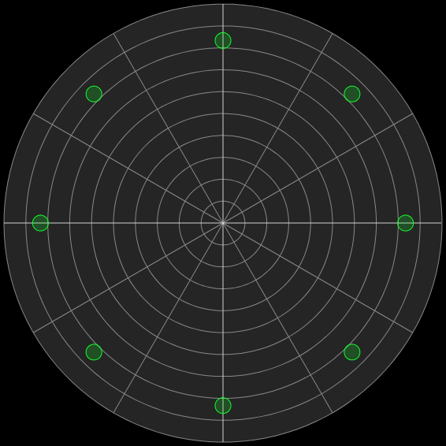
Ambisonics

Slide 4
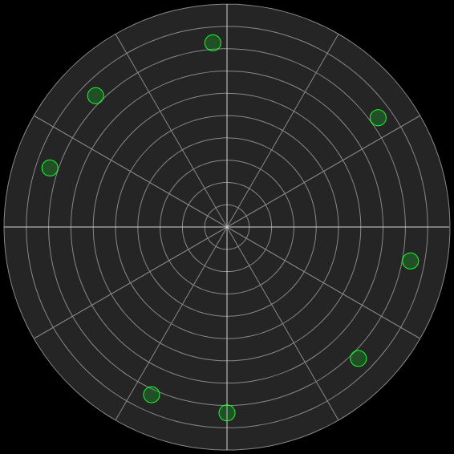
VBAP – Vector-based amplitude panning

Slide 5
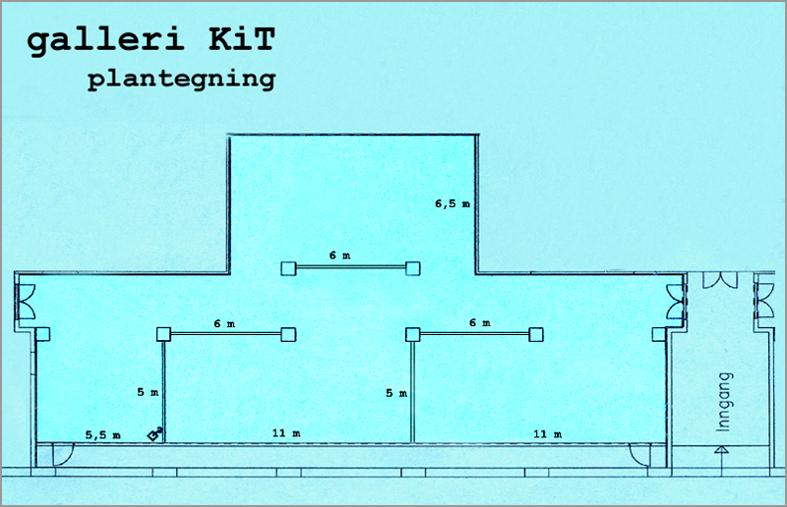

Slide 6
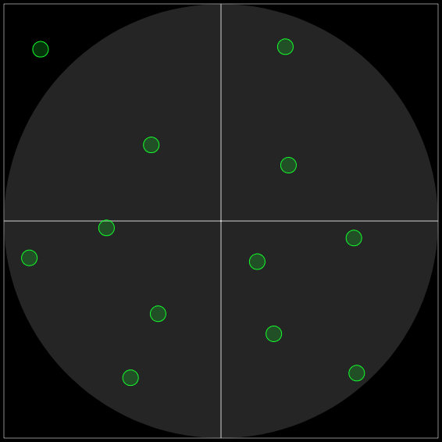
Speakers any way you want

Slide 7
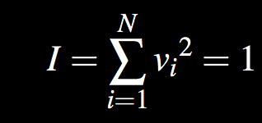
Assumption 1: Constant intensity

Slide 8
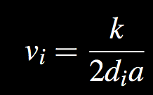
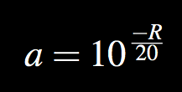
Assumption 2: All speakers active
Relative amplitude of each speaker:
a calculated from rolloff R in dB per doubling of distance:

Slide 9
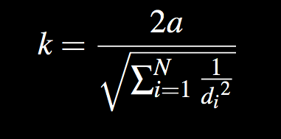

Slide 10
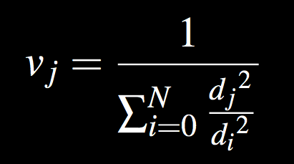
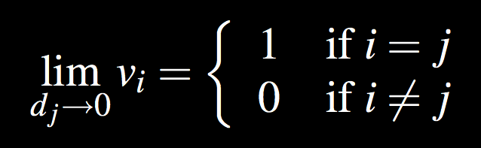
Extension 1: Spatial blur

Slide 11
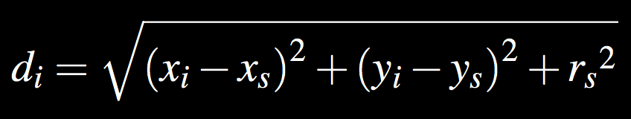

Slide 12
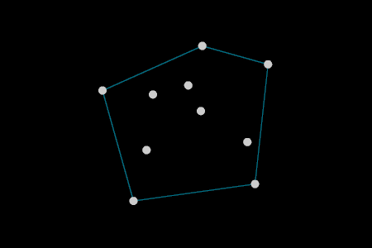
Extension 2: Convex hull

Slide 13
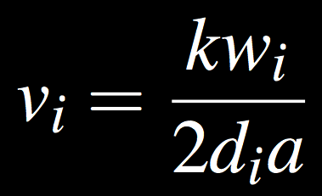
Extension 3: Speaker weights

Slide 14
Implementation
Max and Jamoma
Visualization
Demo !

Slide 15
Discussion
Summary :
Simple matrix-based spatialisation method
No sweet spot
No assumption concerning speaker layout
Other spatialisation techniques :
Wave-field synthesis
ViMiC – Virtual Microphone Control (Braasch et. al., 2008)
Potential uses :

Slide 16
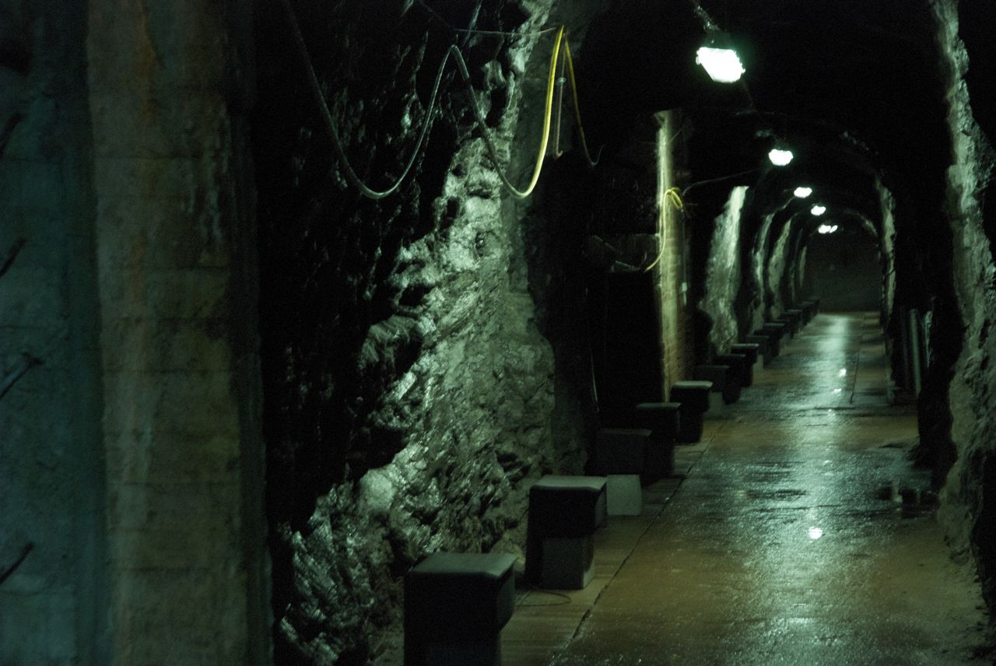

Slide 17
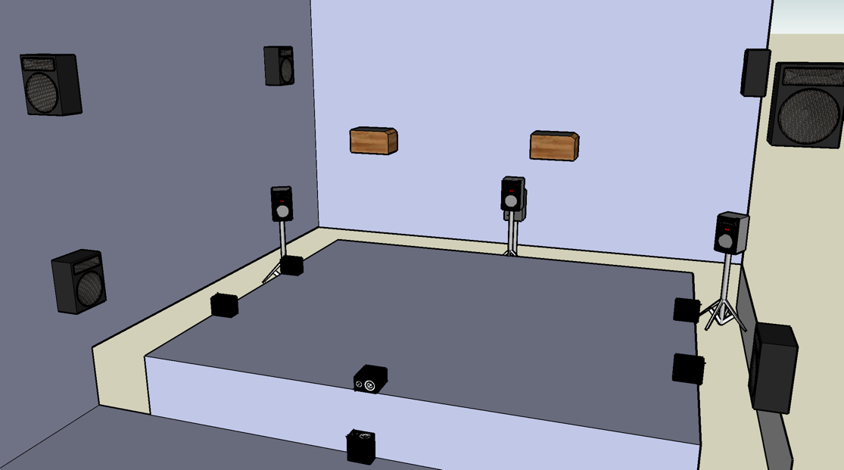

Slide 18
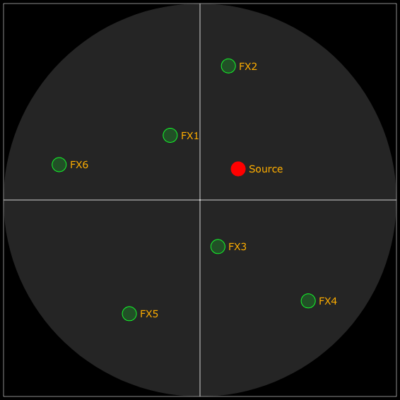
FX bussing

Slide 19
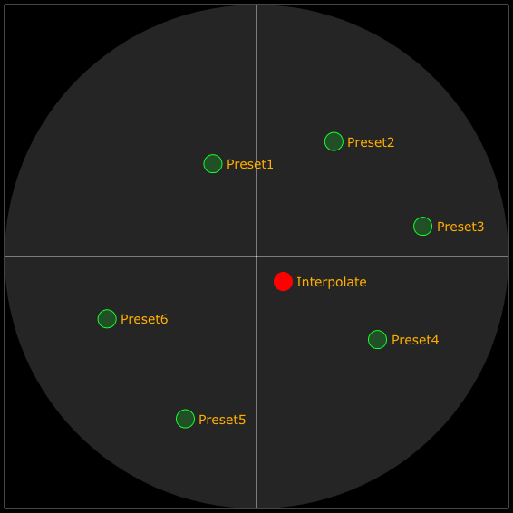
Spatial interpolation between presets

Slide 20


Slide 21
Acknowledgement
Thorolf Thuestad
André Sierr
Jamoma developers – www.jamoma.org
Mathieu Chamangne
PNEK – www.pnek.no
Virage platform – www.virage-platform.org

