Slide 1
Magic Kitchens Meat Loaf Mix
Sales Forecast & Marketing Budget Recommendation
Presented by Sally Bunn · Brand Manager
Group Members: Matvey Firsov · Gennady Petrishchev · Aleksandr Petrunin · Manuel Wills
IS508 · Big Data and Analytics · April 2026

Slide 2
OVERVIEW
Agenda
01
The Business Challenge
Why Sally needs a model — and why past data is confusing
02
Data & Exploration
24 quarters, 4 variables, hidden patterns
03
Methodology
4 regression models built, 1 selected by Adjusted R²
04
Key Findings
What actually drives sales — and what doesn't
05
Recommendation
Where to spend $1K, what to forecast, what to watch

Slide 3
01 · THE CHALLENGE
The Business Challenge
What Sally inherited on Day 1
• Meat loaf mix sales swing from $227K to $703K per quarter — a nearly 3× gap
• Company policy: EITHER promote OR advertise each quarter (never both)
• Long-standing internal debate: does promotion actually work, or just steal future sales?
• Advertising effect unclear — two similar ad spends ($36K vs $39K) produced $648K and $343K
• Economist claims product is counter-cyclical — sells better in recessions
• Possible seasonal effect — cold months may drive more purchases
$227K–$703K
Sales range
85%
Variance explained by our model
24 qtrs
Historical data

Slide 4
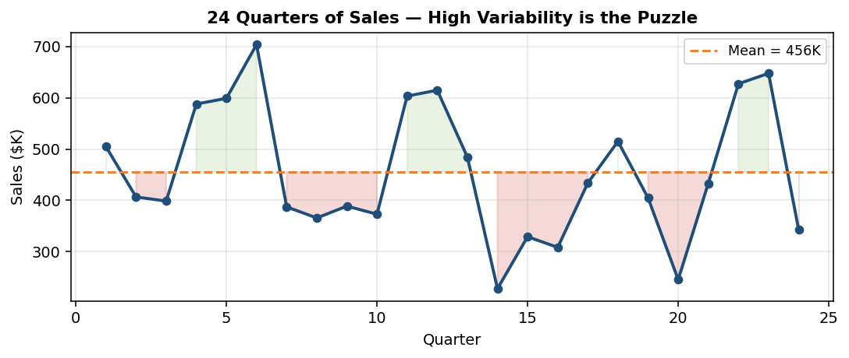
02 · DATA & EXPLORATION
The Data — 24 Quarters of History
Variable | Description | Mean | Min | Max
sales | Quarterly sales ($K) | 456K | 228K | 704K
prom | Promotion spend — to brokers ($K) | 15.9K | 0K | 50.1K
adv | Advertising spend — to consumers ($K) | 26.6K | 0K | 57K
index | Economic conditions index | 105.5 | 96 | 114

Slide 5
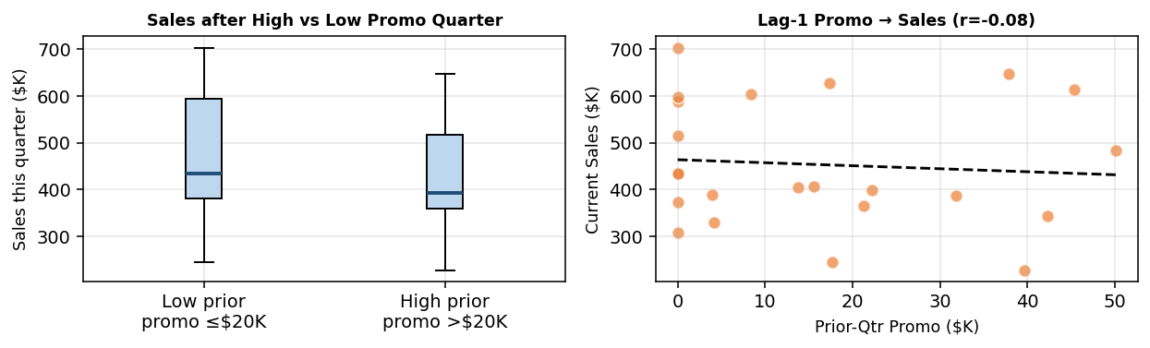
02 · DATA & EXPLORATION
Key Insight: Promotion Creates a Hangover
What the raw data tells us before we even run a model
• Promotion boosts sales THIS quarter — but suppresses NEXT quarter
• When prior-quarter promo > $20K → next quarter median sales DROP ~$80K
• Brokers stockpile inventory during deals, then don't reorder until stock clears
• → This is why we must test lagged (delayed) effects in the model

Slide 6
03 · METHODOLOGY
Model Building — Progressive Complexity
We built 4 OLS regression models, selecting by Adjusted R²
M1
Base
prom + adv + index
Adj R² = 0.547
✗ Missing lag effects
M2
Lags
+ prom_lag₁ + adv_lag₁
Adj R² = 0.800
✗ Missing seasons
M3
Seasonal
+ Q1/Q2/Q3 dummies
Adj R² = 0.536
✗ Missing lags
M4
Full ★
All of the above ← BEST
Adj R² = 0.849
✓ All effects tested
★ Winner: M4 Full — Adj R² = 0.850 (explains 85% of sales variance)

Slide 7
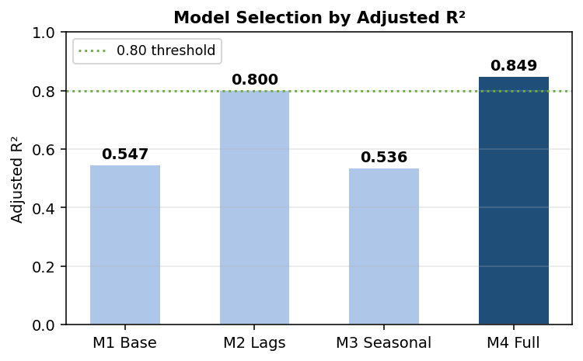
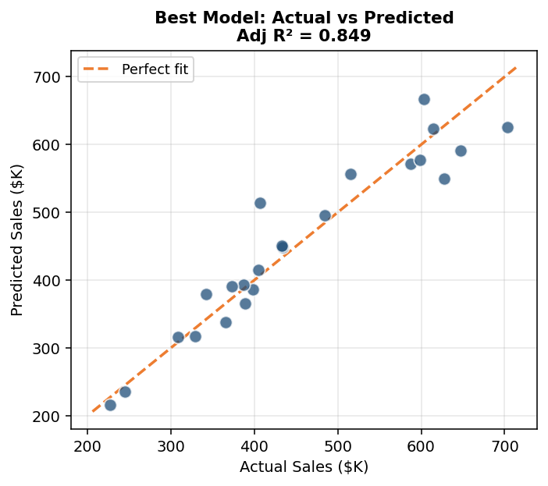
03 · METHODOLOGY
Best Model Performance — M4 Full
Adj R² = 0.849 · n = 23 quarters · AIC = 254
• RMSE: $40.7K (avg forecast error)
• Residuals are well-behaved — no systematic pattern
• No multicollinearity detected (max |r| = 0.46 between predictors)

Slide 8
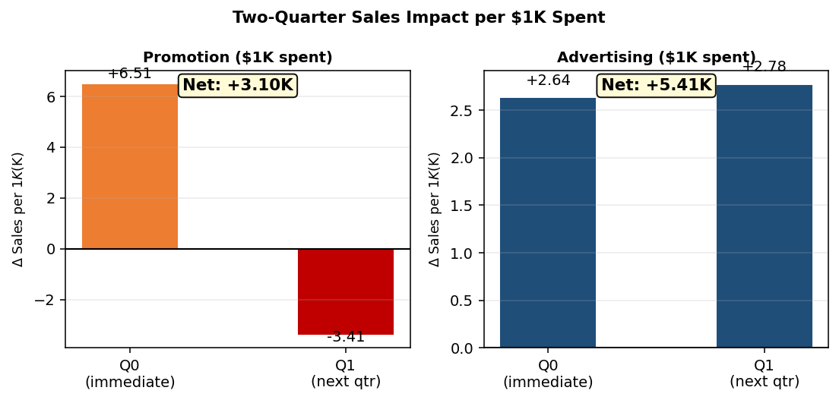
04 · KEY FINDINGS
Q1: Where Should Sally Spend $1,000?
Answer: Advertising yields a higher net sales return
Promotion — Net Effect
+6.51K −3.41K = +3.10K net
Advertising — Net Effect
+2.64K +2.78K = +5.41K net
• Promotion boosts sales NOW (+$6.51K) but creates a hangover
• Lagged promo is negative (−$3.41K): brokers stockpile, then go quiet
• Advertising compounds: +$2.64K now AND +$2.78K next quarter
• ★ Sally should ADVERTISE — net return is $5.41K vs $3.10K

Slide 9
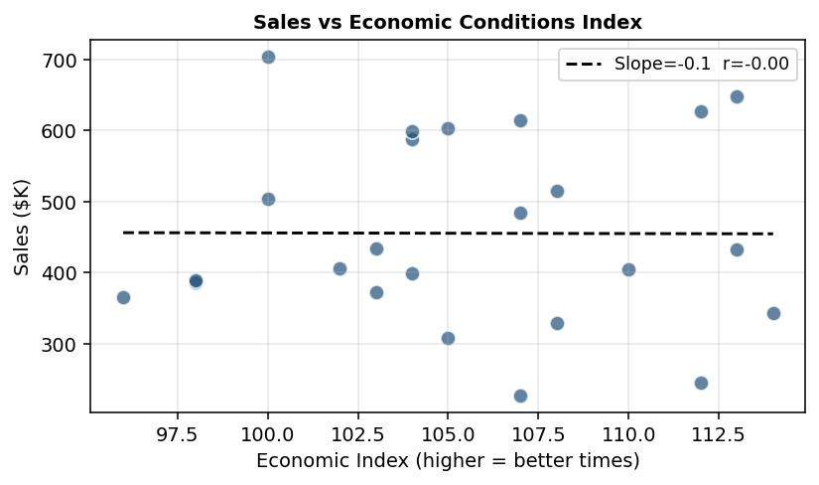
04 · KEY FINDINGS
Q2: Is Meat Loaf Counter-Cyclical?
The economist's theory is plausible — but just misses statistical confirmation
Coefficient (index)
-4.922
t-statistic
-2.11
p-value
0.0530
95% CI
[-9.92, 0.07]
• Coefficient is NEGATIVE (−4.92): ✓ correct direction
• p = 0.053 — misses 5% threshold by a whisker
• Verdict: Suggestive, not conclusive
• Watch economic conditions; cold winters may help

Slide 10
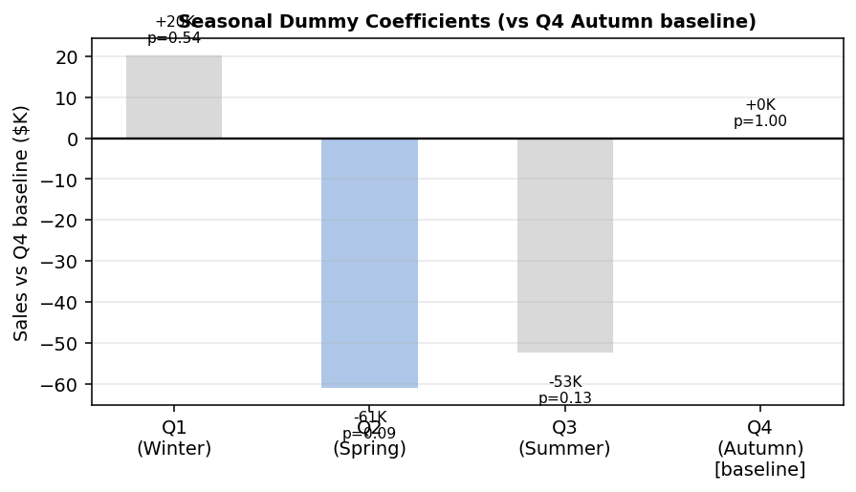
04 · KEY FINDINGS
Q3: Are There Seasonal Effects?
No season significantly outperforms another — after controlling for spend
• Q1 (Winter): +20K vs Q4 — not significant (p=0.54)
• Q2 (Spring): −61K vs Q4 — marginal (p=0.09)
• Q3 (Summer): −53K vs Q4 — not significant (p=0.14)
•
• After controlling for spend & economy,
• seasons cannot be confirmed statistically
• (24 quarters may be too few to isolate)
•
• → Do NOT plan seasonal budget shifts yet
• → Re-evaluate with more data

Slide 11
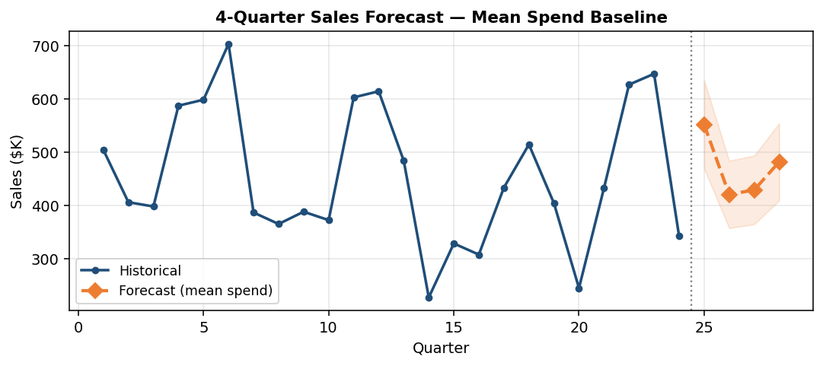
04 · KEY FINDINGS
4-Quarter Sales Forecast
Based on M4 Full model — historical mean spend as baseline
Quarter | Forecast ($K)
Q1 (Year 7) | $552.5K
Q2 (Year 7) | $421.0K
Q3 (Year 7) | $429.6K
Q4 (Year 7) | $482.3K
Annual Total | $1885.5K
• Annual forecast: $1885K (mean-spend baseline)
• To maximise: shift spend toward advertising
• Monitor economic index — weak economy may boost sales

Slide 12
05 · RECOMMENDATION
Sally's Action Plan
Three evidence-based decisions for the coming year
Shift budget toward Advertising
→ Advertising net effect: +$5.41K per $1K — nearly 2× promotion
→ Eliminate or reduce promotion-heavy quarters
→ Use promotion sparingly (max 1–2 quarters) to avoid stockpiling hangover
Monitor economic conditions
→ Index coefficient is negative: bad times → more meat loaf sold
→ Keep a recession-ready plan; this product may be a safe harbour
→ Re-test counter-cyclicality as more data accumulates
Do not yet plan by season
→ Seasonal patterns are unconfirmed at 5% significance
→ Collect 2 more years of data before allocating seasonal budgets
→ Track Q2 (spring) — shows the largest (if marginal) negative effect

Slide 13
OLS Regression Output — Best Model: M4 Full (Adj R² = 0.850)
Dependent Variable
Observations
R-squared
Adjusted R-squared
F-stat p-value
AIC
RMSE
Sales ($K)
23
0.9042
0.8495
0.0000
253.72
$40.7K
Variable | Coefficient | Std Error | t-Stat | P-value | [95% CI Low | 95% CI High] | Significant?
const | 808.2760 | 242.3750 | 3.335 | 0.0049 | 288.4335 | 1328.1186 | ✓ Yes
prom | 6.5088 | 0.8062 | 8.074 | 0.0000 | 4.7798 | 8.2379 | ✓ Yes
adv | 2.6374 | 0.7269 | 3.628 | 0.0027 | 1.0784 | 4.1965 | ✓ Yes
index | -4.9225 | 2.3292 | -2.113 | 0.0530 | -9.9180 | 0.0731 | No
prom_lag1 | -3.4099 | 0.7851 | -4.343 | 0.0007 | -5.0938 | -1.7260 | ✓ Yes
adv_lag1 | 2.7752 | 0.7493 | 3.704 | 0.0024 | 1.1682 | 4.3823 | ✓ Yes
Q1 | 20.3601 | 32.8144 | 0.620 | 0.5449 | -50.0198 | 90.7400 | No
Q2 | -61.2449 | 33.7064 | -1.817 | 0.0907 | -133.5380 | 11.0482 | No
Q3 | -52.6502 | 33.1690 | -1.587 | 0.1348 | -123.7906 | 18.4902 | No
Note: Green = statistically significant (p < 0.05). Lagged variables use n=23 (one observation lost to lag).

