Slide 1

Serialization
By: Alexa Summers

Slide 2
Resources & References
https://docs.unity3d.com/Manual/script-Serialization.html
https://docs.microsoft.com/en-us/dotnet/csharp/programming-guide/concepts/serialization/#:~:text=Serialization%20is%20the%20process%20of,reverse%20process%20is%20called%20deserialization.
https://docs.unity3d.com/Manual/script-Serialization.html
https://sometimesicode.wordpress.com/2015/04/11/unity-serialization-part-1-how-it-works-and-examples/
https://www.youtube.com/watch?v=oJrAT8L4BrA&list=PLAeIzH0X_Fobg-uYDydKygpqHjMfPm23Z&index=259
https://stackoverflow.com/questions/31655795/how-to-save-a-color
https://www.youtube.com/watch?v=Fmq7TBCVtRE

Slide 3
Serialization
Object
Bytes
Database
Memory
File
Notes:
The official definition in terms of Unity per the unity documentation is defined as
the automatic process of transforming data structures or object states into a format that Unity can store and reconstruct later.
Let's say you're at a grocery store, and you go to the register to buy a bunch of things. They add it up the on the register, but it turns out, they only accept cash, and all of your cash is at home. A line forms behind you, so you write everything down everything you wanted to buy and put it all back on the shelf, and while you run home to get money, the cashier can check out other customers. When you get back store, you are able to use the list to recollect all the items you wanted to buy, and proceed with the transaction.
The act of having the physical items with you, transferring them to paper and returning the items back to the shelf, and then using the paper to find all the items again, is serialization.
In serialization, the object is converted into a stream of bytes, and then it can get stored to either a database, a file, or memory. Upon reconstruction, the process of deserialization occurs, which is when the stream of bytes from those locations gets converted back into an object, and comes together in the exact same way you left it the last time it was an object.

Slide 4
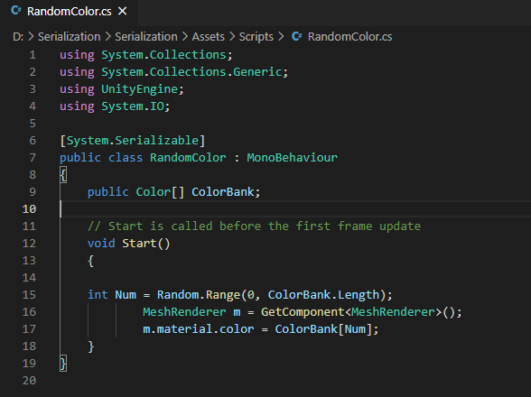
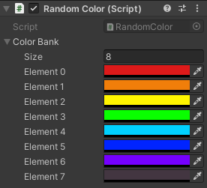
Unity || Serialization
https://docs.unity3d.com/2019.3/Documentation/Manual/script-Serialization-BuiltInUse.html
Notes:
Now Unity itself actually uses this process in a lot of different ways. A great example is the ability to create and edit scripts while the editor is open, and being able to immediately apply the script's behaviors. You don't have to restart anything for the scripts to take affect. This is something called Hot Reloading. Another aspect to serialization to be aware of is the inspector window. When you change the value of a game objects component field in the inspector window, these changes do not go to the getters and setters-- everything is serialized in the inspector's fields directly. Also, if you’ve ever used a prefab before– those are composed of serialized data from game objects and their components. Once a prefab is instantiated, it contains a reference to the prefab source and the modifications done to it– these are two pieces of serialized data.
Unity uses serialization in other ways as well– you can check out the link at the bottom to the Unity documentation site where it gives an extensive breakdown on these other methods.

