Slide 1

Serialization
By: Alexa Summers
Notes:
This lecture looks a little different than my last one due to a longer time frame as well as the assumption that my students have prior programming knowledge, and don’t need to see me do it in real time.
This includes Giving my students problems throughout the lectures as a way to create engagement by encouraging questions and getting them familiar with searching the Unity documentation site and what kinds of queries to use when looking for something. I generally give them a few minutes to figure it out and ask questions, and then we go over the answer. I give them a folder of all the example scripts with the problems and solutions.

Slide 2
Resources & References
https://docs.unity3d.com/Manual/script-Serialization.html
https://docs.microsoft.com/en-us/dotnet/csharp/programming-guide/concepts/serialization/#:~:text=Serialization%20is%20the%20process%20of,reverse%20process%20is%20called%20deserialization.
https://docs.unity3d.com/Manual/script-Serialization.html
https://sometimesicode.wordpress.com/2015/04/11/unity-serialization-part-1-how-it-works-and-examples/
https://www.youtube.com/watch?v=oJrAT8L4BrA&list=PLAeIzH0X_Fobg-uYDydKygpqHjMfPm23Z&index=259
https://stackoverflow.com/questions/31655795/how-to-save-a-color
https://www.youtube.com/watch?v=Fmq7TBCVtRE

Slide 3
Serialization
Object
Bytes
Database
Memory
File
Notes:
The official definition of serialization in terms of Unity per the unity documentation is defined as
the automatic process of transforming data structures or object states into a format that Unity can store and reconstruct later.
Let's say you're at a grocery store, and you go to the register to buy a bunch of things. They add it up the on the register, but it turns out, they only accept cash, and all of your cash is at home. A line forms behind you, so you write everything down everything you wanted to buy and put it all back on the shelf, and while you run home to get money, the cashier can check out other customers. When you get back store, you are able to use the list to recollect all the items you wanted to buy, and proceed with the transaction.
The act of having the physical items with you, transferring them to paper and returning the items back to the shelf, and then using the paper to find all the items again, is serialization.
In serialization, the object is converted into a stream of bytes, and then it can get stored to either a database, a file, or memory. Upon reconstruction, the process of deserialization occurs, which is when the stream of bytes from those locations gets converted back into an object, and comes together in the exact same way you left it the last time it was an object.

Slide 4
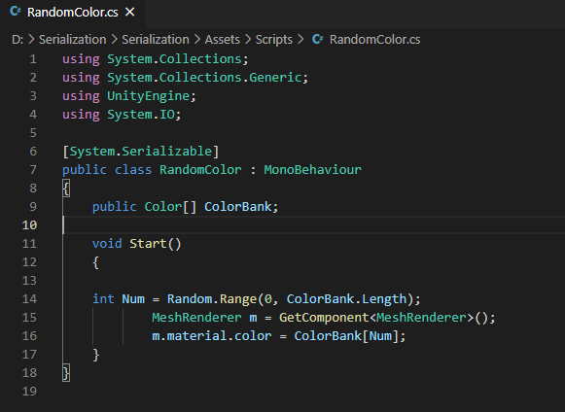
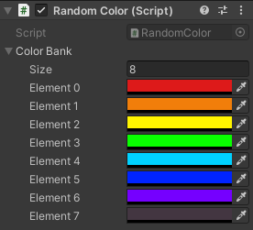
Unity || Serialization
https://docs.unity3d.com/2019.3/Documentation/Manual/script-Serialization-BuiltInUse.html
Notes:
Now Unity itself actually uses this process in a lot of different ways. A great example is the ability to create and edit scripts while the editor is open, and being able to immediately apply the script's behaviors. You don't have to restart anything for the scripts to take affect, and this is something called Hot Reloading. Another aspect to serialization to be aware of is the inspector window. When you change the value of a game objects component field in the inspector window, these changes do not go to the getters and setters-- everything is serialized in the inspector's fields directly. Also, prefabs– those are composed of serialized data from game objects and their components. Once a prefab is instantiated, it contains a reference to the prefab source and the modifications done to it– these are two pieces of serialized data.
And Unity uses serialization in a bunch of other ways as well– you can check out the link at the bottom to the Unity documentation site where it gives an extensive breakdown on other built-in features.

Slide 5
Unity || Serialization
Public or [SerializeField]
Cannot be static, const or readonly
Custom structs or non-abstract, non-generic classes, [SerializeField]
UnityEngine.Object
Primitive Data Types
Enumerations
Certain Unity built-in types
https://docs.unity3d.com/2019.3/Documentation/Manual/script-Serialization.html
Notes:
Now, serializers in Unity run differently than in other programming environments. This is because unity is running in a real-time game environment. So there are some restrictions to help preserve performance. In order to user field serialization, the object must:
Be public or has a SerializeField attribute. So, that means that, if the object is defined as private, the serializefield attribute allows it to still be serialized.
Cannot be static, const or readonly
And fits the qualifying field types, like:
Custom structs or non-abstract, non-generic classes, both with the serialization attribute
References to objects that derive from UnityEngine.Object
Primitive data types like int, float, string, etc. as well as arrays or lists containing these types
Enumerations
And certain unity built-in types like vector 2, 3 and four, rect, color, layer mask, etc.
One important thing to note is that dictionaries are not serializable. This is because even though the keys and values are easy to retrieve during deserialization, we don’t know if the classes derived from the dictionary have been serialized.
Specifics on these restrictions can be found on the Unity Script Serialization Documentation listed at the bottom of the screen.

Slide 6
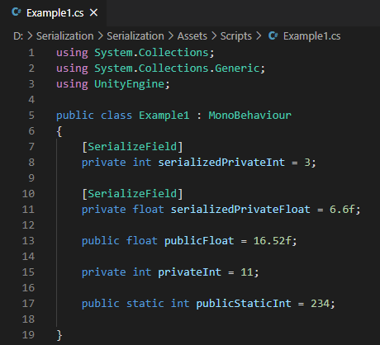
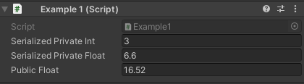
Serializing Variables
Assets/Scripts/Example1.CS -> Example1
Notes:
So we have this example over here on the left. We’re going to do a quick comparison between the fields that can be serialized, and the ones that can’t.
On lines 8 and 11, we have a private integer and a private float respectively. Since a private field cannot be automatically serialized, we have added the SerializeField attribute to that field. 13 is both public and a float, and a float is considered a primitive data type, so that is automatically serialized. On line 15, there is a private integer that does NOT have the serialize field attribute, so it will not be serialized, and on line 17 there is a static int that is public. Despite the fact that this field is public, this is NOT serializable because static is on the list of fields that cannot be serialized. We’ll talk about why in the next example.
So, our serializable fields are SerializedPrivate Int, SerializedPrivateFloat, and PublicFloat. Over on the right, this is what the component in the inspector looks like once the script has been applied to my object. As you can see, it only those three fields that we deemed serializable, appear.
This script can be found in the scripts folder on Canvas under Example1, and this script should be applied to the game object called Example1.
SHOW EXAMPLE IN UNITY. NO PLAY NECESSARY.

Slide 7
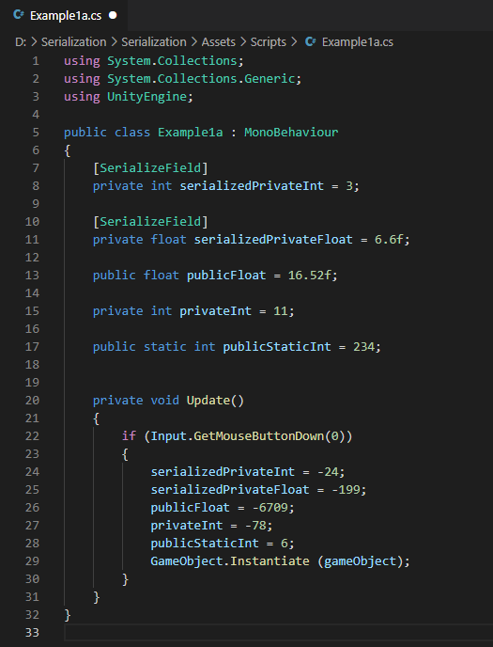
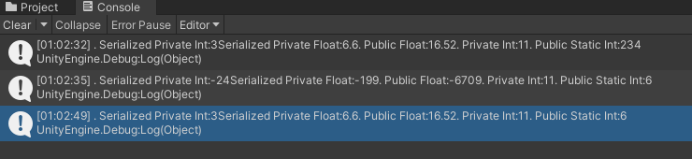
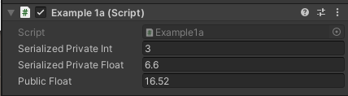
Serialization Via Cloning
Assets/Scripts/Example1a.CS -> Example1
Notes:
Another way to demonstrate serialization is by cloning. So in our example 1a script, we have the same variables initiated as we did in the last example. Then in our Update function, we create a clone of our game object when we click. And then in this clone, it updates the values for each of our variables. Also note that in the complete example script found on Canvas, there is a Start function as well, which prints the values into the console. To run this example, delete the example 1 component from the example1 game object, and apply the example 1a component.
SHOW EXAMPLE.
When we play the scene, the first console message at the top pops up, and once we click to create the clone, the second console message pops up. You'll see that our Serialized values are the ones that updated between the two instances-- the Serialized private int, serialized private float, and public float. Private int did not update, because it is not serialized. You will notice that public static int did update, even though we know based on our restrictions it does not qualify for serialization, and it doesn't show up in our inspector. This is because static fields belong to the class, not the instance. So, for example, if I were to keep this in play mode, and create a new game object and apply the example 1a script, the static integer is the same value as the object I cloned, but we know that this is not a clone of the clone-- I just created it! And if we look at the serialized private int (the first one listed), the value is that of our original object– this is serialization.

Slide 8
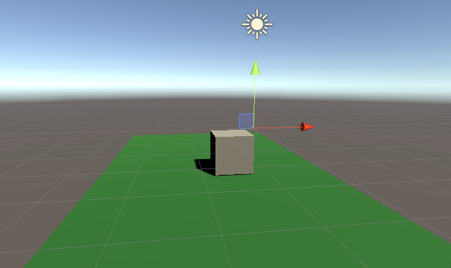
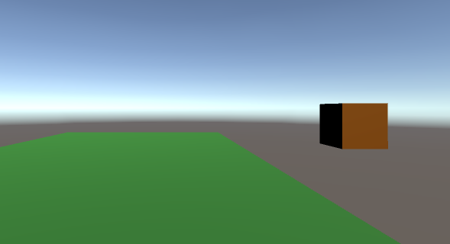
Save a Game
Notes:
So now, we’re going to implement a visual example of serialization. We have a box that we can freely move around the screen, and every time we play the scene, the box is going to be a different color. However, we are going to implement a save function that allows us to serialize the location and the color of the box, so after we end our game play, we can restart the scene, and the box will still be the same color and in the same location as the last time we had it open.

Slide 9
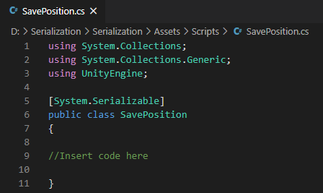
Problem
Create a serialized class in SavePosition.cs that contains floats for the three different axes.
Problems/SavePosition.CS
Notes:
So, first things first: we need to create our class to store the x, and y locations of our player. I want you to create a serialized class in SavePosition.cs that contains floats for the two different axees.

Slide 10
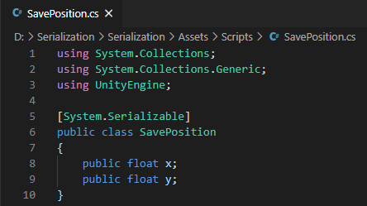
Solution
Assets/Scripts/SavePosition.CS
Notes:
So here is what our answer is going to look like. The floats themselves are public and primitive-- they are automatically serialized per our serialization rules, so this is all you needed to add. However, I want to point out the [system.serializable] attribute on line 5. We are going to be using this SavePosition class in our game save script because we want these floats to jump across our scripts. Therefore, we are going to make our entire class serializable using this attribute.

Slide 11
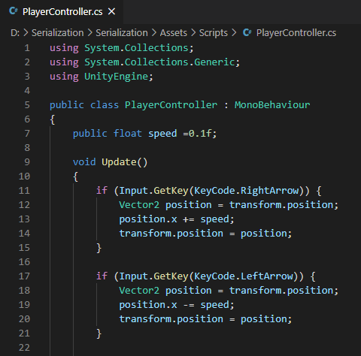
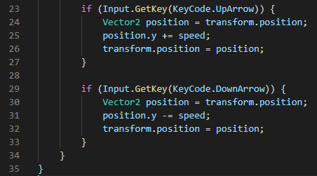
PlayerController.cs
Assets/Scripts/PlayerController.CS -> Cube
Notes:
We also have our PlayerController script. We want our player to freely be able to move about in order to test our serialization, so we are going to allow the use of arrow keys to place the player wherever we want it, over and over again.
We are utilizing our monobehavior here by putting everything inside the Update() method, which will get refreshed every frame.
On line 7 we are declaring our speed as a public float, which is automatically serialized and viewable from within the inspector.
We have our four Input.GetKeys declared for the arrow keys, and I’m going to declare a Vector2 called position for each of these. I’m going to go ahead and use a vector2 here rather than a vector3 because I’m going to keep our player off the Z axis with our key inputs for this example.
For the left and right arrow inputs declared on lines 11 and 17, I want to use position.x because we want our box to move along the x axis– left and right. Position.x will be += to speed when we want it to move in the right, and it will be -= to speed when we want it to move to the left. We’ll then set the value for position equal to transform.position, so the player will visibly respond.
Everything is the same for our up and down arrows, however, instead of using position.x, we will use position.y, so we can move our object along the y axis instead.
This script will need to be added to our player object, which in this case, is the cube.

Slide 12
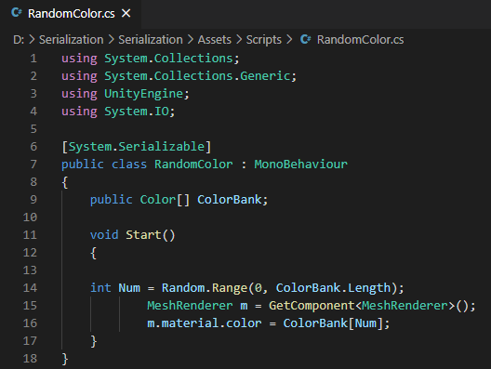
RandomColor.cs
Assets/Scripts/RandomColor.CS -> Cube
Notes:
Next, we want to generate a randomized color of our object. For this one, we want the entire class to be serialized as well, so we’ll use the System.Serializable attribute. We will be using the Start method, so we need to inherit from monobehavior. We declare a public color called ColorBank, which is public and is a type that is serializable, so it will show up in our inspector.
Inside the start method, which will be called once at the beginning of game play, we declare an integer called Num on line 14. This will assign a random number from the range of zero to however many colors we have defined in our color bank. On line 15 we pull in the information from our Mesh Rendererer for whatever object this script is assigned to, and then on line 16 we are changing the material color based on the assigned color associated with the randomly generated number.
This script will also need to be applied to our player object, which again, is our cube- go to next slide before applying

Slide 13
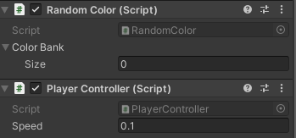
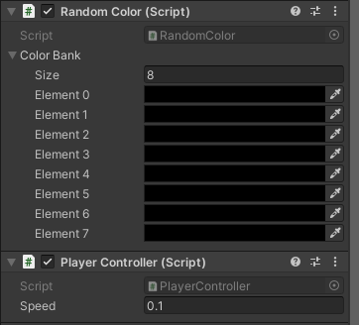
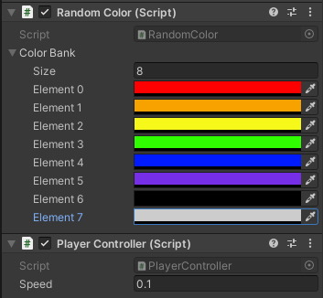
Cube Object
Figure 1
Figure 2
Figure 3
Notes:
So figure 1 is what our inspector for our cube will look like after adding those two scripts.
In the random color script under the color bank drop down, is our size integer. We will put a number in that field, which will determine how many random colors to cycle through, as shown in figure 2 and then we will assign the colors to those values, like in figure 3.
So, let’s go ahead and attach this script and check out what our player looks like and how it functions.
SHOW EXAMPLE, DELETE PLAYER FROM THE GAMESAVE OBJECT.
We’ll press play, and our box moves the way we want it to. It also changes colors. Notice that every time I press play, the color is usually not the same as it was before, and the location goes back to where it started. Now, we’re going to serialize.

Slide 14
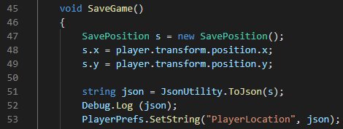

GameSave.cs
Syntax: PlayerPrefs.SetString(string key, string value);
Assets/Scripts/GameSave.CS
Notes:
So first, we are going to write a method called SaveGame() that will basically tell Unity what to carry between plays. Let’s start with the location aspect.
On line 48, we are creating a new SavePosition object, S, which is that class written in the SavePosition script from earlier. If you remember, we declared two floats in there for x, and y
We are setting our player transform positions as those floats, which will change as we move our player around the screen and trigger the saving mechanism.
Next comes the data conversion. We want utilize something called json– JSON stands for javascript object notation, which is a data interchange format, with a super easy readability to humans. So, on line 51, we are declaring a string called json, and we are using the json utility function to generate a string representation of the position coordinates. The console output is an example of what this json output would look like (which is printed via line 52).
And then, on line 53, we are using our playerprefs class to set the value of our key– playerprefs is what sends the information to the next scene. The syntax for this class can be found in the upper right corner– We have our key listed as a string called “Player Location”, and our string value is going to contain the information from our string called json.

Slide 15
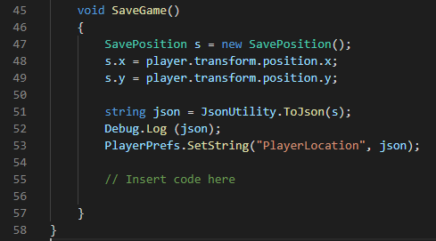

Problem
Syntax: PlayerPrefs.SetString(string key, string value);
Convert the player color value to a string, with the key “StoredColor”.
Problems/SaveGame.CS
Notes:
Hint: the console on the left represents the string that should be outputted.

Slide 16
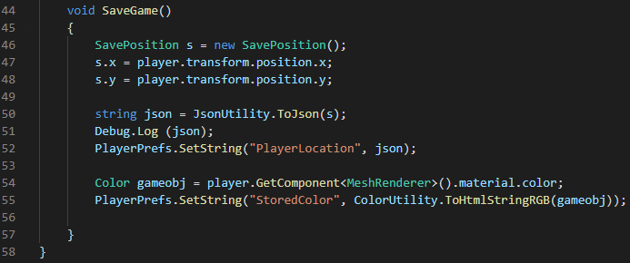
Solution
Syntax: PlayerPrefs.SetString(string key, string value);
https://docs.unity3d.com/ScriptReference/PlayerPrefs.SetString.html
Assets/Scripts/GameSave.CS
Notes:
Here is our solution. I have created a new color called gameobj, and then I am getting the material of the mesh. We have seen this code before in the RandomColor.cs script. Then, we use our PlayerPrefs to set the string called “storedColor”. However, we can’t just convert a color to a string– a color is a visual entity. And up above on line 50, we cleanly defined our variable called json as a string, so there was no extra conversion necessary. We have to figure out how to return a string. For this, we can use our color utility toHTMLStringRGB to return a hexadecimal string representation of the color called gameobj.
So now, with this SaveGame method, both our position and our color have been serialized.

Slide 17
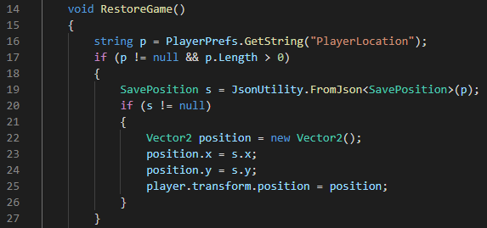
GameSave.cs
Syntax: JsonUtility.FromJson(string json);
Assets/Scripts/GameSave.CS
Notes:
Next, we’ll create a method called RestoreGame. This is what will reload our new play with the previously saved data– this is the process of deserialization.
On line 16, we are setting the value of the key “PlayerLocation” to a string called p, and then if P is valid, we are using the Json utility class to create an object from the json representation, and store it in our SavePosition object called s. Then, if there is data previously stored in the object, we’re going to rewrite it with a new vector 2, and our new positions.

Slide 18
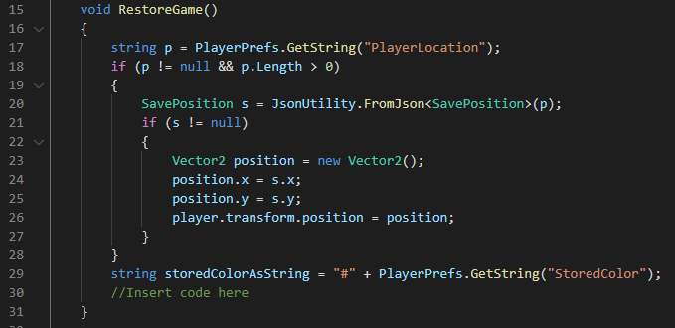
Problem
Deserialize the string “StoredColor” and change the material color to the saved value.
Problems/GameSave.CS
Notes:
Also note, we are adding a pound sign to our hexadecimal for parsing purposes, so I went ahead and included that part in there as a hint.

Slide 19
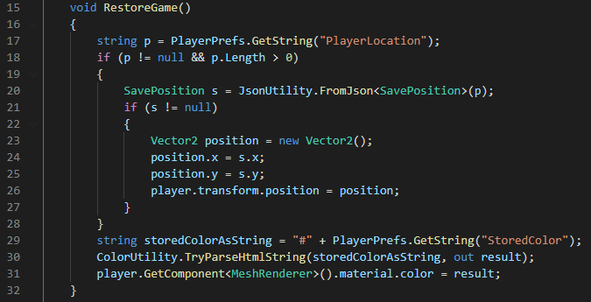
Solution
Syntax: TryParseHtmlString(string htmlString, out Color color);
https://docs.unity3d.com/ScriptReference/ColorUtility.TryParseHtmlString.html
Assets/Scripts/GameSave.CS
Notes:
Using the ColorUtility tryParseHTMLString, we are attempting to convert an html color string to a color object. In this case, we are outputting to the color called “result”. Then, we are setting that new color as the material color of our player.

Slide 20
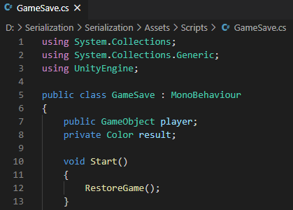
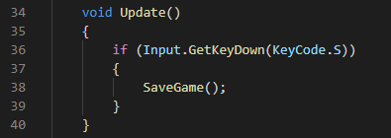
GameSave.cs
Notes:
Lastly, we want to go ahead and utilize our monobehavior methods of Start and Update, so things actually happen.
From the start method, we will call RestoreGame, and from the Update Method, we will assign the keypress of S to SaveGame.

Slide 21
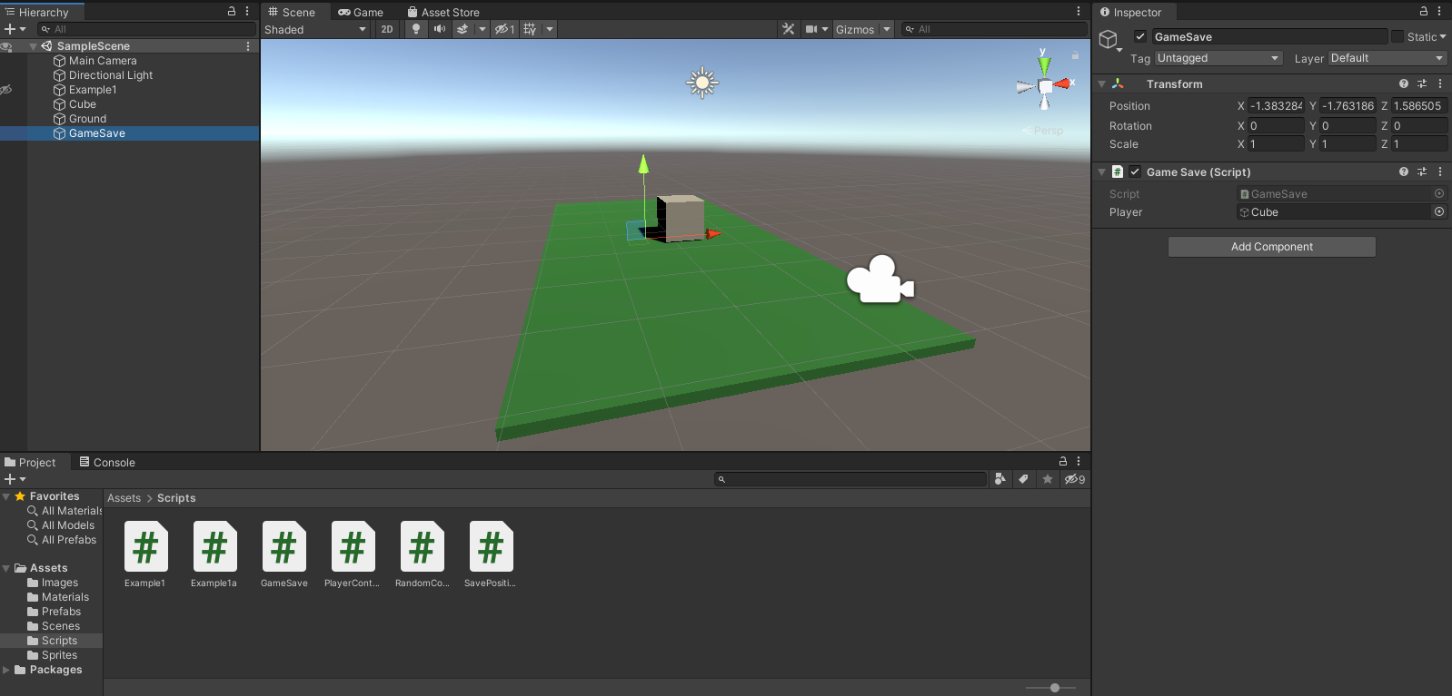
Setup
Notes:
So we have our cube with the random color script attached with a full color bank, and we have the player controller script attached.
I have created an empty game object called GameSave, and I will attach the GameSave script to it.

