Slide 1

Team n°1
11/03/2021

Slide 2



Table of Contents
01
02
03
Our approach
Final results
Recommendations

Slide 3

Our approach
Introduction to the overall project architecture and main functions.

Slide 4
Our approach

Slide 5

Our approach
Dataset Cleaning
Filling null values
Value transformation
Deductibles
Regrouping data
Over-correlation

Slide 6

Our approach
Dataset Cleaning
Preliminary Visualisations
Filling null values
Value transformation
Deductibles
Regrouping data
Over-correlation
Dimensionality reduction
Clustering
Outlier identification
Features distribution
Basic clustering

Slide 7

Our approach
Dataset Cleaning
Preliminary Visualisations
Scrapping External Data
Filling null values
Value transformation
Deductibles
Regrouping data
Over-correlation
Dimensionality reduction
Clustering
Outlier identification
Features distribution
Basic clustering
Financial market indices
Natural hazard data

Slide 8


Our approach
Dataset Cleaning
Preliminary Visualisations
Scrapping External Data
Filling null values
Value transformation
Deductibles
Regrouping data
Over-correlation
Dimensionality reduction
Clustering
Outlier identification
Features distribution
Basic clustering
Financial market indices
Natural hazard data
Models
Features Selection
Recursive Feature Elimination
Intrinsic methods
Filter methods

Slide 9

Our approach
Dataset Cleaning
Preliminary Visualisations
Scrapping External Data
Premium Prediction
Filling null values
Value transformation
Deductibles
Regrouping data
Over-correlation
Dimensionality reduction
Clustering
Outlier identification
Features distribution
Basic clustering
Financial market indices
Natural hazard data
Training different models (GradientBoosting, XGBoost, LightGBM)
Cross-validation
Prevent overfitting
Models
Features Selection
Recursive Feature Elimination
Intrinsic methods
Filter methods

Slide 10

Results
Model performance and feature importance analysis.

Slide 11


Model performance
Test RMSE*
Gradient Boosting
162k
5k contracts data
Auto ML
Tree-based models
XGBoost
Model
160k
External data
Light GBM Model
169k
* Train set size : Test set size = 5 : 3 (The same for our prediction task)

Slide 12
Feature selection
Select most important features
Numerical
Categorical
RFE
Filter
Intrinsic
Filter
RFE
Recursive feature elimination
Pearson’s
correlation
Instrinsic method based on a regressor *
Anova’s
correlation
Recursive feature elimination
* Choice of regressor: Random Forest (RF) regressor for faster training.

Slide 13
Important features
Expected Loss
Market Fluctuation
Risk of Accident
Loss
Given Accident
Economic/Industry Situation
UW index
Weighted hasard
Insured value (PD&BI)
BI time, PD price
Modeled_CAT_Exploss
Financial ratio
Main pricing category
Sector
XXX share
Deduction, Limit
Attachment
XXX
Responsability

Slide 14

Recommendations
Conclusion on how XXX should better target the market based on our analysis.

Slide 15




1. Aggregate more data
Financial Ratio
Hazard Data
UW Index
Scrape market data for each sector
Global seismic hazard map weighted by insured value
averaged across insured sites
Preprocess the UW ratio to make it more exploitable
Significance
Significance
Significance
How well the market is doing for each company’s sector
Risk of earthquake-related PD/BI
Risk of earthquake-related PD/BI
Highly ranked features

Slide 16
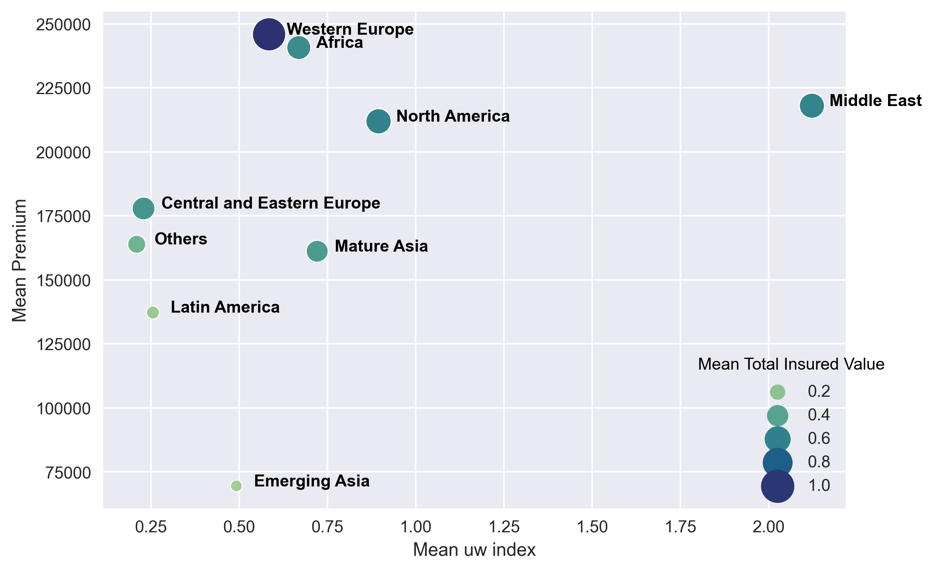
2. Target best markets best markets
Which market should XXX target in priority ?

Slide 17


Conclusion
Key Features
Well-tuned Models
Potential Markets

Slide 18
Thank you for your attention! Any questions?

