Slide 1
Artificial Intelligence hub
Aleksandar aytov
alexaytov92@gmail.com

Slide 2

AI HUB
AI Hub is your one place for all things AI
The AI Hub supports working with predefined chat models
You can chat directly to a chat model or create your own agent customized for your specific needs

Slide 3
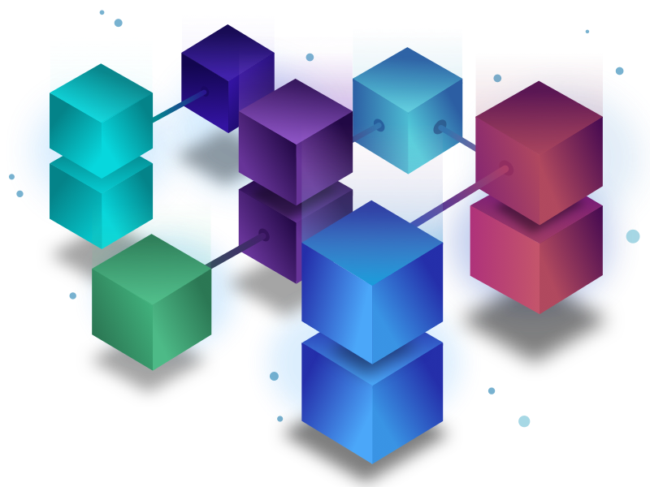
AI HUB Resources
AI Chat Models
Current supported types are OPEN AI and AI CORE
Only ADMIN users can create chat models
System Messages
Messages that can later be used to customize one or multiple chat models
Agents
Represent the combination of a specific chat model and a specific system message

Slide 4
AI HUB Resources
Chats
Chat history with all chat models is saved and can be viewed
Chats older than 30 days are automatically deleted
Audit Logs
Specific events like creation/deletion of resources generated audit logs
Audit logs are handled in a separate application for security reasons
Each audit log contains a timestamp of the event and a message for that specific event

Slide 5
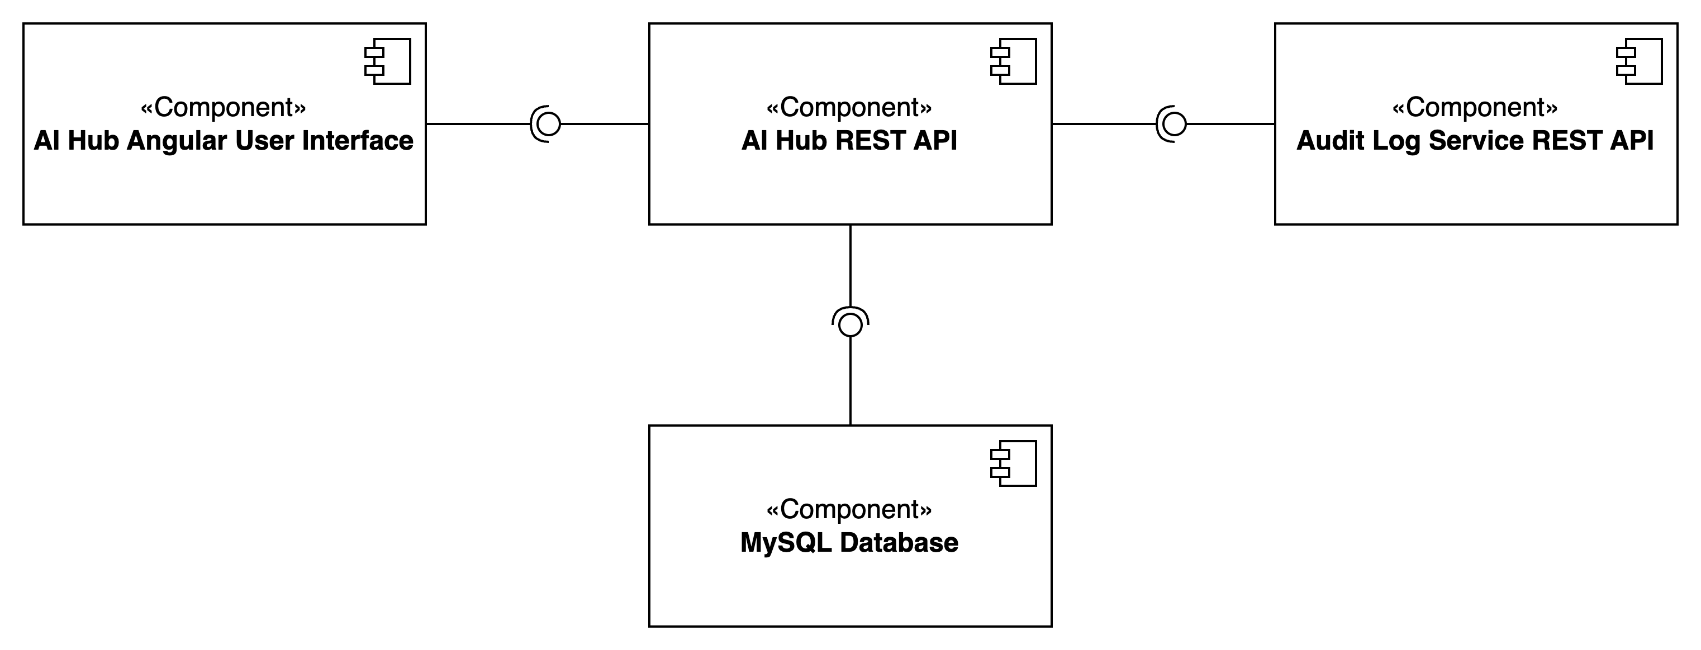
Component diagram

Slide 6

Requirements
Additional information regarding the requirements can be found in the README in the public GitHub repository

Slide 7

Starting the application
Start the Audit Log application
Required environment variables are: DB_USERNAME and DB_PASSWORD for an MySQL availbale MySQL database on localhost:3306
Start the AI Hub Application
Required environment variables are: DB_USERNAME and DB_PASSWORD for an MySQL availbale MySQL database on localhost:3306
The audit log application should be available on localhost:8081 by default
Start the Angular Application
Use the “npm install” command inside the ai-hub-ui folder
Use the “ng serve (--configuration bg // for Bulgarian)” command inside the ai-hub-ui folder
The AI Hub application should be available on localhost:8080
The default admin credentials are
User: admin
Password: admin
Notes:
The application by defaults starts without any resources preconfigured.

Slide 8
THANK YOU FOR YOUR ATTENTION
ALEKSANDAR AYTOV
alexaytov92@gmail.com

