Slide 1
Линейни Структури от Данни

Slide 2

Основи на Структурите от Данни
Организация и управление на данни
Градивни елементи в приложенията
Ефективен достъп и модификация на данните
Играят ключова роля в софтуера

Slide 3
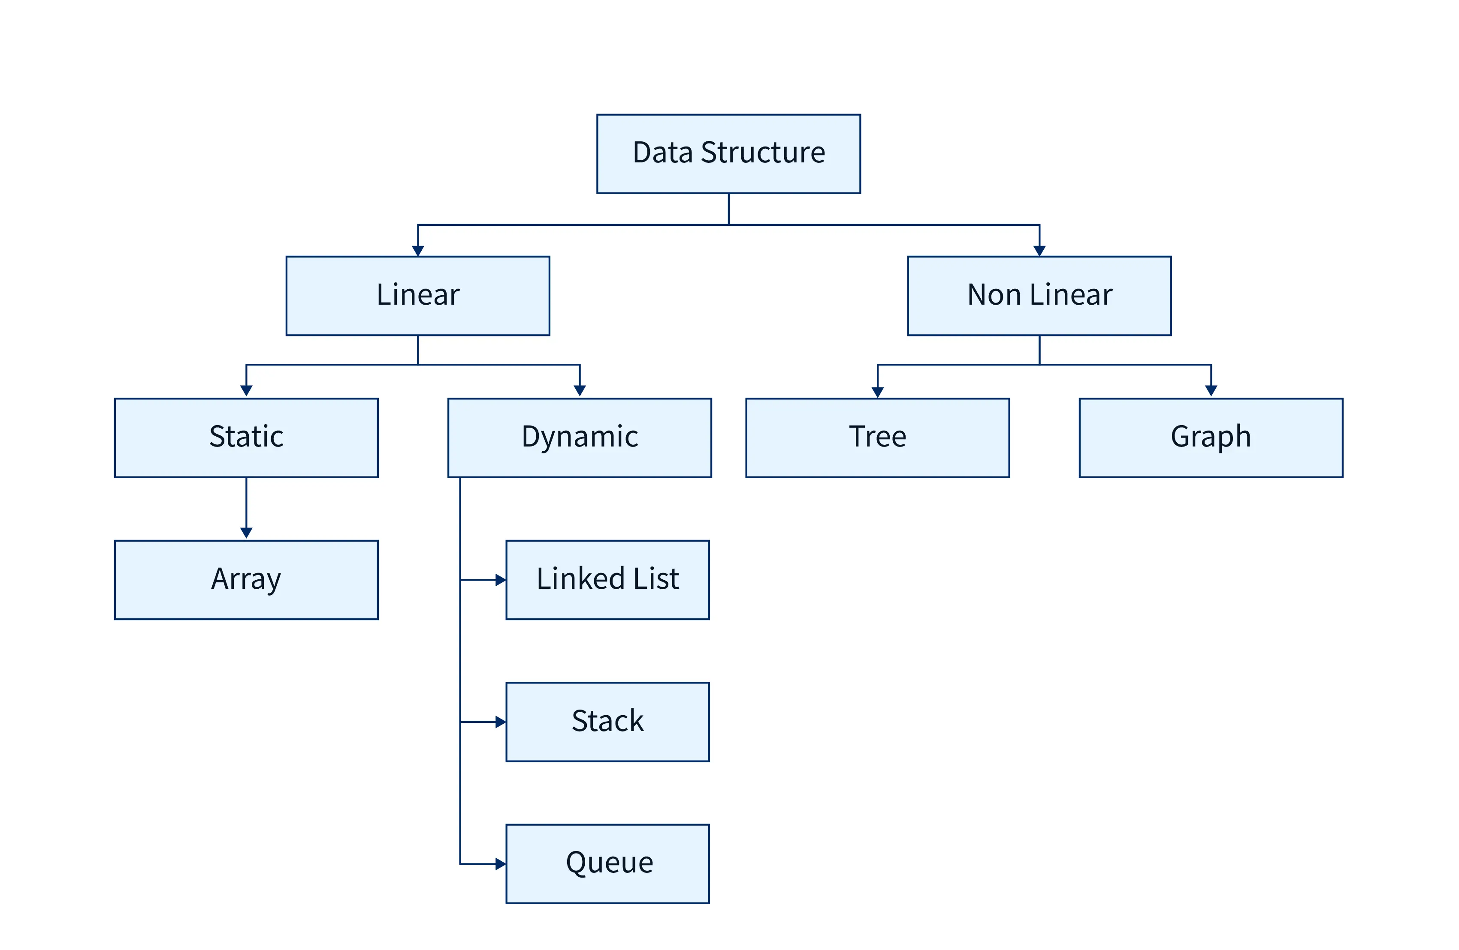
Структури от Данни Типове

Slide 4
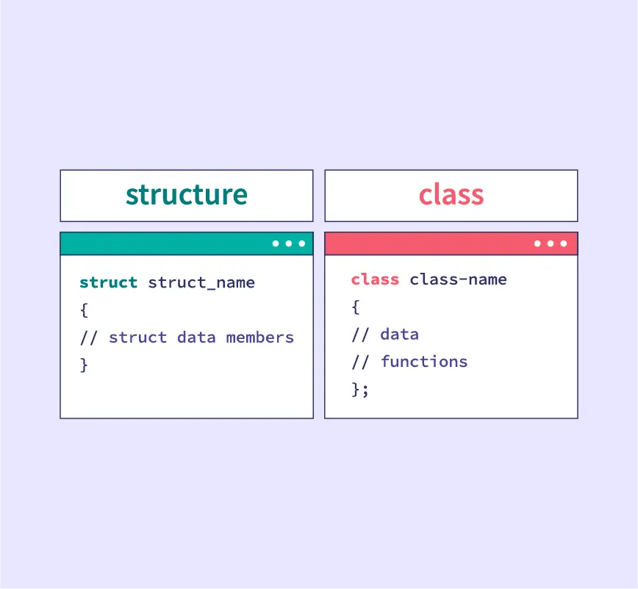
Структури от Данни в
Обектно-Ориентираното Програмиране (ООП)
Структури като Абстракция
Абстрактен тип данни, реализиран чрез класове
Комбинират данни и операции в единна структура
Запазват набор от свойства и методи без детайли за реализация
Предимства
Гъвкав интерфейс, който позволява различни имплементации
Различни реализации имат различни предимства за скорост и памет
Енкапсулация и скриване на данните

Slide 5
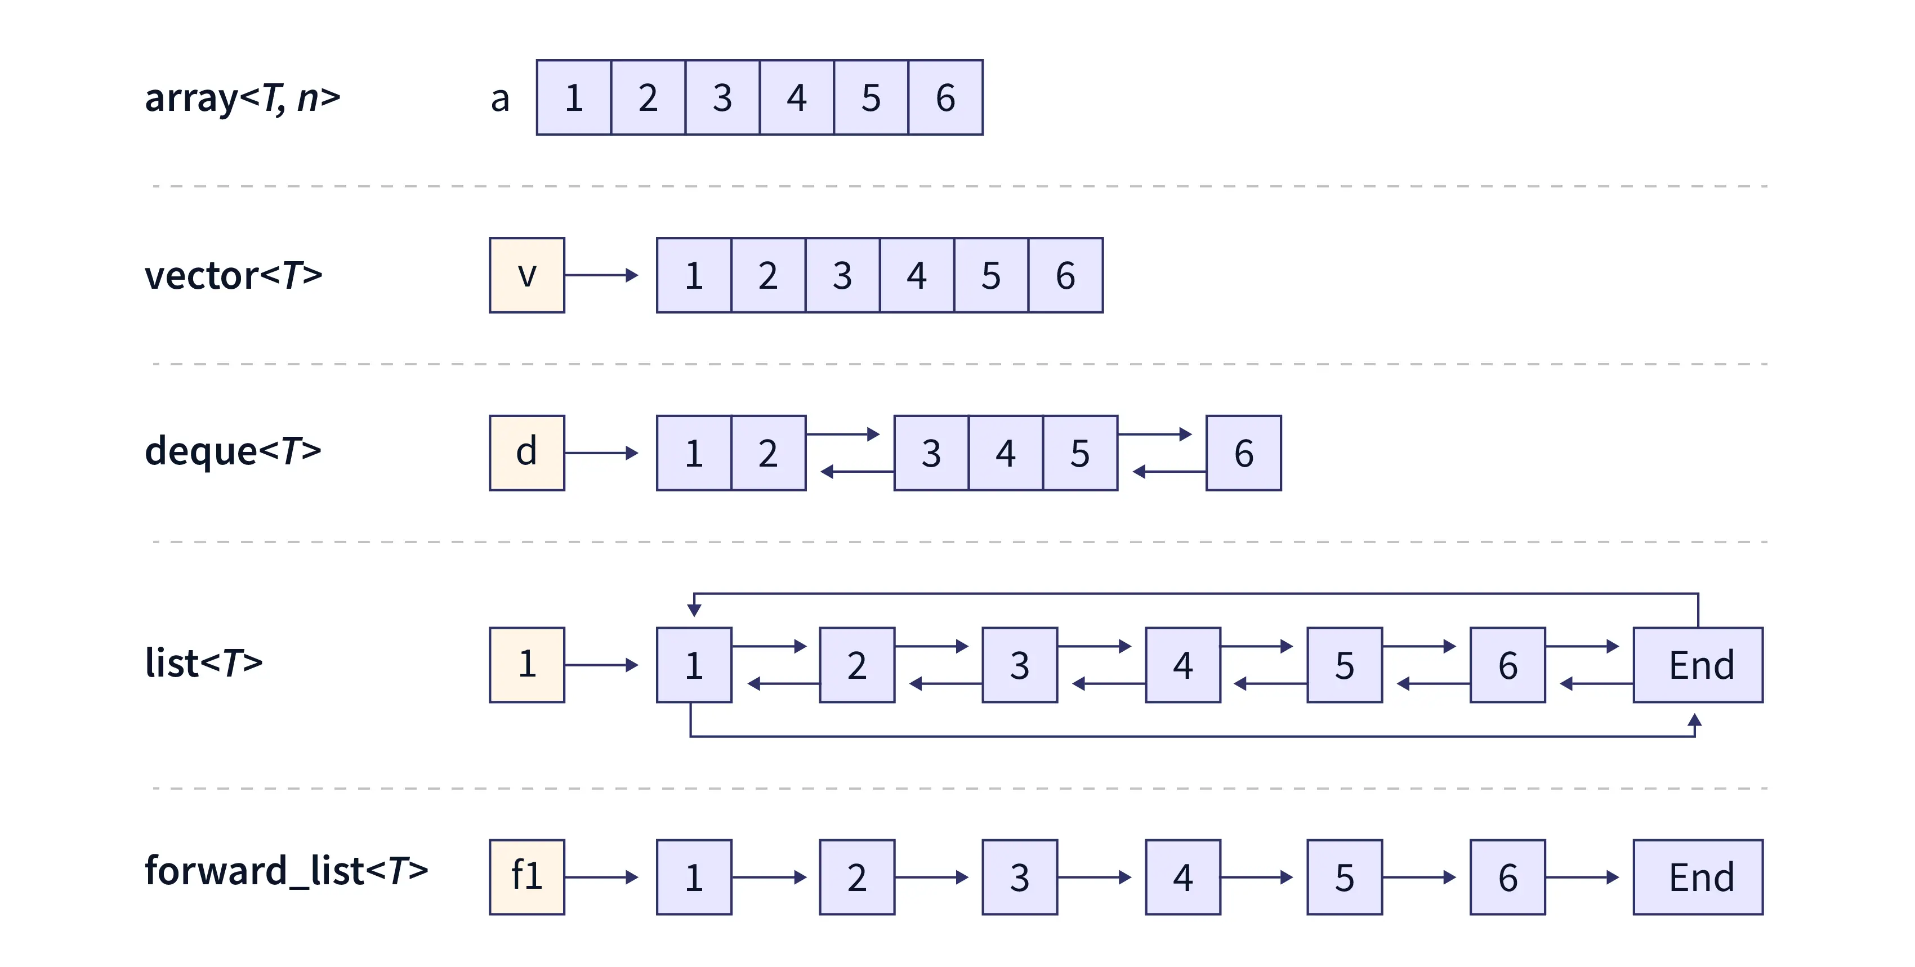
Sequential Containers in C++

Slide 6
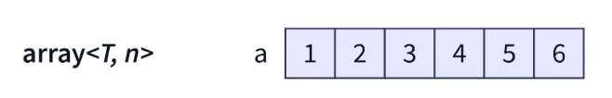
Sequential Containers in C++
Array
Method | Time Complexity | Space Complexity
operator[] / at() | O(1) | O(1)
front() | O(1) | O(1)
back() | O(1) | O(1)
size() | O(1) | O(1)
empty() | O(1) | O(1)

Slide 7
Sequential Containers in C++
Array in Practice
#include <iostream>
#include <array>
using namespace std;
int main()
{
// creating an array
array<int, 5> arr = {10, 11, 12, 12, 13};
// creating an iterator for the array
array<int, 5>::iterator it;
// iterating through each element of the array using the iterator
cout << "The array is: ";
for(it = arr.begin(); it < arr.end(); it++)
{
cout << *it << " ";
}
cout << endl;
cout << "Size of the array is: " << arr.size() << endl;
return 0;
}

Slide 8
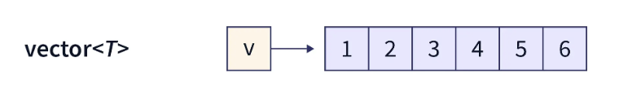
Sequential Containers in C++
Vector
Method | Time Complexity | Space Complexity
operator[] / at() | O(1) | O(1)
front() | O(1) | O(1)
back() | O(1) | O(1)
push_back() | O(1) amortized | O(1)
pop_back() | O(1) | O(1)
insert() | O(n) | O(1)
erase() | O(n) | O(1)
size() | O(1) | O(1)
empty() | O(1) | O(1)
clear() | O(n) | O(1)
Notes:
vector<T>: Dynamic array with contiguous memory on the heap, ideal for frequent random access and back insertions, but costly for front/middle operations due to element shifting.

Slide 9
Sequential Containers in C++
Vector in Practice
#include <iostream>
#include <vector>
using namespace std;
int main()
{
vector<int> vec;
for (int i = 1; i <= 30; i = i * 3)
vec.push_back(i);
cout << "Output with vec.begin() and vec.end(): ";
for (auto i = vec.begin(); i != vec.end(); i++)
cout << *i << " ";
cout << "\nOutput with vec.rbegin() and vec.rend(): ";
for (auto ir = vec.rbegin(); ir != vec.rend(); ir++)
cout << *ir << " ";
return 0;
}

Slide 10
Sequential Containers in C++
Forward List

Slide 11
Sequential Containers in C++
Forward List
Method | Time Complexity | Space Complexity
front() | O(1) | O(1)
push_front() | O(1) | O(1)
pop_front() | O(1) | O(1)
insert_after() | O(1)* | O(1)
erase_after() | O(1)* | O(1)
empty() | O(1) | O(1)
clear() | O(n) | O(1)
sort() | O(n log n) | O(1)

Slide 12
Sequential Containers in C++
Forward List in Practice
#include <iostream>
#include <forward_list>
using namespace std;
int main()
{
// creating a forward list
forward_list<int> fr_lst = {1, 2, 3, 4, 5};
fr_lst.push_front(6);
fr_lst.push_front(7);
// printing the forward list
cout << "The forward list is: ";
for (int& i : fr_lst)
{
cout << i << " ";
}
cout << endl;
// deleting first value using pop_front()
fr_lst.pop_front();

Slide 13
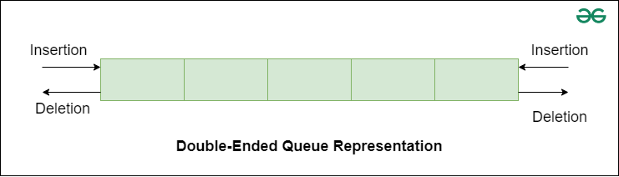
Sequential Containers in C++
Deque
Notes:
vector<T>: Dynamic array with contiguous memory on the heap, ideal for frequent random access and back insertions, but costly for front/middle operations due to element shifting.

Slide 14
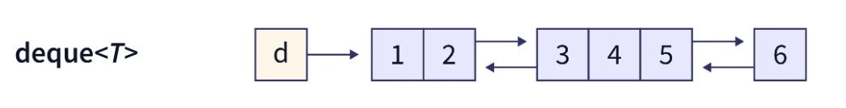
Sequential Containers in C++
Deque
Method | Time Complexity | Space Complexity
operator[] / at() | O(1) | O(1)
front() | O(1) | O(1)
back() | O(1) | O(1)
push_back() | O(1) | O(1)
push_front() | O(1) | O(1)
pop_back() | O(1) | O(1)
pop_front() | O(1) | O(1)
size() | O(1) | O(1)
empty() | O(1) | O(1)
clear() | O(n) | O(1)

Slide 15
Sequential Containers in C++
Deque in Practice
#include <iostream>
#include <deque>
using namespace std;
int main()
{
deque<int> dq;
dq.push_back(1); // added element at the back
dq.push_front(2); // added element at the front
dq.push_back(3); // added element at the back
dq.push_front(4); // added element at the front
deque<int>::iterator it;
cout << "The deque dq is: ";
for (it = dq.begin(); it != dq.end(); it++)
{
cout << *it << " ";
}

Slide 16
Sequential Containers in C++
Deque Exercise
Задача: Опашка в ресторант
Създай std::deque<string> за имена на клиенти. Използвай push_back() за добавяне на нови клиенти отзад, push_front() за VIP клиенти отпред, pop_front() за обслужване на следващия клиент, и front() за преглед кой е на ред.
std::deque<std::string> queue;
// push_back() за редовни клиенти
// push_front() за VIP клиенти
// pop_front() за обслужване
// front() за преглед

Slide 17
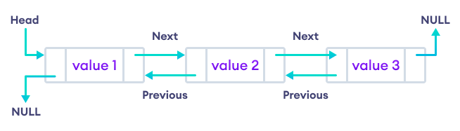
Sequential Containers in C++
List

Slide 18
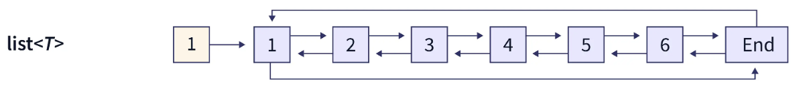
Sequential Containers in C++
List
Method | Time Complexity | Space Complexity
front() | O(1) | O(1)
back() | O(1) | O(1)
push_back() | O(1) | O(1)
push_front() | O(1) | O(1)
pop_back() | O(1) | O(1)
pop_front() | O(1) | O(1)
insert() | O(1)* | O(1)
erase() | O(1)* | O(1)
size() | O(1) | O(1)
empty() | O(1) | O(1)
clear() | O(n) | O(1)
sort() | O(n log n) | O(1)

Slide 19
Sequential Containers in C++ List in Practice
#include <iostream>
#include <iterator>
#include <list>
using namespace std;
int main()
{
list<int> lst;
list<int>::iterator it;
for (int i = 0; i < 7; i++)
{
// adding element to the back
lst.push_back(i * 3);
}
cout << "List (lst) is -> ";
for (it = lst.begin(); it != lst.end(); ++it)
{
cout << *it << " ";
}
cout << endl;

Slide 20
Източници
https://www.scaler.com/topics/cpp/containers-in-cpp/
https://alyssaq.github.io/stl-complexities/
https://www.geeksforgeeks.org/cpp/analysis-of-time-and-space-complexity-of-stl-containers/
https://alyssaq.github.io/stl-complexities/
https://www.programiz.com/cpp-programming/vectors
https://www.geeksforgeeks.org/cpp/containers-cpp-stl

