Slide 1

MATHEMATICS DAYS IN SOFIA 2026
Knowledge Before Action

Slide 2

Hello, my name is Aleks
Introduction
• Bachelors in
Computer Science in the Technical University in Sofia
• Masters in
Information Technology for Business Management
• PHD candidate in
Bulgarian Academy of Sciences with a focus on AI systems
• Hobbies:
  Latin dancing – Bachata, Salsa
  Building AI Powered products and helping the world run best

Slide 3

What does it take for an AI agent to act reliably?
Central question · Four parts ahead
• The Problem — why information systems fragment and resist automation
• Why Agents Fail — architectural failures, not language-model failures
• The Framework — a multi-layer knowledge-before-action architecture
• In Practice — illustrative domain, ablation design, contributions

Slide 4
Part 1
The Problem

Slide 5

Modern Organisations: Three Structural Problems
• Fragmented — ERP, CRM, SaaS, portals in isolation
• Heterogeneous — different interfaces, schemas, protocols
• Passive — systems store knowledge but cannot reason over it
• Extracting knowledge and acting on it requires humans to do all the translation.
Fragmented business information systems — no shared schema, no unified access

Slide 6
Part 2
Why Current AI Agents Fail

Slide 7


Two Root Causes — Both Architectural
Domain Ignorance
Action Without Grounding
• Selects the wrong procedure
• Ignores eligibility rules
• Hallucinates regulatory codes
• No authoritative domain state to check against
• Acts on parametric (trained) knowledge
• Not the current authoritative domain state
• These are architectural failures
• Not language-model quality failures

Slide 8

“
"The agent acts before it knows."
— The core diagnosis

Slide 9
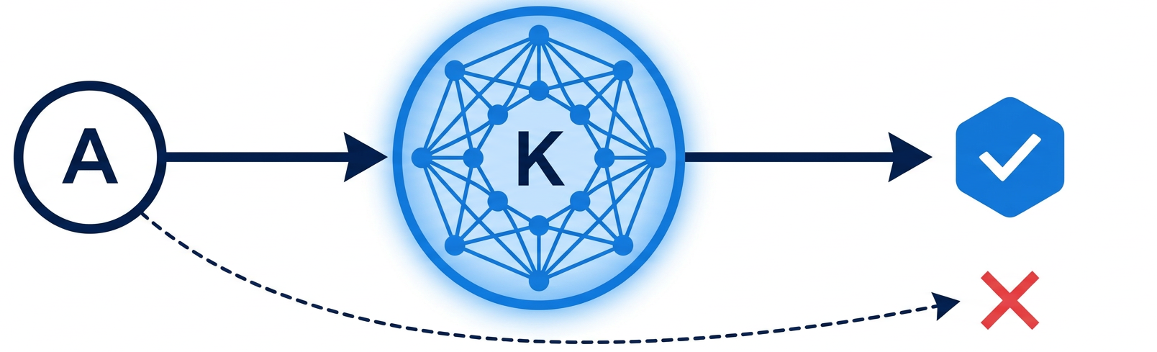
The Testable Hypothesis
Mathematical Foundations of CS and AI · IMI-BAS 2026
• Let A be an autonomous agent operating over information system I
• Let K be a structured knowledge base encoding domain semantics of I
• Claim: grounding A's action selection in K
▸ reduces task error compared to A operating without K
• This is the testable hypothesis the framework is built to instantiate.

Slide 10
Part 3
The Proposed Framework

Slide 11
A 5-Layer Knowledge-Before-Action Architecture
System-agnostic · Each layer independently replaceable · Contracts between layers
Application
API Endpoints, User Interfaces
L5
Agent Engine
Planner, Executor, Tool Registry, Memory
L4
RAG / Retrieval
Query Router, Vector Store, Reranker
L3
Knowledge Graph
Domain Ontology, Graph DB, Entity Relationship
L2
Data Sources
Registries, Regulations, Service Catalog, Documents
L1

Slide 12
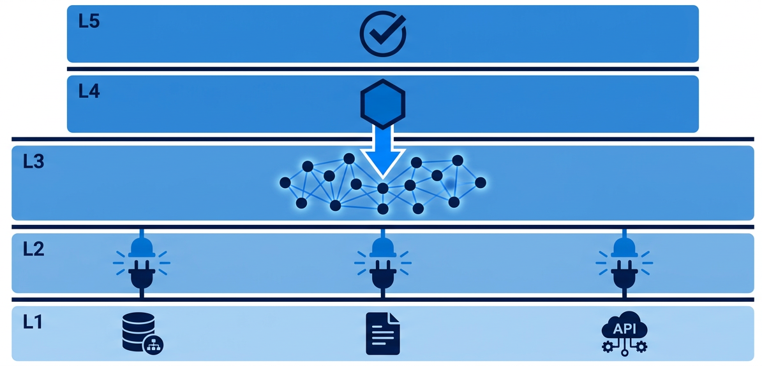
What Makes This Architecture Different
Four key properties revealed in sequence
• One responsibility per layer — independently replaceable
• REST/gRPC contracts between layers — no framework coupling
• The agent (L4) cannot act without first querying L2 and L3
▸ This constraint is structural, not a guideline or convention
• One adapter per source type — never hardcoded integration
• Governance by design — audit, access control, explainability are structural

Slide 13
Five Core Design Principles
Each principle addresses a known failure mode in current AI deployments
🧩
Separation of Concerns
🔌
Technology Agnosticism
🛡
Governance by Design
Each layer has one responsibility
Independently replaceable
Layers communicate via contracts
No framework coupling
Audit, access control, explainability
are structural — not optional
🪂
Graceful Degradation
🎚
Progressive Autonomy
If KG unavailable, fall back
to retrieval gracefully
Routine tasks fully autonomous
High-stakes require human approval

Slide 14
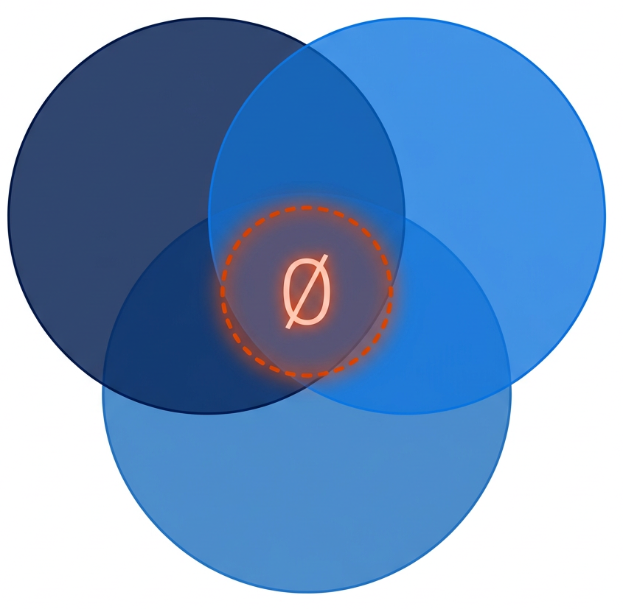
Framework’s Place in Space
Combining 3 crucial elements
Action-capable
Agents
Knowledge from
Authoritative Sources
System-agnostic
Architecture

Slide 15
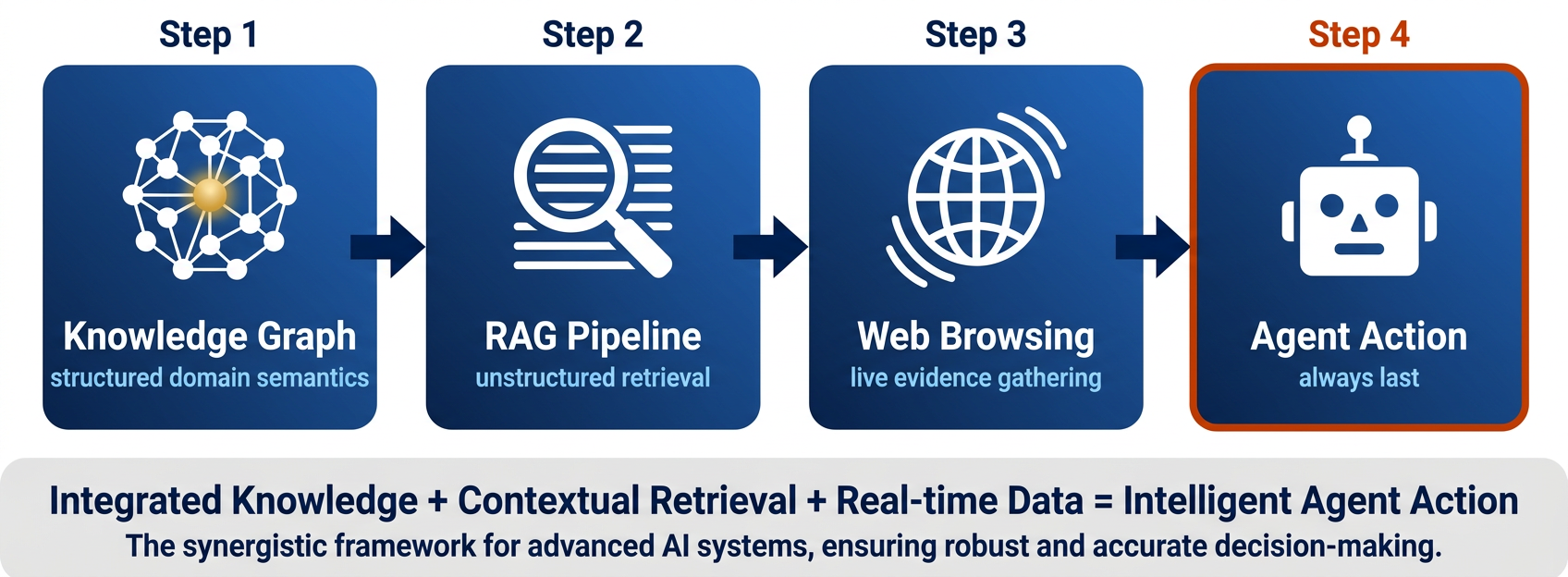
Knowledge Before Action — The Pipeline
The agent is always last · Every action has a knowledge provenance

Slide 16
Part 4
In Practice

Slide 17
Illustrative Domain: Bulgarian Citizen Service Delivery
Why This Domain
What the Agent Actually Does
• Publicly available government data (egov.bg)
• Real regulatory complexity
▸ Eligibility rules, required documents, fees
• Multilingual context (Bulgarian + EU regulations)
• Representative of the broader class
▸ Fragmented, heterogeneous, passive systems
• Citizen request arrives
• KG lookup + RAG retrieval — get verified values
• Agent plans the steps for this citizen's case
• Navigates real egov.bg web interfaces
• Fills real forms with KG-verified values
• The agent acts. It does not just answer questions.

Slide 18
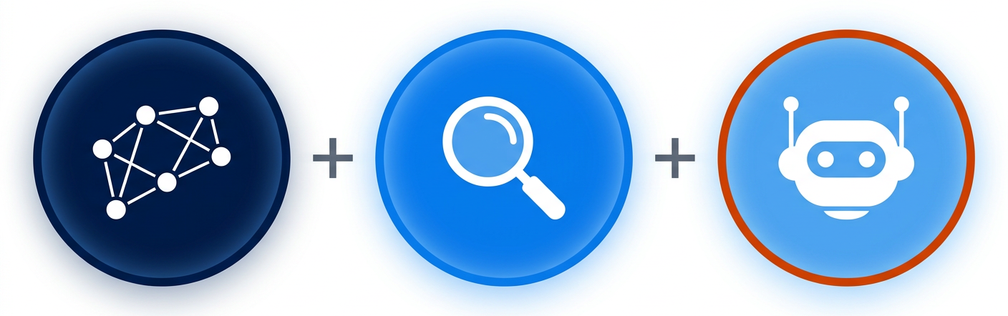
Planned Evaluation: Factorial Ablation Design
Each condition removes one component — isolating its causal contribution
• Full System (KG + RAG + Agent) — the complete framework
• Agent + RAG (no KG) — isolates the KG contribution
• Agent + KG (no RAG) — isolates the RAG contribution
• Baseline (no KG, no RAG). — parametric knowledge only
• Metrics: task completion rate · form-filling accuracy
• Design question: how much of agent performance is attributable to structured knowledge?

Slide 19
Summary
What This Research Contributes

Slide 20

Three Core Contributions
Open question: Under what conditions does structured knowledge become a bottleneck — when it is stale, incomplete, or contradicted by retrieved documents?
1. Architectural Framework —
System-agnostic multi-layer framework for integrating AI agents with business information systems
2. Formal Design Principle —
Knowledge before action as a structural architectural invariant, not a guideline
3. Evaluation Methodology —
Factorial ablation design attributing agent performance to specific knowledge components

Slide 21
Thank You
∀ action a : a is grounded in K · knowledge before action
Aleksandar Aytov · IMI-BAS · Mathematics Days in Sofia 2026

