Slide 1
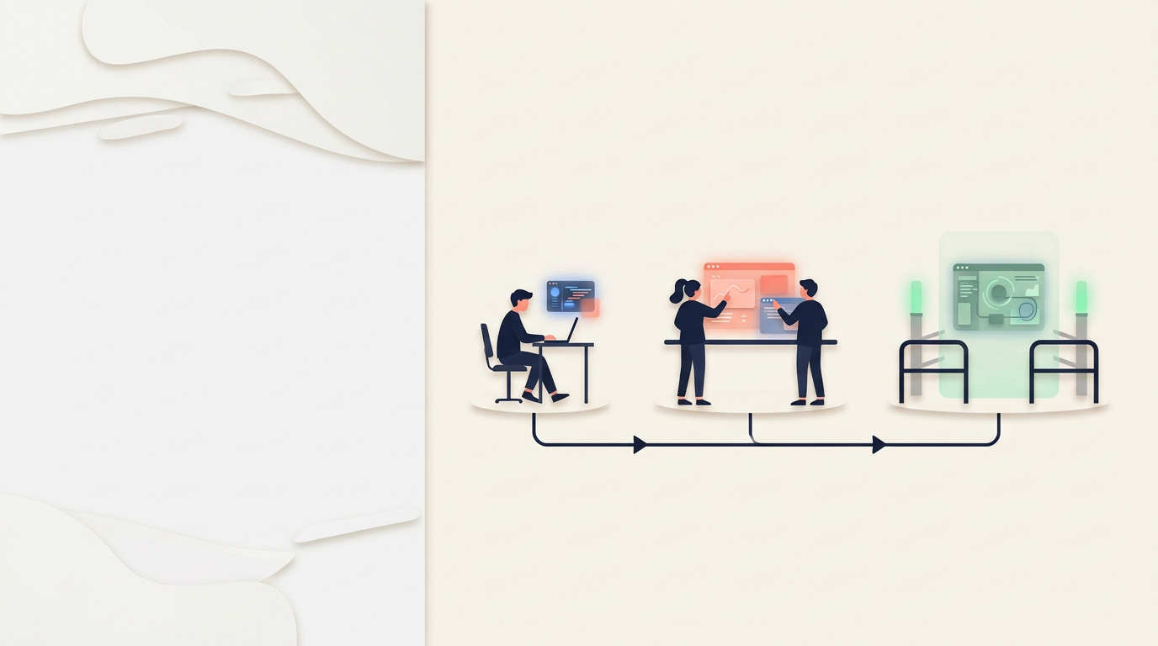
AI-Assisted
Software
Engineering
LIVE AGENT
AFK AGENT
COPILOT
From coding assistance
to reliable autonomous
workflows
Notes:
Opening question: If an AI can write code for eight hours while you sleep, what must be true before you trust it to start? Do not answer yet. This talk is about engineering the relationship between a human and an AI agent, not choosing the smartest model. Return to the question on the final slide.

Slide 2

If AI writes code, why study CS?
02
AI can generate code.
You need to judge the result.
System design
Choose boundaries and understand trade-offs.
Correctness
Recognize broken assumptions and test behavior.
Ownership
Explain, change and maintain what you ship.
AI-Assisted Software Engineering
Notes:
Ask what a student would need to know to judge a generated LibraryService. Syntax knowledge still helps you read and change code. Computer science also provides models for data, complexity, abstraction, concurrency and correctness. A plausible program can still embody the wrong rules. The human remains responsible for the problem definition and for evaluating the result.
Sources:
- User-provided reference slide: Screenshot 2026-10-16 at 9.21.56.png
- Illustration: AI-generated using SAP image generation, Gemini, 16 October 2026.

Slide 3
One prompt. Many hidden decisions
03
1 Who may borrow?
2 What makes a book available?
“Build a Java
library system.”
3 What happens when borrowing fails?
4 How many active loans?
PROOF How do we verify it?
AI-Assisted Software Engineering
Notes:
Ask the room for one more missing decision. Take two or three answers. The point is that implementation begins with uncertainty, not code. A fast implementation of the wrong idea is still wrong. Use the Campus Library example throughout: Book, Member, Loan, LibraryService and JUnit.

Slide 4



Three levels of AI coding
04
COPILOT
LIVE AGENT
AFK AGENT
You write the code.
AI suggests the next change.
The agent edits and runs tools.
You stay present and steer.
The agent works while you are away.
You review its evidence later.
AI-Assisted Software Engineering
Notes:
Introduce a useful teaching model. Copilot means inline or next-edit assistance while the human remains the author. A live agent can explore and edit several files while the human stays present. An AFK agent works while the human is away. The empty chair marks the defining shift: feedback moves from during the run to before and after it. State clearly that Matt Pocock does not publish this as a formal three-mode taxonomy. Current GitHub Copilot itself spans all three levels.

Slide 5
What is actually doing the work?
05
WORKFLOW
Chooses when each procedure runs
SKILLS
Reusable engineering procedures
CODEBASE
HARNESS
Coordinates tools and permissions
Reads and changes the project
MODEL
Predicts the next useful output
The model predicts. The surrounding system turns predictions into work.
AI-Assisted Software Engineering
Notes:
Define the terms. Claude Code, Codex and Copilot are harnesses. A skill is a reusable procedure loaded for a task. A workflow orders decisions, artifacts, checks and handoffs. A loop repeatedly dispatches work. The model is only one layer. The workflow and codebase determine how useful its output becomes.

Slide 6
The autonomy equation
06
requires
AUTONOMY ↑
GUARDRAILS ↑
STRUCTURE
FEEDBACK
HUMAN OVERSIGHT
clear rules
tests + types
approval gates
small, isolated tasks
automatic checks
final review
A better model helps. It does not remove the guardrail system.
AI-Assisted Software Engineering
Notes:
This is the thesis for the talk. As the human moves away from the keyboard, the work needs clearer artifacts, smaller units, stronger executable checks, safer isolation and explicit review. Ask: Which of these does a better model remove? Answer: none completely.

Slide 7

Skills for real engineers
07
Not one giant prompt
Small, composable
engineering skills
adaptable
versioned
human-controlled
A skill is a reusable operating procedure, not extra intelligence.
AI-Assisted Software Engineering
Notes:
Pocock contrasts small skills with comprehensive systems that can take control of the process and make workflow failures hard to isolate. His repository packages established engineering practices as adaptable procedures. User-invoked skills create explicit gates. Model-invoked skills provide reusable disciplines such as TDD, research and review.
Sources:
- https://github.com/mattpocock/skills
- https://github.com/mattpocock/skills/blob/main/README.md

Slide 8






The entire journey
08
GRILL
SPEC
TICKETS
BUILD
REVIEW
RETRO
decide
preserve
slice
prove
inspect
improve
AI-Assisted Software Engineering
Notes:
Give the audience the whole map before the details. The core journey is grill, spec, tickets, build, review and retro. Research or a prototype branches off when external facts or uncertain behavior need evidence. Spec and tickets are optional for genuinely small work. The workflow should scale with the task, not force ceremony onto every edit.
Sources:
- https://github.com/mattpocock/skills
- https://www.aihero.dev/skills-changelog-v13-implement-spec-pr-retro-and-glossary-md

Slide 9

Step 1: Grill the idea
09
Facts
agent investigates
Decisions
human answers
Ask only what can be decided now
AI-Assisted Software Engineering
Notes:
Grilling treats the problem as a decision tree. Ask the current frontier of answerable questions in rounds, recommend an answer for each and wait for the human. Questions that depend on unresolved answers come later. Repository facts belong to the agent. Product and policy decisions belong to the human. No implementation starts until shared understanding is confirmed. Example decision: May a member borrow a reference-only book? Example fact: How does the current Java code represent borrowing failures?
Sources:
- https://github.com/mattpocock/skills/blob/main/skills/productivity/grilling/SKILL.md
- https://github.com/mattpocock/skills/blob/main/skills/engineering/grill-with-docs/SKILL.md

Slide 10
Shared words reduce repeated confusion
10
BEFORE
AFTER
“A loan record that has
not been returned yet”
ACTIVE LOAN
GLOSSARY.md
ADRs for durable decisions
Name the domain once. Reuse the meaning everywhere.
AI-Assisted Software Engineering
Notes:
grill-with-docs writes agreed project terms into GLOSSARY.md. Hard-to-reverse and surprising tradeoffs with real alternatives may become architecture decision records. Most other decisions remain in the conversation until a spec preserves them. A shared vocabulary lowers repeated ambiguity for humans and agents.
Sources:
- https://github.com/mattpocock/skills/blob/main/skills/engineering/grill-with-docs/SKILL.md

Slide 11
Step 2: Preserve the destination
12
A spec remembers what
the conversation decided
USER BEHAVIOR
TECHNICAL DECISIONS
TEST SEAMS
OUT OF SCOPE
Skip it when the entire change fits one live session
AI-Assisted Software Engineering
Notes:
to-spec turns decisions that are already settled into a durable specification. It should synthesize rather than restart the interview or invent new decisions. Include user behavior, implementation choices, testing decisions and explicit boundaries. A spec is valuable when work crosses context windows, sessions or people. Skip it for a genuinely small change.
Sources:
- https://github.com/mattpocock/skills/blob/main/skills/engineering/to-spec/SKILL.md

Slide 12

Blueprints before bricks: /to-spec
13
A contract for one behavior
INPUT
An eligible member and an available book
SUCCESS
Create an active loan and mark the book unavailable
FAILURE
Reject an unavailable book without changing state
EVIDENCE
“Build borrowing”
Tests check both outcomes through LibraryService
Leaves success and failure undefined
AI-Assisted Software Engineering
Notes:
A spec turns the agreed behavior into a durable reference. The Campus Library contract names the input, observable success, an explicit failure and the test boundary. Also preserve invariants, important implementation choices and what is out of scope. Tests are evidence for stated cases, not a proof that all requirements are complete. When an implementation is wrong, use a reviewable branch to revise or redo the scoped change while preserving valuable work. A clear contract reduces repeated prompting but does not remove engineering judgment.
Sources:
- User-provided reference slide: Screenshot 2026-10-16 at 9.23.24.png
- https://github.com/mattpocock/skills/blob/main/skills/engineering/to-spec/SKILL.md
- Illustration: AI-generated using SAP image generation, Gemini, 16 October 2026.

Slide 13

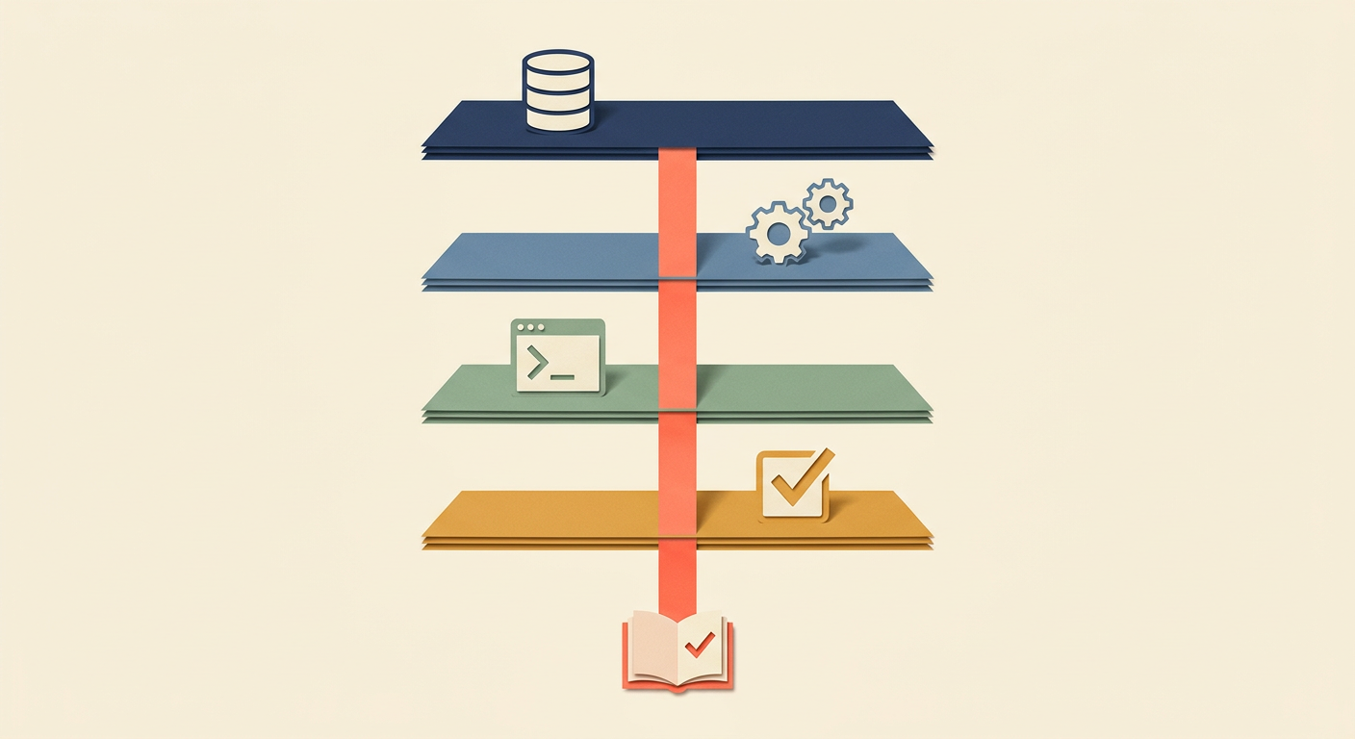
Step 3: Fire tracer bullets
14
HORIZONTAL LAYERS
VERTICAL SLICE
Four polished parts
that do not work together
Borrow one available book
from database to passing test
Small. Vertical. Testable.
AI-Assisted Software Engineering
Notes:
to-tickets creates small vertical slices that pass through every necessary layer and produce something demonstrable. Each ticket should fit a fresh context window and state its blockers. Campus Library ticket: load Book and Member, create a Loan, mark the book unavailable, expose the result through LibraryService and verify it through JUnit. Wide mechanical refactors may need a different expand-migrate-contract strategy.
Sources:
- https://github.com/mattpocock/skills/blob/main/skills/engineering/to-tickets/SKILL.md
- https://www.aihero.dev/tracer-bullets

Slide 14
The task graph
15
2 Reject unavailable book
3 Return borrowed book
Build on the borrowing path
Close the active loan
1 Borrow available book
Establish the happy path
FRONTIER: READY NOW
4 Enforce loan limit
Reuse established rules
A graph reveals safe parallel work. A checklist hides dependencies.
AI-Assisted Software Engineering
Notes:
Tickets form a dependency graph, not merely a checklist. The frontier is the set of tickets whose blockers are complete. Here, the initial happy path establishes shared behavior. The unavailable-book and loan-limit cases can then build on it. Returning a book follows after the loan representation is stable. Concurrency is useful only when dependencies and shared Java files are understood.

Slide 15

Focused context for each task
16
Longer chats can obscure
the details that matter.
One bounded task
Keep unrelated work out of the session.
Save the decisions
Preserve the spec, progress and open issues.
Start with a useful handoff
Load the ticket, relevant code and constraints.
AI-Assisted Software Engineering
Notes:
Context is the information available to the model in the current run. Performance can decline as a context becomes longer or noisier, but there is no universal 100,000-token boundary. Anthropic describes a performance gradient rather than a hard cliff. A useful default is one bounded ticket per implementation session. Save the settled spec, progress, relevant decisions, verification results and remaining questions before a fresh session or compaction. Committing code alone does not preserve conversational decisions. Reload the necessary project instructions, glossary, relevant ADRs, ticket and code. Some tools provide a clear command and others use new sessions or compaction. Do not clear unresolved planning work before capturing it.
Sources:
- User-provided reference slide: Screenshot 2026-10-16 at 9.22.11.png
- https://www.anthropic.com/engineering/effective-context-engineering-for-ai-agents
- https://github.com/mattpocock/skills/blob/main/docs/engineering/grill-with-docs.md
- https://github.com/mattpocock/skills/blob/main/skills/engineering/to-tickets/SKILL.md
- Illustration: AI-generated using SAP image generation, Gemini, 16 October 2026.

Slide 16
Step 4: Pick an execution loop
17
1
2
3
MANUAL
AGENT LOOP
SCRIPTED LOOP
You dispatch
Agent dispatches
Code dispatches
Maximum visibility
Easy first AFK step
Predictable orchestration
learn
easy starting point
mature AFK
Pocock’s direction: deterministic orchestration wins after you tune it
AI-Assisted Software Engineering
Notes:
Three execution choices appear in Pocock’s recent material. Manual implement sessions give maximum control. implement-spec lets an orchestrator agent dispatch subagents in isolated worktrees and is easy to start with. Ralph or Sandcastle-style scripted loops make dispatch deterministic. Pocock says the agent loop is less reliable than deterministic orchestration but easier to adopt before a software factory matures.
Sources:
- https://github.com/mattpocock/skills/blob/main/skills/engineering/implement/SKILL.md
- https://github.com/mattpocock/skills/blob/main/skills/engineering/implement-spec/SKILL.md
- https://www.aihero.dev/getting-started-with-ralph

Slide 17
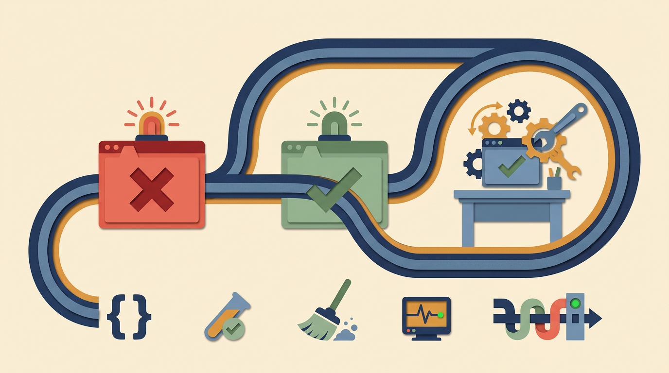
Step 5: Give the code feedback
18
RED
Start with a failing check
GREEN
Write the smallest code that passes
REFACTOR
Improve the design until it is a success
types
tests
lint
runtime
CI
A failing check can stop the agent
AI-Assisted Software Engineering
Notes:
Executable feedback is the main quality engine during implementation. Agree on public seams. Start with a failing test where appropriate, implement the smallest behavior, refactor, typecheck frequently, run focused tests while working and the full suite near completion. Add runtime or browser evidence when applicable. Tests do not prove correctness, but a failing check can stop work in a way prose cannot.
Sources:
- https://github.com/mattpocock/skills/blob/main/skills/engineering/implement/SKILL.md

Slide 18

Automated guardrails during implementation
19
/tdd
/diagnosing-bugs
/implement
Failing test first
Reproduce the bug
Verify before review
Express expected behavior.
Watch the test fail, then
implement the change.
Capture the exact symptom.
Test a cause before
choosing a fix.
Run relevant tests and
project checks. Report the
results and any gaps.
AI-Assisted Software Engineering
Notes:
The three procedures supply different feedback. TDD starts from behavior at a suitable test seam. diagnosing-bugs first establishes a fast runnable reproduction that catches the reported symptom, then minimizes it, tests hypotheses and instruments the path. A reproduction demonstrates a failure, not its root cause. A regression test should exercise the actual bug pattern. implement calls TDD where possible at agreed seams, runs type checks and focused tests during work, then the full suite and code review. Run the project's other required checks, such as lint and compilation, when applicable. Skill prose guides the agent but does not guarantee enforcement. A CI gate or another configured control is needed to block progress mechanically.
Sources:
- User-provided reference slide: Screenshot 2026-10-16 at 9.23.13.png
- https://github.com/mattpocock/skills/blob/main/skills/engineering/diagnosing-bugs/SKILL.md
- https://github.com/mattpocock/skills/blob/main/skills/engineering/implement/SKILL.md
- https://github.com/mattpocock/skills/blob/main/skills/engineering/tdd/SKILL.md
- Illustration: AI-generated using SAP image generation, Gemini, 16 October 2026.

Slide 19

Step 6: Review with two lenses
20
BUILT RIGHT?
RIGHT THING?
Standards review
Specification review
Conventions, design and maintainability
Behavior, scope and acceptance
Clean code can solve the wrong problem
AI-Assisted Software Engineering
Notes:
Pocock separates review into independent axes. Standards review asks whether the code follows repository conventions and remains maintainable. Spec review asks whether it implements the requested behavior and boundaries. Do not let one passing axis hide the other. Ask the audience: Can perfectly clean code still fail? Yes, if it solves the wrong requirement.
Sources:
- https://github.com/mattpocock/skills/blob/main/skills/engineering/code-review/SKILL.md

Slide 20
Step 7: Make the next run better
21
Mistake
Guardrail
Search
Pointer
Mechanical rule
Automated check
Judgment call
Review standard
Improve the environment, not only the prompt
AI-Assisted Software Engineering
Notes:
retro studies a difficult session and proposes changes that make future work better. If the agent could not find a file, add a navigation pointer. If a mistake is mechanically detectable, add a type, lint rule, test, hook or CI check. Reserve prose for judgment calls. A healthy AGENTS.md should not become an unstructured memory dump; mechanical rules belong in deterministic checks.
Sources:
- https://github.com/mattpocock/skills/blob/main/skills/engineering/retro/SKILL.md

Slide 21

Copilot: the human remains the driver
22
1
You choose the location
2
AI suggests the next edit
3
You accept or reject immediately
Best for syntax, repetition and known designs
AI-Assisted Software Engineering
Notes:
Define Copilot-style assistance as low autonomy. The human remains the primary author and evaluates suggestions in tiny increments. It works well for syntax, boilerplate, repetitive changes and tests after the design is understood. Current GitHub Copilot also has planning, agent and cloud modes, so do not describe the product as autocomplete only.
Sources:
- https://code.visualstudio.com/docs/editing/ai-powered-suggestions
- https://docs.github.com/en/copilot/concepts/agents/cloud-agent/about-cloud-agent

Slide 22

Live versus AFK
23
LIVE
AFK
Ask the human · steer now
Use prepared defaults · review later
Start live. Earn the right to go AFK.
AI-Assisted Software Engineering
Notes:
The characteristic AFK failure is coherent work built on an early wrong assumption. Live sessions allow immediate clarification and steering. AFK execution fits low-risk, prepared work whose important decisions are already settled. Keep risky architecture, product and privacy choices live. AFK defers human review. It does not eliminate review.
Sources:
- https://www.aihero.dev/ai-coding-dictionary/afk
- https://www.aihero.dev/ai-coding-dictionary/agent-mode

Slide 23

The AFK safety envelope
24
BEFORE
DURING
AFTER
Clear spec + small tickets
Sandbox + checks + hard limit
Reviewable branch
AI-Assisted Software Engineering
Notes:
Before: resolve ambiguity, prepare the spec and small tickets. During: isolate the work, grant bounded permissions, run automated checks, track progress and impose a hard stop. After: inspect commits, evidence and the final diff before merging. A reviewable branch keeps the work reversible.

Slide 24
How much workflow do you want?
25
LIGHTER / FLEXIBLE
STRUCTURED / PRESCRIPTIVE
Bare harness
Pocock Skills
Spec Kit
GSD / BMAD
Plan mode, instructions, subagents
Choose small procedures
Standard spec-driven sequence
Full workflow systems
Less setup
More repeatability
AI-Assisted Software Engineering
Notes:
Compare philosophies rather than ranking quality. A bare harness offers capabilities with little ceremony. Pocock keeps the human as workflow owner and composes narrow skills. Spec Kit defines a repeatable specification-driven sequence. GSD and BMAD provide broader context, state and specialist roles. Ralph or Sandcastle are execution loops after discovery and planning, not replacements for product decisions.
Sources:
- https://github.com/github/spec-kit
- https://github.com/gsd-build/get-shit-done
- https://github.com/bmad-code-org/bmad-method
- https://github.com/mattpocock/skills

Slide 25
No workflow is magic
26
Decisions can be lost
Agents can collide
Conversation details weaken during synthesis
Parallel branches still meet at merge time
Review can recurse
Plans can become waterfall
Agents may delegate more review agents
Too much wayfinding speculates far ahead
Workflows have bugs too
AI-Assisted Software Engineering
Notes:
Pocock’s documentation is candid about rough edges. Delegated skills can fail to load. Decisions may be softened when converted to a spec. A parent spec can be mistaken for one giant autonomous task. Parallel worktrees postpone some conflicts until integration. Review agents can recurse. Wayfinding can over-plan. Repeated LLM review has no guaranteed convergence. Treat workflows like software: inspect, version and adapt them.
Sources:
- https://github.com/mattpocock/skills
- https://www.aihero.dev/skills-changelog-v13-implement-spec-pr-retro-and-glossary-md

Slide 26

Your starter workflow
27
1
Explain
2
Question
3
Slice
4
Verify
5
Understand
Never submit code you cannot explain
Use the lightest workflow that protects the result and your learning
Questions
Notes:
Give students a five-step routine. First, explain users, behavior, constraints and what done means. Second, ask the AI to surface the most important ambiguities before coding. Third, build one end-to-end behavior at a time. Fourth, run the program, tests and inspect the diff. Fifth, explain and modify every important line yourself. Follow course policy and disclose AI use when required. AI coding maturity is measured by deliberate choices about autonomy, not by how long the agent can run alone. Leave this slide visible for questions.

Slide 27
Thank you
Questions and discussion
Aleksandar Aytov
aleksandar.aytov@sap.com
AI-Assisted Software Engineering
Notes:
Thank the audience and invite questions. Contact: Aleksandar Aytov, aleksandar.aytov@sap.com.

