Slide 1

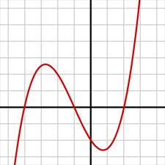
WP3 – Quantitative Analysis Tools
Useful techniques:
fitting, fuzzy & more
Mariëlle Stoelinga (UT)
23-10-2014
Amsterdam

Slide 2
Agenda
Fitting
Fault tree analysis
Fuzzy fault trees
Disclaimer: MS is user of this technology, not expert

Slide 3
Agenda
Fitting
Fault tree analysis
Fuzzy fault trees
Disclaimer: MS is user of this technology, not expert

Slide 4
Data fitting (aka curve fitting)
Data fitting = given set of data point, give best matching curve
What is best?
Which curves do we consider?

Slide 5
Data fitting (aka curve fitting)
Data fitting = given set of data point, give best matching curve
What is best?
Which curves do we consider?
This is not what we want:
perfect match
BUT: ugly curve
We want:
nice curve
good match

Slide 6
Data fitting (aka curve fitting)
Data fitting = given set of data point, give best matching curve
What is best?
lease squares
expected values match
Which curves do we consider?
linear functions
polynomials
probability distributions
exponentials
normal distributions
APH distributions

Slide 7
Data fitting (aka curve fitting)
Data fitting = given set of data point, give best matching curve
Example
curves: linear functions
good match: least squares
datapoints (d_{i},e_{i})
f(x) = ax + b
- minimize Σ_{i} |f(d_{i}) – e_{i}| ²

Slide 8
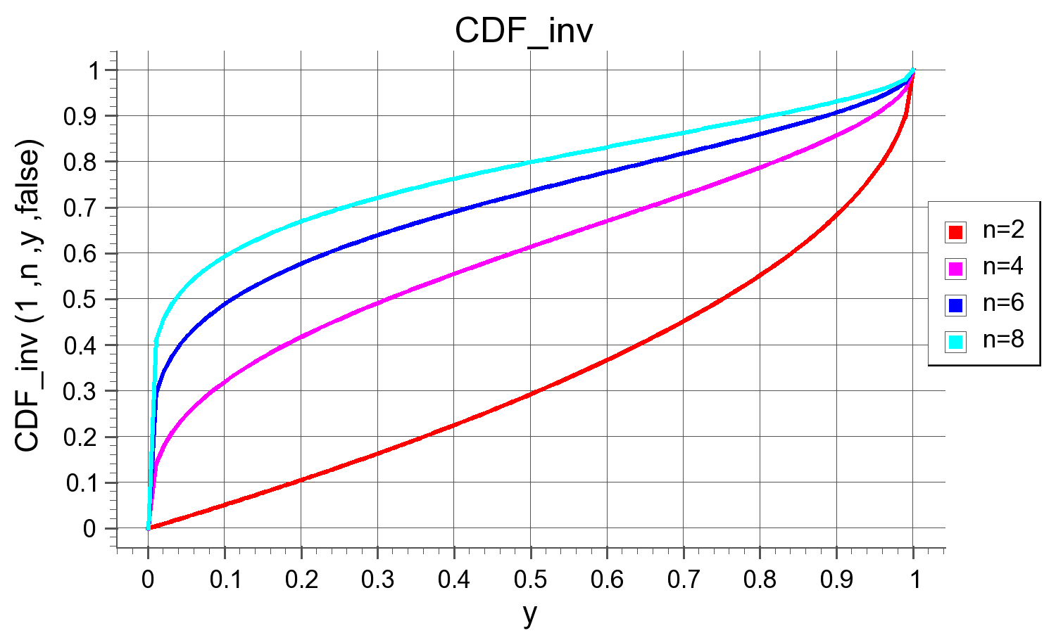
Data fitting (aka curve fitting)
Data fitting = given set of data point, give best matching curve
Example 2
curves: exponential probability distributions: Exp(λ)
good match: expected value match
n datapoints (d_{i},e_{i})
f(x) = 1- e^{-λt}
- take λ = 1/n * Σ_{i} e_{i}

Slide 9
Data fitting (aka curve fitting)
Data fitting = given set of data point, give best matching curve
Example 2
curves: exponential probability distributions: Exp(λ)
good match: expected value match
fast but could be imprecise
remove outliers
confidence intervals:
how reliable is your
estimation?

Slide 10
Data fitting (aka curve fitting)
Data fitting = given set of data point, give best matching curve
fast but could be imprecise
remove outliers
confidence intervals: how reliable is estimation?
exponential distrs are not dense
you cannot approximate upto arbitrary precision
λ
μ
ν
λ

Slide 11
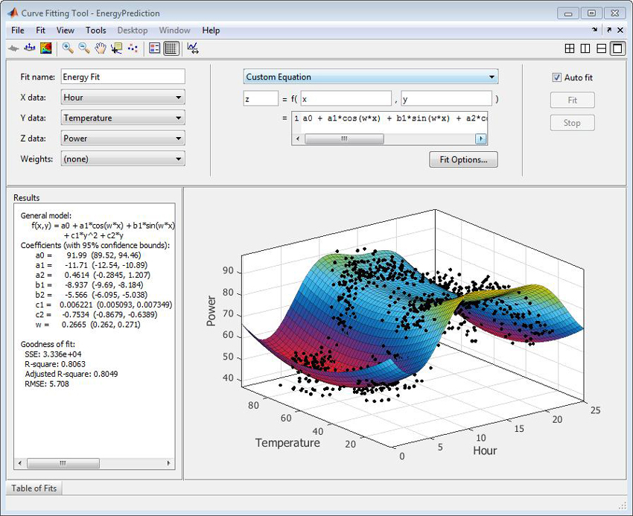
Tools

Slide 12
Agenda
Fitting
Fault tree analysis
Fuzzy fault trees

Slide 13
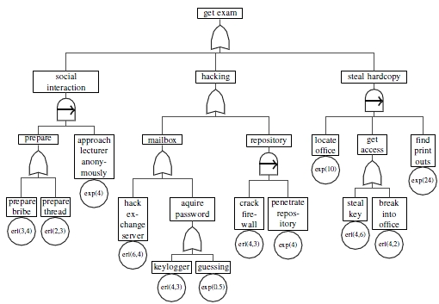
Qualitative Fault Tree Analysis
minimal cut sets / cut sequences

Slide 15
Quantitative
Impact
Preferably quantitative
Qualitative
Vulnerability

Slide 18
Agenda
Fitting
Fault tree analysis
Fuzzy fault trees

Slide 19
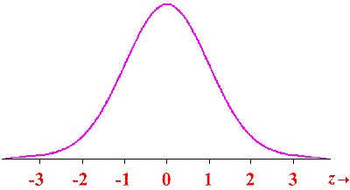
Fuzzy numbers / sets
Half of the experts rate 0.3 as low probability
Membership function
Intuitionistic fuzzy sets
Possibility measures
Normal distributions

Slide 20
Fuzzy numbers / sets
Propagate through gates
Bayesian Networks
Fuzzy Gates
Dynamic analysis
Y. A. Mahmood, A. Ahmadi, A. K. Verma, A. Srividya, and U. Kumar. Fuzzy fault tree analysis: a review of concept and application. International Journal of System Assurance Engineering and Management, 4(1):19–32, 2013.

Slide 21
Advertisement:

Slide 22
Agenda
Fitting
Fault tree analysis
Fuzzy fault trees
Questions?

