Slide 2
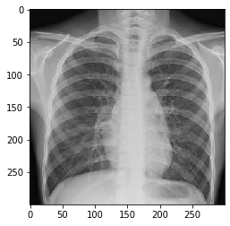
297 x 297 x 32
145 x 145 x 32
69 x 69 x 64
31 x 31 x 64
12 x 12 x 256
Flatten (4719104)
148 x 148 x 32
72 x 72 x 32
34 x 34 x 64
15 x 15 x 128
6 x 6 x 256
Dense (512)
Bacteria
SoftMax
Normal
RELU
(2 x 2 pool)
RELU
(2 x 2 pool)
RELU
(2 x 2 pool)
RELU
(2 x 2 pool)
RELU
(2 x 2 pool)
300 x 300 x 3
(270000)
Virus
Conv 3 x 3, 32
Conv 3 x 3, 32
Conv 3 x 3, 64
Conv 3 x 3, 128
Conv 3 x 3, 256

Slide 3
