Slide 1
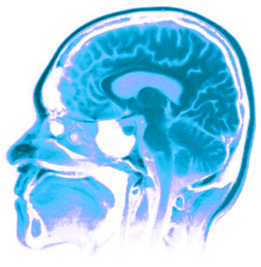
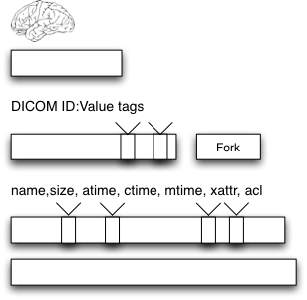
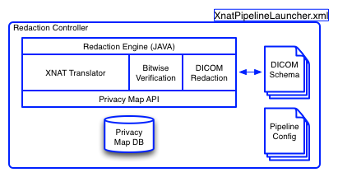
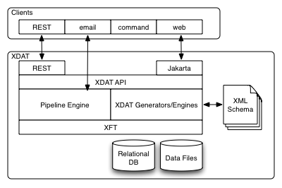
Redacting PHI in Neurological Images using XNAT
Alex Barclay – Computer Scientist¹ Ph.D. Canidate²
Nakeisha Schimke – Ph.D. Canidate²
Dr. John Hale, Ph.D. – Professor of Computer Science²
1 – Laureate Institute for Brain Research, Tulsa OK, USA
2 – University of Tulsa, Tulsa OK, USA
Institute of Bioinformatics and Computational Biology
1. Motivation
The Problem
Why redact?
XNAT Background
Large-scale studies have huge amounts of data (1PB/3Yrs)
Data shared must be HIPAA compliant
Inter-organizational collaboration must be easy
Data exists as multiple abstractions, and simply removing it from a single layer is insufficient
Method is needed to specifically redact entire data stack of PHI
Primary neuroimagering data management tool www.nat.org
Java middeware
Blah Blah Blah
Primary neuroimagering data management tool www.nat.org
Java middeware
Blah Blah Blah
1. Motivation
1. Motivation
1. Motivation
1. Motivation
Data Stack
Issues
XNAT Architecture
PHI Redaction Engine
Logical (not architectural or physical) break down of different storage and display components
Bottom up approach to understand what contains PHI
Neuroscience
Operating Sys
Forensics
Logical (not architectural or physical) break down of different storage and display components
Bottom up approach to understand what contains PHI
1. Motivation
Modified/Added Architecture
IBuilds upon XNAT pipeline interfaces
Input: selected images, output: redacted images in new project
Java/Python/XML
1. Motivation
Discussion + Future Work
Comprehensive redaction is combination of recursive redaction at the block and file layer, with additional techniques to find and reduce inferred data
Based upon body of work and code for legal production
First step in exploring imaging specific redaction issues
Expand and bundle current tools, produce integrated tool
References:
Acknowledgments:
William K. Warren Medical Research Institute
David Greer + Patrick Bellgowan
Photobucket – mri picture
Arkfeld, M. R. (2005), Electronic Discovery and Evidence, Law Partner Publishing, L.L.C.
Bischoff-Grethe, A., et al. (2007), A technique for the Deidentification of Structural Brain MR Images. Human Brain Mapping, 28:892-903.
Carrier, B. (2005), File System Forensic Analysis, Addison-Wesley Professional.
G. Manes, L. Watson, E. Downing, A. Barclay, D. Greer, J. Hale, A Framework for Redacting Digital Information from Electronic Devices, Proceedings of the 8th Annual IEEE SMC Information Assurance Workshop, West Point, New York, June 20-22, 2007.

