Slide 1
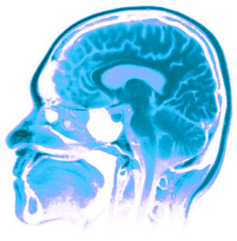
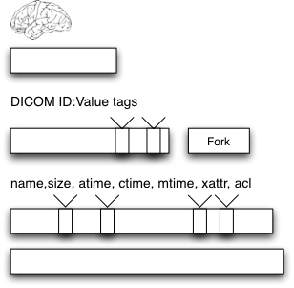
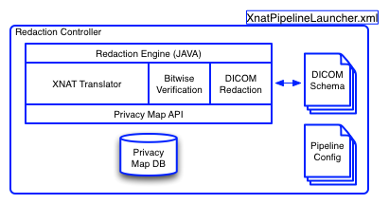
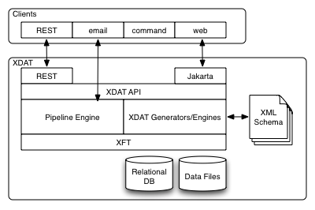
Redacting PHI in Neurological Images using XNAT
Alex Barclay – Computer Scientist¹ Ph.D. Candidate²
Nakeisha Schimke – Ph.D. Candidate²
Dr. John Hale, Ph.D. – Professor of Computer Science²
1 – Laureate Institute for Brain Research, Tulsa OK, USA
2 – University of Tulsa, Tulsa OK, USA
Institute of Bioinformatics and Computational Biology
1. Motivation
The Problem
Why redact?
XNAT Background
Large-scale studies have huge amounts of data (1PB/3Yrs)
Data shared must ensure privacy of subject (HIPAA)
Inter-organizational collaboration must be easy
Data exists as multiple abstractions, and simply removing it from a single layer is insufficient
Tool is needed to specifically redact entire data stack of PHI and share data
Neuroimaging data management platform www.xnat.org
Combination relational database and file data store
Remote data processing/execution pipepine
Jakarta Turbine Web Application Framework / REST Interface
Java with XML configuration files
PostgreSQL database and Unix filesystem file store
1. Motivation
1. Motivation
1. Motivation
1. Motivation
Data Stack
Issues
XNAT Architecture
PHI Redaction Engine
Logical (not architectural or physical) break down of different storage and display components
Bottom up approach to understand what contains PHI
Neuroscience
Operating Sys
Forensics
Developed as separate units:
Clients (Turbine/REST/E-mail)
Core (XML configured/Java middleware)
Pipeline (XML configured/implementation independent)
1. Motivation
Modified/Added Architecture
Builds upon XNAT pipeline interface (XML/Java/Python)
Input: subjects with full scan data (DICOM)
Output: mapped subject identifiers coupled to redacted images
1. Motivation
Discussion + Future Work
Architecture and implementation of issues presented in poster at USENIX Security 09
Comprehensive redaction is combination of recursive redaction at the block and file layer, with additional techniques to find and reduce inferred data such as DICOM
Based upon body of work and code for legal production
Project is started with goal to finish by August 2011
References:
Acknowledgments:
We gratefully acknowledge support from the William K. Warren Foundation, The National Institute of Health (1R03EB011961-01).
Arkfeld, M. R. (2005), Electronic Discovery and Evidence, Law Partner Publishing, L.L.C.
Bischoff-Grethe, A., et al. (2007), A technique for the Deidentification of Structural Brain MR Images. Human Brain Mapping, 28:892-903.
Carrier, B. (2005), File System Forensic Analysis, Addison-Wesley Professional.
G. Manes, L. Watson, E. Downing, A. Barclay, D. Greer, J. Hale, A Framework for Redacting Digital Information from Electronic Devices, Proceedings of the 8th Annual IEEE SMC Information Assurance Workshop, West Point, New York, June 20-22, 2007.
Marcus, D. S, Oslen, T. R., Ramaratnam, M. and Buckner, R. L. (2007), The Extensible Neuroimaging Archive Toolkit: an informatics platform for managing, exploring, and sharing neuroimaging data, Neuroinformatics 5(1), 11-34.

