Slide 1
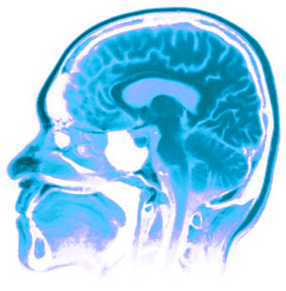
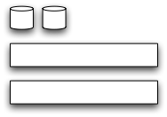
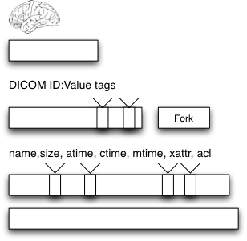
Comprehensive Redaction for Neurological Imaging
Alex Barclay – Computer Scientist¹ Ph.D. Student²
Nakeisha Schimke – Ph.D. Student²
Dr. John Hale, Ph.D. – Professor of Computer Science²
1 – Laureate Institute for Brain Research, Tulsa OK, USA
2 – University of Tulsa, Tulsa OK, USA
Institute of Bioinformatics and Computational Biology
1. Motivation
The Problem
Workflow
Why redact?
Large-scale studies have huge amounts of data (1PB/3Yrs)
Data shared must be HIPAA compliant
Inter-organizational collaboration must be easy
Data exists as multiple abstractions, and simply removing it from a single layer is insufficient
Method is needed to specifically redact all layers of PHI
1. Motivation
1. Motivation
1. Motivation
1. Motivation
Data Stack
Example
PHI Issues
Remediation & Redaction
Techniques
Our Redaction Process
Logical (not architectural or physical) break down of different storage and display components
Bottom up approach to understand what contains PHI
Mac OS X
Functional MRI
Osirix/AFNI viewer
Partial list of problems by layer mapping
Complex, need knowledge of neuro study, computer science, and file formats
1. Motivation
1. Motivation
External stores
Discussion + Future
Data is not just stored in expected file location,
Depending on application+ file system architecture, data is transferred to working copies
Operating systems also index data for fast searching
External data stores when producing images sets require redaction upon the entire media.
Low level (bitwise) redaction of media is the only way to find all sources of PHI
Comprehensive redaction is combination of recursive redaction at the block and file layer, with additional techniques to find and reduce inferred data
Based upon body of work and code for legal production
First step in exploring imaging specific redaction issues
Expand and bundle current tools, produce integrated tool
References:
Acknowledgments:
William K. Warren Medical Research Institute
TU Bioinformatics reading group
David Greer + Patrick Bellgowan
Photobucket – mri picture
Arkfeld, M. R. (2005), Electronic Discovery and Evidence, Law Partner Publishing, L.L.C.
Bischoff-Grethe, A., et al. (2007), A technique for the Deidentification of Structural Brain MR Images. Human Brain Mapping, 28:892-903.
Carrier, B. (2005), File System Forensic Analysis, Addison-Wesley Professional.
G. Manes, L. Watson, E. Downing, A. Barclay, D. Greer, J. Hale, A Framework for Redacting Digital Information from Electronic Devices, Proceedings of the 8th Annual IEEE SMC Information Assurance Workshop, West Point, New York, June 20-22, 2007.

