Slide 1
Web Scraping for Economists
Abhishek Nagaraj
MIT Sloan School of Management nagaraj@mit.edu http://abhishek.mit.edu

Slide 2

What is Web Scraping?

Slide 3
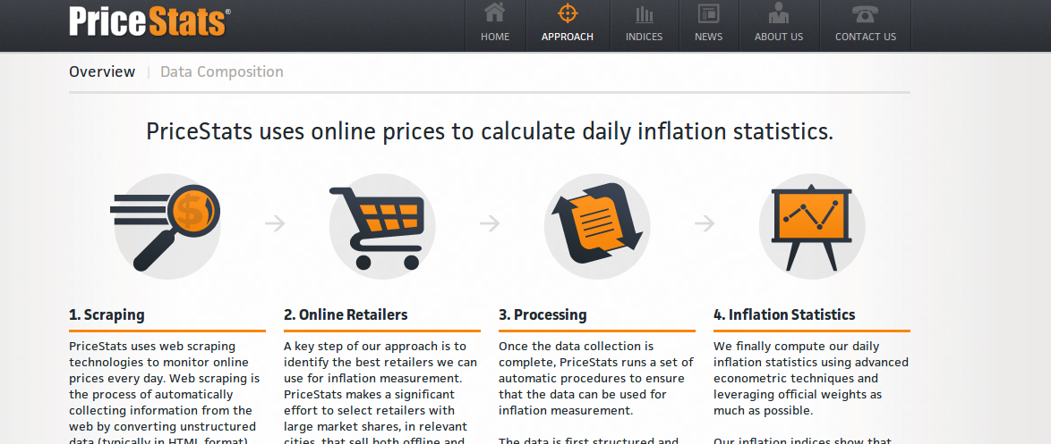
Why is it useful?

Slide 4

Why is it useful?

Slide 5
Caveats?
... we grant you a limited, revocable, nonexclusive, nonassignable, nonsublicenseable license and right to access the Services, through a generally available web browser, mobile device or LinkedIn authorized application (but not through scraping, spidering, crawling or other technology or software used to access data without the express written consent of LinkedIn or its Members),

Slide 6
Lets get started!
Learn basics of scraping
Simple Example
Some advanced issues
Resources

Slide 7
4 Basic Steps of a Simple Scraping Project
Figure out what you want to scrape (if you can see it, you can scrape it)
Programatically download all pages that you will need and store them locally
Study the source code for the website, get a handle on how you will go about doing it and develop parsing algorithm
Write parser output to flatfile, ready for analysis in STATA

Slide 8
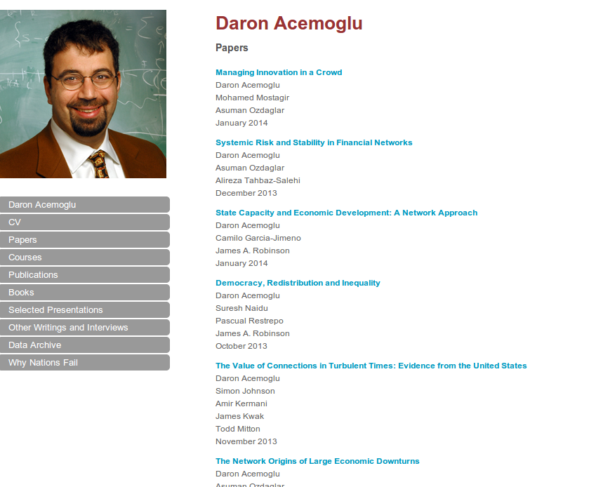
Our Exercise
Build a database of all faculty publications and then build a network graph of collaborators

Slide 9
1. Study the URLs
“Directory URL” – http://economics.mit.edu/faculty/#
“Data URL”
  Contact Data
  Publications
  Working Papers

Slide 10
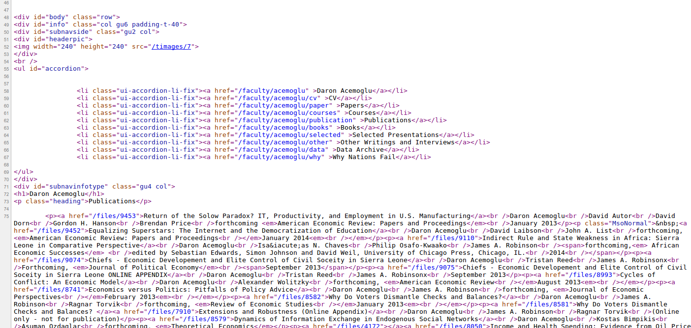
2. Study the Source

Slide 11
Diversion #1
Basics of HTML and Web programming

Slide 12
3. Get cracking in Python!
See https://github.com/cheerfulguy/mitscraping

Slide 13
4. Advanced Issues
Dealing with nasty webpages:
  AJAX
  Unicode / Foreign scripts
Scaling
  Parallel processing
  Databases
  Caching etc

Slide 14
References
http://www.people.fas.harvard.edu/~astorer/scraping/scraping.html
http://www.econpy.org/tutorials/beginner/beautifulsoup/1/

