Slide 1
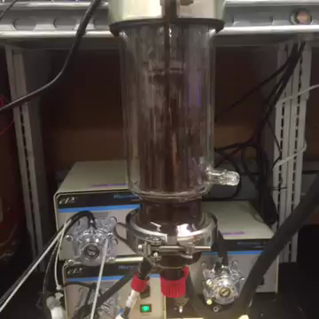
Bioreactor Data Logging
Kathryn Cogert, Alex Gilman, Alexandr Baryshev, Michael Newton

Slide 2
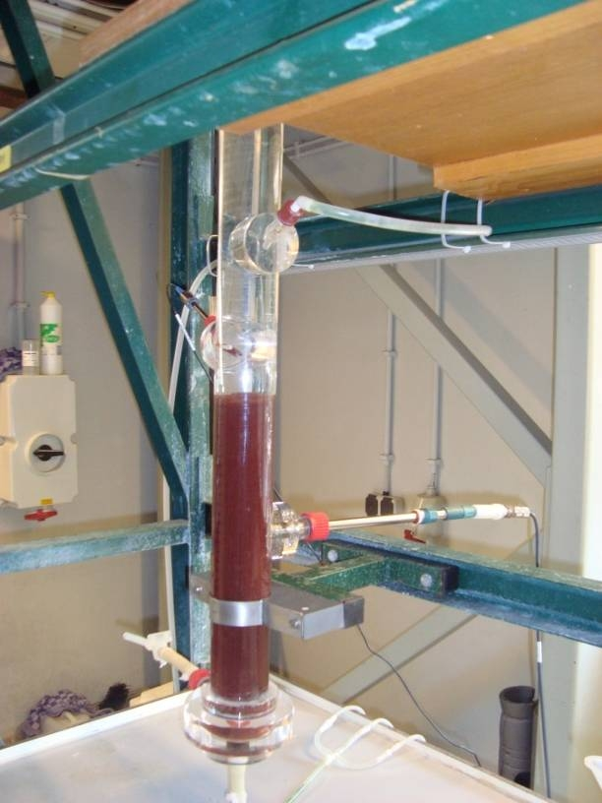
Brief Project Overview
pH
Dissolved
Oxygen
Ammonium
Concentration
Reactor Phase
Control Loop Log
How can we organize & visualize all this noise???
Notes:
BioReactors are full of data! They just need you to listen.
This bioreactor is very loud. (Not Literally)

Slide 3
Why do we need PyDrive?
Now, all the data logged is being saved locally.
We want to
Make sure data is safe
Be able to access that data from anywhere
So let’s upload to google drive!
But, how to do that programmatically…
PyDrive

Slide 4

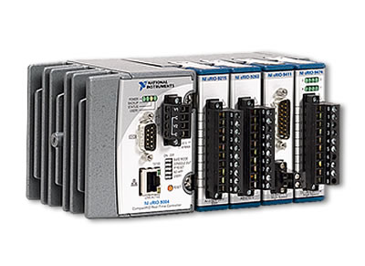

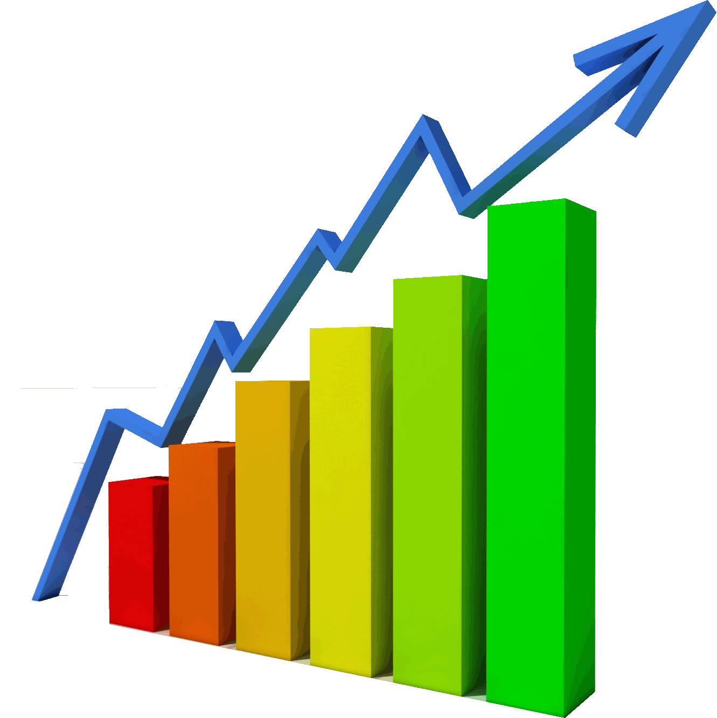
How will we use PyDrive?
Probes
in Reactor
How to do
this step?
How to do
this step?
Probe readings currently
Logged locally every second
Google Drive
Back up every
15 mins
PyDrive
Visualization

Slide 5
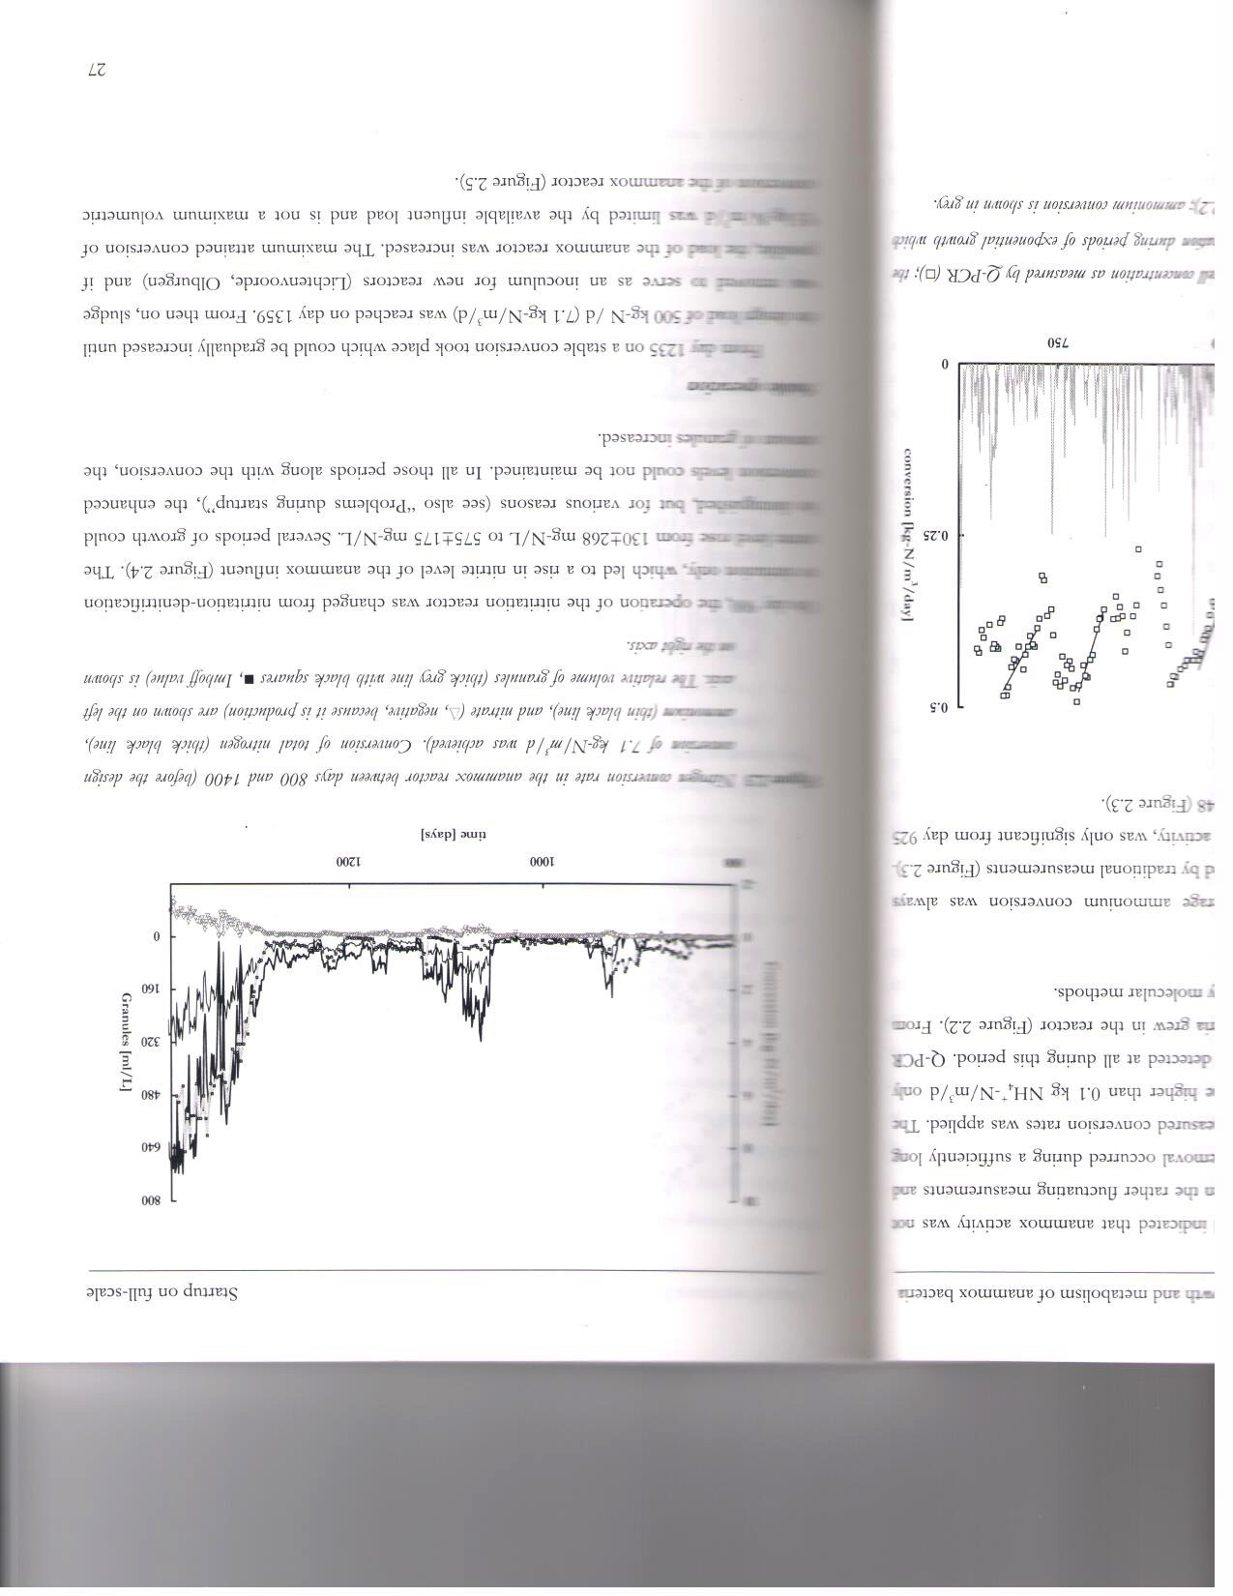
Why do we need Bokeh?
These reactors require a lot of data collection.
Data published for a similar reactor:
More than 1200 days of data!
Many data points per day!
Multiple plots!
(van der Star, 2008)
Notes:
Bokeh allows for very large and STREAMING datasets (real time)

Slide 6

How will we use Bokeh?
Bokeh
(Hat tip to the amazing brains group who tipped us off to Bokeh! Thanks guys!)

Slide 7
Bokeh
Low-level: bokeh.models
Intermediate-level: bokeh.plotting
High-level: bokeh.charts
Bokeh Server!
Widgets
Streaming Data
Notes:
Interactive visualization library for modern web browsers

Slide 8
Bokeh Server
Model Objects in Python
Model Objects in JSON
Consumed by BokehJS
Notes:
Synchronize between Python and the Browser
Use periodic,timeout, and asynchromous callbacks to drive streaming updates

