Slide 1

Seismic Detection Across the Solar System
NASA Space Apps 2024

Slide 2
Core functionalities of the application
A web application was developed with Vue.js to visualize the data and manipulate them with various operations.
The application has four core functionalities:
Select the data.
Select the filters to apply on the data.
Apply a seismic detection algorithm to the filtered data.
Visualize the data through every steps.

Slide 3
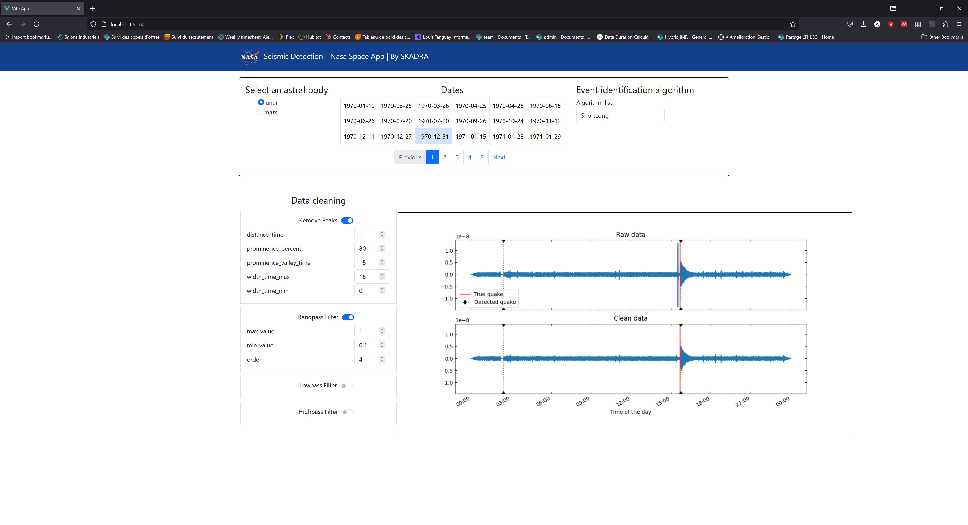
Select the data
The application is provided with the Apollo mission and InSight mission.
Simply click on the desired data to visualize it.

Slide 4
Apply filters
The filters can be enabled/disabled and reordered by dragging them in the desired order.
Default parameter values are proposed when enabling a filter and can be changed.

Slide 5
Select the detection algorithm
The short-term average over long term average (STA/LTA) algorithm provided with the challenge is available.
Possible detection shows once the algorithm is selected.
A Python Jupyter notebook exploring seismic detection algorithm that are not yet integrated is available. It showcases an algorithm where peaks are detected and a cross-correlation algorithm. Examples of seismic events are provided to the cross-correlation algorithms, and it detects how similar the studied data is to the examples.
The notebooks are available at : https://github.com/alexbeaulieu/skadra-space-apps-2024-notebooks/blob/master/notebooks/DetectionAlgoDebug.ipynb
https://github.com/alexbeaulieu/skadra-space-apps-2024-notebooks/blob/master/notebooks/notebook_with_filters.ipynb

Slide 6
Visualization window
The visualization window shows the raw and filtered data. The detections are identified with red lines displayed on both data.

Slide 7
Conclusion & future work
A framework for visualization and exploration of the seismic data from the Apollo mission and Insight was developed.
The core feature are extendable:
Data from Earth could be added
New filters can be integrated (i.e. zero signal detection)
Other detection algorithm can be integrated

