Slide 1
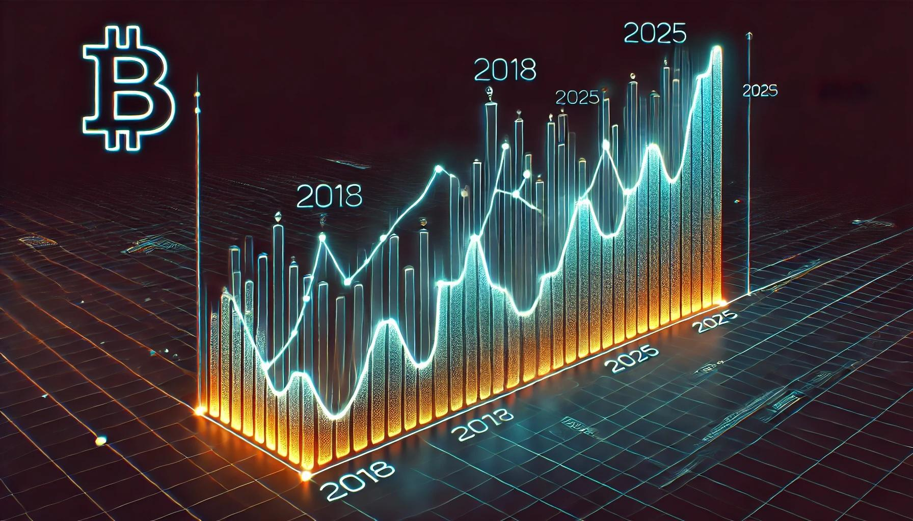
Prediction of Bitcoin Price Direction
By Alexander Berezinsky
Github repo: https://github.com/alexber2024/ml1

Slide 2
01
The Problem

Slide 3
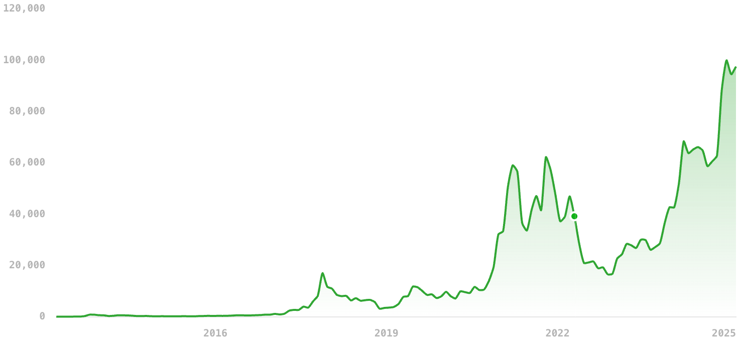
Predict the unpredictable
Launched on January 3, 2009
Based on cryptography
From 0.1 cent to 100,000 USD
Not regulated, free market
Continuous trading

Slide 4
02
The ML approach

Slide 5
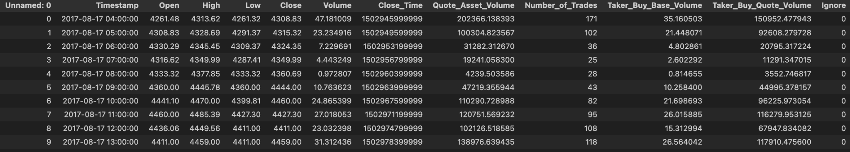
Original dataset
Downloaded from Kaggle: https://www.kaggle.com/datasets/zackyzac/bitcoin-dataset-hourly

Slide 6
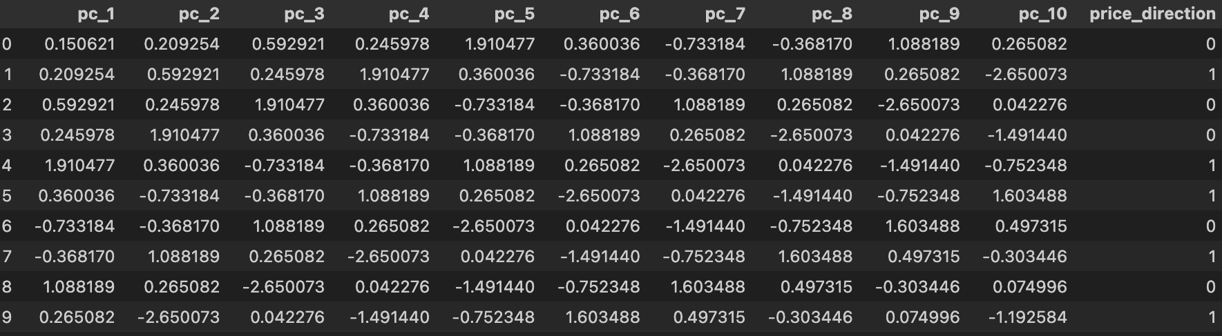
Transformed dataset

Slide 7
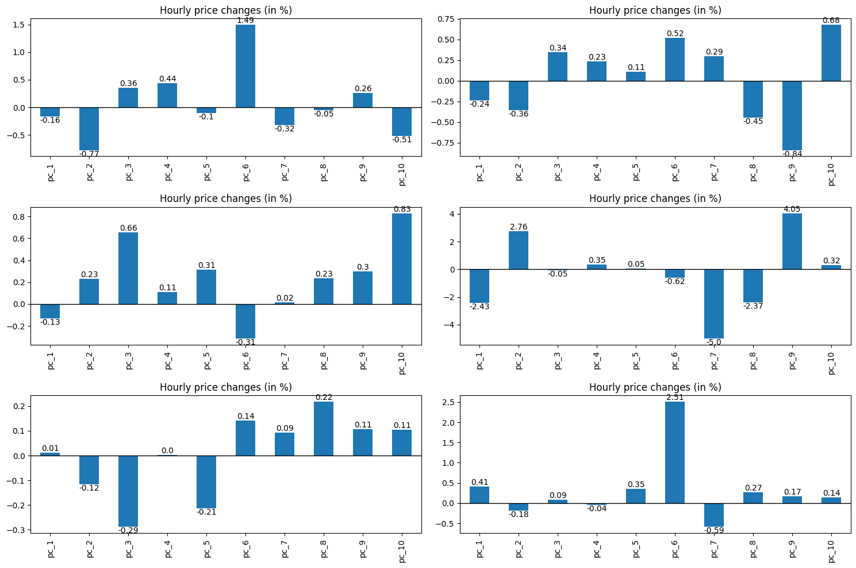
Row samples

Slide 8
Models
Logistic Regression
Decision Tree
Random Forest
Cross Validation
Hyperparameter tuning - Grid search

Slide 9
03
Results

Slide 10
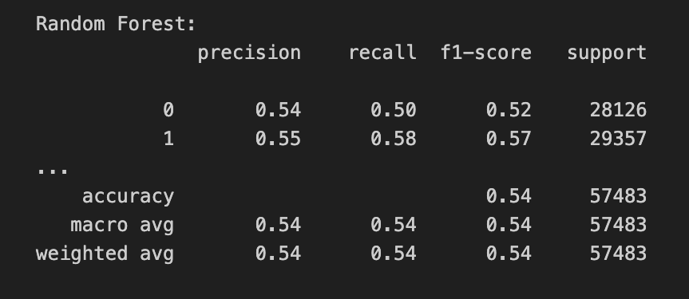
Classification report

Slide 11
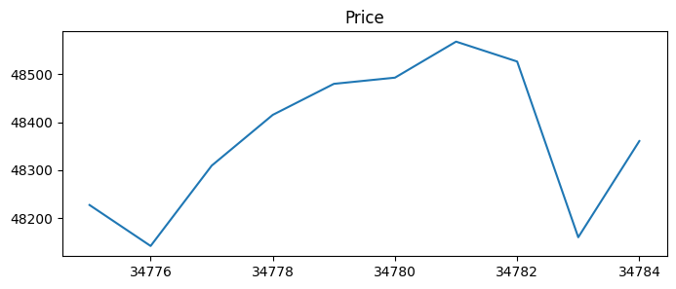
Trading strategy
On every hour:
Buy Bitcoins when the model predicts upward movement
Sell one hour later.
Repeat

Slide 12
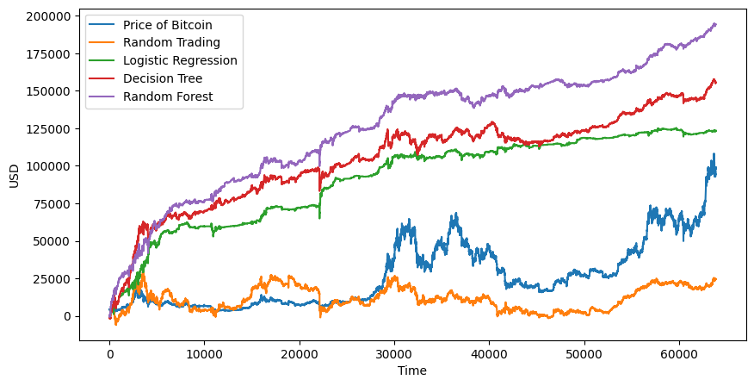
Simulation
Accuracy of 0.57%

Slide 13
Conclusions
Bitcoin price is not entirely random
Huge potential to improve accuracy
Low accuracy can still be significant
Theory != practice

Slide 14
THANK YOU

