Slide 1
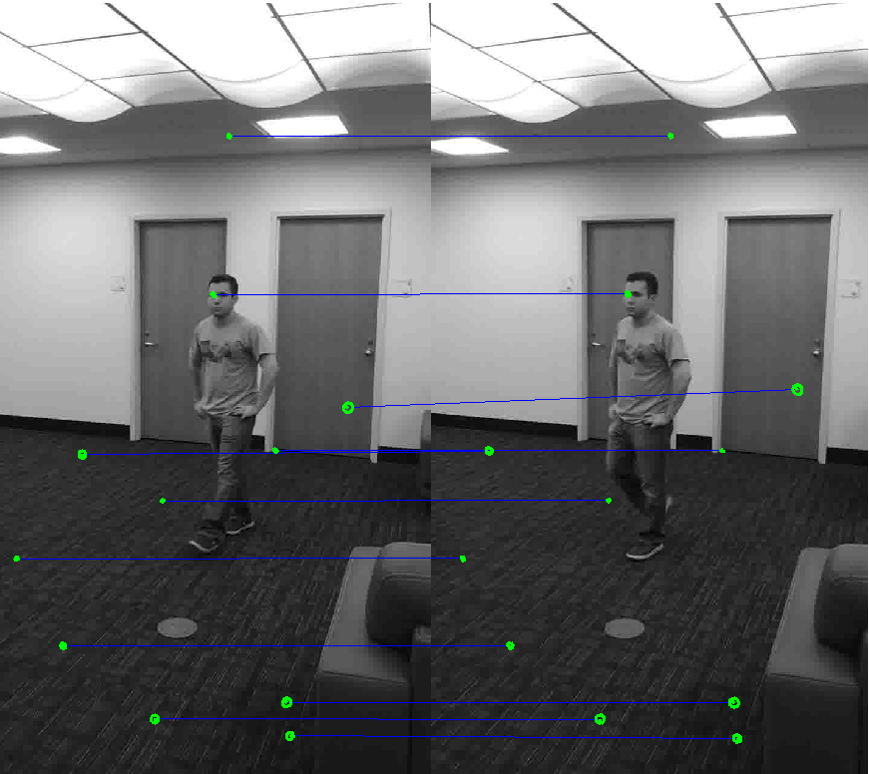
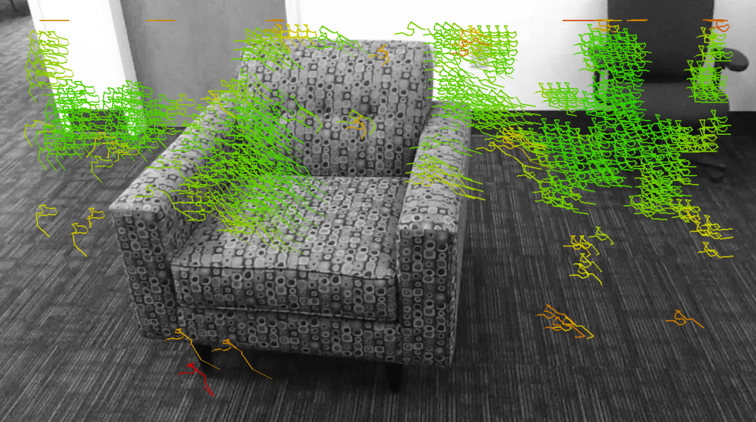
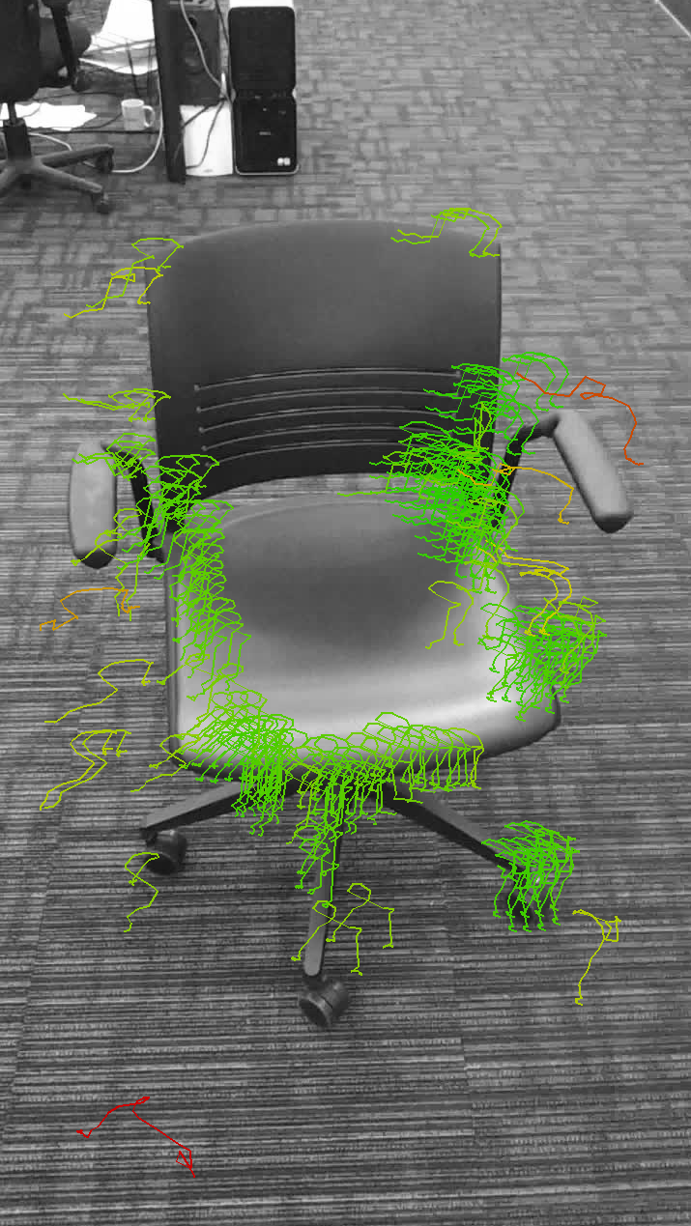
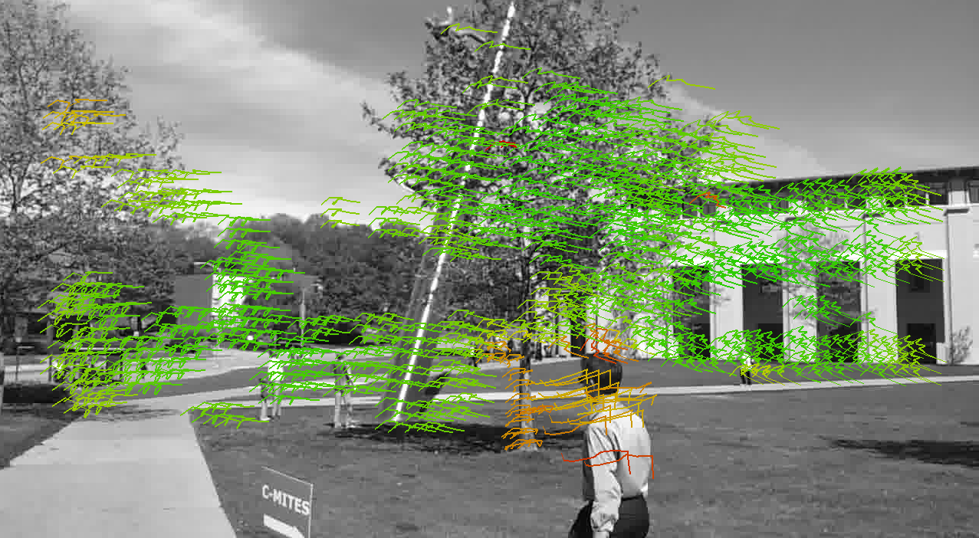
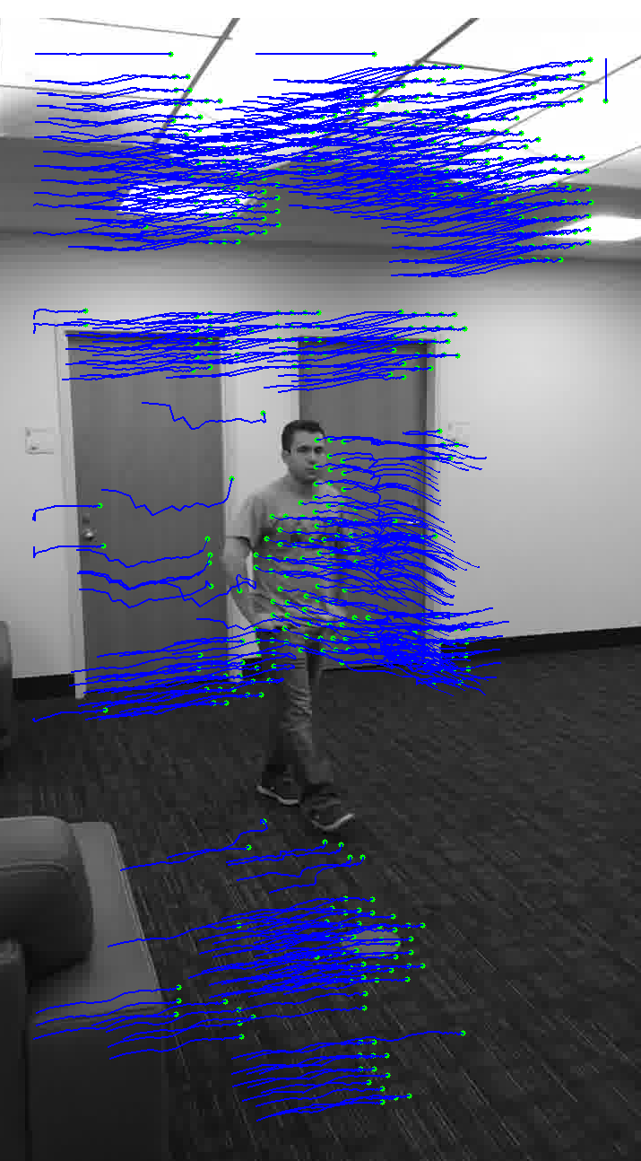
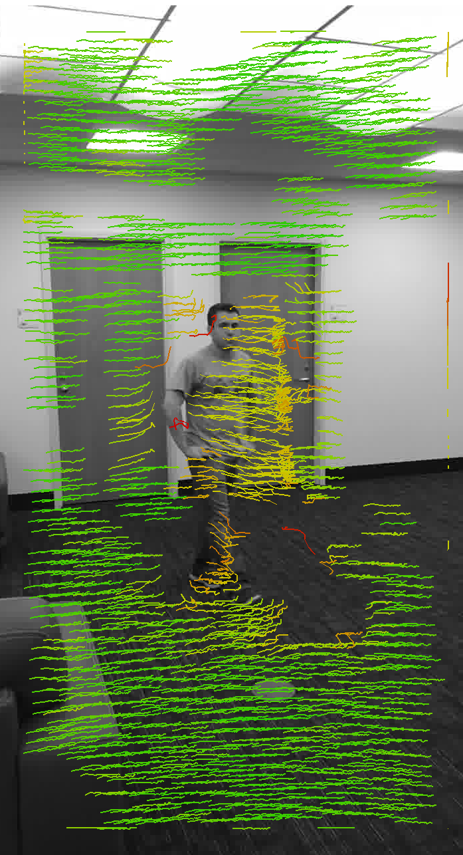
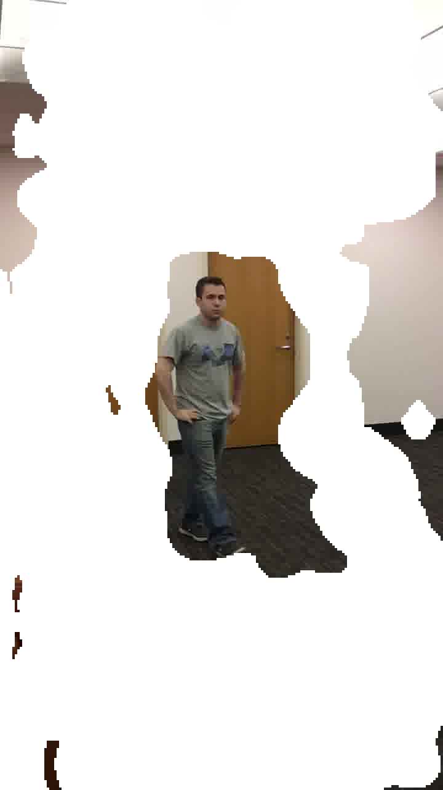

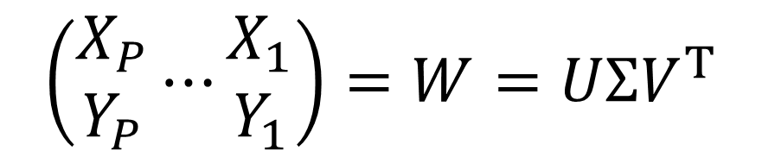

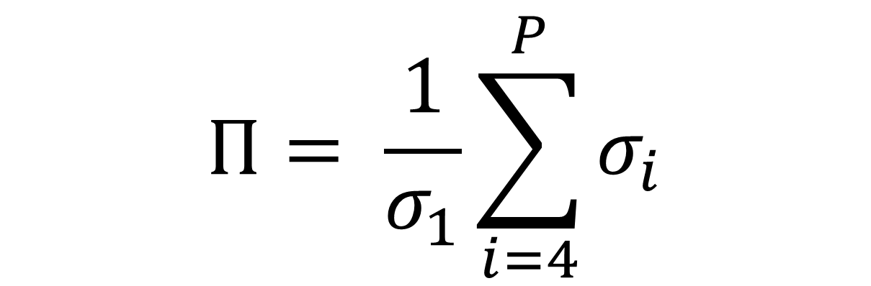
Tracked Feature Outlier Detection
Nicolas Feltman Alex Beutel
B
Feature Tracking
(SIFT)
+
Feature Matching
(KLT)
Image-space traces of features through time.
$$\left(\begin{matrix}\dot{X_{1}} \\ \dot{Y_{1}}\end{matrix}\right)⋯\left(\begin{matrix}\dot{X_{P}} \\ \dot{Y_{P}}\end{matrix}\right)$$
$$\dot{X_{p}}=\left(\begin{matrix}x_{p,t=2}−x_{p,t=1} \\ ⋮ \\ x_{p,t=F}−x_{p,t=F−1}\end{matrix}\right)$$
x100
$$\left(\begin{matrix}X_{1} \\ Y_{1}\end{matrix}\right)⋯\left(\begin{matrix}X_{P} \\ Y_{P}\end{matrix}\right)$$
$$X_{p}=\left(\begin{matrix}x_{p,t=1} \\ ⋮ \\ x_{p,t=F}\end{matrix}\right)$$
Train GMM
Score Traces
Application:
Structure from Motion
Application:
Robust Movement Isolation
Structure from motion: given traces of points under orthographic projection, reconstruct the structure of the scene and the location of the camera.
Robust movement isolation: given shaky video of a moving object, separate the camera motion from scene motion.
A matrix of the points through time should be largely rank-3.
$$\left(\begin{matrix}X_{P} \\ Y_{P}\end{matrix}⋯\begin{matrix}X_{1} \\ Y_{1}\end{matrix}\right)=W=UΣV^{T}$$
This incorporates all data. It deals well with noise, but large outliers could be problematic.
Goal: Find erroneous traces and cull them from the data set.
$$Π= \frac{1}{σ_{1}}\sum_{i=4}^{P}{σ_{i}}$$

