Slide 1
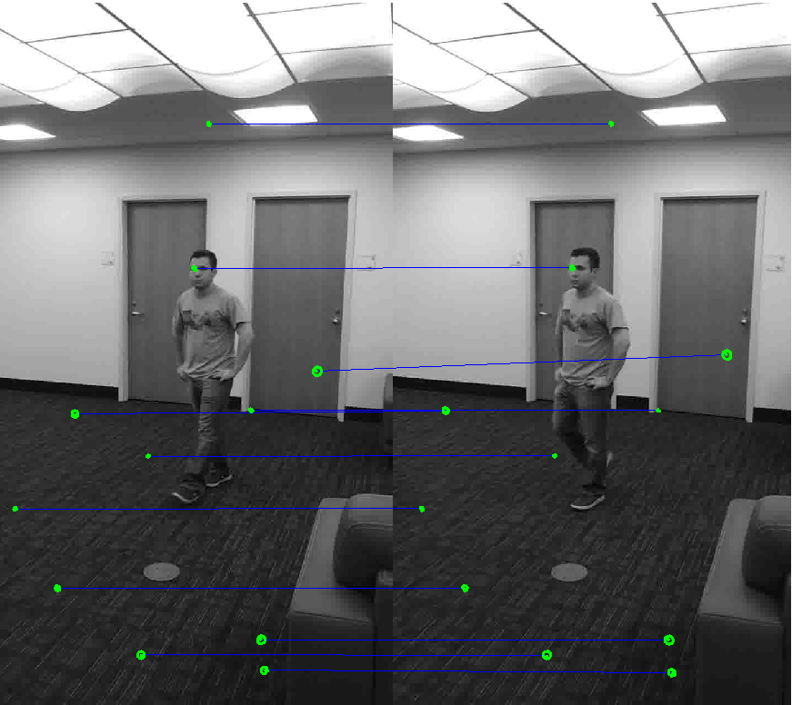
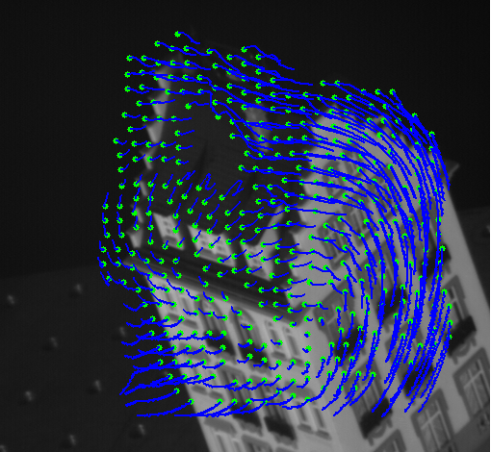
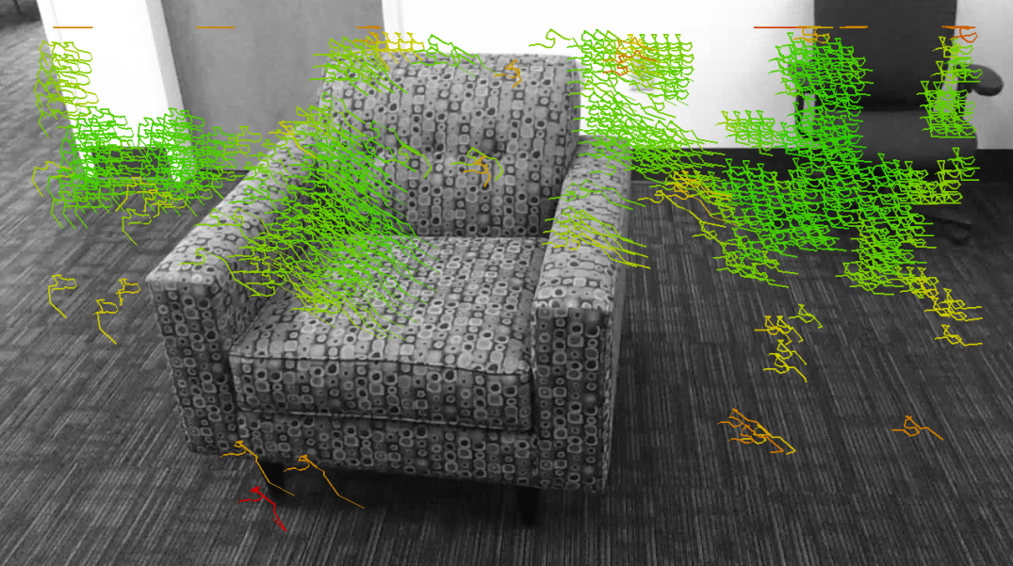
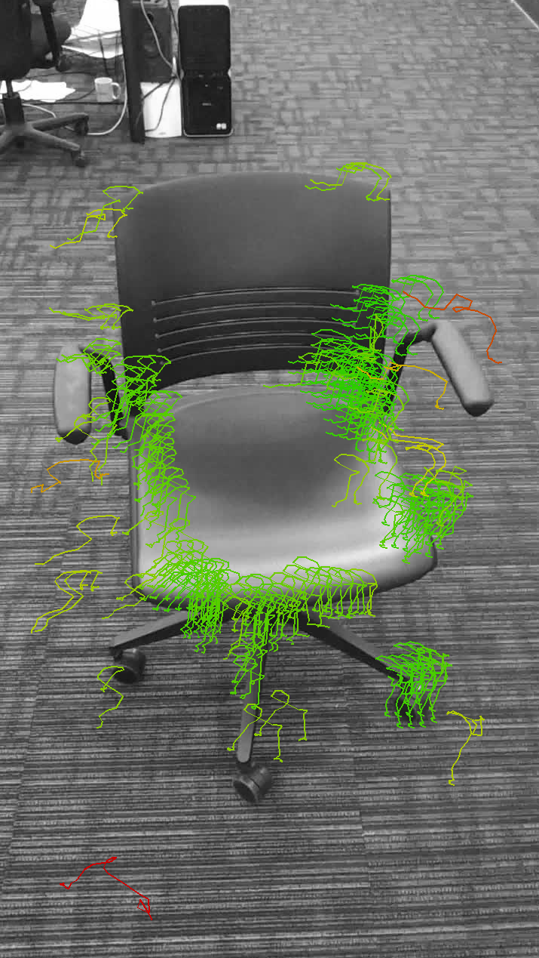
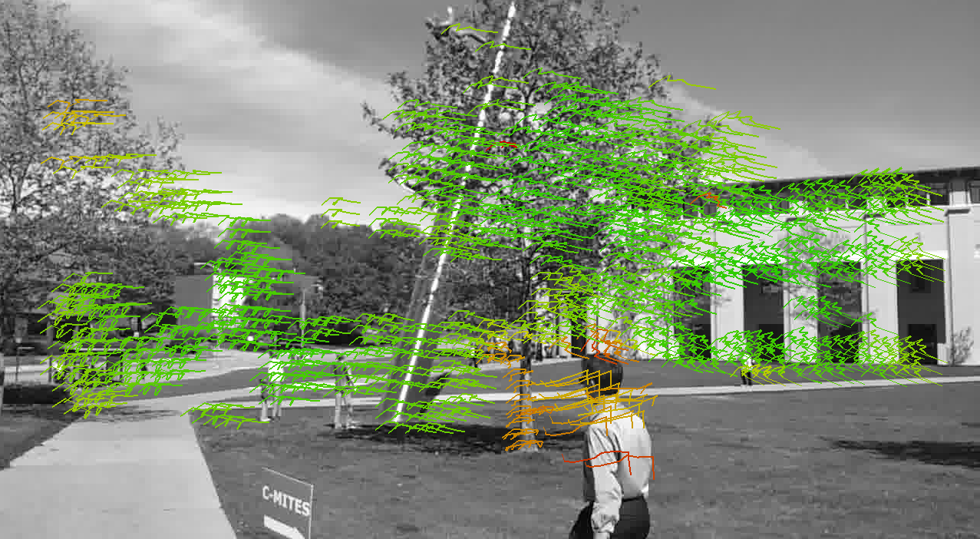
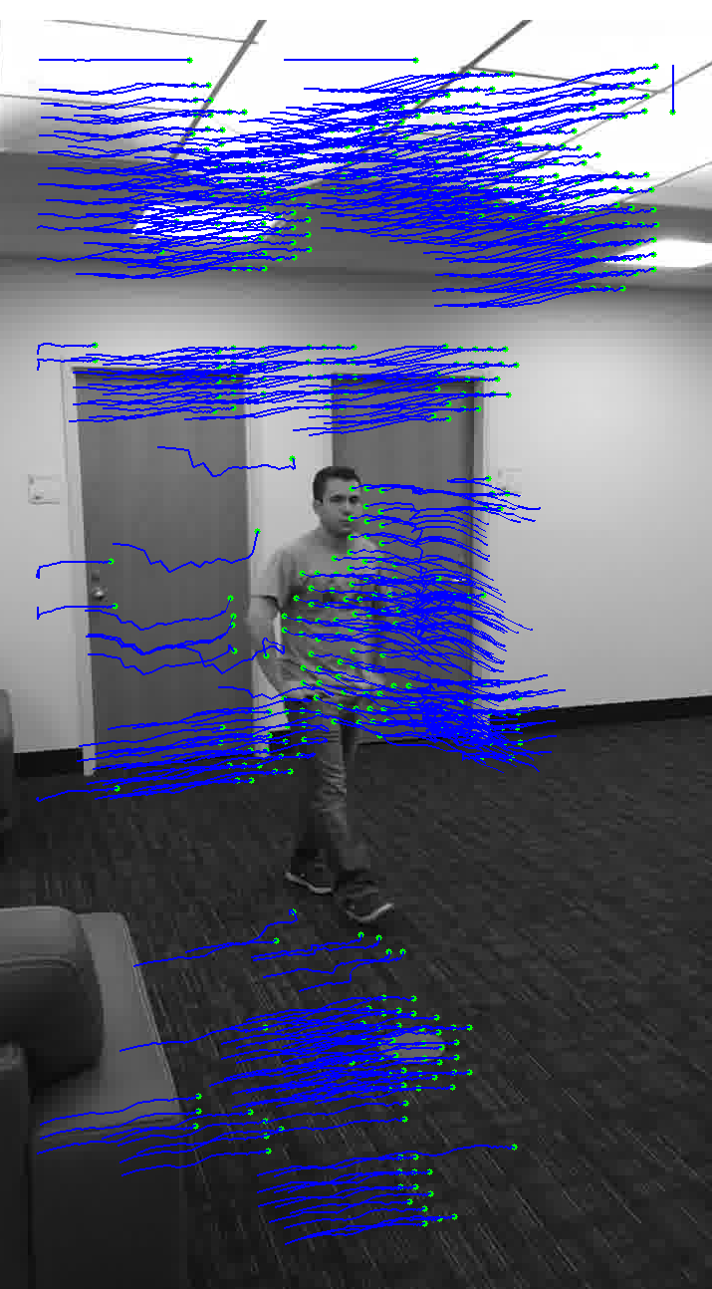
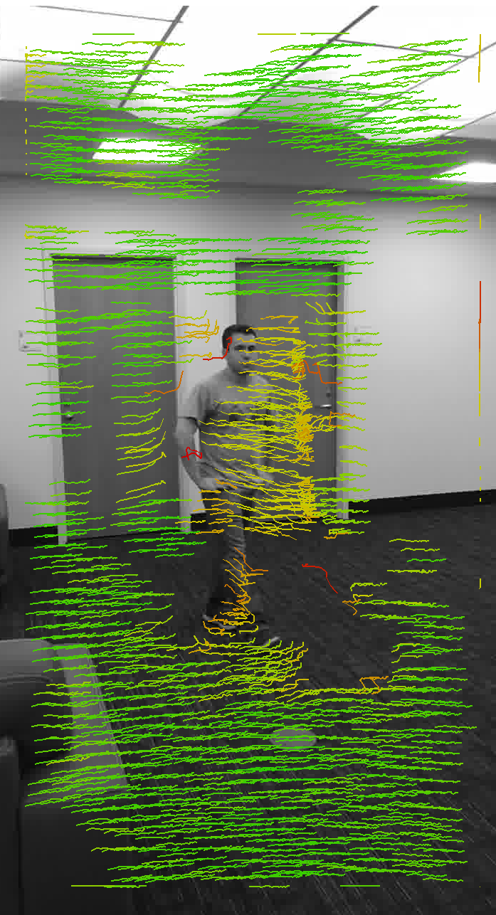
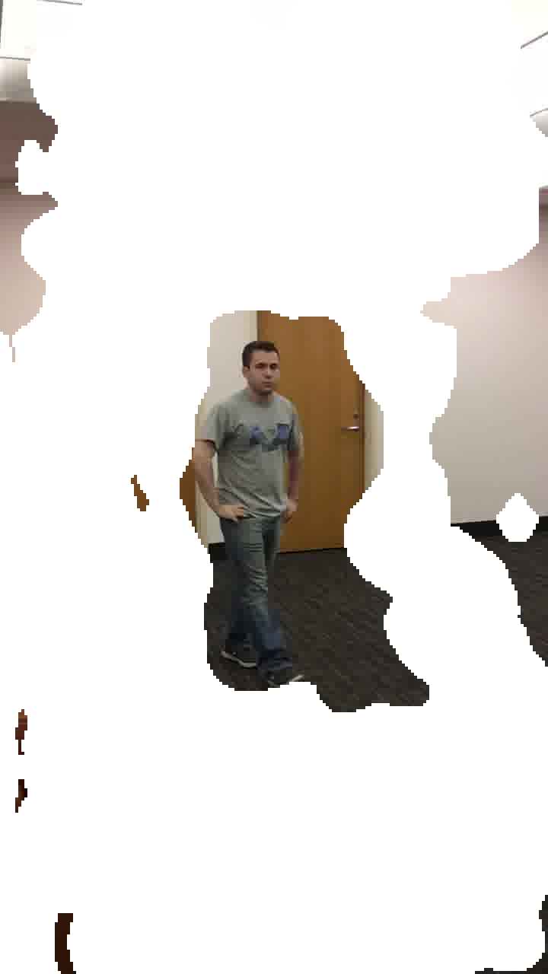

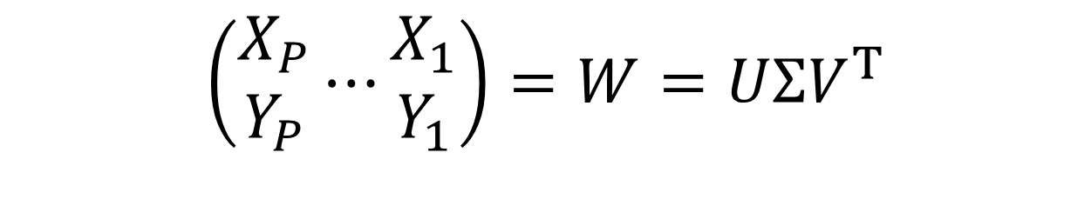

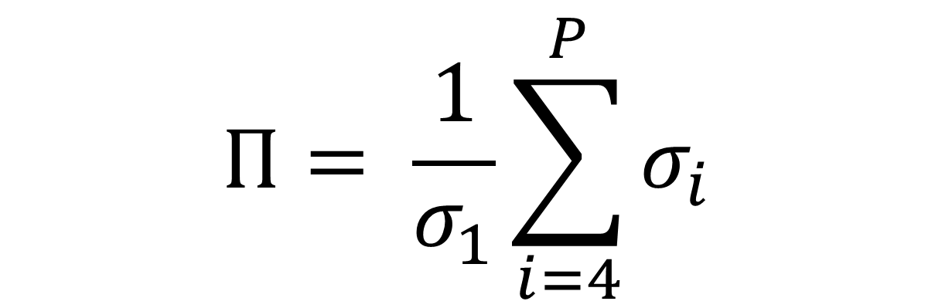
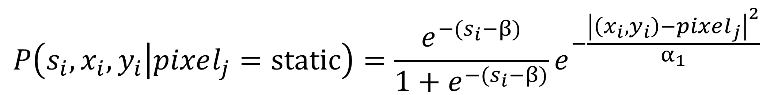
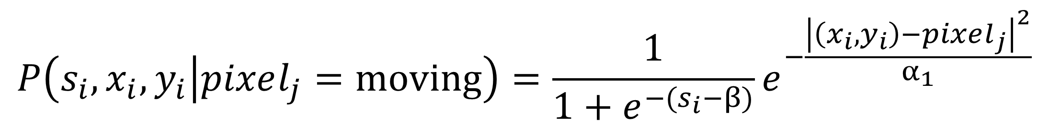
Tracked Feature Outlier Detection
Nicolas Feltman (nfeltman) Alex Beutel (abeutel)
B
Feature Tracking
(SIFT)
+
Feature Matching
(KLT)
Image-space traces of features through time.
$$\left(\begin{matrix}\dot{X_{1}} \\ \dot{Y_{1}}\end{matrix}\right)⋯\left(\begin{matrix}\dot{X_{P}} \\ \dot{Y_{P}}\end{matrix}\right)$$
$$\dot{X_{p}}=\left(\begin{matrix}x_{p,t=2}−x_{p,t=1} \\ ⋮ \\ x_{p,t=F}−x_{p,t=F−1}\end{matrix}\right)$$
Train naïve Gaussian mixture model.
$$\left(\begin{matrix}X_{1} \\ Y_{1}\end{matrix}\right)⋯\left(\begin{matrix}X_{P} \\ Y_{P}\end{matrix}\right)$$
$$X_{p}=\left(\begin{matrix}x_{p,t=1} \\ ⋮ \\ x_{p,t=F}\end{matrix}\right)$$
P points in 2(F-1) dimensions.
Take average over 100 runs, randomized by GMM initialization.
Take 1-step differentials in time.
Score Traces
Application:
Structure from Motion
Application:
Robust Movement Isolation
Task - Structure from motion: given traces of points under orthographic projection, reconstruct the structure of the scene and the location of the camera.
Task - Robust movement isolation: given shaky video of a moving object, separate the camera motion from scene motion.
A matrix of the points through time should be largely rank-3.
$$\left(\begin{matrix}X_{P} \\ Y_{P}\end{matrix}⋯\begin{matrix}X_{1} \\ Y_{1}\end{matrix}\right)=W=UΣV^{T}$$
SVD can be used to recover feature location and camera movement.
Intuition: Moving objects in the scene leave very different traces than static objects, regardless of camera motion.
Method: Build a model to determine if a pixel in a particular frame represents a moving or static object. We assume independence among both pixels and traces.
This incorporates all data. It deals well with noise, but large outliers could be problematic.
Goal: Find erroneous traces and cull them from the data set.
$$s_{i}=Movement Score derived from GMM$$
$$P\left(s_{i},x_{i},y_{i} | pixel_{j}=moving\right)=\frac{1}{1+e^{−{(s}_{i}−β)}}e^{−\frac{{\left|\left(x_{i},y_{i}\right)−pixel_{j}\right|}^{2}}{α_{1}}}$$
Intuition: Valid traces (of static objects) are largely similar; others are not.
Method: Filter out the 10% of traces with the lowest probabilities in the Gaussian mixture model.
$$P\left(s_{i},x_{i},y_{i} | pixel_{j}=static\right)=\frac{e^{−{(s}_{i}−β)}}{1+e^{−{(s}_{i}−β)}}e^{−\frac{{\left|\left(x_{i},y_{i}\right)−pixel_{j}\right|}^{2}}{α_{1}}}$$
Our Π-score measures how well the scene can be factorized.
$$Π= \frac{1}{σ_{1}}\sum_{i=4}^{P}{σ_{i}}$$
Our filtering method improves the
Π-score in all cases. When there are many erroneous traces to be filtered (due to scene movement), we show substantial improvement.
C. Tomasi, T. Kanade. Detection and Tracking of Point Features. 1991.
B. Lucas, T. Kanade. An Iterative Image Registration Technique with an Application to Stereo Vision. 1981.
Code: http://note.sonots.com/SciSoftware/Factorization.html
KLT Code: http://www.ces.clemson.edu/~stb/klt/

