Slide 1
AWS Fleet Provisioning
Alex Berger
2021-04-06

Slide 2

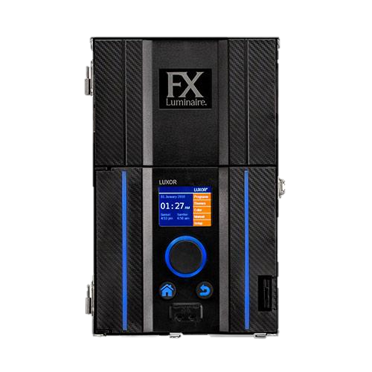




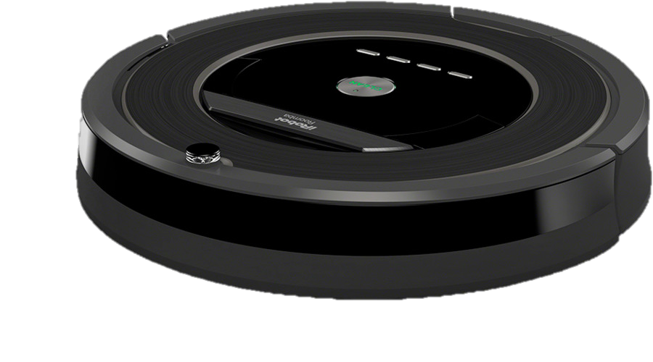

IoT devices connection to AWS

Slide 3






Conventional device provisioning process
Each private cert is burned into firmware file
Firmware files
Files stored on the USB drive
Device is ready to be connected to AWS
Hand delivered to factory

Slide 4
Fleet Provisioning process 1
All devices can be manufactured using the same firmware file
Create single firmware file
Send to manufacturer
Single
bootstrap cert
When device connects to internet at Customer’s home, unique certificate is created for the device and sent over the air to be used for the AWS connection

Slide 5






Fleet Provisioning process 2
1
Get device certificate
Bootstrap certificate
Bootstrap
policy
2
Not activated certificate
7
3
Provision certificate
6
8
Provisioning accepted
5
4
9
Lambda validates
Provisioning req
Reboot with new certificate

Slide 6

First work then beer (tavern)

Slide 7



Fleet Provisioning testing with tavern
1
Get device certificate
Bootstrap certificate
Bootstrap
policy
2
Not activated certificate
7
New provision
Re-provision
Rejected provision
3
Provision certificate
6
8
Provisioning accepted
5
4
9
Delete. and
Lambda validates
Provisioning req

Slide 8


Now it’s time to celebrate!

