Slide 1
Adaptive and Bayesian Methods for Clinical Trial Design Short Course
Dr. Alex Kaizer
Welcome and Expectation Setting
Notes:
xx

Slide 2

My Background
Alex Kaizer, PhD
PhD in Biostatistics from University of Minnesota
Faculty in Biostatistics and Informatics at the Colorado School of Public Health, University of Colorado Anschutz Medical Campus
Have a pup named Baisy

Slide 3
My Research Areas
Adaptive Clinical Trial Designs
Bayesian Methods
Interim monitoring methods
Adaptive enrichment designs
Master protocol studies (e.g., platform and basket trials)
Rare disease settings (e.g., cystic fibrosis, cancer)
Development of multi-source exchangeability models (MEMs) to facilitate information sharing amongst multiple, potentially heterogeneous, sources of data
Posterior and predictive posterior probabilities for interim monitoring

Slide 4

Short Course Introductions
Let’s share a bit about ourselves:
Name
Location (work/school)
Position
One thing you’re hoping to take away today
Experience level or comfort with:
Study design and clinical trials generally
Adaptive designs specifically
Bayesian statistics

Slide 5
Administrative Course Details
Materials available on website:
www.alexkaizer.com
https://alexbiostats.github.io
Modular set-up of different topics, each with slides, brief simulation studies, and code examples
Feel free to interrupt with questions!

Slide 6
Course Purpose
For those wanting to become acquainted with the basics of adaptive and Bayesian clinical trial methodology, either to broaden their knowledge of public health and clinical research, or to obtain a basis for more advanced study of the design and conduct of clinical trials.
This course is a survey of multiple topics, with the goal of providing knowledge on resources and code examples to further explore topics of interest in the future.

Slide 7
What are adaptive designs?
The key to all my research woes!
Designs where I can do whatever I want, whenever I want to (ethically) answer my research questions.
The “good” designs that statisticians have been selfishly keeping to themselves all this time!
“An adaptive design is defined as a clinical trial design that allows for prospectively planned modifications to one or more aspects of the design based on accumulating data from subjects in the trial.” (FDA 2018 Adaptive Designs for Clinical Trials Guidance Document)
Notes:
FDA Guidance on Adaptive Designs (2018)

Slide 8
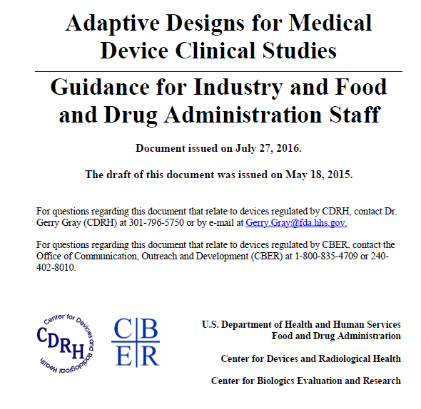
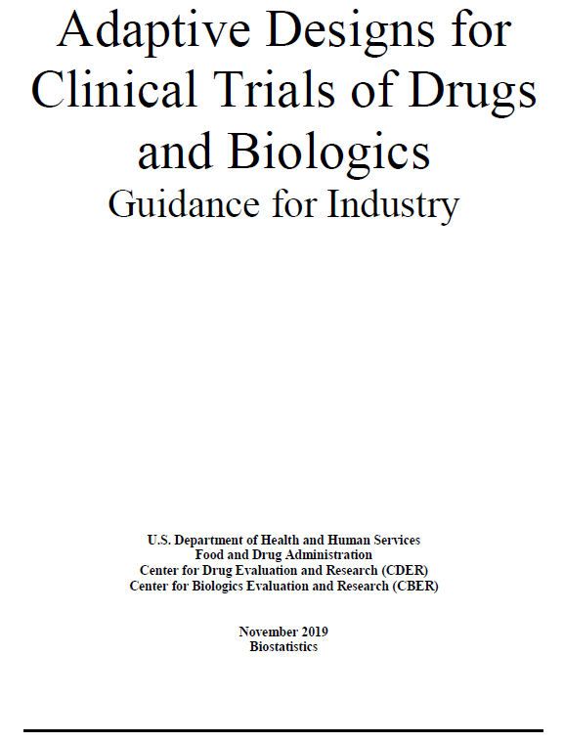
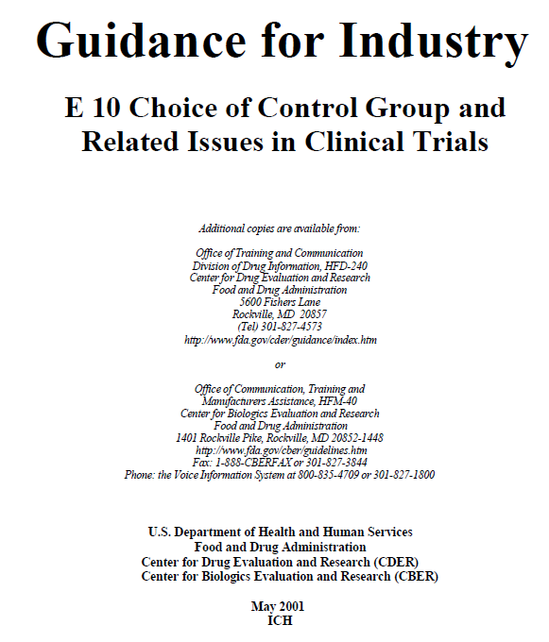
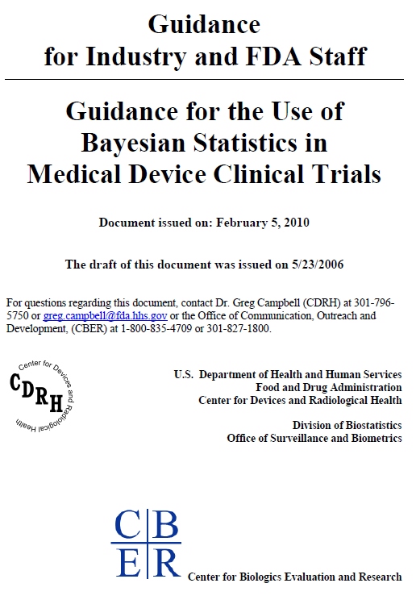

Slide 9
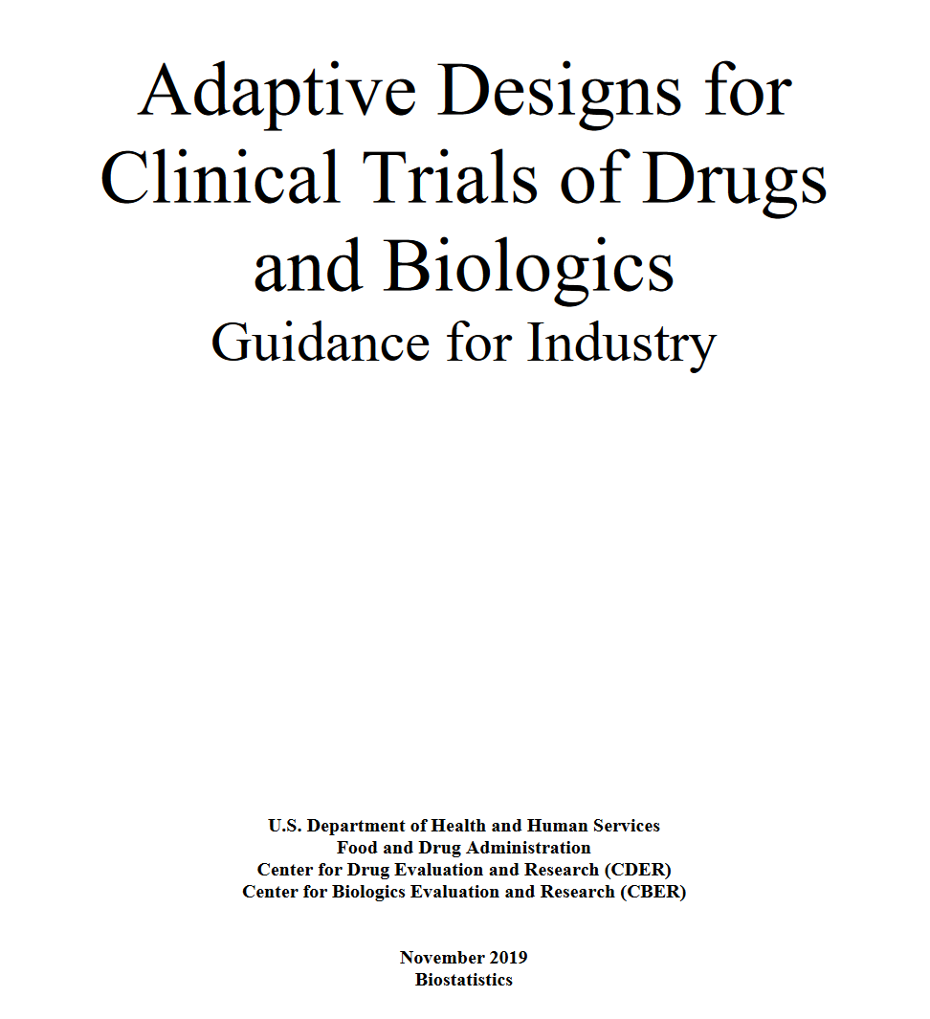
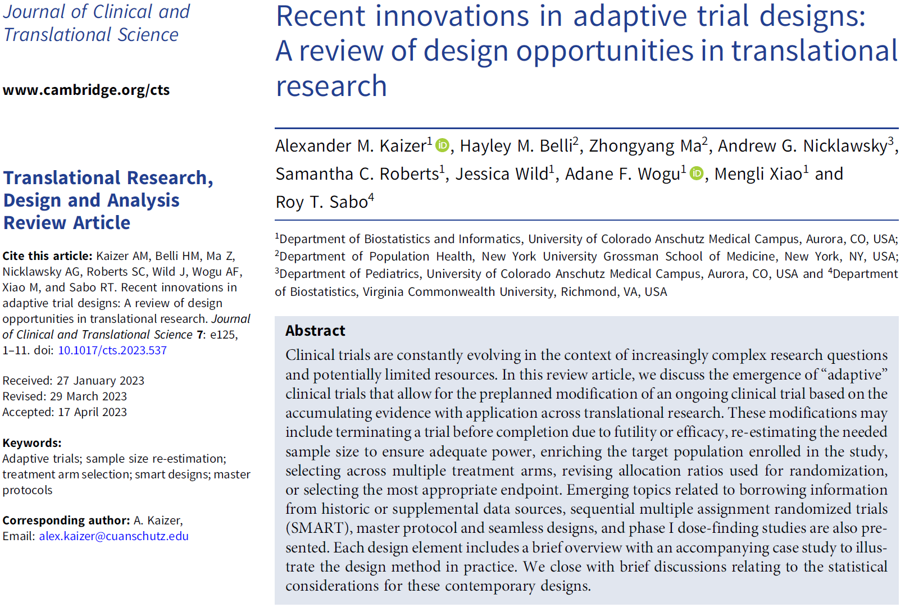
Driving Documents:

Slide 10
Adaptive Designs
“An adaptive design is defined as a clinical trial design that allows for prospectively planned modifications to one or more aspects of the design based on accumulating data from subjects in the trial.”
FDA groups adaptive elements into broad categories of:
Group sequential designs (i.e., interim analyses)
Adaptations to sample size (i.e., sample size reestimation based on interim results to preserve power)
Adaptations to the patient population (i.e., adaptive enrichment)
Adaptations to treatment arm selection (i.e., adding or terminating arms)
Adaptations to patient allocation (i.e., adaptive randomization)
Adaptations to endpoint selection
Adaptations to multiple design features (combining multiple features above)
Notes:
FDA Guidance on Adaptive Designs (2018)

Slide 11
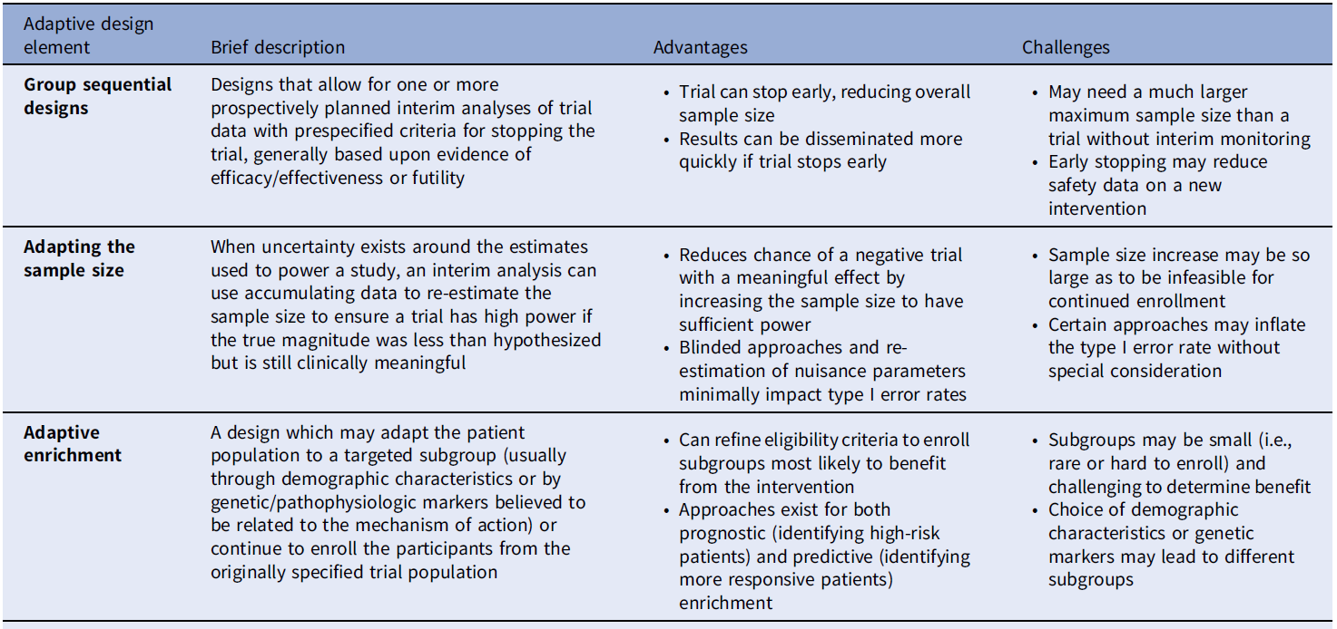
Overview of Designs I
Notes:
Table 1 from JCTS paper “Recent innovations in adaptive trial designs: A review of design opportunities in translational research“ by Kaizer, et al. (2023)

Slide 12
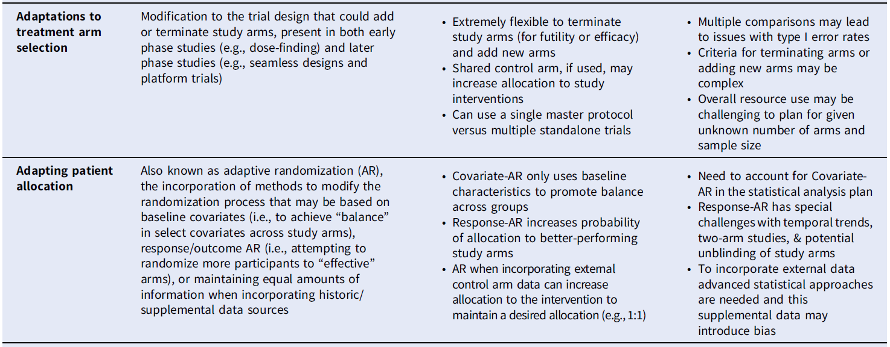
Overview of Designs II
Notes:
Table 1 from JCTS paper “Recent innovations in adaptive trial designs: A review of design opportunities in translational research“ by Kaizer, et al. (2023)

Slide 13
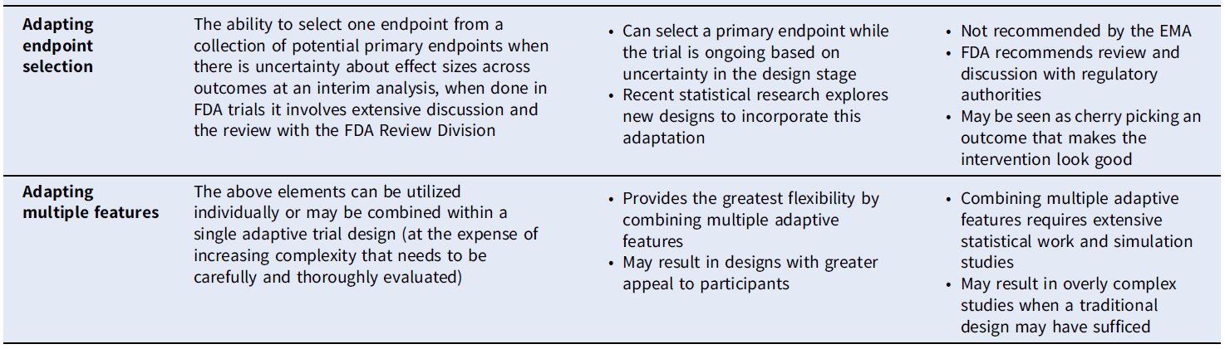
Overview of Designs III
Notes:
Table 1 from JCTS paper “Recent innovations in adaptive trial designs: A review of design opportunities in translational research“ by Kaizer, et al. (2023)

Slide 14
Adaptive Advantages and Challenges
Advantages
Challenges
Improved flexibility
More efficient use or allocation of available resources (e.g., financial or administrative)
Improved statistical efficiency that can provide greater statistical power to detect a true drug effect
Ethical considerations may be more readily addressed
Ability to answer broader questions, that may be refined as the trial progresses, relative to nonadaptive designs
Stakeholders may be more willing to support studies with adaptive elements because of the added flexibility
Advanced and specific analytical methods need to be used to avoid type I error rate inflation (i.e., identifying an ineffective intervention as effective) and control bias in estimates
Gains in efficiency generally represent a tradeoff with other trial components (e.g., interim analyses may decrease expected sample size at the expense of an increase to the maximum sample size)
Logistics to ensure appropriate trial conduct and integrity
Adaptation may be limited by scientific or clinical constraints or make interpretation more challenging
Notes:
Table 2 from JCTS paper “Recent innovations in adaptive trial designs: A review of design opportunities in translational research“ by Kaizer, et al. (2023)

Slide 15
Tentative Course Schedule
Morning
Afternoon
9:00 Welcome
9:15 Clinical Trial Basics/Terminology
9:45 Intro to Bayesian
10:30 Interim Monitoring for Futility/Efficacy
11:15 Sample Size Re-Estimation
12:00 Lunch
1:15* Adaptive Enrichment
2:00 Adaptation to Treatment Arm Selection
2:30 Adaptative Randomization
3:00 Bayesian Information Sharing
3:45 Master Protocol Designs
4:30 Seamless Trial Designs
5:00 End of Course
*Note, morning courses run 9-12 and afternoon 2-5, but to cover as much material as possible I’d like to restart at 1:15. However, this is flexible if everyone was planning on or would like to start around 2.

Slide 16

Contact Info:
Email:
alex.kaizer@cuanschutz.edu
Website: www.alexkaizer.com
GitHub: alexbiostats

