Slide 1
Adaptive and Bayesian Methods for Clinical Trial Design Short Course
Dr. Alex Kaizer
Seamless Designs
Notes:
xx

Slide 2
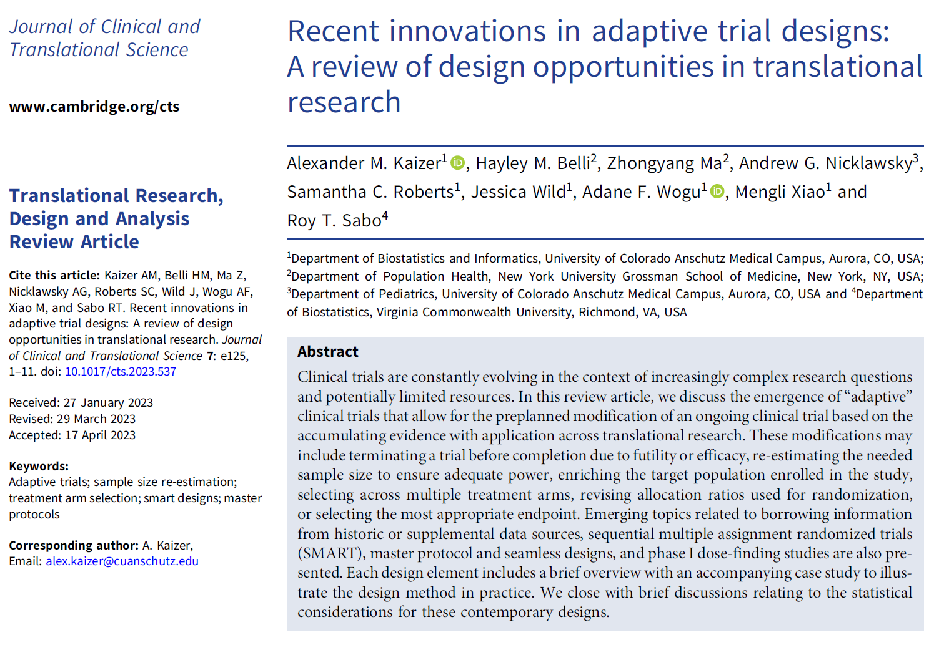
Overview Paper:

Slide 3
Background
When going from one phase to another phase is as easy as consenting your next eligible trial participant

Slide 4
Motivation
In traditional trials we conduct each phase or subphase a standalone trial, which likely extends the time until drawing a conclusion on intervention efficacy and has periods between studies to design the next trial
In seamless designs, we attempt to “seamlessly” move from one phase or subphase to another (e.g., phase 2 to 3, 1b to 2a, 2a to 2b, etc.)
Data may be used from across the entire study in our final analysis
Related to the concept of adaptive treatment arm selection when multiple arms are considered in the earlier stage

Slide 5
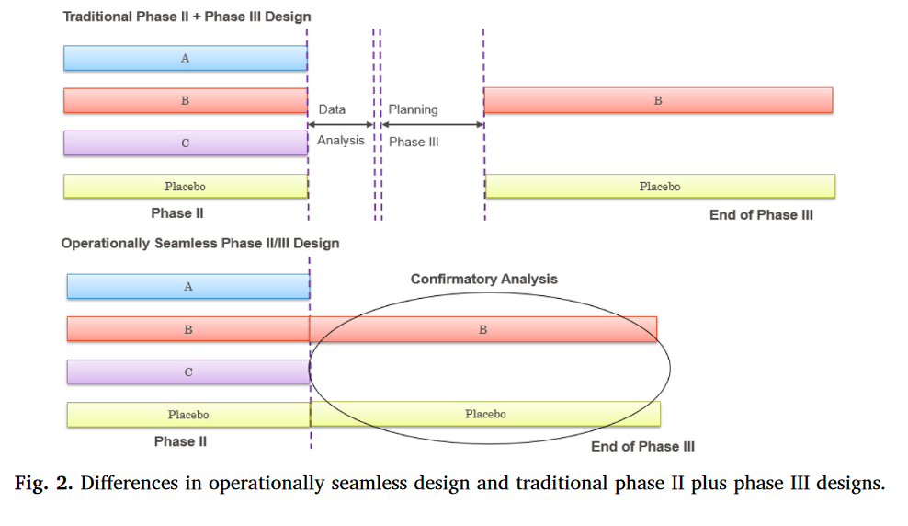
Graphical Comparison of “Traditional” and Seamless Design
Notes:
Li, Qing, Jianchang Lin, and Yunzhi Lin. "Adaptive design implementation in confirmatory trials: methods, practical considerations and case studies." Contemporary Clinical Trials 98 (2020): 106096.

Slide 6
Seamless Designs
Seamless study designs combine multiple phases of a study into one trial
e.g., Phase II and Phase III combined to include both treatment selection and confirmation in one trial
Interim analyses used to determine what continues from first phase portion of the study to the next phase
Advantages include reducing overall study size, shorter development time, more long-term safety information
Disadvantages include logistical challenges and issues maintaining statistical properties

Slide 7
Connection to Adaptive Treatment Arm Selection and Master Protocols
There are numerous connections and similarities with seamless designs to treatment arm selection and master protocol designs like platform trials (see corresponding modules)
Similarities include:
Statistical considerations like type I error rate control
Choice of decision rules (e.g., statistically significant versus using a threshold versus taking “best” arm(s) regardless of significance, etc.)
Challenges with any temporal effects over the course of the trial

Slide 8
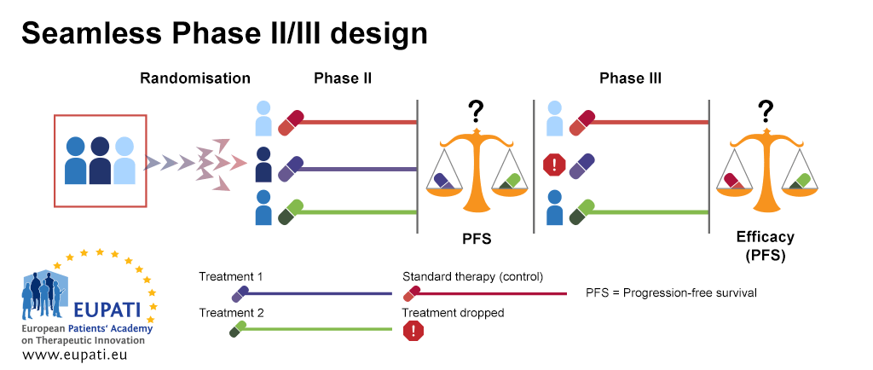
One Version of Seamless Phase II/III Designs
Compare Treatment 1 and 2 after Phase II and drop least effective arm.
Then compare efficacy after Phase III between the SOC and continued treatment using all data from Phases II and III.

Slide 9
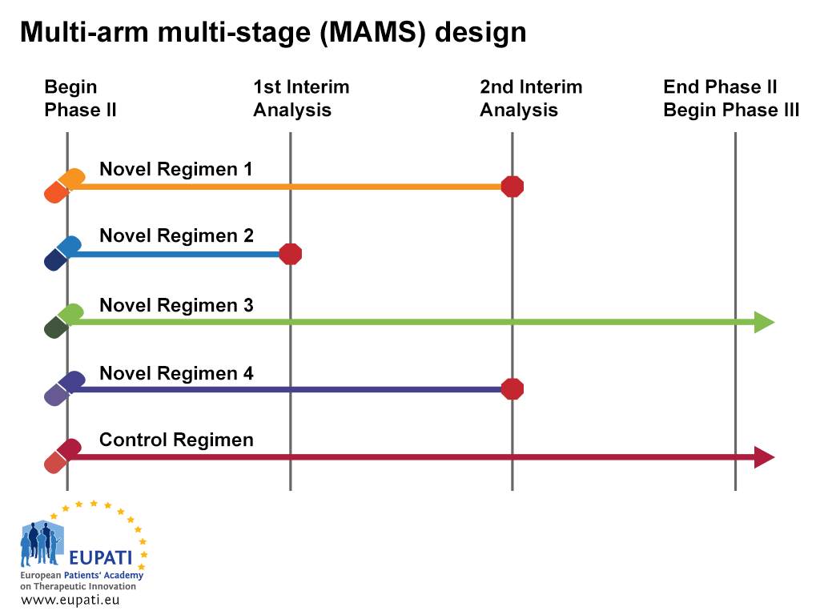
Multi-Arm Multi-Stage
MAMS can drop ineffective arms early on at an interim analysis.
Promising arms seamlessly continue to a (confirmatory) Phase III trial.
One disadvantage is that you can only compare “Novel” arms to the Control arm (to maintain the type I error and power).
Notes:
Sydes, Matthew R., et al. "Issues in applying multi-arm multi-stage methodology to a clinical trial in prostate cancer: the MRC STAMPEDE trial." Trials 10.1 (2009): 39.

Slide 10
Seamless Designs with Dose Finding
Transitioning from dose finding to preliminary efficacy data (e.g., phase 1 to 2) may be an ideal context for a seamless design:
If collecting efficacy data in phase 1, can incorporate in phase 2 to reduce needed sample size
Can carry multiple doses forward and continue to refine (e.g., treatment arm selection) in phase 2 as evidence evolves
May be more efficient than conducting a dose finding study and then having to design a separate, standalone trial

Slide 11
Surrogate Endpoints
In seamless designs, we may use different outcomes for each phase. This may include a surrogate in phase 2 that we hope predicts the primary outcome in phase 3:
“A surrogate endpoint is expected to predict clinical benefit (or harm, or lack of benefit) based on epidemiologic, therapeutic, pathophysiologic, or other scientific evidence.”
(Biomarker Definitions Working Group)
Notes:
Biomarkers Definitions Working Group. Biomarkers and surrogate endpoints: preferred definitions and conceptual framework. Clin Pharmacol Ther 69: 89–95, 2001.
Figure inspired from: Fleming, Thomas R., and David L. DeMets. "Surrogate end points in clinical trials: are we being misled?." Annals of internal medicine 125.7 (1996): 605-613.

Slide 12
Surrogate Mechanism of Action
The surrogate should lie in the “causal pathway”
Treatment has many mechanisms of action
Treatment
Other Mechanisms of Action
Surrogate Marker
Clinical Outcomes
(Fleming and DeMets, Annals of Internal Medicine, 1996)
Notes:
Causal mechanisms background: http://www-personal.umd.umich.edu/~delittle/Encyclopedia%20entries/Causal%20mechanisms.htm

Slide 13
Best Situation for Surrogate Endpoints
Intervention
Disease
Surrogate Endpoint
True Clinical Outcome
The surrogate lies on the only causal pathway of the disease process.
Notes:
Fleming, Thomas R., and David L. DeMets. "Surrogate end points in clinical trials: are we being misled?." Annals of internal medicine 125.7 (1996): 605-613.

Slide 14
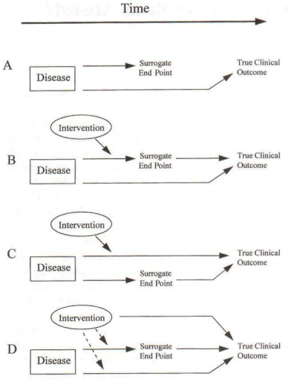
Reasons for Surrogate Endpoint Failure
Surrogate not on the causal pathway of the disease process.
Intervention only affects a pathway mediated through the surrogate.
Surrogate isn’t on pathway affected by intervention.
Unintended or unknown mechanisms also affected by intervention.
Figure 1 (Fleming and DeMets)
Notes:
Fleming, Thomas R., and David L. DeMets. "Surrogate end points in clinical trials: are we being misled?." Annals of internal medicine 125.7 (1996): 605-613.

Slide 15
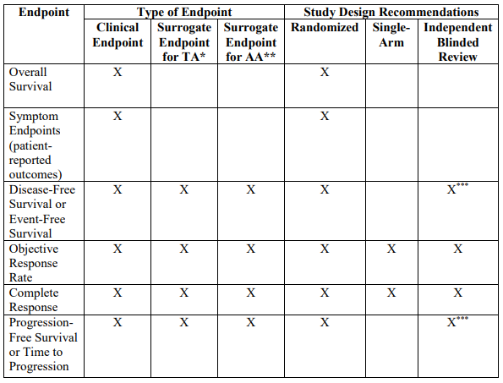
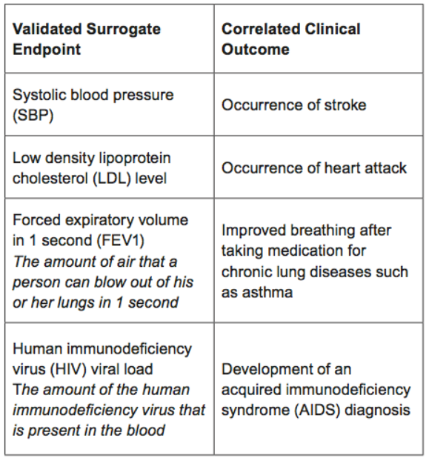
FDA Endpoint Recommendation Examples
Table 1 from Guidance for Industry. Clinical Trial Endpoints for the Approval of Cancer Drugs and Biologics. (December 2018)
* TA-Traditional Approval, ** AA-Accelerated Approval, *** Not always recommended
Table from “FDA Facts: Biomarkers and Surrogate Endpoints” webpage (December 2017)
Notes:
https://www.fda.gov/downloads/drugsGuidanceComplianceRegulatoyInformation/Guidance/UCM071590.pdf

Slide 16
Challenges with Surrogate Choice in Seamless Designs
If we choose a poor or failed surrogate, this may affect the choice of the arm(s) that continue seamless to the next phase
If the incorrect arm(s) are chosen, we may miss out on truly effective interventions and waste resources on a trial with less chance of finding a significant difference
Well-chosen surrogates can help use more efficiently identify effective arms to move to the next phase and reduce sample size

Slide 17
Design Considerations
If using a seamless design with a single study protocol, we must:
Prespecify all decision rules and strategies for dropping/adding arms in the study protocol
Predefine any interim analysis schedules
Develop statistical analysis plans to span the needs of the multiple phases
Identify data safety monitoring strategies and a DSMB with the needed expertise across trial phases

Slide 18
Case Study

Slide 19
Clinical Trial: Seamless Design Example
Name: 26 Week Efficacy, Safety and Tolerability Study of Indacaterol in Patients With Chronic Obstructive Pulmonary Disease (COPD) (NCT00463567)
Design: multi-center, randomized, double blind, double dummy, placebo-controlled, adaptive, seamless, parallel-group, with quadruple masking (participant, care provider, investigator, outcomes assessor)
Population: age 40 and older, moderate-to-severe COPD, history of at least 20 pack years of smoking

Slide 20
Clinical Trial: Seamless Design Example
Purpose: stage 1 was to select dose of indacaterol from 4 options (75, 150, 300, 600 µg) and to evaluate study arms with placebo, formoterol, and tiotropium (which was an open-label arm due to delivery differences)
N: 805 for stage 1 (selected based on simulations in S-plus) enrolled from April 2007 to September 2007
Randomization Ratio: 1:1:1:1:1:1:1

Slide 21
Clinical Trial: Seamless Design Example
Primary Outcome:
Stage 1: trough forced expiratory volume in 1 second (FEV1) assessed by spirometry 24 hours post dose after 15 days of treatment
Stage 2: trough forced expiratory volume in 1 second (FEV1) assessed by spirometry 24 hours post dose after 12 weeks of treatment
Seamless Consideration: at least 110 per group (770 total) with at least 2 weeks of treatment, then brief pause with interim analysis to determine dose(s) to keep or drop for 26-week follow-up in stage 2

Slide 22
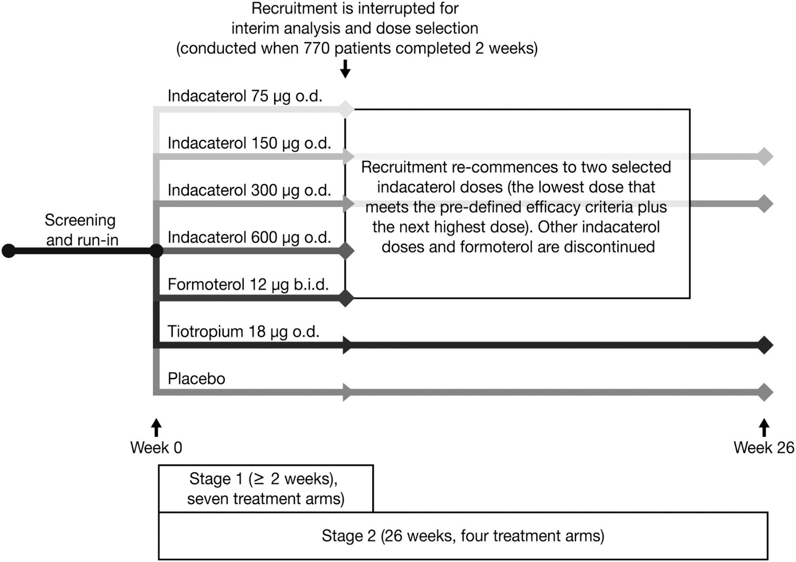
Visual Schematic of the Seamless Design
Notes:
Donohue, James F et al. “Once-daily bronchodilators for chronic obstructive pulmonary disease: indacaterol versus tiotropium.” American journal of respiratory and critical care medicine vol. 182,2 (2010): 155-62. doi:10.1164/rccm.200910-1500OC

Slide 23
Clinical Trial: Seamless Design Example
Arms Kept After Interim Analysis to Move to Phase 2 of Trial
Arms Dropped After Interim Analysis
Indacaterol 150 µg
Indacaterol 300 µg
Tiotropium 18 µg
Placebo
Indacaterol 75 µg
Indacaterol 600 µg
DSMB noted no safety concerns at any dose
Formoterol 12 µg

Slide 24
Clinical Trial: Seamless Design Example
Stage 2 ultimately enrolled 1683 across the four included study arms (this includes Stage 1 participants in addition to participants enrolled in Stage 1)
Those in dropped arms were not re-randomized, but did have study follow-up and close-out debriefed
Noted no major differences in adverse events across study arms
All 3 active therapy arms improved FEV1 significantly relative to placebo (p<0.001 for each pairwise comparison)
“In conclusion, once-daily indacaterol provides clinically and statistically significant bronchodilation compared with placebo at 24 hours post dose after 12 weeks of treatment, demonstrating its suitability for once-daily dosing. Relative to tiotropium, the effect on trough FEV₁ met prespecified requirements for statistical noninferiority.” (Donohue 2010)
Notes:
Donohue, James F et al. “Once-daily bronchodilators for chronic obstructive pulmonary disease: indacaterol versus tiotropium.” American journal of respiratory and critical care medicine vol. 182,2 (2010): 155-62. doi:10.1164/rccm.200910-1500OC

Slide 25
Module Conclusions
Seamless designs allow for more efficient use of data across multiple studies and reduces the time between studies by incorporating them under one protocol
Designs may allow for longer term follow-up, especially of stage 1 participants, and allow for delayed or rarer adverse events
One must carefully consider the outcomes for each stage of a seamless design, especially if surrogate outcomes are used
Ideal to combine dose finding with initial efficacy, more generally useful for nonpivotal studies

Slide 26
References
Kaizer, Alexander M., et al. "Recent innovations in adaptive trial designs: a review of design opportunities in translational research." Journal of Clinical and Translational Science (2023): 1-35.
US Food and Drug Administration. Adaptive designs for clinical trials of drugs and biologics guidance for industry. https://www.fda.gov/regulatory-information/search-fda-guidance-documents/adaptive-design-clinical-trials-drugs-and-biologics-guidance-industry
Li, Qing, Jianchang Lin, and Yunzhi Lin. "Adaptive design implementation in confirmatory trials: methods, practical considerations and case studies." Contemporary Clinical Trials 98 (2020): 106096.
Barnes, Peter J., et al. "Integrating indacaterol dose selection in a clinical study in COPD using an adaptive seamless design." Pulmonary pharmacology & therapeutics 23.3 (2010): 165-171.
Donohue, James F et al. “Once-daily bronchodilators for chronic obstructive pulmonary disease: indacaterol versus tiotropium.” American journal of respiratory and critical care medicine vol. 182,2 (2010): 155-62. doi:10.1164/rccm.200910-1500OC

Slide 27

Contact Info:
Email:
alex.kaizer@cuanschutz.edu
Website: www.alexkaizer.com
GitHub: alexbiostats

