Slide 1
Adaptive and Bayesian Methods for Clinical Trial Design Short Course
Dr. Alex Kaizer
Sample Size Re-Estimation
Notes:
xx

Slide 2
Some Background and Logistics
Some of the practical considerations

Slide 3
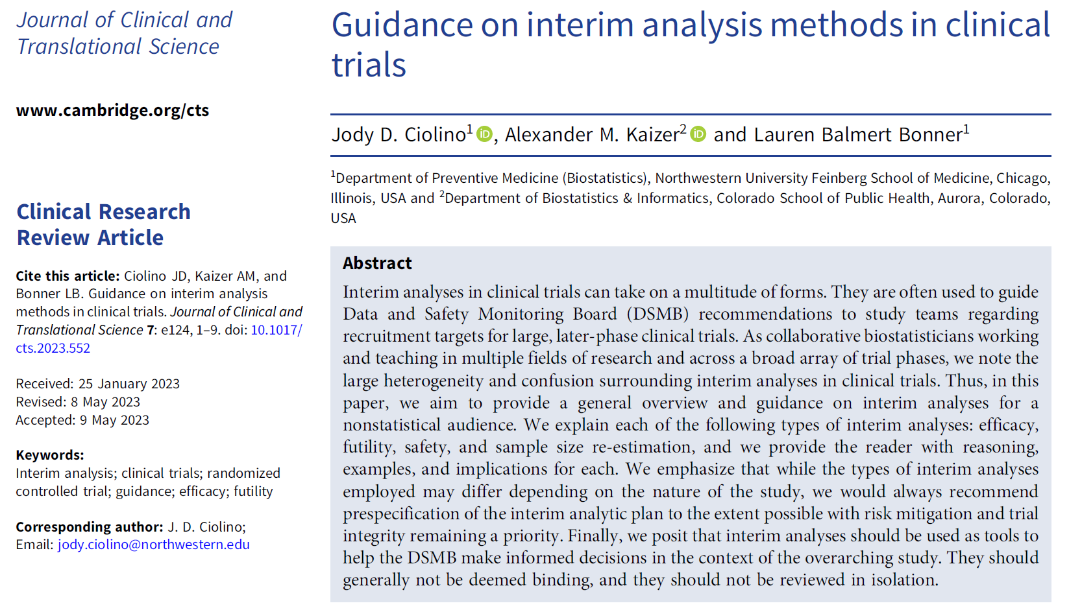
Overview Paper:

Slide 4
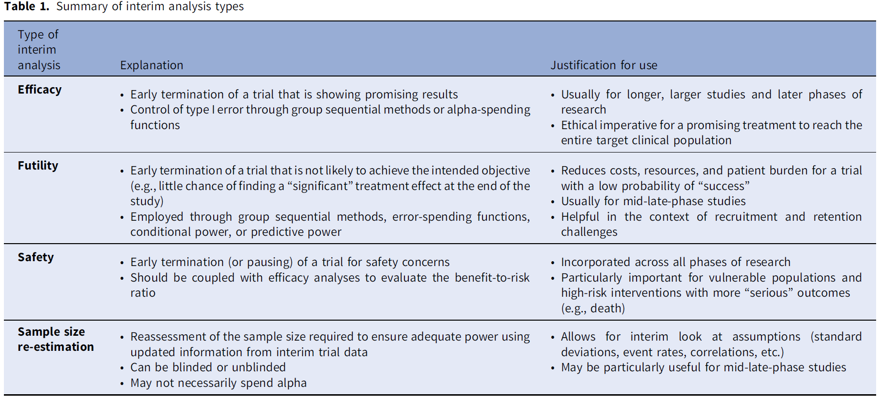
Terminology
Separate module!
Notes:
Table 1 from Ciolino, Jody D., Alexander M. Kaizer, and Lauren Balmert Bonner. "Guidance on interim analysis methods in clinical trials." Journal of Clinical and Translational Science 7.1 (2023): e124.

Slide 5
Background
Sample size re-estimation, when one power calculation isn’t enough!

Slide 6

Why Adapt the Sample Size?
Hypothetical Scenario:
You design and power a study on a research topic with limited prior information (i.e., there is uncertainty in your sample size calculation assumptions)
As the study is being conducted, the observed treatment effect is smaller than expected, but still clinically meaningful
If we maintain the planned sample size, we may be underpowered to detect this difference
Image Source: Everyday Health
Notes:
Image: https://www.everydayhealth.com/multiple-sclerosis/treatment/things-you-should-know-before-joining-ms-clinical-trial/

Slide 7
Purpose
Sample size re-estimation allows a study to modify the planned sample size based on accumulating data to account for uncertainty of power calculations conducted during the initial design
Re-estimation can increase likelihood of a “successful” trial, but may also lead to a substantial increase in the needed sample size
Many methods exist with different considerations for any given study

Slide 8
Categories of Re-Estimation Approaches
Two categories of re-estimation procedures exist with regards to knowledge of study arm allocation of randomized participants:
Blinded
Study arm allocation not known
Often used to estimate nuisance parameters (e.g., variance of continuous outcome, overall event rate, etc.) to revise pre-study assumed value
Little concerns with control of type I error rate
Unblinded
Study arm allocation is known
Often used to estimate the effect size and potentially nuisance parameters to use in revising pre-study values
Concerns with control of the type I error rate (similar to efficacy interim analyses)

Slide 9
Blinded Re-Estimation Methods
Putting the “new” in nuisance (parameter)

Slide 10
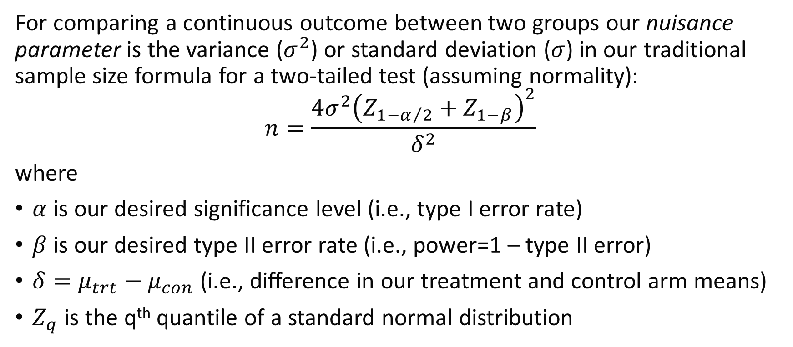
Continuous Outcome Sample Size Formula
For comparing a continuous outcome between two groups our nuisance parameter is the variance ($σ^{2}$) or standard deviation ($σ$) in our traditional sample size formula for a two-tailed test (assuming normality):
$$n=\frac{4σ^{2}{\left(Z_{1−α/2}+Z_{1−β}\right)}^{2}}{δ^{2}}$$
where
$α$ is our desired significance level (i.e., type I error rate)
$β$ is our desired type II error rate (i.e., power=1 – type II error)
$δ=μ_{trt}−μ_{con}$ (i.e., difference in our treatment and control arm means)
$Z_{q}$ is the q^{th} quantile of a standard normal distribution
Notes:
See page 138 of Baumann, Lukas, Maximilian Pilz, and Meinhard Kieser. "blindrecalc-An R Package for Blinded Sample Size Recalculation." R Journal 14.1 (2022) for a formula that allows for allocations other than 1:1.

Slide 11
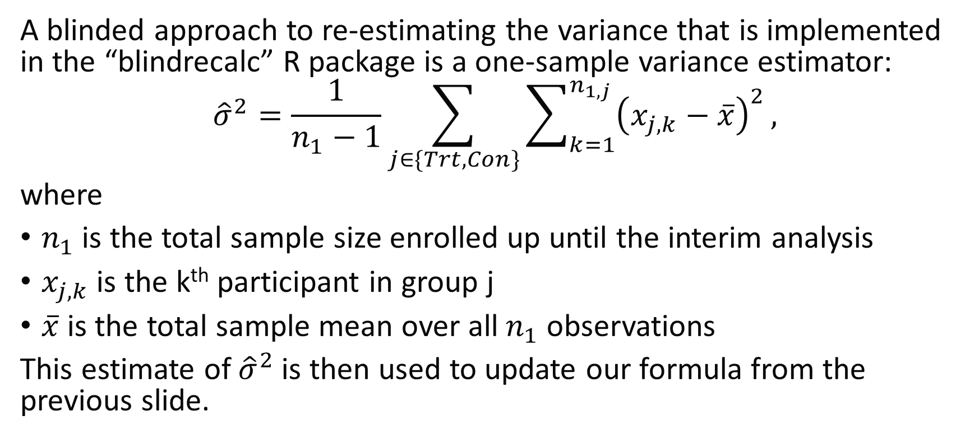
Blinded Continuous Outcome Method
A blinded approach to re-estimating the variance that is implemented in the “blindrecalc” R package is a one-sample variance estimator:
$${\hat{σ}}^{2}=\frac{1}{n_{1}−1}\sum_{j∈\{Trt,Con\}}{\sum_{k=1}^{n_{1,j}}{{\left(x_{j,k}−\overline{x}\right)}^{2}}},$$
where
$n_{1}$ is the total sample size enrolled up until the interim analysis
$x_{j,k}$ is the k^{th} participant in group j
$\overline{x}$is the total sample mean over all $n_{1}$ observations
This estimate of ${\hat{σ}}^{2}$is then used to update our formula from the previous slide.
Notes:
Baumann, Lukas, Maximilian Pilz, and Meinhard Kieser. "blindrecalc-An R Package for Blinded Sample Size Recalculation." R Journal 14.1 (2022).
Note, this one-sample variance estimator is equivalent to the var() function in R.

Slide 12
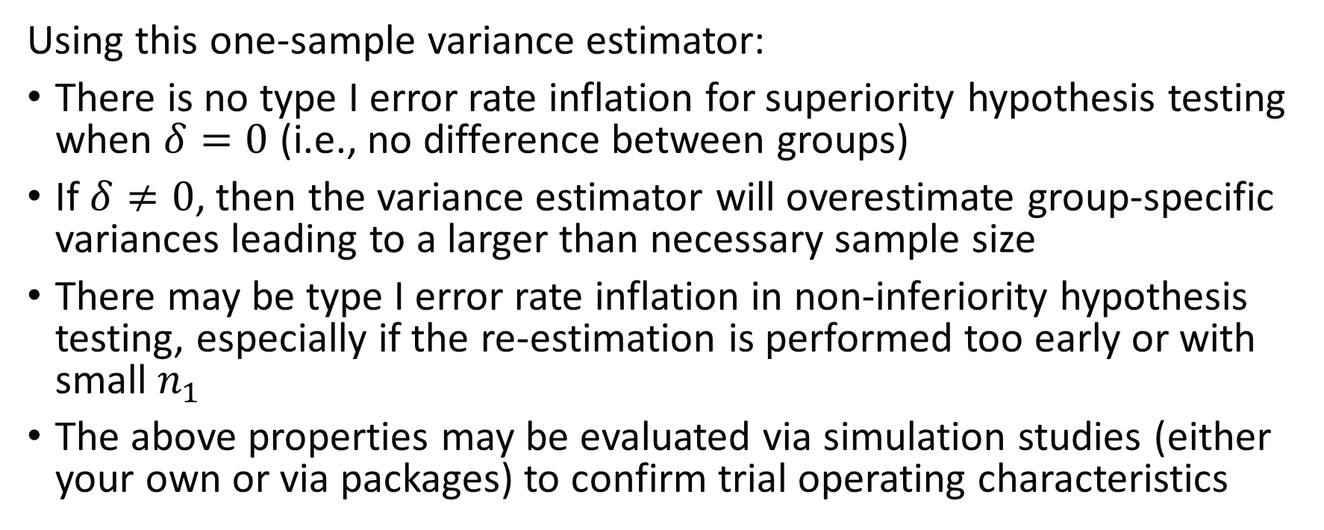
Blinded Continuous Outcome Method
Using this one-sample variance estimator:
There is no type I error rate inflation for superiority hypothesis testing when $δ=0$ (i.e., no difference between groups)
If $δ≠0$, then the variance estimator will overestimate group-specific variances leading to a larger than necessary sample size
There may be type I error rate inflation in non-inferiority hypothesis testing, especially if the re-estimation is performed too early or with small $n_{1}$
The above properties may be evaluated via simulation studies (either your own or via packages) to confirm trial operating characteristics
Notes:
Baumann, Lukas, Maximilian Pilz, and Meinhard Kieser. "blindrecalc-An R Package for Blinded Sample Size Recalculation." R Journal 14.1 (2022).

Slide 13
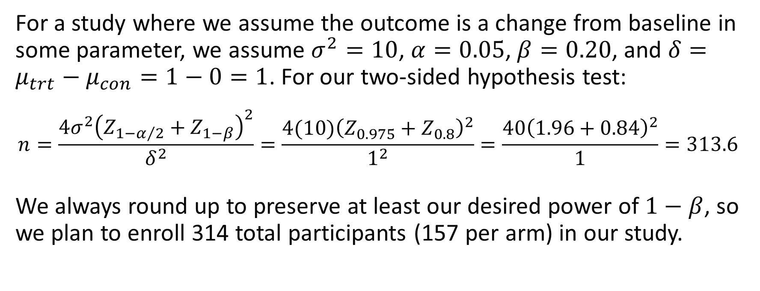
Blinded Continuous Outcome Example
For a study where we assume the outcome is a change from baseline in some parameter, we assume $σ^{2}=10$, $α=0.05$, $β=0.20$, and $δ=μ_{trt}−μ_{con}=1−0=1$. For our two-sided hypothesis test:
$$n=\frac{{4σ}^{2}{\left(Z_{1−α/2}+Z_{1−β}\right)}^{2}}{δ^{2}}=\frac{4(10){\left(Z_{0.975}+Z_{0.8}\right)}^{2}}{1^{2}}=\frac{40{\left(1.96+0.84\right)}^{2}}{1}=313.6$$
We always round up to preserve at least our desired power of $1−β$, so we plan to enroll 314 total participants (157 per arm) in our study.

Slide 14
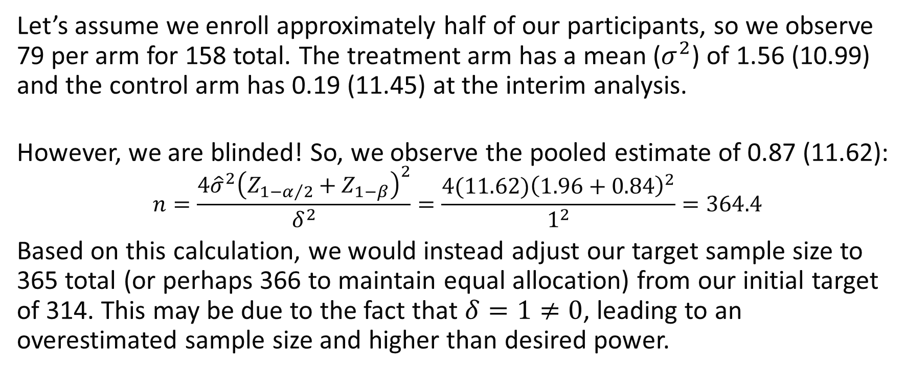
Blinded Continuous Outcome Example
Let’s assume we enroll approximately half of our participants, so we observe 79 per arm for 158 total. The treatment arm has a mean ($σ^{2}$) of 1.56 (10.99) and the control arm has 0.19 (11.45) at the interim analysis.
However, we are blinded! So, we observe the pooled estimate of 0.87 (11.62):
$$n=\frac{{4\hat{σ}}^{2}{\left(Z_{1−α/2}+Z_{1−β}\right)}^{2}}{δ^{2}}=\frac{4(11.62){\left(1.96+0.84\right)}^{2}}{1^{2}}=364.4$$
Based on this calculation, we would instead adjust our target sample size to 365 total (or perhaps 366 to maintain equal allocation) from our initial target of 314. This may be due to the fact that $δ=1≠0$, leading to an overestimated sample size and higher than desired power.
Notes:
Simulate observed interim mean (variance) for each group:
set.seed(515)
trt <- rnorm(n=79, mean=1, sd=sqrt(10))
con <- rnorm(n=79, mean=0, sd=sqrt(10))

Slide 15
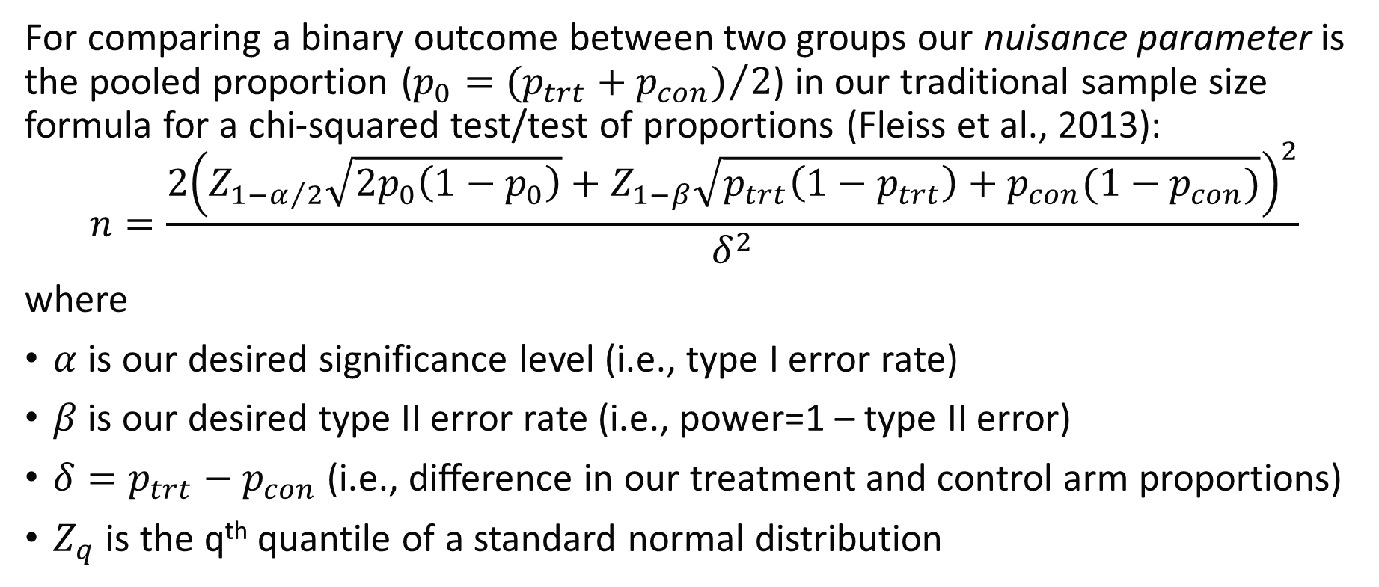
Binary Outcome Sample Size Formula
For comparing a binary outcome between two groups our nuisance parameter is the pooled proportion ($p_{0}={(p_{trt}+p_{con})}/2$) in our traditional sample size formula for a chi-squared test/test of proportions (Fleiss et al., 2013):
$$n=\frac{2{\left(Z_{1−α/2}\sqrt{2p_{0}\left(1−p_{0}\right)}+Z_{1−β}\sqrt{p_{trt}\left(1−p_{trt}\right)+p_{con}(1−p_{con})}\right)}^{2}}{δ^{2}}$$
where
$α$ is our desired significance level (i.e., type I error rate)
$β$ is our desired type II error rate (i.e., power=1 – type II error)
$δ=p_{trt}−p_{con}$ (i.e., difference in our treatment and control arm proportions)
$Z_{q}$ is the q^{th} quantile of a standard normal distribution
Notes:
Fleiss, Joseph L., Bruce Levin, and Myunghee Cho Paik. Statistical methods for rates and proportions. john wiley & sons, 2013.
See page 139 of Baumann, Lukas, Maximilian Pilz, and Meinhard Kieser. "blindrecalc-An R Package for Blinded Sample Size Recalculation." R Journal 14.1 (2022) for a formula that allows for allocations other than 1:1.

Slide 16
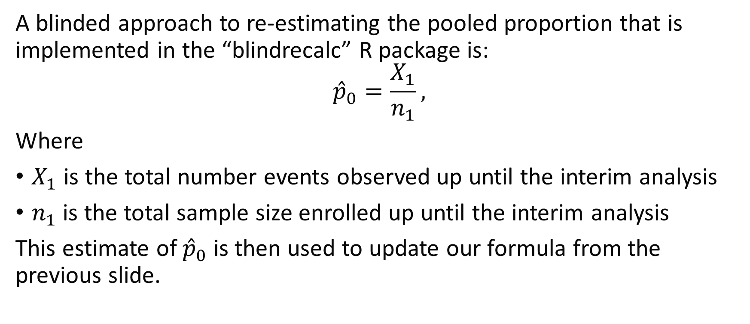
Blinded Binary Outcome Method
A blinded approach to re-estimating the pooled proportion that is implemented in the “blindrecalc” R package is:
$${\hat{p}}_{0}=\frac{X_{1}}{n_{1}},$$
Where
$X_{1}$ is the total number events observed up until the interim analysis
$n_{1}$ is the total sample size enrolled up until the interim analysis
This estimate of ${\hat{p}}_{0}$ is then used to update our formula from the previous slide.
Notes:
Baumann, Lukas, Maximilian Pilz, and Meinhard Kieser. "blindrecalc-An R Package for Blinded Sample Size Recalculation." R Journal 14.1 (2022).

Slide 17
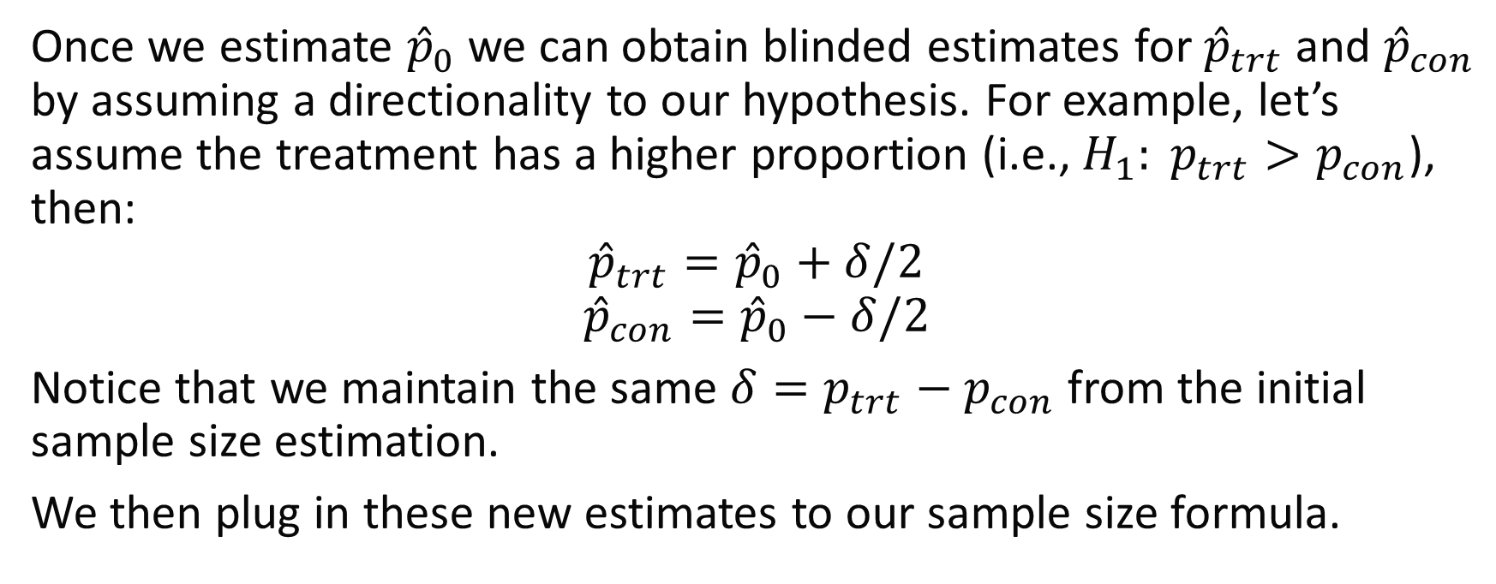
Blinded Binary Outcome Method
Once we estimate ${\hat{p}}_{0}$ we can obtain blinded estimates for ${\hat{p}}_{trt}$ and ${\hat{p}}_{con}$ by assuming a directionality to our hypothesis. For example, let’s assume the treatment has a higher proportion (i.e., $H_{1}: p_{trt}>p_{con}$), then:
$${\hat{p}}_{trt}={\hat{p}}_{0}+δ/2$$
$${\hat{p}}_{con}={\hat{p}}_{0}−δ/2$$
Notice that we maintain the same $δ=p_{trt}−p_{con}$ from the initial sample size estimation.
We then plug in these new estimates to our sample size formula.
Notes:
Baumann, Lukas, Maximilian Pilz, and Meinhard Kieser. "blindrecalc-An R Package for Blinded Sample Size Recalculation." R Journal 14.1 (2022).

Slide 18
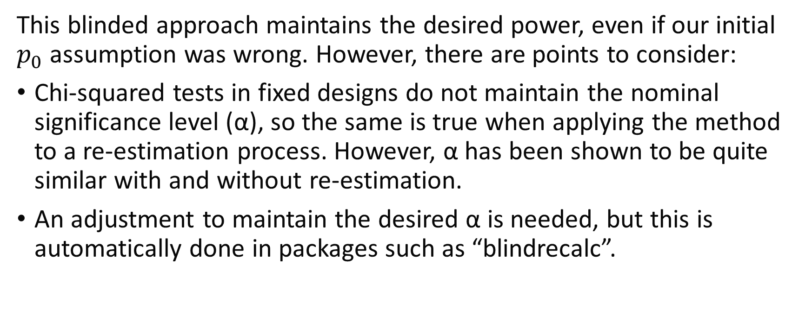
Blinded Binary Outcome Method
This blinded approach maintains the desired power, even if our initial $p_{0}$ assumption was wrong. However, there are points to consider:
Chi-squared tests in fixed designs do not maintain the nominal significance level (α), so the same is true when applying the method to a re-estimation process. However, α has been shown to be quite similar with and without re-estimation.
An adjustment to maintain the desired α is needed, but this is automatically done in packages such as “blindrecalc”.
Notes:
Baumann, Lukas, Maximilian Pilz, and Meinhard Kieser. "blindrecalc-An R Package for Blinded Sample Size Recalculation." R Journal 14.1 (2022).

Slide 19
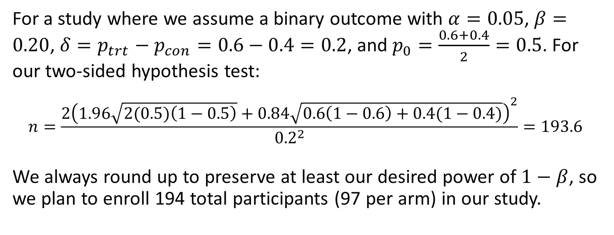
Blinded Binary Outcome Example
For a study where we assume a binary outcome with $α=0.05$, $β=0.20$, $δ=p_{trt}−p_{con}=0.6−0.4=0.2$, and $p_{0}=\frac{0.6+0.4}{2}=0.5$. For our two-sided hypothesis test:
$$n=\frac{2{\left(1.96\sqrt{2(0.5)\left(1−0.5\right)}+0.84\sqrt{0.6\left(1−0.6\right)+0.4(1−0.4)}\right)}^{2}}{{0.2}^{2}}=193.6$$
We always round up to preserve at least our desired power of $1−β$, so we plan to enroll 194 total participants (97 per arm) in our study.

Slide 20
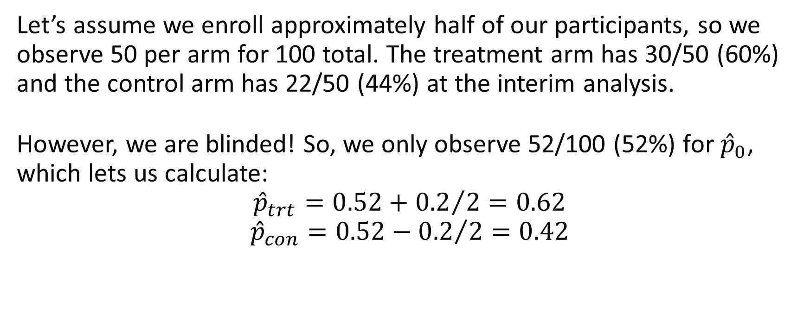
Blinded Binary Outcome Example
Let’s assume we enroll approximately half of our participants, so we observe 50 per arm for 100 total. The treatment arm has 30/50 (60%) and the control arm has 22/50 (44%) at the interim analysis.
However, we are blinded! So, we only observe 52/100 (52%) for ${\hat{p}}_{0}$, which lets us calculate:
$${\hat{p}}_{trt}=0.52+{0.2}/2=0.62$$
$${\hat{p}}_{con}=0.52−{0.2}/2=0.42$$
Notes:
Simulate interim data for example:
set.seed(515)
trt <- rbinom(n=50, prob=0.6, size=1)
con <- rbinom(n=50, prob=0.4, size=1)

Slide 21
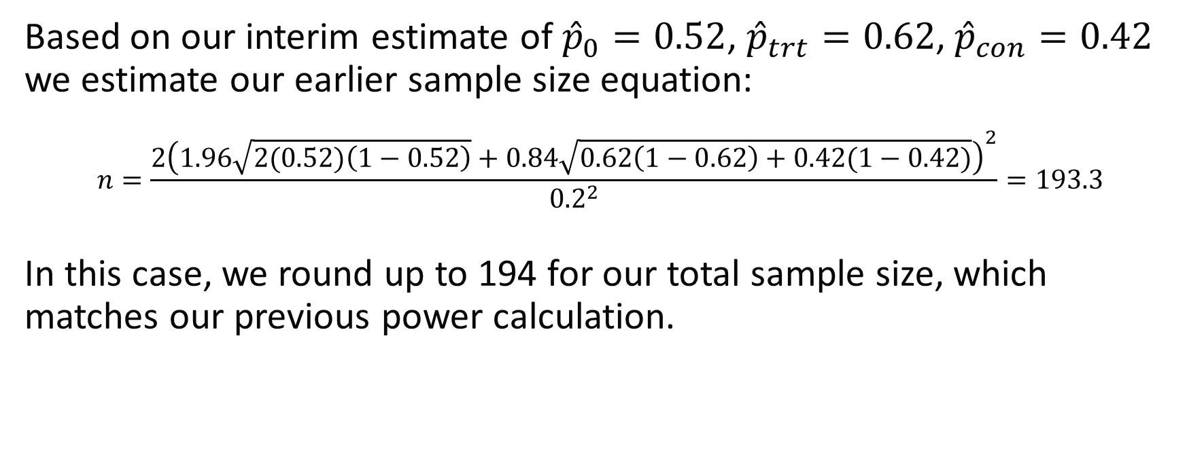
Blinded Binary Outcome Example
Based on our interim estimate of ${\hat{p}}_{0}=0.52$, ${\hat{p}}_{trt}=0.62$, ${\hat{p}}_{con}=0.42$ we estimate our earlier sample size equation:
$$n=\frac{2{\left(1.96\sqrt{2(0.52)\left(1−0.52\right)}+0.84\sqrt{0.62\left(1−0.62\right)+0.42(1−0.42)}\right)}^{2}}{{0.2}^{2}}=193.3$$
In this case, we round up to 194 for our total sample size, which matches our previous power calculation.

Slide 22
Blinded Re-estimation for Binary Outcome with Blocked Randomization Method
It is also possible to maintain blinding while estimating group-specific treatment effects based on a clever application of block randomization.
We will explore the proposed method by Shih and Peng-Liang (1997) in the following slides.
Notes:
Shih, Weichung Joseph, and Peng‐Liang Zhao. "Design for sample size re‐estimation with interim data for double‐blind clinical trials with binary outcomes." Statistics in Medicine 16.17 (1997): 1913-1923.

Slide 23
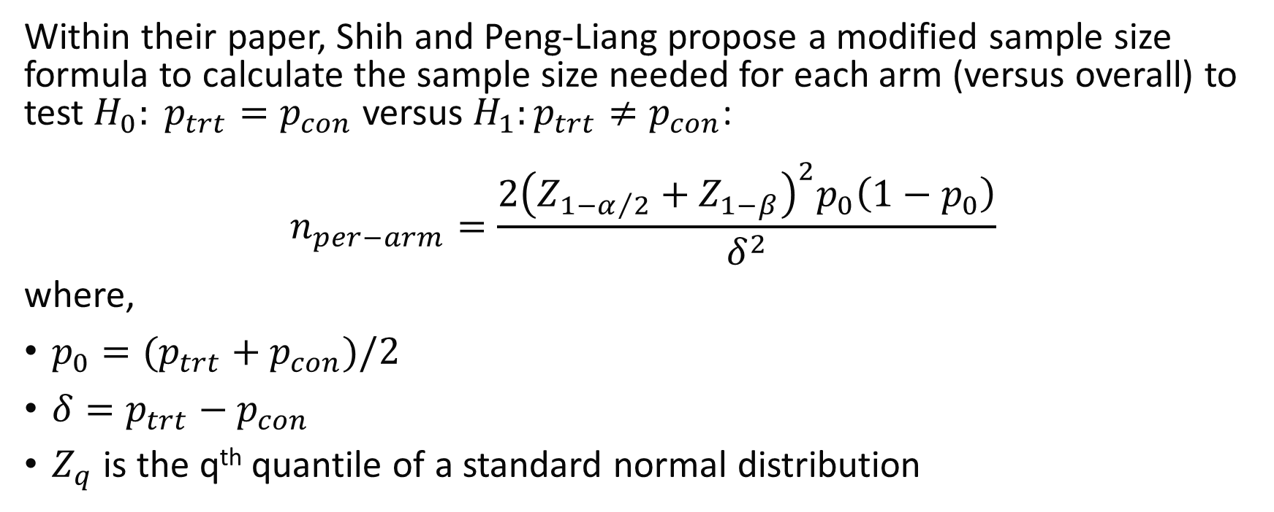
Blinded Re-estimation for Binary Outcome with Blocked Randomization Method
Within their paper, Shih and Peng-Liang propose a modified sample size formula to calculate the sample size needed for each arm (versus overall) to test $H_{0}: p_{trt}=p_{con}$ versus $H_{1}:p_{trt}≠p_{con}$:
$$n_{per−arm}=\frac{2{\left(Z_{{1−α}/2}+Z_{1−β}\right)}^{2}p_{0}\left(1−p_{0}\right)}{δ^{2}}$$
where,
$p_{0}=(p_{trt}+p_{con})/2$
$δ=p_{trt}−p_{con}$
$Z_{q}$ is the q^{th} quantile of a standard normal distribution
Notes:
Shih, Weichung Joseph, and Peng‐Liang Zhao. "Design for sample size re‐estimation with interim data for double‐blind clinical trials with binary outcomes." Statistics in Medicine 16.17 (1997): 1913-1923.

Slide 24
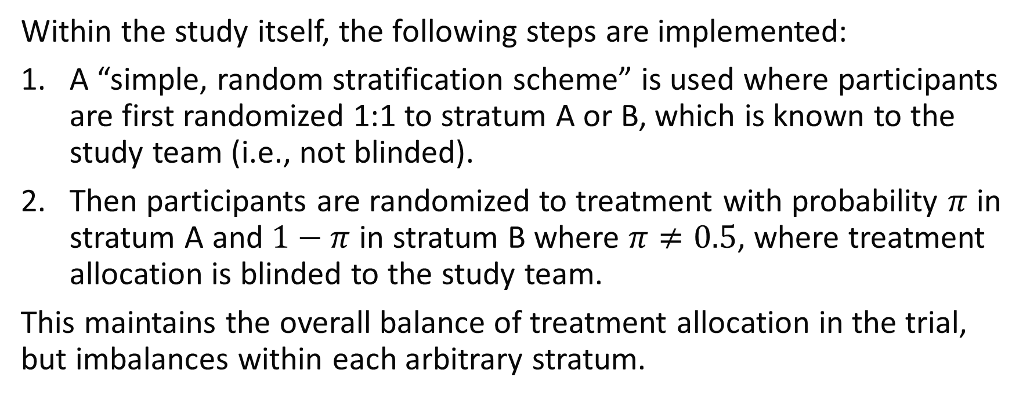
Blinded Re-estimation for Binary Outcome with Blocked Randomization Method
Within the study itself, the following steps are implemented:
A “simple, random stratification scheme” is used where participants are first randomized 1:1 to stratum A or B, which is known to the study team (i.e., not blinded).
Then participants are randomized to treatment with probability $π$ in stratum A and $1−π$ in stratum B where $π≠0.5$, where treatment allocation is blinded to the study team.
This maintains the overall balance of treatment allocation in the trial, but imbalances within each arbitrary stratum.
Notes:
Shih, Weichung Joseph, and Peng‐Liang Zhao. "Design for sample size re‐estimation with interim data for double‐blind clinical trials with binary outcomes." Statistics in Medicine 16.17 (1997): 1913-1923.

Slide 25
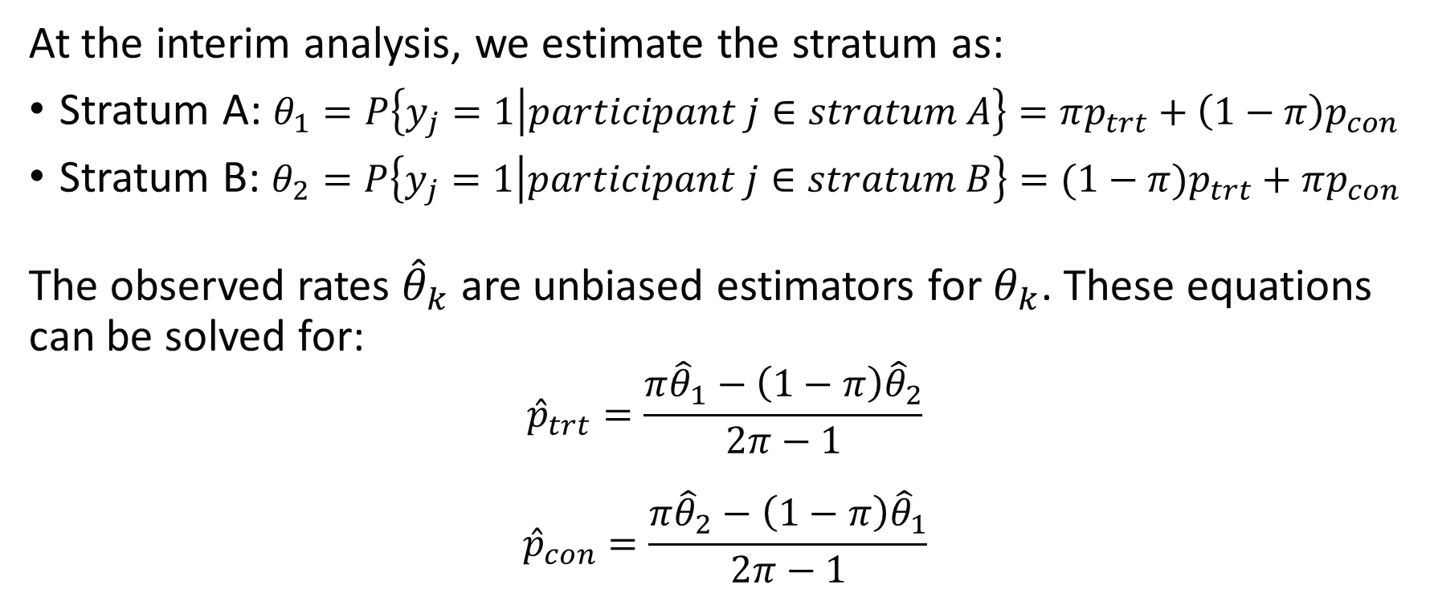
Blinded Re-estimation for Binary Outcome with Blocked Randomization Method
At the interim analysis, we estimate the stratum as:
Stratum A: $θ_{1}=P\left\{y_{j}=1 | participant j∈stratum A\right\}=πp_{trt}+\left(1−π\right)p_{con}$
Stratum B: $θ_{2}=P\left\{y_{j}=1 | participant j∈stratum B\right\}=(1−π)p_{trt}+πp_{con}$
The observed rates ${\hat{θ}}_{k}$ are unbiased estimators for $θ_{k}$. These equations can be solved for:
$${\hat{p}}_{trt}=\frac{π{\hat{θ}}_{1}−\left(1−π\right){\hat{θ}}_{2}}{2π−1}$$
$${\hat{p}}_{con}=\frac{π{\hat{θ}}_{2}−\left(1−π\right){\hat{θ}}_{1}}{2π−1}$$

Slide 26
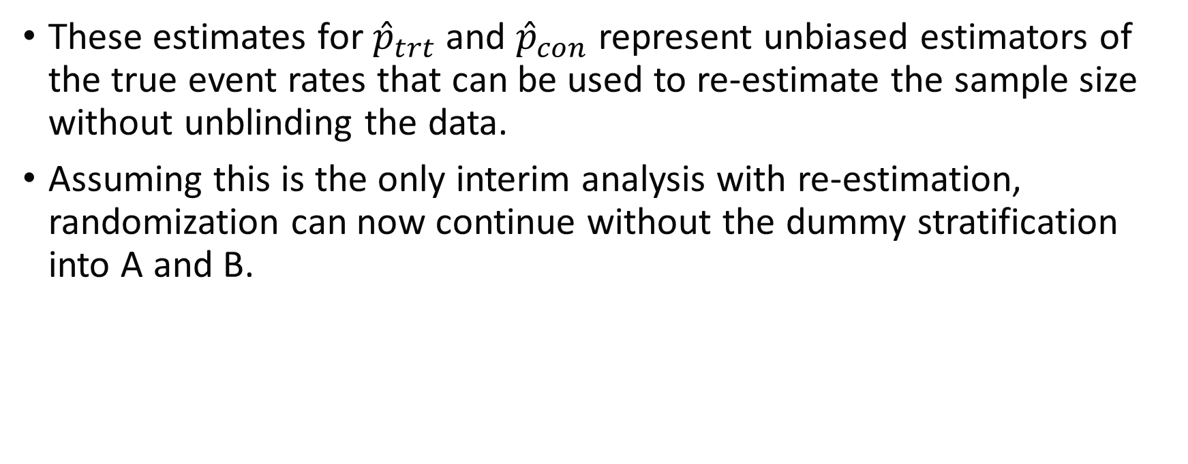
Blinded Re-estimation for Binary Outcome with Blocked Randomization Method
These estimates for ${\hat{p}}_{trt}$ and ${\hat{p}}_{con}$ represent unbiased estimators of the true event rates that can be used to re-estimate the sample size without unblinding the data.
Assuming this is the only interim analysis with re-estimation, randomization can now continue without the dummy stratification into A and B.

Slide 27
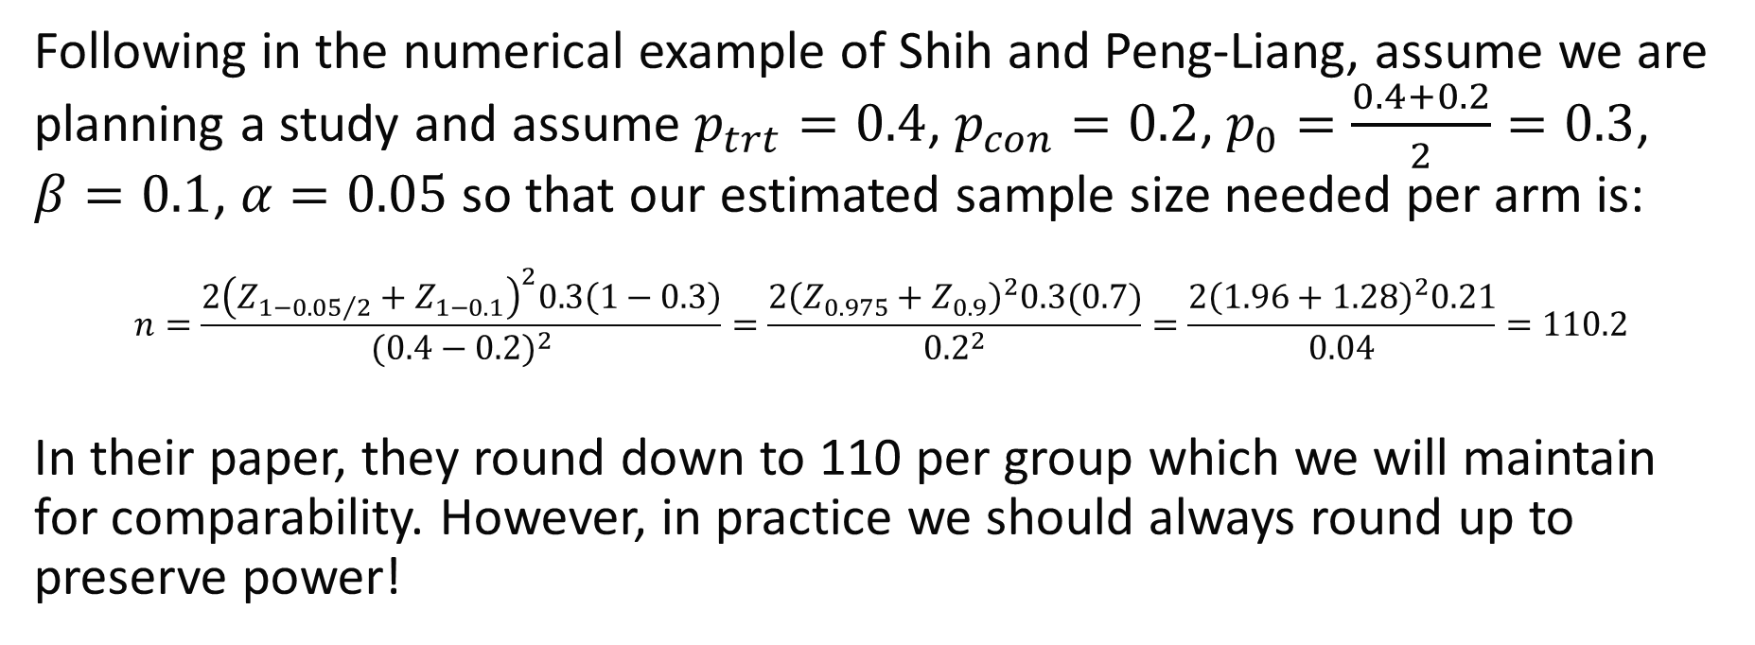
Blinded Re-estimation for Binary Outcome with Blocked Randomization Example
Following in the numerical example of Shih and Peng-Liang, assume we are planning a study and assume $p_{trt}=0.4$, $p_{con}=0.2$, $p_{0}=\frac{0.4+0.2}{2}=0.3$, $β=0.1$, $α=0.05$ so that our estimated sample size needed per arm is:
$$n=\frac{2{\left(Z_{{1−0.05}/2}+Z_{1−0.1}\right)}^{2}0.3\left(1−0.3\right)}{{(0.4−0.2)}^{2}}=\frac{2{\left(Z_{0.975}+Z_{0.9}\right)}^{2}0.3(0.7)}{{0.2}^{2}}=\frac{2{\left(1.96+1.28\right)}^{2}0.21}{0.04}=110.2$$
In their paper, they round down to 110 per group which we will maintain for comparability. However, in practice we should always round up to preserve power!

Slide 28
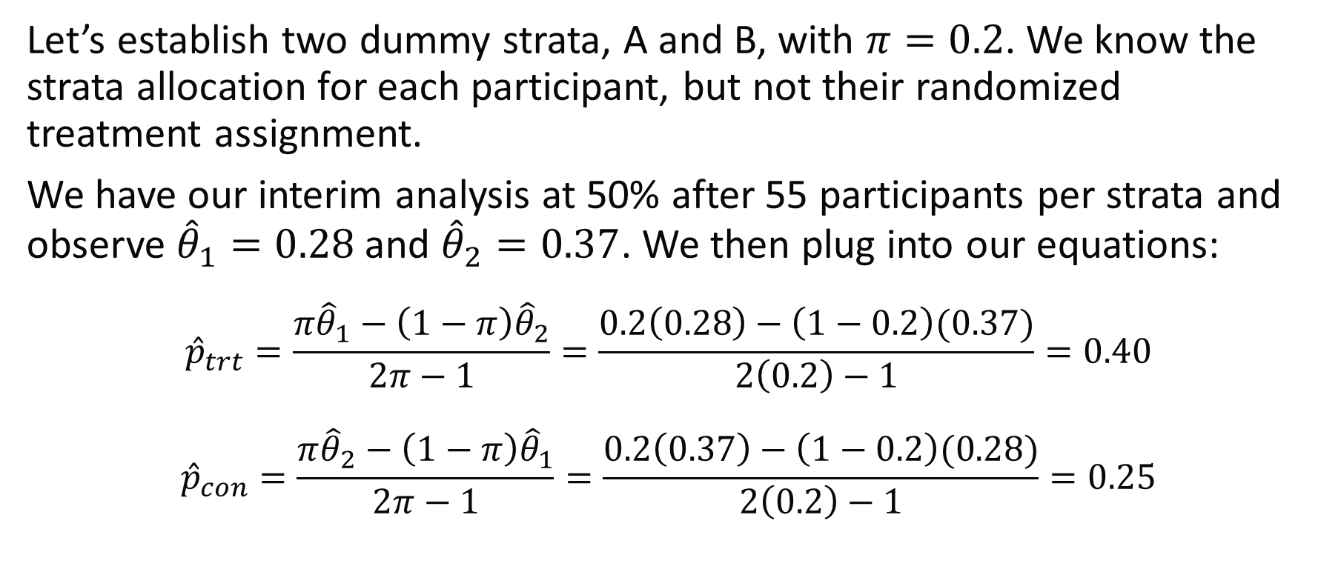
Blinded Re-estimation for Binary Outcome with Blocked Randomization Example
Let’s establish two dummy strata, A and B, with $π=0.2$. We know the strata allocation for each participant, but not their randomized treatment assignment.
We have our interim analysis at 50% after 55 participants per strata and observe ${\hat{θ}}_{1}=0.28$ and ${\hat{θ}}_{2}=0.37$. We then plug into our equations:
$${\hat{p}}_{trt}=\frac{π{\hat{θ}}_{1}−\left(1−π\right){\hat{θ}}_{2}}{2π−1}=\frac{0.2\left(0.28\right)−\left(1−0.2\right)(0.37)}{2\left(0.2\right)−1}=0.40$$
$${\hat{p}}_{con}=\frac{π{\hat{θ}}_{2}−\left(1−π\right){\hat{θ}}_{1}}{2π−1}=\frac{0.2\left(0.37\right)−\left(1−0.2\right)(0.28)}{2\left(0.2\right)−1}=0.25$$

Slide 29
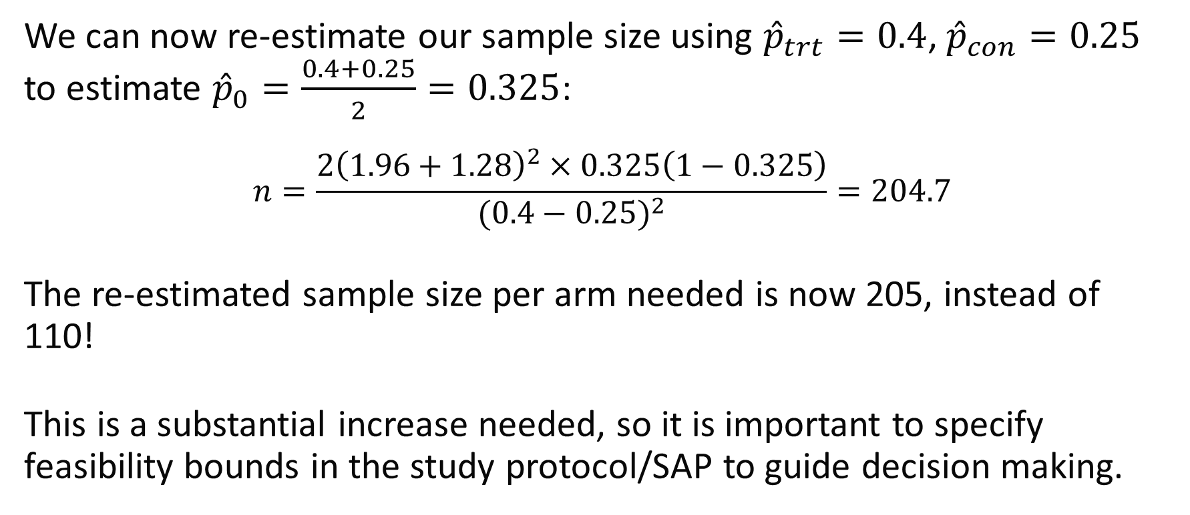
Blinded Re-estimation for Binary Outcome with Blocked Randomization Example
We can now re-estimate our sample size using ${\hat{p}}_{trt}=0.4$, ${\hat{p}}_{con}=0.25$ to estimate ${\hat{p}}_{0}=\frac{0.4+0.25}{2}=0.325$:
$$n=\frac{2{\left(1.96+1.28\right)}^{2}×0.325\left(1−0.325\right)}{{(0.4−0.25)}^{2}}=204.7$$
The re-estimated sample size per arm needed is now 205, instead of 110!
This is a substantial increase needed, so it is important to specify feasibility bounds in the study protocol/SAP to guide decision making.

Slide 30
Unblinded Re-Estimation Methods
Knowing the allocation, but inflating the risk of a type I error

Slide 31
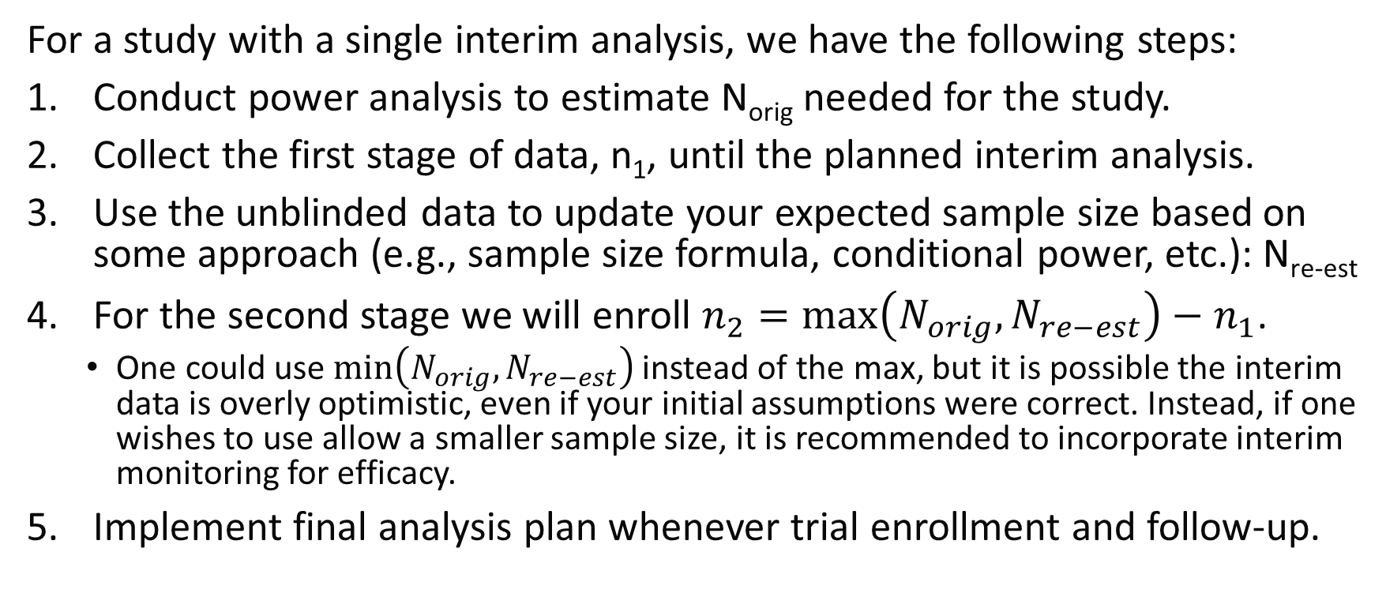
General Steps for Unblinded Re-Estimation
For a study with a single interim analysis, we have the following steps:
Conduct power analysis to estimate N_{orig} needed for the study.
Collect the first stage of data, n₁, until the planned interim analysis.
Use the unblinded data to update your expected sample size based on some approach (e.g., sample size formula, conditional power, etc.): N_{re-est}
For the second stage we will enroll $n_{2}=max\left(N_{orig},N_{re−est}\right)−n_{1}$.
One could use $\min\left(N_{orig},N_{re−est}\right)$ instead of the max, but it is possible the interim data is overly optimistic, even if your initial assumptions were correct. Instead, if one wishes to use allow a smaller sample size, it is recommended to incorporate interim monitoring for efficacy.
Implement final analysis plan whenever trial enrollment and follow-up.

Slide 32
Type I Error Inflation
Unblinded re-estimation approaches may inflate the type I error rate because we observe the raw data and essentially are conducting a statistical test of significance via re-estimating the sample size
To maintain our trial operating characteristics, we need to consider statistical approaches that adjust for the unblinded re-estimation procedure in our final analysis plan.

Slide 33
Combination Tests
One strategy to control the type I error rate in an unblinded re-estimation procedure is to employ a combination test.
Many combination strategies have been proposed:
Inverse normal combination test (our focus on the next slides)
Inverse chi-squared test
Cauchy combination test
Fisher’s method

Slide 34
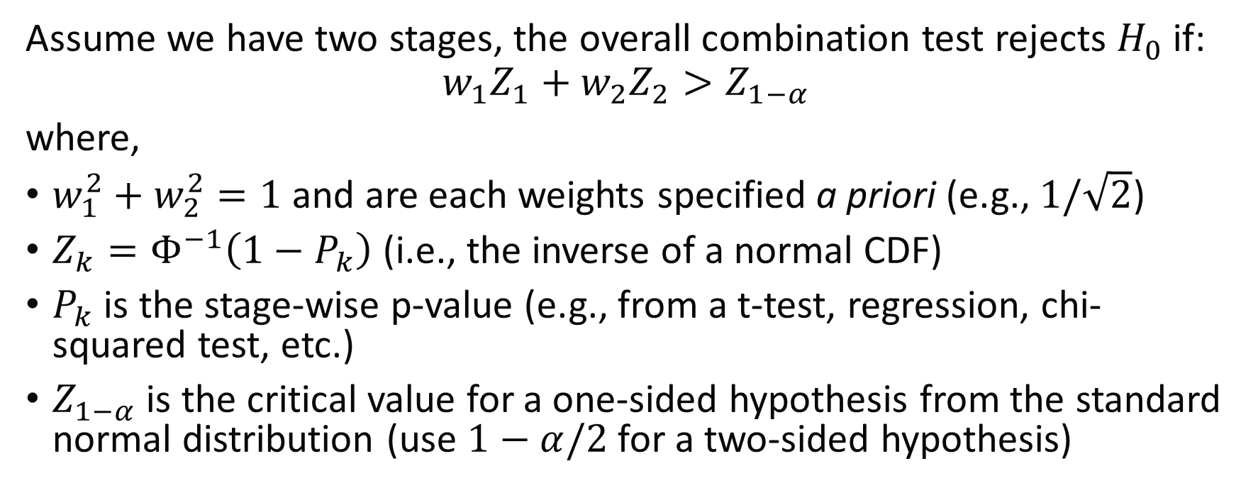
Inverse Normal Combination Test
Assume we have two stages, the overall combination test rejects $H_{0}$ if:
$$w_{1}Z_{1}+w_{2}Z_{2}>Z_{1−α}$$
where,
$w_{1}^{2}+w_{2}^{2}=1$ and are each weights specified a priori (e.g., $1/\sqrt{2}$)
$Z_{k}=Φ^{−1}\left(1−P_{k}\right)$ (i.e., the inverse of a normal CDF)
$P_{k}$ is the stage-wise p-value (e.g., from a t-test, regression, chi-squared test, etc.)
$Z_{1−α}$ is the critical value for a one-sided hypothesis from the standard normal distribution (use $1−α/2$ for a two-sided hypothesis)

Slide 35
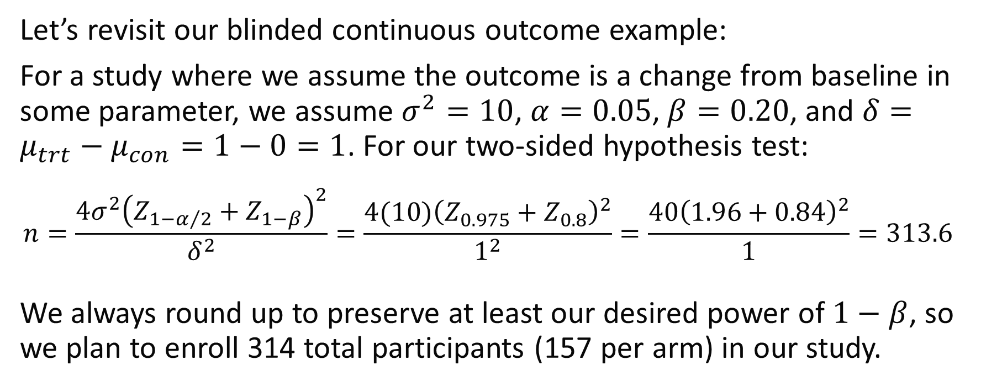
Unblinded Continuous Outcome with Inverse Normal Combination Test Example
Let’s revisit our blinded continuous outcome example:
For a study where we assume the outcome is a change from baseline in some parameter, we assume $σ^{2}=10$, $α=0.05$, $β=0.20$, and $δ=μ_{trt}−μ_{con}=1−0=1$. For our two-sided hypothesis test:
$$n=\frac{{4σ}^{2}{\left(Z_{1−α/2}+Z_{1−β}\right)}^{2}}{δ^{2}}=\frac{4(10){\left(Z_{0.975}+Z_{0.8}\right)}^{2}}{1^{2}}=\frac{40{\left(1.96+0.84\right)}^{2}}{1}=313.6$$
We always round up to preserve at least our desired power of $1−β$, so we plan to enroll 314 total participants (157 per arm) in our study.

Slide 36
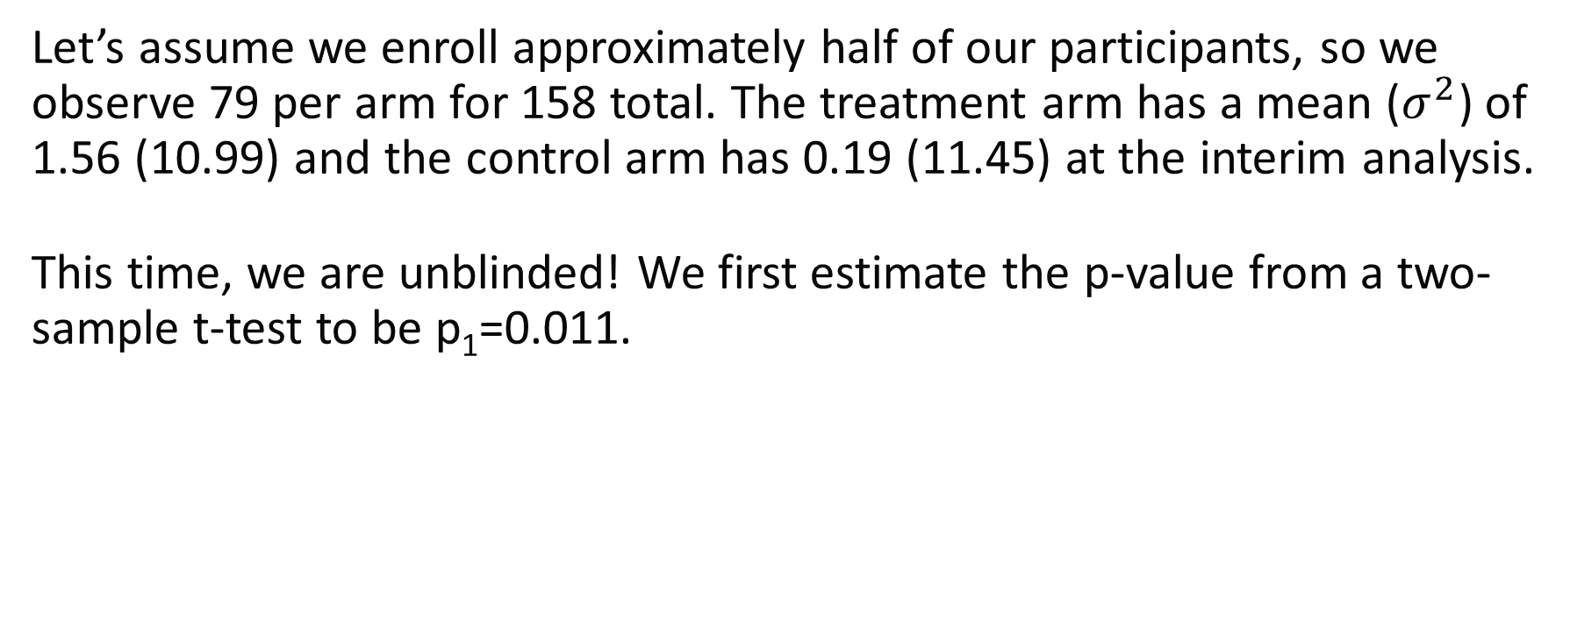
Unblinded Continuous Outcome with Inverse Normal Combination Test Example
Let’s assume we enroll approximately half of our participants, so we observe 79 per arm for 158 total. The treatment arm has a mean ($σ^{2}$) of 1.56 (10.99) and the control arm has 0.19 (11.45) at the interim analysis.
This time, we are unblinded! We first estimate the p-value from a two-sample t-test to be p₁=0.011.
Notes:
Simulate observed interim mean (variance) for each group:
set.seed(515)
trt <- rnorm(n=79, mean=1, sd=sqrt(10))
con <- rnorm(n=79, mean=0, sd=sqrt(10))

Slide 37
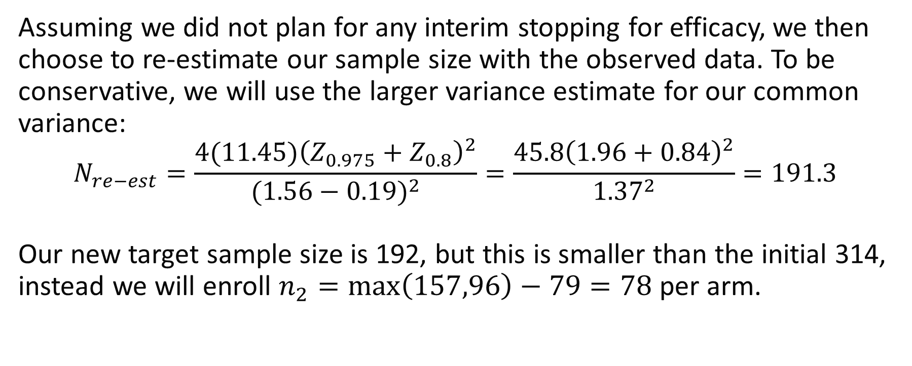
Unblinded Continuous Outcome with Inverse Normal Combination Test Example
Assuming we did not plan for any interim stopping for efficacy, we then choose to re-estimate our sample size with the observed data. To be conservative, we will use the larger variance estimate for our common variance:
$$N_{re−est}=\frac{4(11.45){\left(Z_{0.975}+Z_{0.8}\right)}^{2}}{{(1.56−0.19)}^{2}}=\frac{45.8{\left(1.96+0.84\right)}^{2}}{{1.37}^{2}}=191.3$$
Our new target sample size is 192, but this is smaller than the initial 314, instead we will enroll $n_{2}=\max\left(157,96\right)−79=78$ per arm.
Notes:
Simulate observed interim mean (variance) for each group:
set.seed(515)
trt <- rnorm(n=79, mean=1, sd=sqrt(10))
con <- rnorm(n=79, mean=0, sd=sqrt(10))

Slide 38
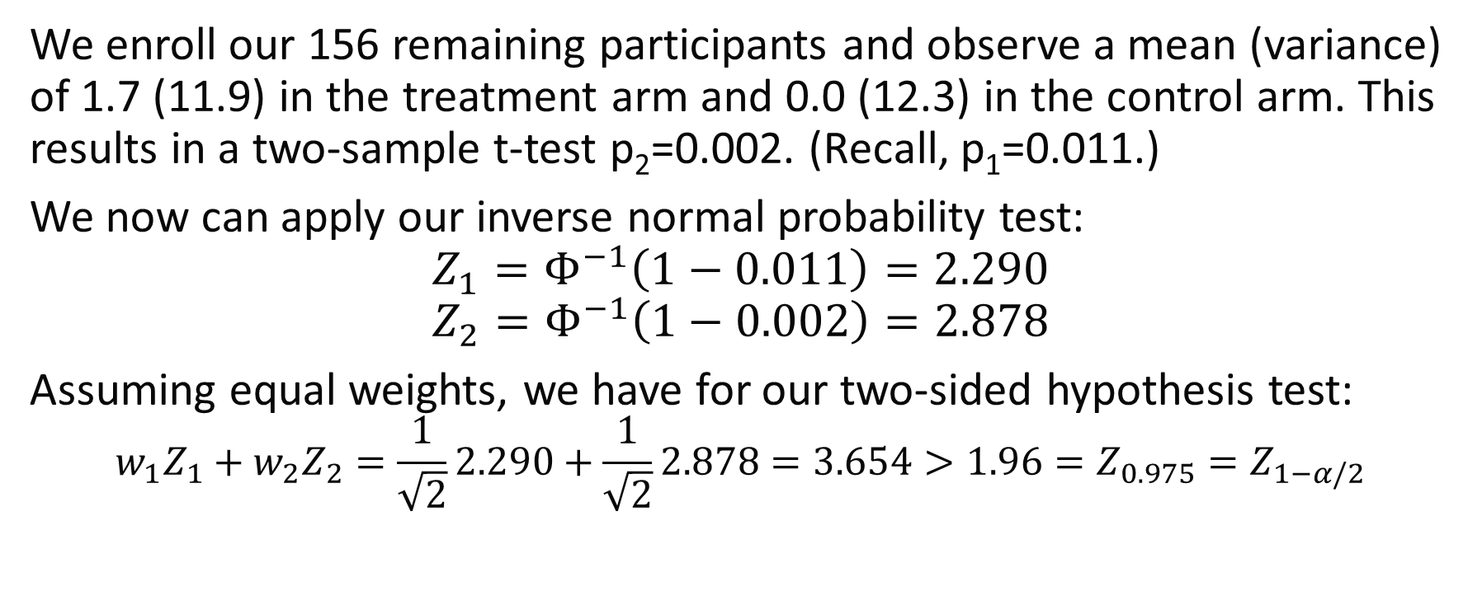
Unblinded Continuous Outcome with Inverse Normal Combination Test Example
We enroll our 156 remaining participants and observe a mean (variance) of 1.7 (11.9) in the treatment arm and 0.0 (12.3) in the control arm. This results in a two-sample t-test p₂=0.002. (Recall, p₁=0.011.)
We now can apply our inverse normal probability test:
$$Z_{1}=Φ^{−1}\left(1−0.011\right)=2.290$$
$$Z_{2}=Φ^{−1}\left(1−0.002\right)=2.878$$
Assuming equal weights, we have for our two-sided hypothesis test:
$$w_{1}Z_{1}+w_{2}Z_{2}=\frac{1}{\sqrt{2}}2.290+\frac{1}{\sqrt{2}}2.878=3.654>1.96=Z_{0.975}=Z_{1−α/2}$$
Notes:
Simulate observed interim mean (variance) for each group:
set.seed(515)
trt <- rnorm(n=79, mean=1, sd=sqrt(10))
con <- rnorm(n=79, mean=0, sd=sqrt(10))
t.test(trt, con)
qnorm(1 - t.test(trt, con)$p.value) # Z1
trt2 <- rnorm(n=78, mean=1, sd=sqrt(10))
con2 <- rnorm(n=78, mean=0, sd=sqrt(10))
t.test(trt2,con2)
qnorm(1 - t.test(trt2, con2)$p.value) # Z2

Slide 39
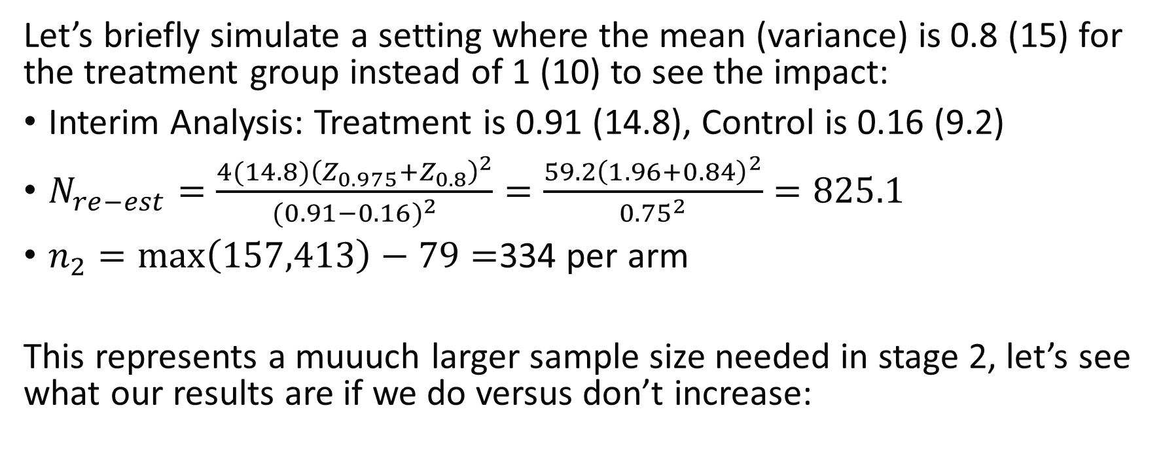
Unblinded Continuous Outcome with Inverse Normal Combination Test Example 2
Let’s briefly simulate a setting where the mean (variance) is 0.8 (15) for the treatment group instead of 1 (10) to see the impact:
Interim Analysis: Treatment is 0.91 (14.8), Control is 0.16 (9.2)
$N_{re−est}=\frac{4(14.8){\left(Z_{0.975}+Z_{0.8}\right)}^{2}}{{(0.91−0.16)}^{2}}=\frac{59.2{\left(1.96+0.84\right)}^{2}}{{0.75}^{2}}=825.1$
$n_{2}=\max\left(157,413\right)−79=$334 per arm
This represents a muuuch larger sample size needed in stage 2, let’s see what our results are if we do versus don’t increase:
Notes:
Simulate observed interim mean (variance) for each group:
set.seed(303)
trt <- rnorm(n=79, mean=0.8, sd=sqrt(15))
con <- rnorm(n=79, mean=0, sd=sqrt(10))
t.test(trt, con)
qnorm(1 - t.test(trt, con)$p.value) # Z1

Slide 40
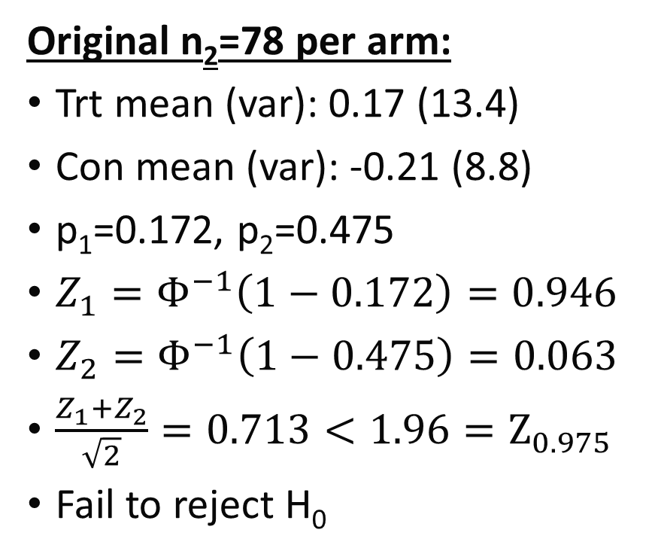
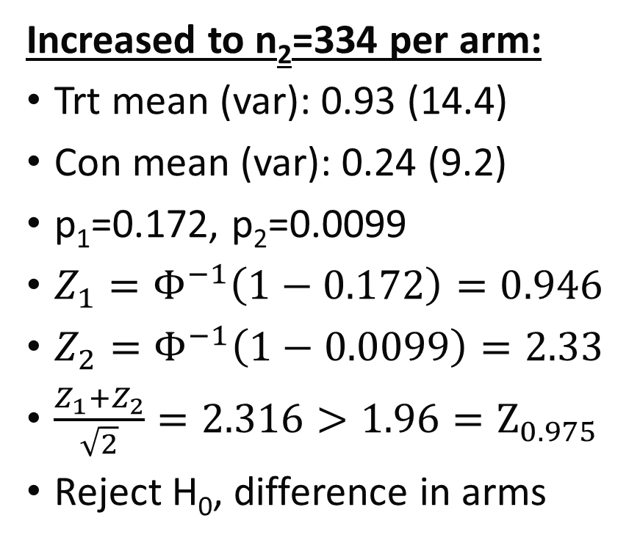
Unblinded Continuous Outcome with Inverse Normal Combination Test Example 2
Original n₂=78 per arm:
Trt mean (var): 0.17 (13.4)
Con mean (var): -0.21 (8.8)
p₁=0.172, p₂=0.475
$Z_{1}=Φ^{−1}\left(1−0.172\right)=0.946$
$Z_{2}=Φ^{−1}\left(1−0.475\right)=0.063$
$\frac{Z_{1}+Z_{2}}{\sqrt{2}}=0.713<1.96=Z_{0.975}$
Fail to reject H₀
Increased to n₂=334 per arm:
Trt mean (var): 0.93 (14.4)
Con mean (var): 0.24 (9.2)
p₁=0.172, p₂=0.0099
$Z_{1}=Φ^{−1}\left(1−0.172\right)=0.946$
$Z_{2}=Φ^{−1}\left(1−0.0099\right)=2.33$
$\frac{Z_{1}+Z_{2}}{\sqrt{2}}=2.316>1.96=Z_{0.975}$
Reject H₀, difference in arms
Notes:
Simulate observed interim mean (variance) for each group:
set.seed(303)
trt <- rnorm(n=79, mean=0.8, sd=sqrt(15))
con <- rnorm(n=79, mean=0, sd=sqrt(10))
t.test(trt, con)
qnorm(1 - t.test(trt, con)$p.value) # Z1
trt2 <- rnorm(n=334, mean=0.8, sd=sqrt(15))
con2 <- rnorm(n=334, mean=0, sd=sqrt(10))
# Assume original sample size
t.test(trt2[1:78], con2[1:78])
qnorm(1 - t.test(trt2[1:78], con2[1:78])$p.value) # Z2
# Use re-estimated sample size
t.test(trt2,con2)
qnorm(1 - t.test(trt2, con2)$p.value) # Z2

Slide 41
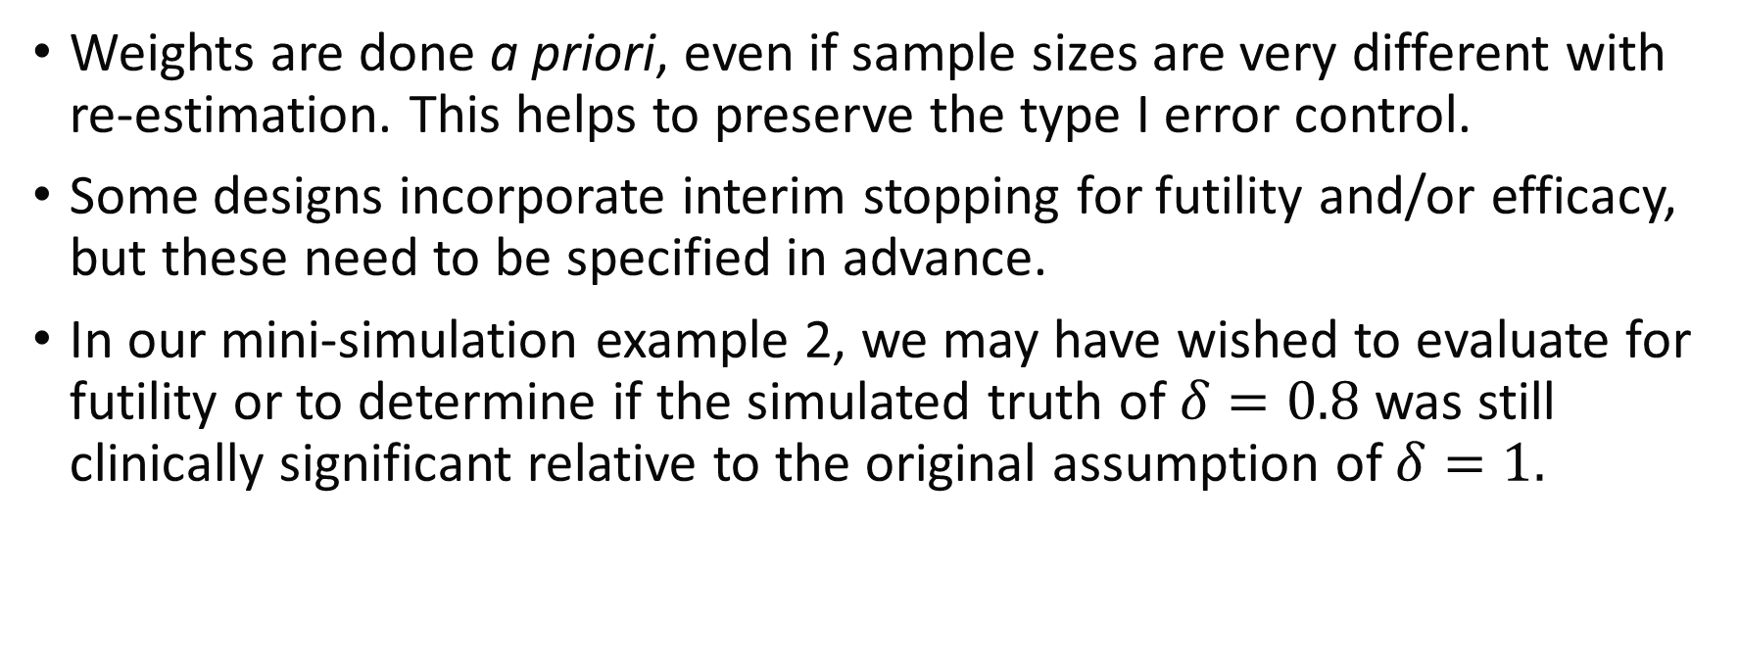
Combination Test Notes
Weights are done a priori, even if sample sizes are very different with re-estimation. This helps to preserve the type I error control.
Some designs incorporate interim stopping for futility and/or efficacy, but these need to be specified in advance.
In our mini-simulation example 2, we may have wished to evaluate for futility or to determine if the simulated truth of $δ=0.8$ was still clinically significant relative to the original assumption of $δ=1.$

Slide 42
Conditional Power/Predictive Power for Re-Estimation
It is also possible to use the frequentist conditional power or Bayesian predictive power (also called the predictive posterior probability of success or the probability of success (PPoS)) for re-estimation
At the interim analysis, the sample size needed to achieve a targeted conditional power is detected (e.g., via a grid search or other software)
These methods still require some form of correction for multiple testing (e.g., combination test for final inference)
As with any study design, operating characteristics can be evaluated via simulation studies

Slide 43
Case Studies

Slide 44
Clinical Trial: Sample Size Re-Estimation Example I
Name: Tenecteplase versus Alteplase before Endovascular Therapy for
Ischemic Stroke (EXTEND-IA TNK) (NCT02388061)
Design: multi-center, randomized, open-label, non-inferiority, blinded-outcome
Population: ischemic stroke within 4.5 hours after onset and eligible to undergo intravenous thrombolysis and endovascular thrombectomy
Purpose: compare intravenous tenecteplase with alteplase to evaluate non-inferiority, then potentially superiority, of tenecteplase

Slide 45
Clinical Trial: Sample Size Re-Estimation Example I
N: 120 based on initial power calculation for 80% power, but substantial uncertainty over participant disposition and prevalence of outcome
Randomization Ratio: 1:1
Primary Outcome: proportion of participants with restoration of blood flow to >50% of the affected arterial territory or absence of retrievable thrombus at initial angiogram
Re-Estimation Approach: blinded re-estimation

Slide 46
Clinical Trial: SSR Example I Conclusion
Blinded re-estimation approach implemented after enrollment of 100 participants
Re-estimated sample size was 202 participants to establish non-inferiority, a 68% increase from initial estimate of 120
Trial continued to enroll a total of 202 participants, 101 in each arm
Ultimately determined that tenecteplase (22% event rate) was non-inferior to alteplase (10% event rate)

Slide 47
Clinical Trial: Sample Size Re-Estimation Example II
Name: A Clinical Trial Comparing Cangrelor to Clopidogrel Standard of Care Therapy in Subjects Who Require Percutaneous Coronary Intervention (CHAMPION PHOENIX; NCT01156571)
Design: double-blind, placebo-controlled trial
Population: adults undergoing urgent or elective percutaneous coronary intervention (PCI)
Purpose: compare use of clopidogrel (SOC) with cangrelor (intervention)
Notes:
NEJM article: Bhatt, Deepak L., et al. "Effect of platelet inhibition with cangrelor during PCI on ischemic events." New England Journal of Medicine 368.14 (2013): 1303-1313.
Design article: Leonardi, Sergio, et al. "Rationale and design of the Cangrelor versus standard therapy to acHieve optimal Management of Platelet InhibitiON PHOENIX trial." American heart journal 163.5 (2012): 768-776.
FDA Statistical Reviews: https://www.accessdata.fda.gov/drugsatfda_docs/nda/2015/204958Orig1s000StatR.pdf

Slide 48
Clinical Trial: Sample Size Re-Estimation Example II
N: 10,900 to achieve 85% power, two-sided α=0.05 for event rates of 5.1% vs. 3.9% in study arms
Randomization Ratio: 1:1
Primary Outcome: composite of death, myocardial infarction, ischemia-driven revascularization, or stent thrombosis at 48 hours after randomization
Re-Estimation Approach: unblinded re-estimation after 70% enrolled, with included efficacy interim analysis

Slide 49
Clinical Trial: SSR Example II Conclusion
Unlinded re-estimation approach implemented after enrollment of 70% of study participants
Early stopping boundary crossed for efficacy, but DSMB recommended continuing to the planned sample size
Trial continued to enroll a total of 11,145 participants
Rate of the primary efficacy end point was 4.7% in the cangrelor group and 5.9% in the SOC clopidogrel group (adjusted odds ratio with cangrelor, 0.78; 95% confidence interval [CI], 0.66 to 0.93; P=0.005

Slide 50
Module Conclusions - I
Underpowered studies happen often and result in participant and resource waste
Re-estimation procedures can better use limited resources and increase likelihood of detecting an effect, if it exists
Blinded re-estimation methods have limited effect on type I error rate
Unblinded re-estimation methods may have a substantial effect on the type I error rate, potentially doubling the desired α-level, without using appropriate preplanned methods

Slide 51
Module Conclusions - II
Practical considerations should be considered and included in the protocol for how much of a sample size change would be feasible or possible (e.g., budget, timeframe, patient population, minimal effect size of interest, etc.)
Care should be taken in reporting interim results, since it may be possible to back-calculate the effect size if one knows general assumptions (resulting in an accidental unblinding)
Possible to combine re-estimation with stopping for futility, efficacy, or safety, as well as other adaptive methods
We only consider a small subset of methods, and more exist to explore and consider

Slide 52
References
Ciolino, Jody D., Alexander M. Kaizer, and Lauren Balmert Bonner. "Guidance on interim analysis methods in clinical trials." Journal of Clinical and Translational Science 7.1 (2023): e124.
Kaizer, Alexander M., et al. "Recent innovations in adaptive trial designs: a review of design opportunities in translational research." Journal of Clinical and Translational Science (2023): 1-35.
Proschan, Michael A. "Sample size re‐estimation in clinical trials." Biometrical Journal: Journal of Mathematical Methods in Biosciences 51.2 (2009): 348-357.
Baumann, Lukas, Maximilian Pilz, and Meinhard Kieser. "blindrecalc-An R Package for Blinded Sample Size Recalculation." R Journal 14.1 (2022).
Fleiss, Joseph L., Bruce Levin, and Myunghee Cho Paik. Statistical methods for rates and proportions. John Wiley & Sons, 2013.
Shih, Weichung Joseph, and Peng‐Liang Zhao. "Design for sample size re‐estimation with interim data for double‐blind clinical trials with binary outcomes." Statistics in Medicine 16.17 (1997): 1913-1923.
Campbell, Bruce CV, et al. "Tenecteplase versus alteplase before thrombectomy for ischemic stroke." New England Journal of Medicine 378.17 (2018): 1573-1582.
Bhatt, Deepak L., et al. "Effect of platelet inhibition with cangrelor during PCI on ischemic events." New England Journal of Medicine 368.14 (2013): 1303-1313.
Leonardi, Sergio, et al. "Rationale and design of the Cangrelor versus standard therapy to acHieve optimal Management of Platelet InhibitiON PHOENIX trial." American heart journal 163.5 (2012): 768-776.
US Food and Drug Administration. Adaptive designs for clinical trials of drugs and biologics guidance for industry. https://www.fda.gov/regulatory-information/search-fda-guidance-documents/adaptive-design-clinical-trials-drugs-and-biologics-guidance-industry

Slide 53

Contact Info:
Email:
alex.kaizer@cuanschutz.edu
Website: www.alexkaizer.com
GitHub: alexbiostats

