Slide 1
Adaptive and Bayesian Methods for Clinical Trial Design Short Course
Dr. Alex Kaizer
Introduction to Clinical Trials
Notes:
xx

Slide 2
Phases of the Translational Research Paradigm
Everyone has a place at the research table

Slide 3
The Translational Research Paradigm
T1 research explores basic research for clinical effect or applicability (sometimes split into T0 and T1)
T2 research uses controlled environments to test new interventions
T3 research attempts to identify how interventions work in real-world settings (beyond the controlled environment)
T4 research focuses on the health of populations with the intent to improve global health
Notes:
More information from: https://www.ctsi.umn.edu/about/what-we-do/what-translational-research

Slide 4
The Translational Research Paradigm cont.
Where might it be useful to have training in study design?
The answer:
Across the entire translational paradigm!!!

Slide 5
The Translational Research Paradigm cont.
T1 research explores basic research for clinical effect or applicability
Preclinical and animal studies
Human physiology studies
First in human (FIH) studies (with healthy volunteers)
Proof of concept studies
Phase I clinical trials
T2 research uses controlled environments to test new interventions
Phase II clinical trials
Phase III clinical trials
Notes:
More information from: https://www.ctsi.umn.edu/about/what-we-do/what-translational-research

Slide 6
The Translational Research Paradigm cont.
T3 research attempts to identify how interventions work in real-world settings (beyond the controlled environment)
Phase IV clinical trials
Health services research
Clinical outcomes research
T4 research focuses on the health of populations with the intent to improve global health
Population-level outcome studies
Social determinants of health
Notes:
More information from: https://www.ctsi.umn.edu/about/what-we-do/what-translational-research

Slide 7
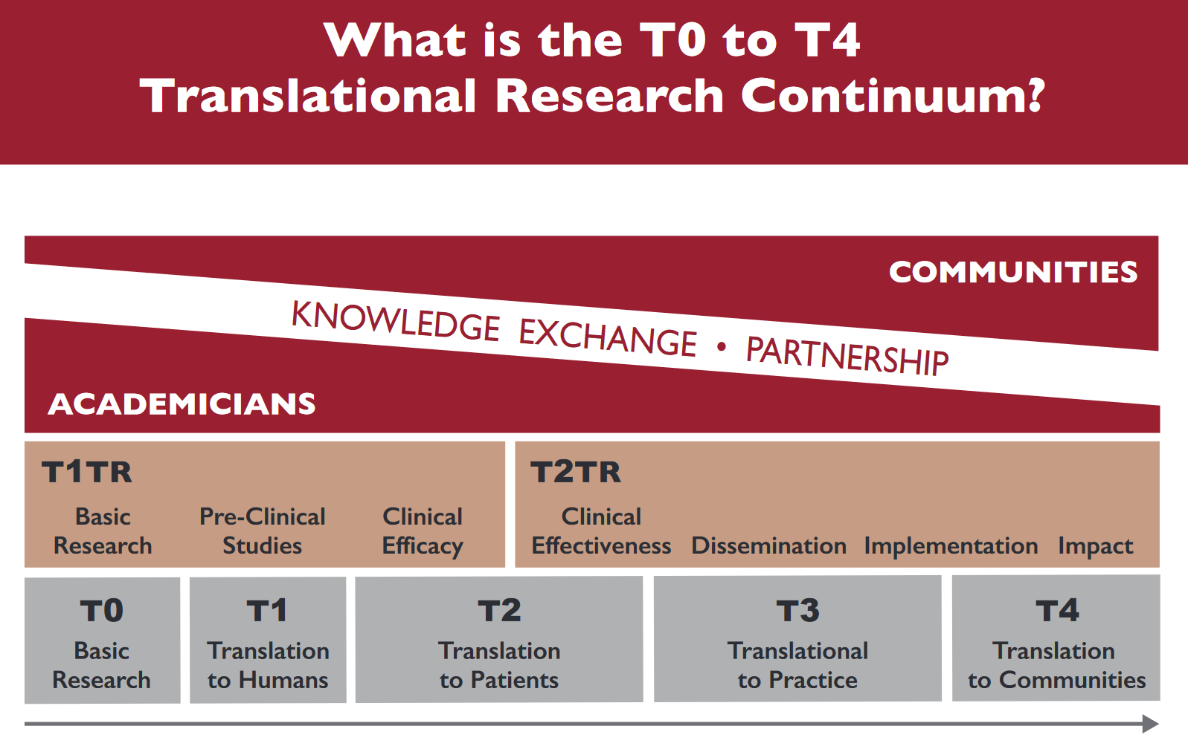
Source: UW Institute for Clinical and Translational Research
Notes:
Source: https://ictr.wisc.edu/what-are-the-t0-to-t4-research-classifications/

Slide 8
Study Design Overview
A quick run through of the basics of study designs

Slide 9
General Methods of Investigation
No planned concurrent comparison group
Chance observations
Case histories (individual cases and case series)
Uncontrolled trials of an intervention
Cross-sectional (naturalistic) studies
Case-control studies
Prospective follow-up studies
Randomized clinical trial

Slide 10
Overview of Study Designs
Randomized Controlled Trial
YES
Experimental Study
Random allocation?
NO
Non-Randomized Controlled Trial
YES
Did the investigator assign exposures?
Cohort Study
Exposure → Outcome
NO
Analytic Study
Case-Control Study
YES
Observational Study
Comparison group?
Exposure ← Outcome
NO
Descriptive Study
Cross-Sectional Study
Exposure & Outcome
at the same time

Slide 11
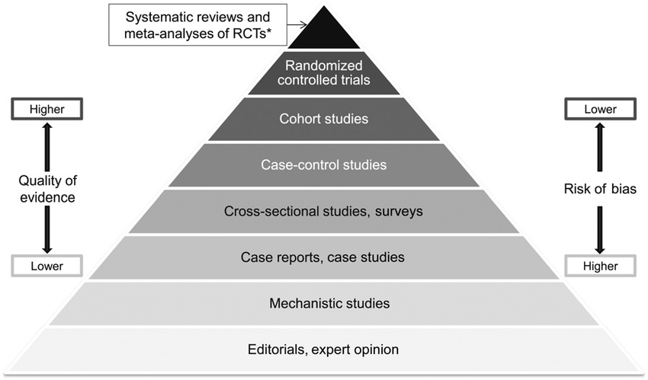
Hierarchies of Evidence
Coherence of evidence from multiple sources
Systematic review of well-designed, large randomized trials
Strong evidence from one large randomized trial
Systematic review of small trials (e.g., surrogate outcome studies)
Systematic review of from well-designed cohort studies
Strong evidence from one cohort study
Unsystematic observations (expert opinions)
Notes:
Text summary adapted from Devereaux PJ et al, Evidence-Based Cardiology, 2nd Edition, BMJ Books, 2003.
Image from Yetley, Elizabeth A., et al. "Options for basing Dietary Reference Intakes (DRIs) on chronic disease endpoints: report from a joint US-/Canadian-sponsored working group–." The American journal of clinical nutrition 105.1 (2016): 249S-285S.

Slide 12
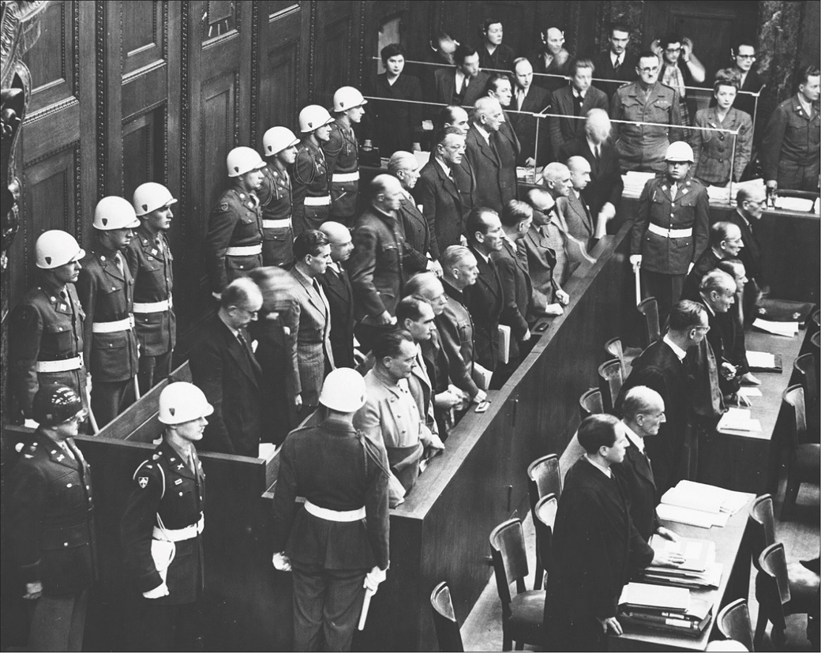
Ethical Guidelines for Research I
Nuremberg Code (1947): research ethics and principles resulting from the Nuremberg trials at the end of the Second World War
Helsinki Declaration (original 1964; revised multiple times, most recently 2013): a set of ethical principles for human experimentation developed by the World Medical Association, regarded as a cornerstone document for human research ethics
Notes:
Nuremberg Code: https://history.nih.gov/research/downloads/nuremberg.pdf
Helsinki Declaration: https://www.wma.net/what-we-do/medical-ethics/declaration-of-helsinki/
Nuremberg Trial image: https://www.thelancet.com/journals/lanonc/article/PIIS1470-2045(07)70381-9/fulltext?version=printerFriendly

Slide 13
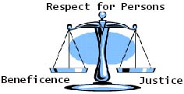
Ethical Guidelines for Research II
Belmont Report (1978): a US government report summarizing ethical principles and guidelines for research with human subjects, partly prompted by the Tuskegee Syphilis Study (1932-1972)
3 principles: respect for persons, beneficence (“do no harm”), justice
Guidelines from the government, hospitals, societies, etc. (HHS, FDA, Uniform Federal Policy)
Notes:
Belmont Report: https://www.hhs.gov/ohrp/regulations-and-policy/belmont-report/index.html
Principles image: http://www.northeastern.edu/research/hsrp/files/2012/07/scales.jpg

Slide 14
Introduction to Clinical Trials
An introduction to the focus of a majority of the short course

Slide 15
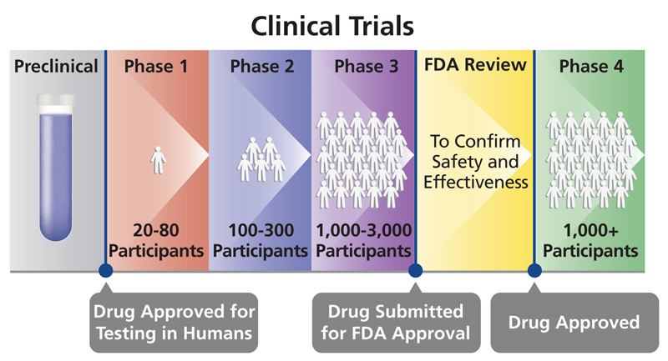
Randomized Clinical Trial
A prospective study in which the investigators determine who receives or does not receive the intervention by a random process
It should represent a carefully planned manipulation of a “natural” state
Notes:
Image: https://aidsinfo.nih.gov/understanding-hiv-aids/glossary/144/clinical-trial

Slide 16
Clinical Trial: Phases
Phase I: safety of the treatment/to identify the highest dose of the drug that can administered safely, usually in healthy individuals, no placebo
Phase II: efficacy of the treatment in cases (potentially healthy controls for an early comparison group), further describe safety
Phase III: comparing the safety and effectiveness of the treatment to the current standard treatment, promising results here may lead to FDA approval
Phase IV: surveillance of drugs already approved by the FDA to continue examining safety over time

Slide 17
“Types” of Clinical Trials (NIH)
Treatment trials test new treatments, new combinations of drugs, or new approaches to surgery or radiation therapy.
Prevention trials look for better ways to prevent a disease in people who have never had the disease or to prevent the disease from returning. Approaches may include medicines, vaccines, or lifestyle changes.
Screening trials test new ways for detecting diseases or health conditions.
Diagnostic trials study or compare tests or procedures for diagnosing a particular disease or condition.
Behavioral trials evaluate or compare ways to promote behavioral changes designed to improve health.
Quality of life trials explore and measure ways to improve the comfort and quality of life of people with conditions or illnesses.
Notes:
Text from NIH website: https://www.nih.gov/health-information/nih-clinical-research-trials-you/basics

Slide 18
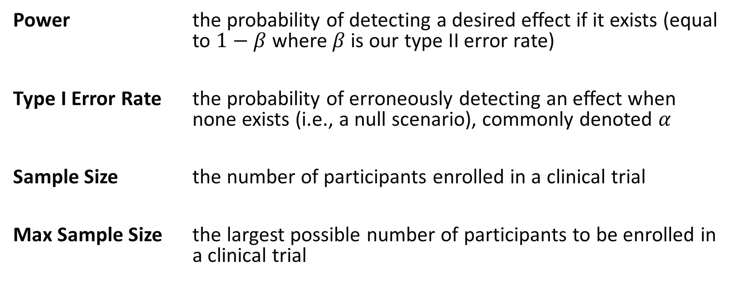
Clinical Trials Lexicon: (Frequentist) Trial Operating Characteristics
Power the probability of detecting a desired effect if it exists (equal to $1−β$ where $β$ is our type II error rate)
Type I Error Rate the probability of erroneously detecting an effect when none exists (i.e., a null scenario), commonly denoted $α$
Sample Size the number of participants enrolled in a clinical trial
Max Sample Size the largest possible number of participants to be enrolled in a clinical trial

Slide 19
Clinical Trials Lexicon: Documentation
Protocol The written description of a clinical study. It includes the study's objectives, design, and methods. It may also include relevant scientific background and statistical information.
Statistical Analysis Plan
(SAP) Provides specific information on the statistical analyses to be conducted. May also include planned or mock tables/listings/figures.

Slide 20
Clinical Trials Lexicon: Enrollment
Blinding/Masking Process of preventing someone from knowing their study allocation (e.g., single-blind often means participants do not know allocation, double-blind means research team also does not know)
Inclusion/Exclusion Criteria
Details included in the study protocol that identifies who is eligible to participate. May also be called Eligibility Criteria.

Slide 21
Clinical Trials Lexicon: Enrollment
Informed Consent A process used by researchers to communicate to potential and enrolled participants the risks and potential benefits of participating in a clinical study.
Informed Consent Form Document (may be physical or electronic) that records participants consent to participate in the study.

Slide 22
Clinical Trials Lexicon: Randomization
Randomization The process of prospectively assigning participants to study arms by chance instead of by choice.
Allocation Ratio The target ratio for randomization to study arms (e.g., 1:1 represents equal allocation to arms A and B, 2:1 indicates for 2 participants in A for every 1 in B, etc.).

Slide 23
Clinical Trials Lexicon: Study Arms
Study Arm Group of participants in a clinical trial to receive an intervention based on the study protocol.
Placebo An intervention that looks like the “new” or “active” treatment but without active ingredients.
Control Arm not receiving any intervention being studied.
Standard of Care (SOC) Arm receiving whatever intervention(s) are considered standard of care outside the study.

Slide 24
Clinical Trials Lexicon: Analysis Population
Intention to Treat (ITT) Includes all patients ever enrolled in their assigned treatment group regardless of treatment ultimately received.
Per Protocol (PP) Subgroup of participants who followed the protocol without “major” deviations.
Modified ITT (mITT) Subgroup of ITT that allows for pre-planned exclusion criteria set prior to enrollment (e.g., gold standard diagnosis delayed by 48 hours, only include those with positive test).
As Treated (AT) Treatment grouping based on whatever treatment(s) were received during the study.

Slide 25
Clinical Trials Lexicon: Outcomes
Primary The most important measure(s) in the study, specified in advance, often the basis for power calculations to estimate sample size.
Secondary Often pre-specified and limited in number, represent other important outcomes beyond the primary. May also be used or noted for potential statistical power and sample size justification.
Exploratory Additional questions of interest, may or may not be stated in advance, often are hypothesis generating.

Slide 26
Clinical Trials Lexicon: Outcomes
Co-Primary The presence of two (or more) primary outcomes, need to reject both null hypotheses for an intervention to be considered effective.
Composite An event that is considered to have occurred if any one of several different events or outcomes are observed (e.g., fatal or non-fatal stroke).
Notes:
Composite definition: Meinert CL. Clinical Trials Dictionary, 1996.

Slide 27
Clinical Trials Lexicon: Monitoring
Data Safety Monitoring Board (DSMB) A group of independent scientists who monitor the safety and scientific integrity of a clinical trial. May also be called a Data Monitoring Committee (DMC).
Interim Analysis A look at certain aspects of an ongoing trial; often pre-planned for DSMB meetings, making interim decisions, etc.

Slide 28
Clinical Trials Lexicon: Safety
Adverse Event An unfavorable change in the health of a participant, including abnormal laboratory findings, that happens during a clinical study or within a certain amount of time after the study has ended. This change may or may not be caused by the intervention/treatment being studied.
Serious AE AE that results in death, is life-threatening, requires inpatient hospitalization or extends a current hospital stay, results in an ongoing or significant incapacity or interferes substantially with normal life functions, or causes a congenital anomaly or birth defect.
Notes:
https://clinicaltrials.gov/study-basics/glossary

Slide 29
Clinical Trials Lexicon: Safety
Mild/Moderate/Severe AE Severity is not synonymous with seriousness, instead it classifies how the AE may interfere with normal activities and need for medical intervention.
Expected/Unexpected AE An AE is assessed for whether it is expected or unexpected based on current knowledge found in the protocol, consent form, investigator brochure, product label, etc.

Slide 30
Clinical Trials Lexicon: Efficacy vs. Effectiveness
Efficacy Treatment effect estimated under ideal conditions (e.g., a well-controlled clinical trial of a subset of the overall population). Comparison group is often a placebo.
Effectiveness Treatment effect estimated in more real-world settings with minimal control (e.g., a pragmatic trial). Comparison group is often usual care.
Notes:
https://www.ncbi.nlm.nih.gov/books/NBK44024/; https://www.nottingham.ac.uk/helmopen/rlos/ebp/rct/page_three.html

Slide 31
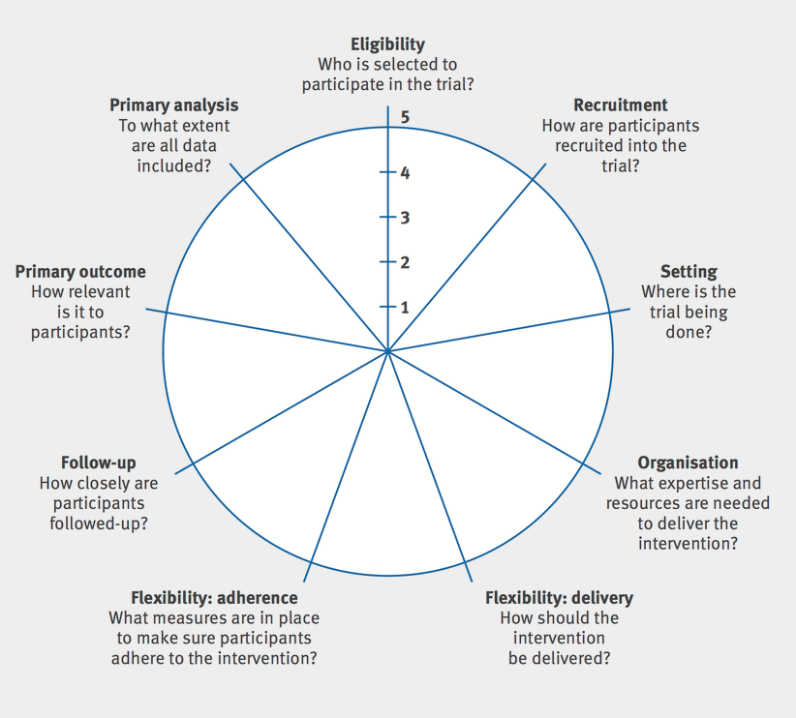
Clinical Trials Lexicon: Pragmatic
Pragmatic A study undertaken in a more “real-word” setting, measuring effectiveness of an intervention. The PRECIS-2 framework may be helpful to summarize how flexible a study is:
Source:
https://www.precis-2.org/
Notes:
https://www.precis-2.org/; https://www.bmj.com/content/350/bmj.h2147

Slide 32
Clinical Trials Lexicon: Estimands
Estimand Parameter in the population which is to be estimated in a statistical analysis
Estimator Approach/function for calculating an estimate of a given quantity based on observed data
Estimate Result of applying the estimator to observed data
Notes:
https://bookdown.org/paul/applied-causal-analysis/estimator.html

Slide 33
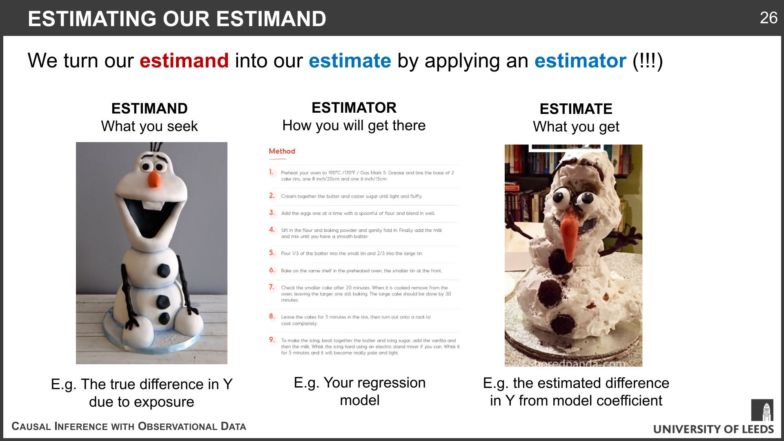
Clinical Trials Lexicon: Estimands
Source: @PWGTennant on X
Notes:
Image reference: https://x.com/PWGTennant/status/1164084443742691328/photo/1

Slide 34
Trial Reporting

Slide 35
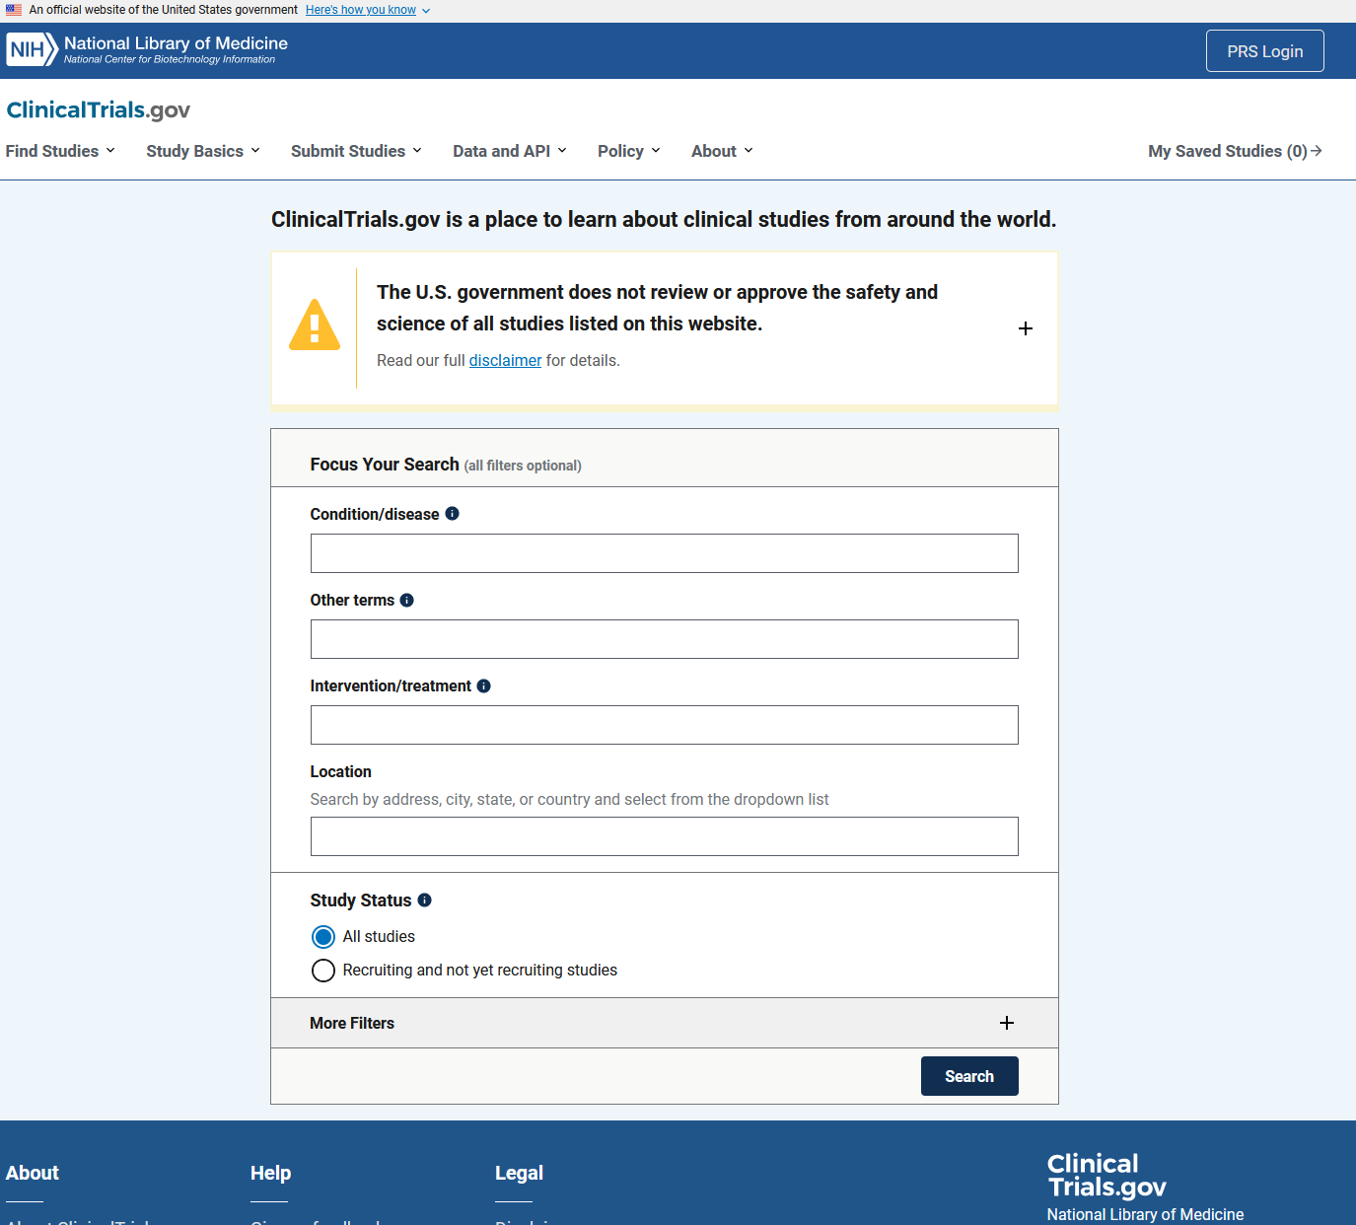
ClinicalTrials.gov
ClinicalTrials.gov allows you to search for existing/completed clinical trials
Also includes background and information on study design (e.g., “Study Basics” tab on the screenshot)
Required to submit your trial for most research projects

Slide 36





How to Report Your Data
CONsolidated Standard Of Reporting Trials (CONSORT) Group developed framework for randomized controlled trials to address challenge of inadequate reporting
STrengthening the Reporting of OBservational studies in Epidemiology (STROBE)
STAndards for the Reporting of Diagnostic accuracy studies (STARD)
STrengthening the REporting of Genetic Association studies (STREGA)
Preferred Reporting Items for Systematic reviews and Meta-Analyses (PRISMA)
Notes:
CONSORT Statement: http://www.consort-statement.org/
STROBE Statement: https://www.strobe-statement.org/index.php?id=strobe-home
Checkmark: https://s3.amazonaws.com/checkli.com/avatars/blue-check.png
Gene image: https://psmag.com/.image/t_share/MTI3NTgyNDE4Nzk3MzY5ODIy/dna-edit.jpg
PRISMA Statement: http://www.prisma-statement.org/

Slide 37

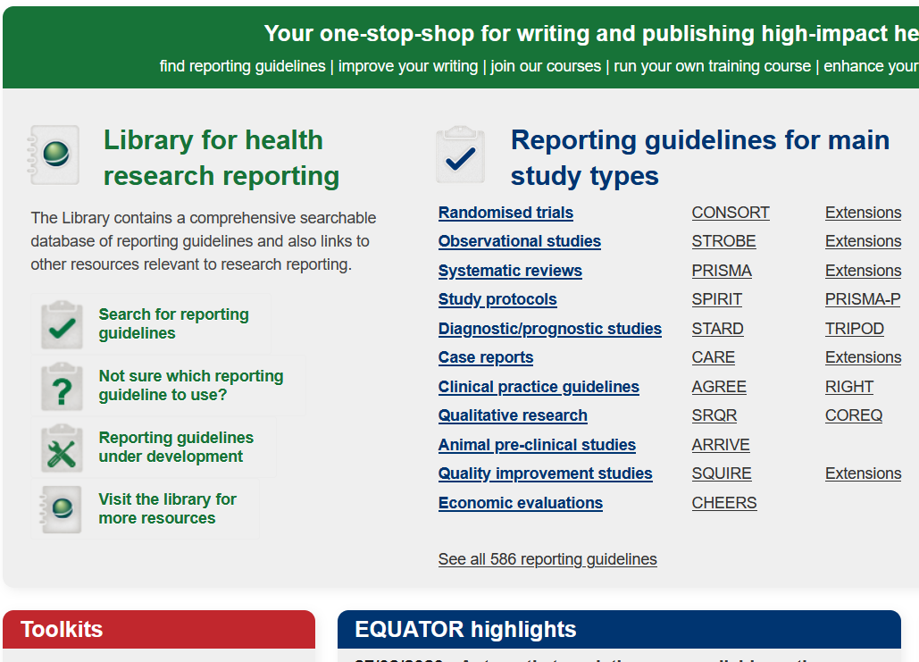
Where to get more information…
Enhancing the QUAlity and Transparent Of health Research
International initiative to promote transparency
http://www.equator-network.org/
!!!!!!!!!

Slide 38
CONSORT History
Initial statement came from concurrent, yet independent, meetings of
30 experts (medical journal editors, clinical trialists, methodologists) in Ottawa, Canada in 1993
Asilomar (California) Working Group on Recommendations for Reporting of Clinical Trials in Biomedical Literature
Drummond Rennie, Deputy Editor of JAMA, suggested the groups meet to combine their statements and checklists
The original CONSORT statement was published in 2001 and a revision was completed in 2010

Slide 39
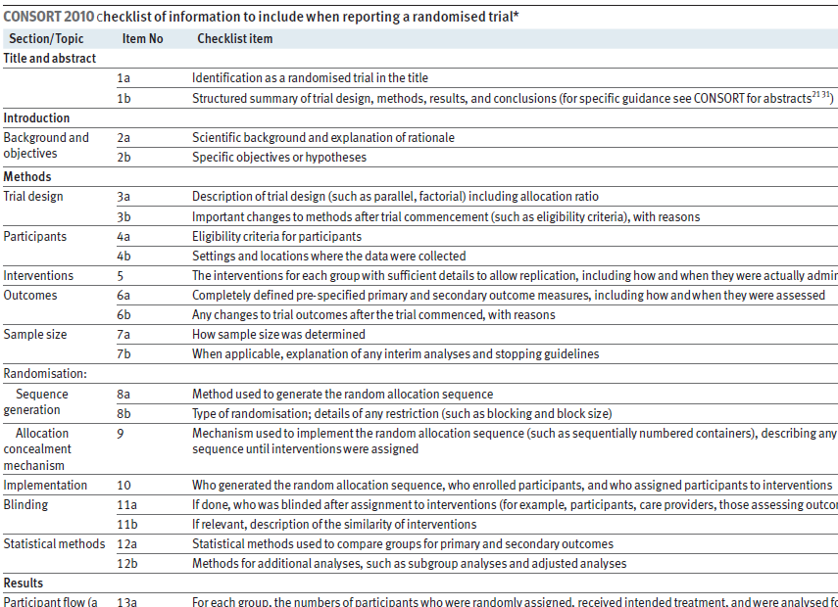
CONSORT Key Pieces: Checklist
25-item checklist to make sure you’ve included all important information in your article
Note: Their website is very interactive and provides free materials to use or modify as needed: http://www.consort-statement.org/consort-statement/checklist
Notes:
Schulz, Kenneth F., Douglas G. Altman, and David Moher. "CONSORT 2010 statement: updated guidelines for reporting parallel group randomised trials." BMC medicine 8.1 (2010): 18.

Slide 40
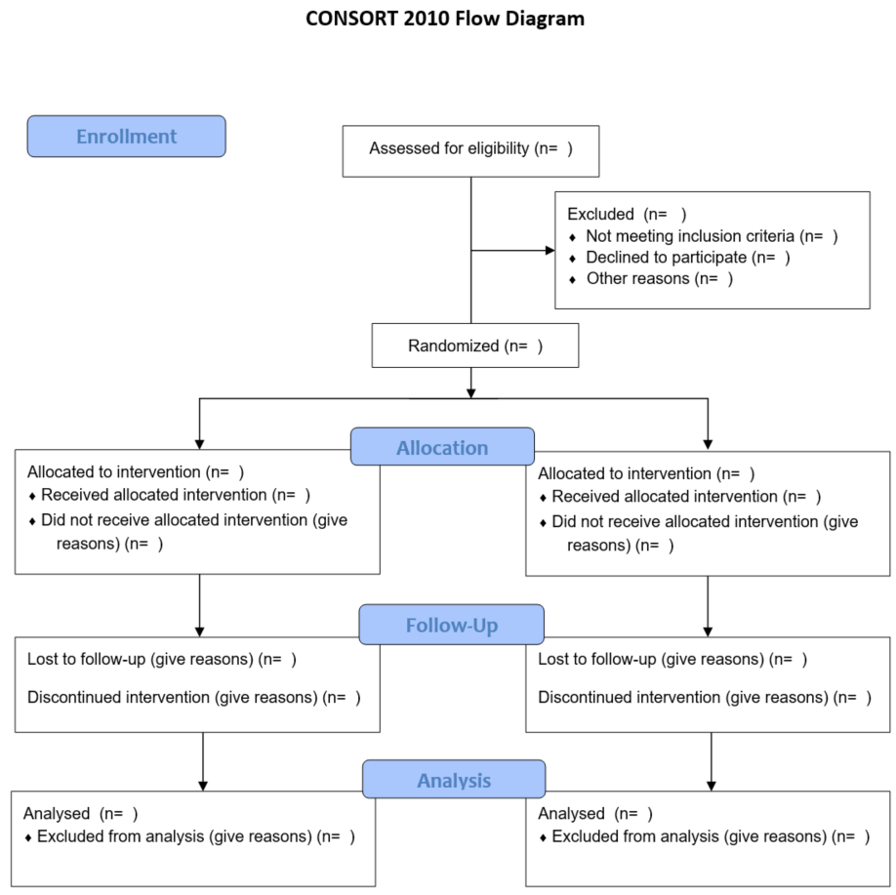
CONSORT Key Pieces: Flow Diagram
Common figure we saw in many trial examples throughout the course
Available on CONSORT website as PDF and MS Word file:
http://www.consort-statement.org/consort-statement/flow-diagram

Slide 41
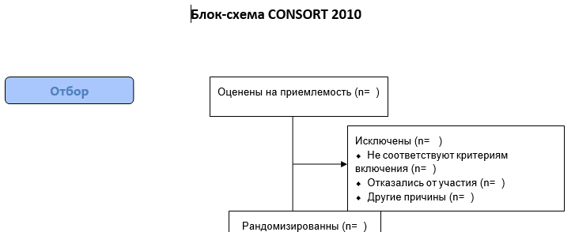
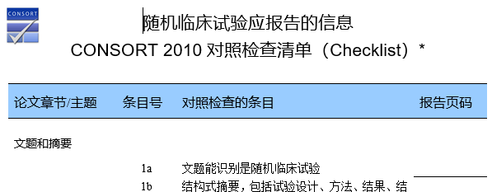
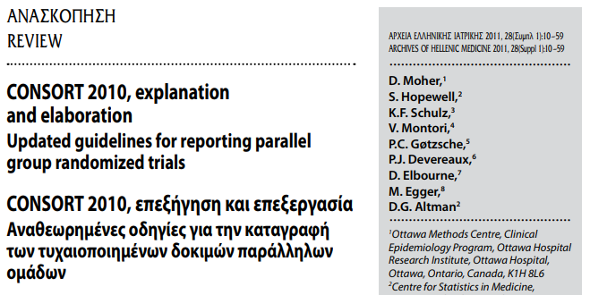
The Global Reach of CONSORT
CONSORT 2010 has been formally translated into 13 languages (for various components):
Chinese, French, German, Greek, Italian, Japanese, Persian, Polish, Portuguese, Russian, Spanish, Turkish, Vietnamese
Translations help to illustrate concern for appropriate reporting globally
Notes:
http://www.consort-statement.org/downloads/translations

Slide 42
CONSORT Extensions
Given the wide variety of trials and research, CONSORT has also produced extensions for special cases, such as
Chinese herbal medicine formulas
Herbal interventions
Acupuncture
Cluster trials
N-of-1 trials
Non-inferiority and equivalence trials
Pilot and feasibility trials
Pragmatic trials
Reporting harms in randomized trials
Notes:
http://www.consort-statement.org/downloads/extensions

Slide 43
Case Study

Slide 44
Clinical Trial: Example
Name: Aspirin Myocardial Infarction Study (AMIS) (no NCT, trial published 1991)
Design: multi-site, double-blind, placebo-controlled, secondary prevention
Population: men and women 30-69, able to take aspirin, had at least one previously documented MI
Purpose: to determine whether regular use of aspirin resulted in a reduction in 3-year mortality among patients who had at least one documented MI
Notes:
Manson, JoAnn E., et al. "A prospective study of aspirin use and primary prevention of cardiovascular disease in women." Jama 266.4 (1991): 521-527.

Slide 45
Clinical Trial: Example
N: 4524
Randomization Ratio: 1:1
Primary Outcome: total mortality (expect most deaths are due to cardiovascular disease), need at least 3 years of follow-up from start of study
Notes:
Manson, JoAnn E., et al. "A prospective study of aspirin use and primary prevention of cardiovascular disease in women." Jama 266.4 (1991): 521-527.

Slide 46
Clinical Trial: AMIS Characteristics
Covariate | Aspirin (N=2267) | Placebo (N=2257)
Men (%) | 88.4 | 89.4
White (%) | 91.7 | 91.5
SBP (mmHg) | 127.9 | 128.2
Cholesterol (μ mol/l) | 6.1 | 6.1
Age (years) | 54.8 | 54.8
Smoker (%) | 27.5 | 27.2
Number of MI’s | 1.2 | 1.2

Slide 47
Clinical Trial: AMIS Conclusions
No beneficial effect of aspirin…
In this population (at least one previous MI)
At this dose
When given for (only) 3 years
On total mortality (there was some reduction in non-fatal MI and stroke found in their study)
Final recommendation: “Aspirin is not recommended for routine use in patients who have survived an MI.”

Slide 48
Module Conclusions
Many study designs exist, in this course we focus on clinical trials
Studies are needed across the translational spectrum
Clinical trials have their own lexicon that is helpful to know

Slide 49
References
Meinert, Curtis L. Clinical trials dictionary: terminology and usage recommendations. John Wiley & Sons, 2012.
Schulz, Kenneth F., Douglas G. Altman, and David Moher. "CONSORT 2010 statement: updated guidelines for reporting parallel group randomised trials." Journal of Pharmacology and pharmacotherapeutics 1.2 (2010): 100-107.
Loudon, Kirsty, et al. "The PRECIS-2 tool: designing trials that are fit for purpose." BMJ 350 (2015).
Manson, JoAnn E., et al. "A prospective study of aspirin use and primary prevention of cardiovascular disease in women." Jama 266.4 (1991): 521-527.

Slide 50

Contact Info:
Email:
alex.kaizer@cuanschutz.edu
Website: www.alexkaizer.com
GitHub: alexbiostats

