Slide 1
Adaptive and Bayesian Methods for Clinical Trial Design Short Course
Dr. Alex Kaizer
A Crash Course in Bayesian (Bayes 101)
Notes:
xx

Slide 2
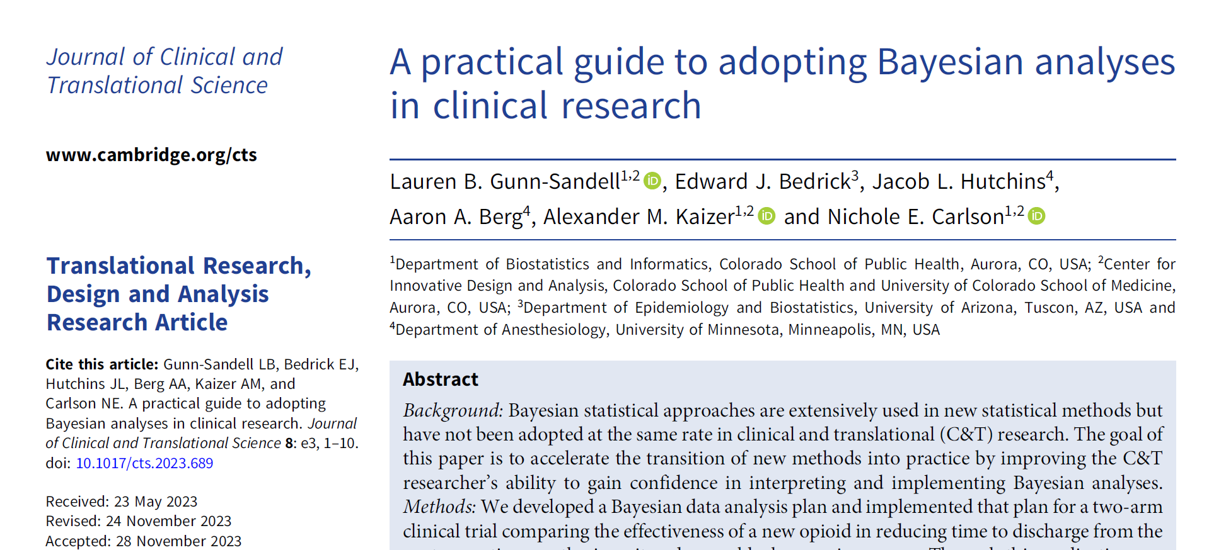
Paper Reference

Slide 3
Paper Motivation
Increase access and interest in the use of Bayesian methods
Introduce Bayesian concepts and contrast with frequentist approaches
Provide coding examples in R, SAS, and Stata
Use a previously completed clinical trial to illustrate how to implement and interpret the Bayesian analysis for both linear and logistic regression

Slide 4
Why Bayes?
Ability to integrate prior assumptions and knowledge
Interpretation of many summaries are more natural (e.g., posterior probabilities and credible intervals)
Usefulness in adaptive clinical trial designs
Methods to incorporate historic data through information sharing
Potential for more stable estimation properties in complex modeling problems

Slide 5
Where be the Bayes?
While Bayesian statistical methods papers have increased 30% from 2010 to 2020, there was only a 1.8% increase in clinical journals. This may be due to:
Bayesian methods not traditionally taught in intro courses
Need for prior specification (can be tricky!)
Perception as more complex than frequentist approaches

Slide 6
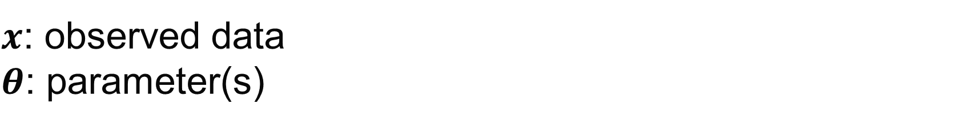
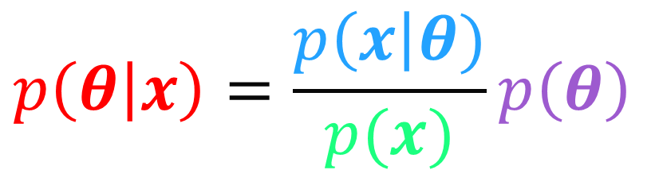
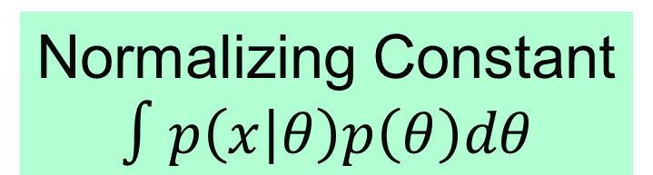
Bayes Overview
$x$: observed data
$θ$: parameter(s)
Likelihood
$$p\left(θ | x\right)=\frac{p\left(x\right|θ)}{p(x)}p\left(θ\right)$$
Posterior
Prior
Normalizing Constant
$$∫p\left(x | θ\right)p\left(θ\right)dθ$$

Slide 7
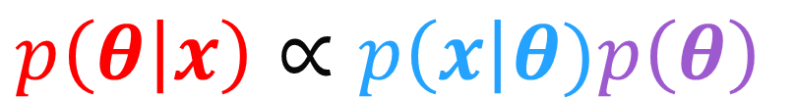
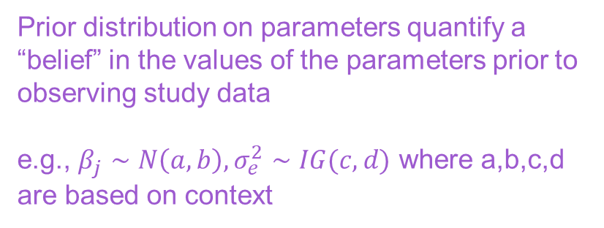
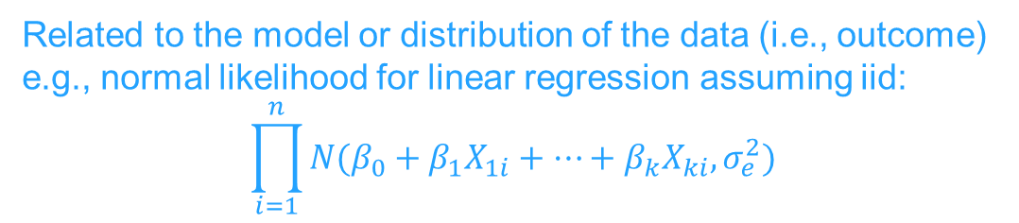
Bayes Overview
Related to the model or distribution of the data (i.e., outcome)
e.g., normal likelihood for linear regression assuming iid:
$$\prod_{i=1}^{n}{N(β_{0}+β_{1}X_{1i}+…+β_{k}X_{ki}, σ_{e}^{2})}$$
$x$: observed data
$θ$: parameter(s)
Likelihood
Posterior
$$p\left(θ | x\right)∝p\left(x\right|θ)p\left(θ\right)$$
Prior
Expresses uncertainty in the parameter(s) after observing the data and incorporating priors
Commonly summarized by its mean, median, or mode; probability; and credible interval from the Markov Chain Monte Carlo (MCMC) chain(s)
Prior distribution on parameters quantify a “belief” in the values of the parameters prior to observing study data
e.g., $β_{j}∼N\left(a,b\right), σ_{e}^{2}∼IG(c,d)$ where a,b,c,d are based on context

Slide 8
Bayesian vs. Frequentist Concepts
Frequentist | Bayesian
P-value (p): the probability of obtaining a test result at least as extreme as the result observed, assuming the null hypothesis is true | Posterior probability (PP): the probability of the event occurring given our observed data and prior information [it means what you think it means]
95% confidence interval (CI): we are 95% confident that the true parameter falls in this interval OR the long-run proportion of CIs that theoretically contain the true value of the parameter | 95% credible interval (CrI): there is a 95% probability that the true estimate would lie within the interval [however, there are multiple ways to approach this calculation such as highest posterior density (HPD) and equal-tailed]
Treats CI bounds as random variables and the parameter as a fixed value | Treats CrI bounds as fixed and the estimated parameter as a random variable
Conditional power: probability of rejecting the null hypothesis at the final analysis, given the current data | Predictive probability [of success]: the result of averaging the conditional power over the posterior distribution of the effect size

Slide 9
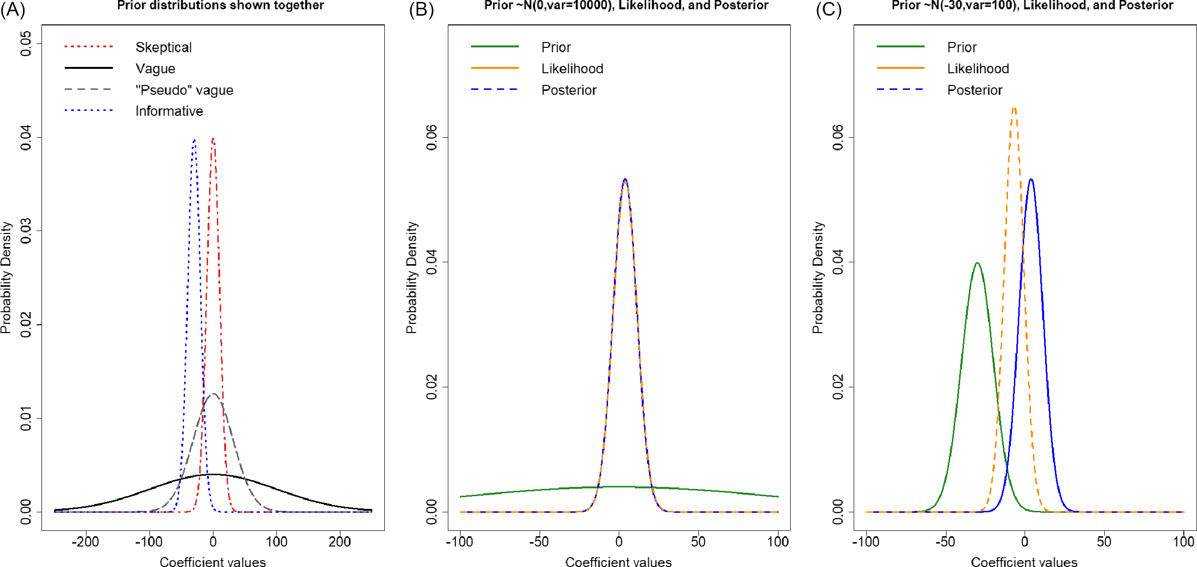
Priors
Prior distributions on the parameters quantify a belief in the parameter values
In linear and logistic regression we place a prior on each beta coefficient
For example, a treatment effect prior with a mean of 0 indicates a prior belief of no difference
Priors have different “strengths” of information
Should specify multiple priors to evaluate for sensitivity analyses

Slide 10
Posterior Estimation
The posterior is used to estimate our parameter(s) of interest and conduct any statistical inference
In many cases the posterior is not a known distribution that can be mathematically derived, instead we must use algorithms (e.g., Markov Chain Monte Carlo methods) to sample from this distribution

Slide 11

Markov Chain Monte Carlo (MCMC)
In Bayesian analyses, posterior is rarely known or closed form
Instead, we can use MCMC algorithms to simulate samples from the posterior distribution
Numerous algorithms have been proposed (e.g., 42 different ones in LaplacesDemon R package →)

Slide 12
MCMC cont.
Many software packages (e.g., PROC MCMC in SAS, brms in R) include default MCMC algorithms to avoid users having to code their own
Output from MCMC algorithms are usually rectangular datasets with a column for each chain and a row for each iteration
Chains are separate instances of the MCMC algorithm, often with different initial values
Burn-in periods are the first “X” of each chain discarded to provide time for convergence

Slide 13
MCMC Diagnostics
While not the focus of this talk, we note a few diagnostic tools:
Trace plots
Autocorrelation plots
Density plots
Numerical diagnostics
Major goal is to assess whether simulation converged to the posterior distribution or if changes need to be made

Slide 14
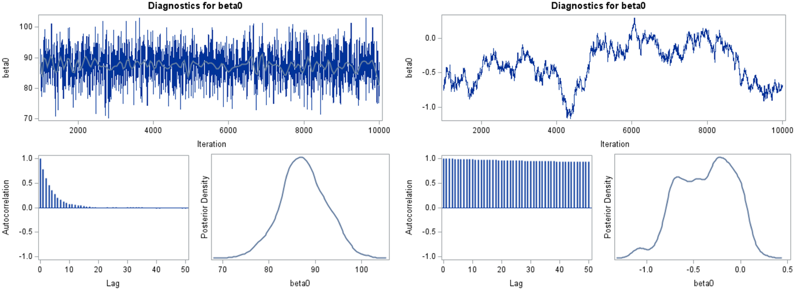
MCMC Convergence
Example of Good MCMC Performance
Example of Suboptimal MCMC Performance

Slide 15

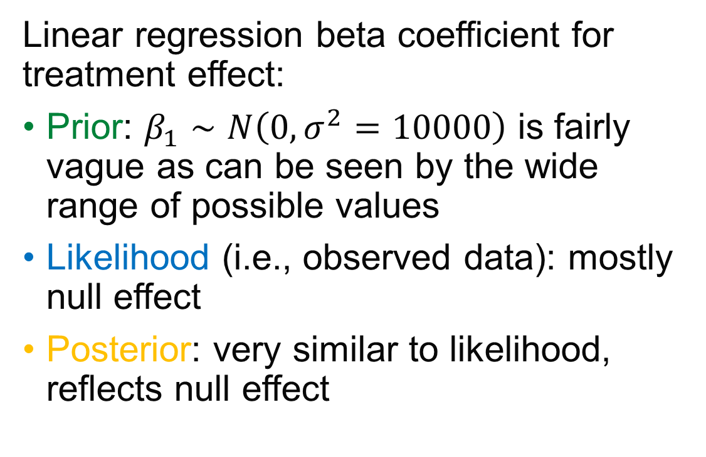
Prior, Likelihood, and Posterior - I
Linear regression beta coefficient for treatment effect:
Prior: $β_{1}∼N\left(0,σ^{2}=10000\right)$ is fairly vague as can be seen by the wide range of possible values
Likelihood (i.e., observed data): mostly null effect
Posterior: very similar to likelihood, reflects null effect

Slide 16
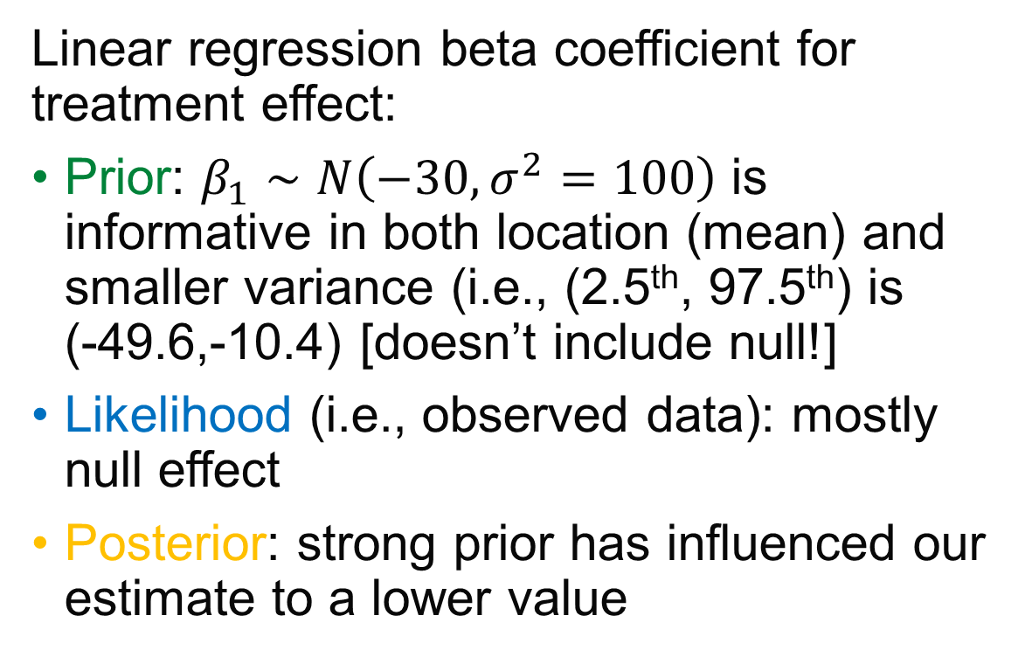
Prior, Likelihood, and Posterior - II
Linear regression beta coefficient for treatment effect:
Prior: $β_{1}∼N\left(−30,σ^{2}=100\right)$ is informative in both location (mean) and smaller variance (i.e., (2.5th, 97.5th) is (-49.6,-10.4) [doesn’t include null!]
Likelihood (i.e., observed data): mostly null effect
Posterior: strong prior has influenced our estimate to a lower value

Slide 17
JCTS Data Illustration
Small clinical trial from anesthesiologist collaborators
Comparing sublingual sufentanil to standard of care IV fentanyl
75 total randomized, but we use the 66 per protocol population to illustrate the analysis (and to avoid duplicating past work)
Continuous outcome of time to readiness for discharge after arrival in the post-anesthesia care unit (minutes)
Categorical outcome of preoperative nerve block used

Slide 18
Per Protocol Table 1
 | Drug Group
Factor | Sublingual Sufentanil, n=33 | Fentanyl, n=33
Sex, Female, N (%) | 20 (60.6) | 17 (51.5)
Preoperative nerve block, Yes, N (%) | 6 (18.2) | 10 (30.3)
Time to readiness for discharge after arrival in PACU, mean (SD) | 98.1 (31.7) | 94.4 (29.0)
Procedure length (minutes), mean (SD) | 57.0 (41.6) | 84.6 (54.3)

Slide 19
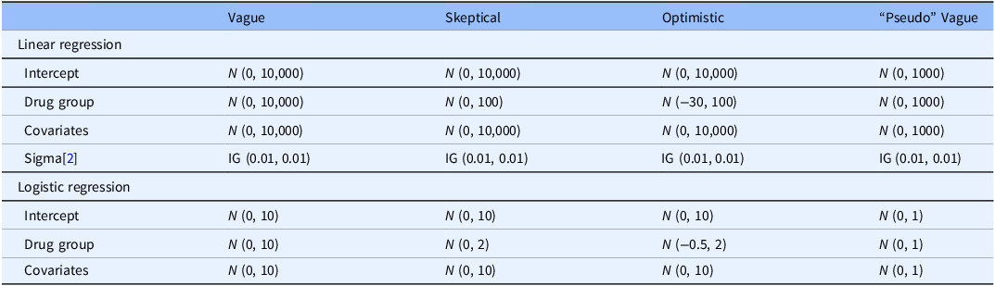
Priors Explored
Explored a range of priors:
Vague (e.g., large variances)
Skeptical (e.g., smaller variance for treatment group)
Optimistic (e.g., smaller variance for treatment group and mean specified at power calculation)
“Pseudo” Vague (e.g., not as vague as one may think for the intercept)

Slide 20
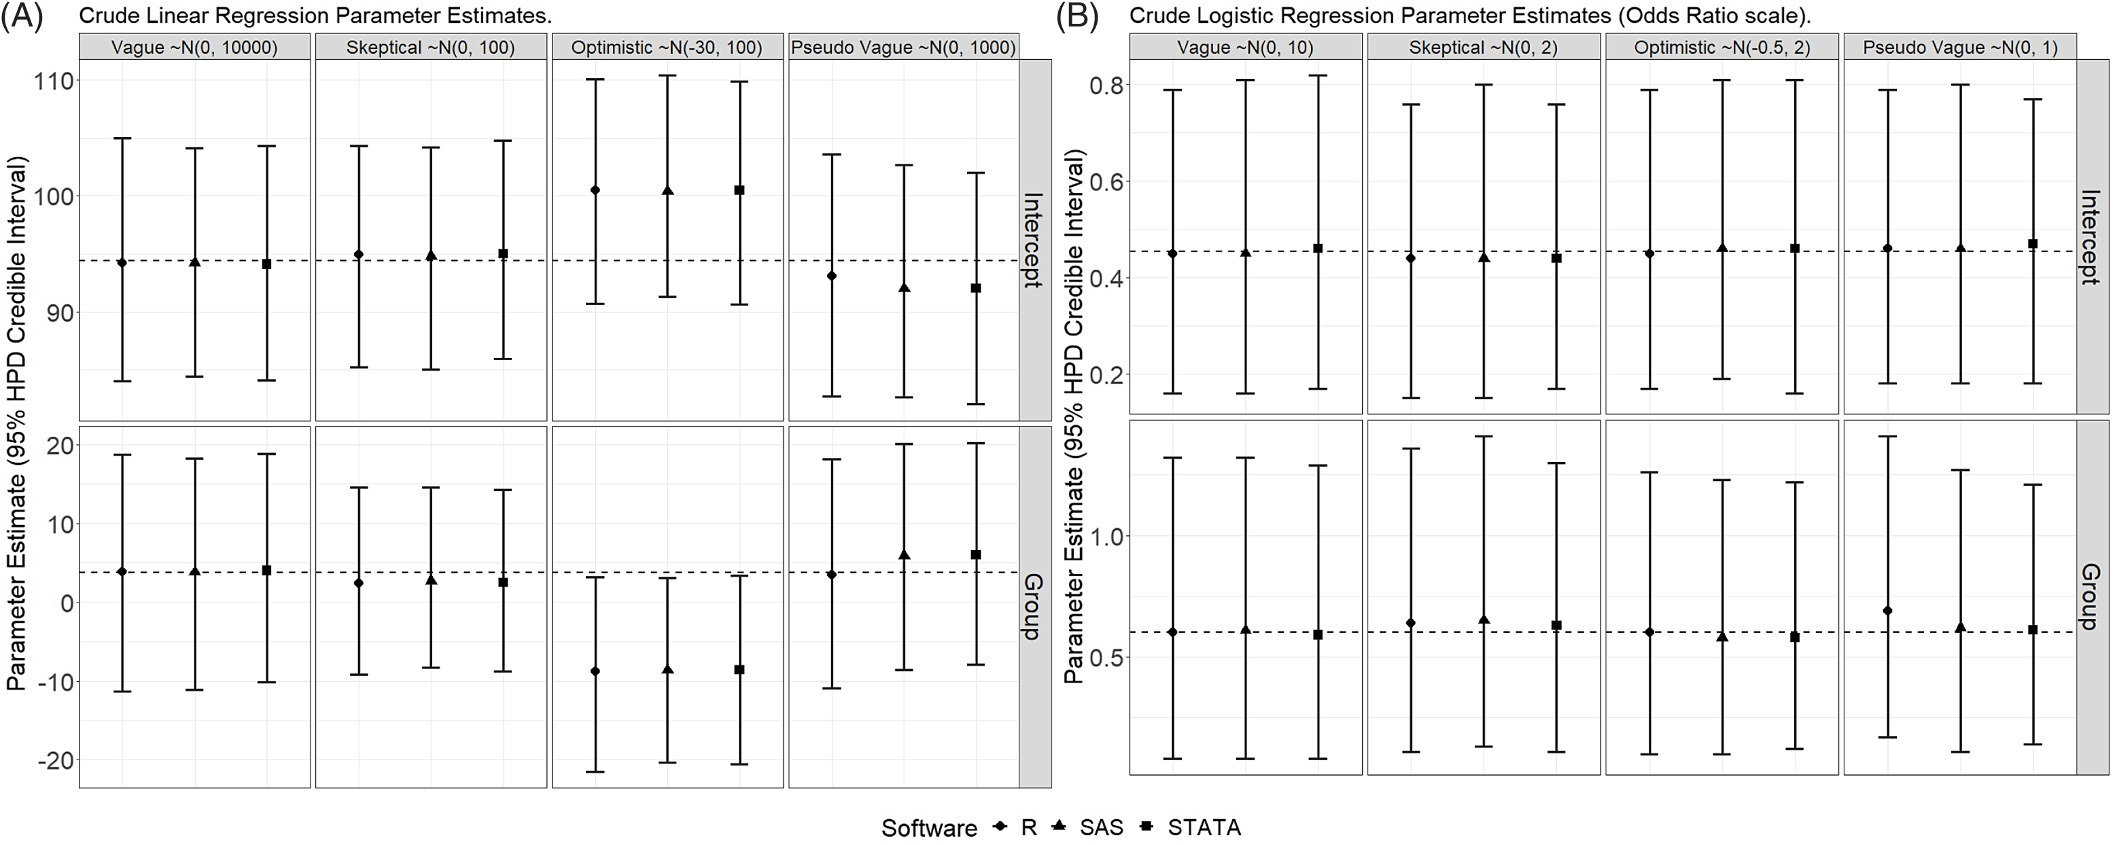
Time to Readiness Results
Dashed line is frequentist estimate
SAS Vague Prior Interpretation:
Those in the sublingual sufentanil group had on average a 3.8 minute longer time to readiness for discharge compared to the fentanyl group (95% HPD CrI: −11.1, 18.2).
The posterior probability of a decrease in time to readiness for discharge was 29.7% indicating there is not a high posterior probability that the new drug reduces the outcome.

Slide 21
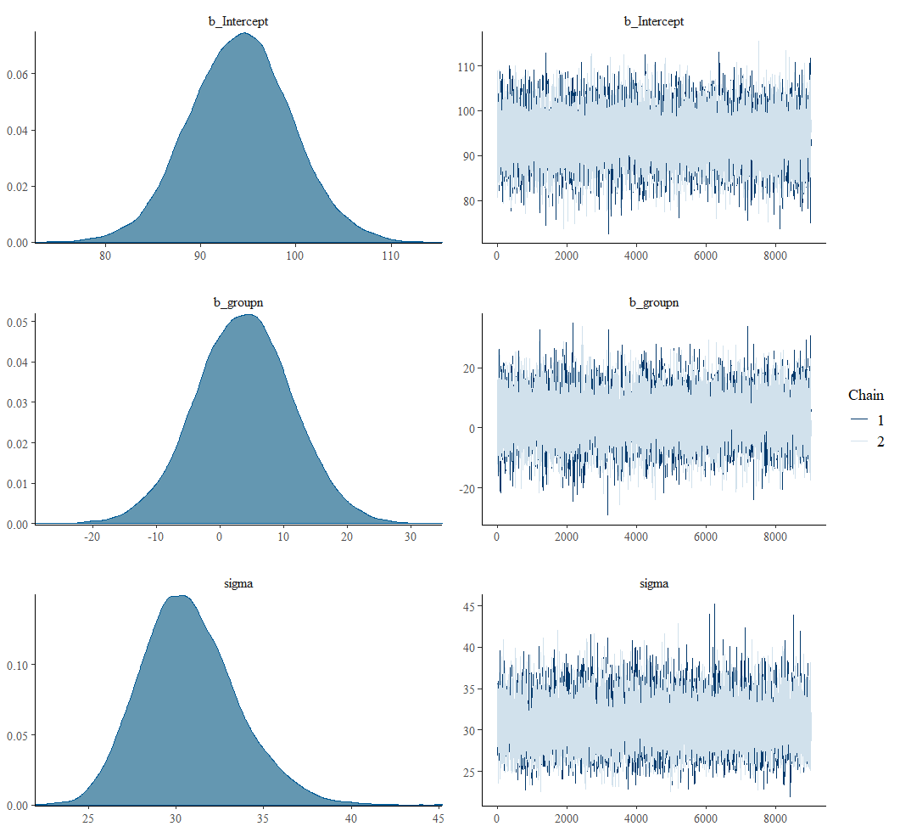
RStan Diagnostics, Vague Prior
Good mixing of MCMC chains (2 here)
Posterior density plots look largely unimodal

Slide 22
Preop Nerve Block Results
Dashed line is frequentist estimate
SAS Vague Prior Interpretation:
Sublingual sufentanil reduced the odds of preoperative nerve block by 39% on average (Posterior Mean OR: 0.61, 95% HPD CrI: 0.08, 1.32).
The posterior probability that sublingual sufentanil reduced the odds of preoperative nerve block was 87.5%, a high posterior probability that the new drug reduces the odds of the outcome.

Slide 23
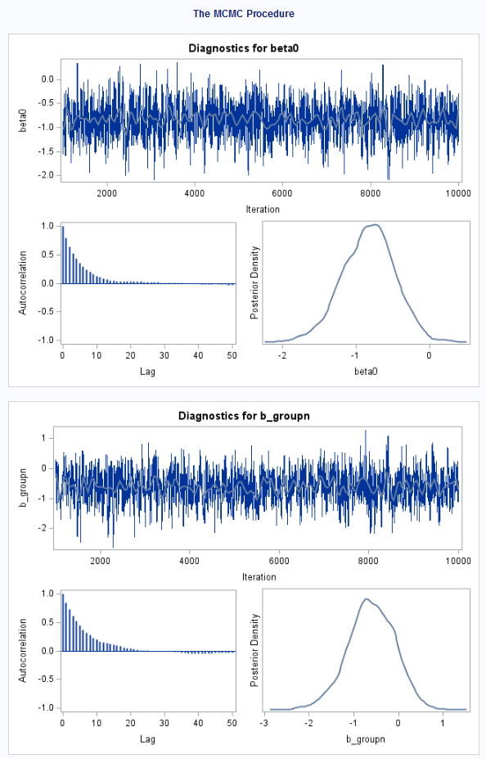
SAS/Stata Diagnostics, Vague Prior
Good mixing of chain(s in Stata)
Posterior density plots look largely unimodal
Autocorrelation (lag) decreases quickly

Slide 24
Checklist: Statistical Components to Include in Bayesian Data Analysis Plan (Table 2)
The outcome, primary variable of interest, and covariates with labels as to their function as adjustment for confounding, precision variables, or mediators, etc.
Regression modeling framework being used (linear regression, logistic regression, or other).
Prior distribution with parameters; a description of non-informative to informative and a justification for the selection when appropriate; multiple priors should be investigated over a range of assumptions regarding a priori beliefs about the values of the parameters.
Package and software version with specifics about the MCMC algorithm used.
Chain/iteration length and number, burn-in, and thinning if used.
Parameter initialization values.
Assessment(s) of convergence.
Description of how posteriors will be summarized.

Slide 25
Case Study

Slide 26
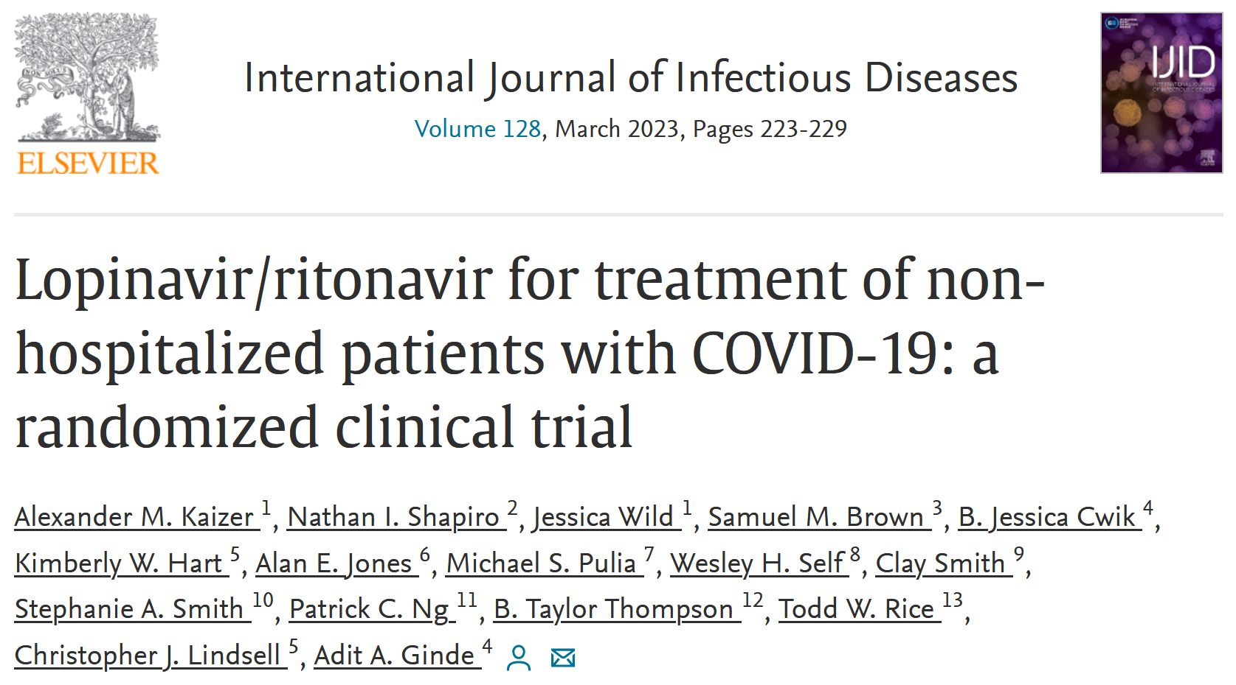
Example of More Complex Analysis

Slide 27
Motivation: COVID-19
Declared a global pandemic by the World Health Organization in March 2020
Need to identify potential interventions (both novel and existing drugs for other conditions)
Many unknowns in 2020 when study was designed (planning April 2020, first patient enrolled June 2020)
Continual evolution of new variants

Slide 28
Clinical Trial: Bayesian Example
Name: TRial of Early Antiviral Therapies during Non-hospitalized Outpatient Window (TREAT NOW; NCT04372628)
Design: multi-center, double-blind, randomized, placebo-controlled, decentralized trial; initial design as a platform trial
Population: outpatient treatment of adults with COVID-19 within 7 days of positive test
Purpose: compare existing anti-viral therapies to a placebo arm to identify if any are effective in treating COVID-19; initial anti-viral therapies included lopinavir/ritonavir and hydroxychloroquine

Slide 29
Clinical Trial: Bayesian Example
N: 300 per arm
Randomization Ratio: 1:1 (equal allocation across all arms)
Primary Outcome: daily ordinal scale over 15 days:
Not hospitalized without symptoms nor limitation in activity
Not hospitalized with symptoms but no limitation in activity
Not hospitalized with symptoms and limitation in activity
Hospitalized not on supplemental oxygen
Hospitalized on supplemental oxygen
Hospitalized on mechanical ventilation or ECMO
Death

Slide 30
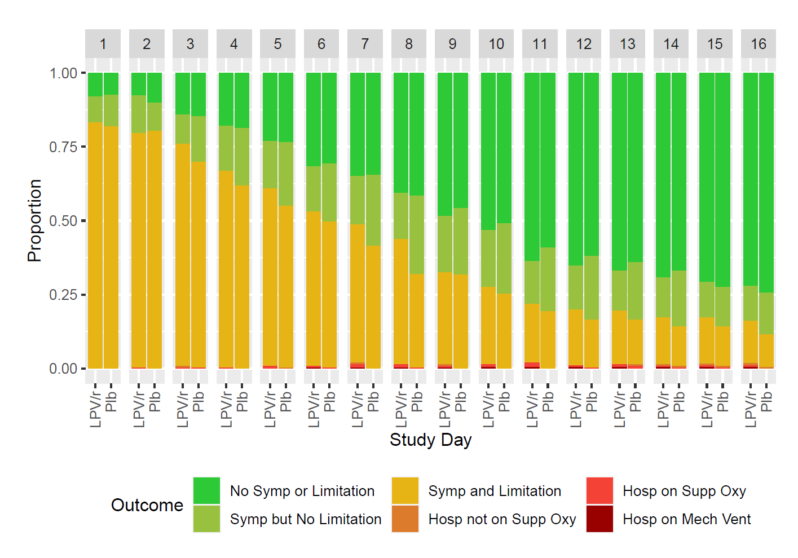
Primary Outcome

Slide 31
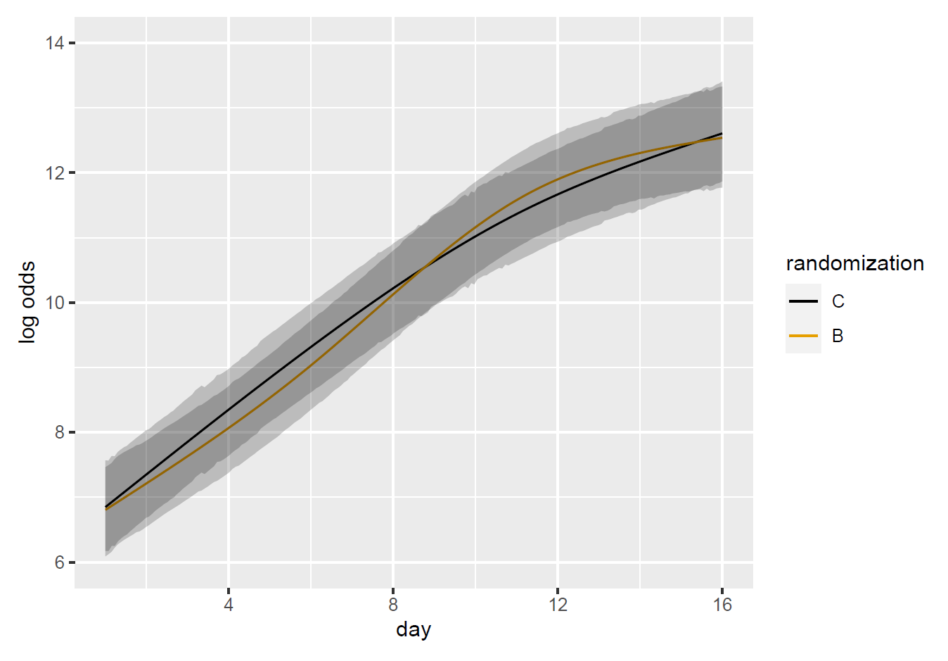
Primary Outcome Conclusion
Analysis implemented in brms package in R
Figure shows benefit for control (C) versus lopinavir/ritonavir (B)
Final trial results after stopping early for futility:
Unadjusted OR=0.956 (95% CrI: 0.656, 1.411)

Slide 32
Module Conclusions
JCTS paper meant to be hands-on guide with code examples of how to implement Bayesian approaches to translational research projects
TREAT NOW showed example of a more complex trial with Bayesian methods and primary form of analysis
In many cases, Bayesian and frequentist methods are not that different but important philosophical differences exist

Slide 33
References
Gunn-Sandell, Lauren B., et al. "A practical guide to adopting Bayesian analyses in clinical research." Journal of Clinical and Translational Science 8.1 (2024): e3.
Kaizer, Alexander M., et al. "Trial of Early Antiviral Therapies during Non-hospitalized Outpatient Window (TREAT NOW) for COVID-19: a summary of the protocol and analysis plan for a decentralized randomized controlled trial." Trials 23.1 (2022): 273.
Kaizer, Alexander M., et al. "Lopinavir/ritonavir for treatment of non-hospitalized patients with COVID-19: a randomized clinical trial." International Journal of Infectious Diseases 128 (2023): 223-229.

Slide 34

Contact Info:
Email:
alex.kaizer@cuanschutz.edu
Website: www.alexkaizer.com
GitHub: alexbiostats

