Slide 1
Adaptive and Bayesian Methods for Clinical Trial Design Short Course
Dr. Alex Kaizer
Interim Monitoring for Efficacy/Futility/Safety
Notes:
xx

Slide 2
Some Background and Logistics
Some of the practical considerations

Slide 3
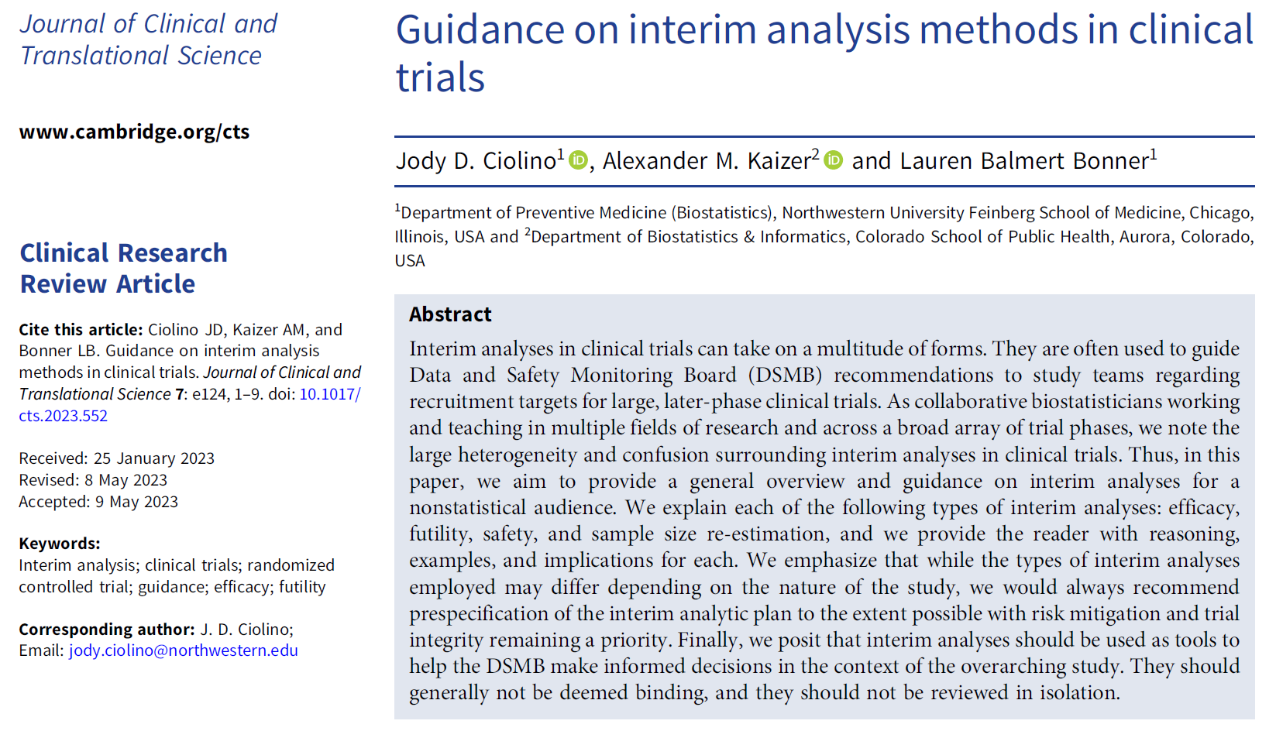
Overview Paper:

Slide 4
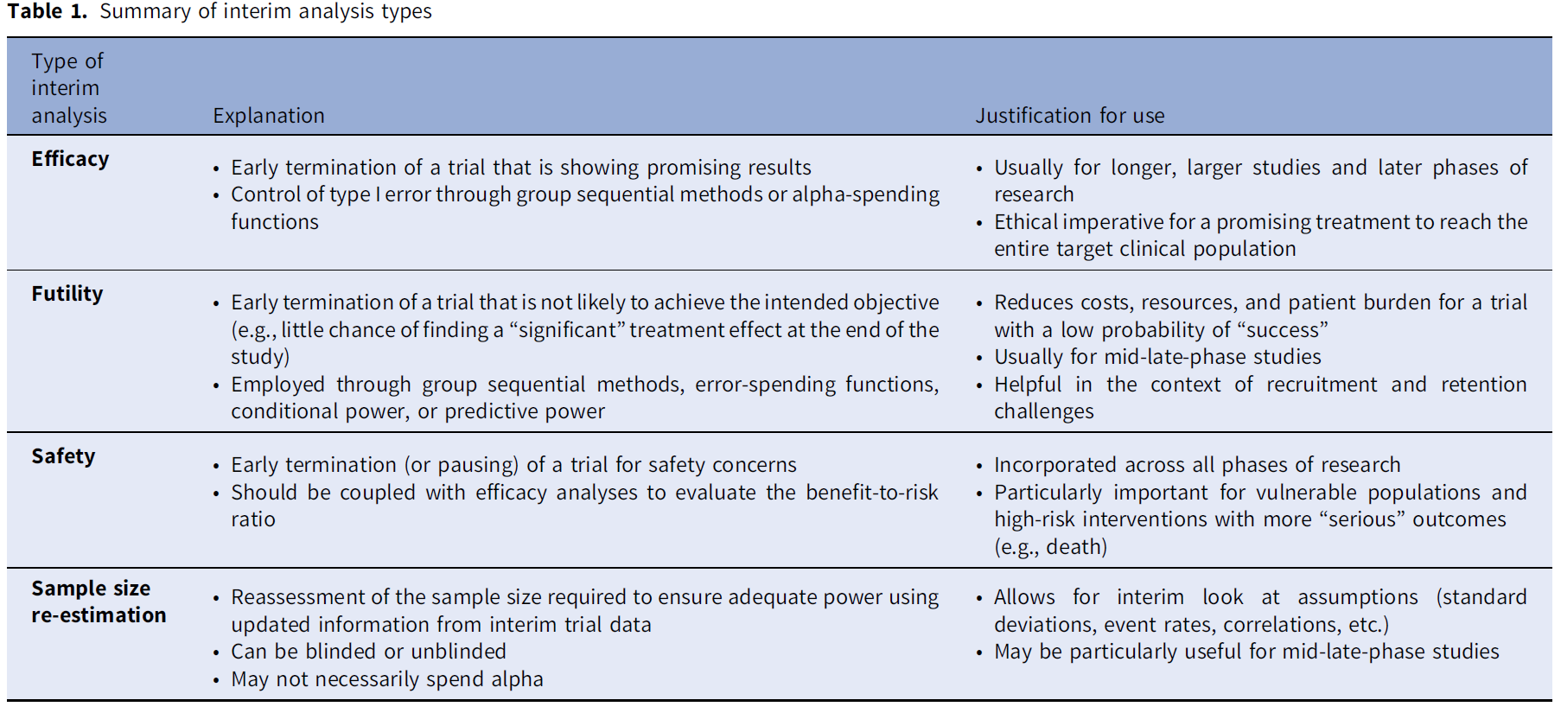
Terminology
Separate module!
Notes:
Table 1 from Ciolino, Jody D., Alexander M. Kaizer, and Lauren Balmert Bonner. "Guidance on interim analysis methods in clinical trials." Journal of Clinical and Translational Science 7.1 (2023): e124.

Slide 5
Some Monitoring Committee Acronyms
DSMB = Data and Safety Monitoring Board
DMC = Data Monitoring Committee
ESMB = Efficacy and Safety Monitoring Board
OSMB = Observational Study Monitoring Board
PAB = Policy Advisory Board

Slide 6

Interim Monitoring
Study Start
The process of taking interim looks at the data collected in a study
Can lead to a multiple comparisons problem
Can be specified for a variety of contexts or motivations
Interim Look 1
study enrollment
or time
Interim Look 2
Planned End

Slide 7
Interim Monitoring Rationales
There are ethical, scientific, and economic reasons to consider interim monitoring of data in clinical trials.
Safety is best assured by comparing the rate of adverse events with a control group
Studies should not stop before there is a definitive answer and should not continue longer than necessary to obtain one
Regular assessment of the relevance of the question
Regular assessment of whether the trial will address the question posed

Slide 8
Division of Responsibilities
Steering Committee
Study design
Patient recruitment and follow-up
Data collection
Quality assurance
Study reports
DMC or DSMB
Safety of patients
Protection of integrity of study
Review of (blinded) data on safety and efficacy of treatments
Review of trial conduct, amendments and external data

Slide 9
Modern Times (In General)
All NIH sponsored clinical trials are required to have a data monitoring plan
NIH-sponsored trials with clinical endpoints have a DSMB
Many industry sponsored studies have a DSMB
The FDA has prepared a guidance document (Establishment and Operation of Clinical Trial Data Monitoring Committees) http://www.fda.gov/RegulatoryInformation/Guidances/ucm127069.htm and document in course files
There is variation in operating procedures for DSMBs

Slide 10
When do we need an independent DSMB?
Early phase studies
Monitoring usually at local level; independent DMC not usually needed.
Phase III & IV studies with morbidity/mortality outcomes; pivotal phase III trials
Frail populations, e.g., children, elderly
Trial with substantial uncertainty about safety, e.g., gene therapy
See FDA Guidance documents and ICH/E9, section 4.5 for more information.

Slide 11
Statistical Designs and Considerations
Some trade-offs and considerations for different interim analyses

Slide 12
Reasons for Early Termination of Trials
Based on accumulated data from the trial:
Unequivocal evidence of treatment benefit or harm
Unexpected, unacceptable side effects
No emerging trends and no reasonable chance of demonstrating benefit
Based on overall progress of the trial:
Failure to include enough patients at a sufficient rate
Lack of compliance in a large number of patients
Poor follow-up
Poor data quality

Slide 13
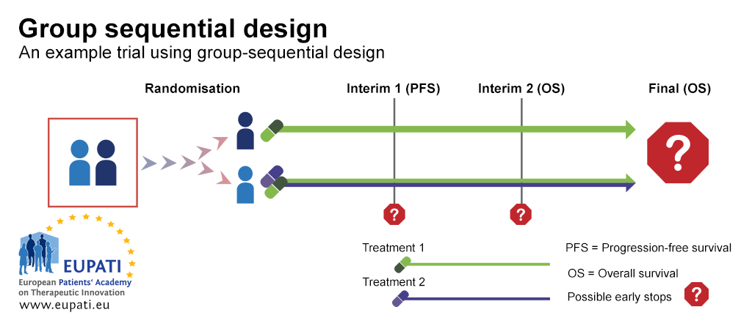
The Original Adaptive Design: Interim Monitoring
Notes:
Image: https://www.eupati.eu/clinical-development-and-trials/new-approaches-to-clinical-trials-adaptive-designs/

Slide 14
How to stop early (statistically)
The important things are to…
Define a priori how many interim “looks” you want to do
The trade-off with stopping earlier vs. later (clearly define boundary type)
There are many, many different methods that have been proposed (e.g., Pocock, O’Brien-Fleming, Haybittle-Peto, alpha spending, etc.)
There is “no free lunch” with interim monitoring, you have trade-offs with sample size, type I/II errors, and the number of looks

Slide 15
When to “look”
Can vary depending on purpose (e.g., stopping early for futility and/or efficacy, safety monitoring, enrollment reports, etc.)
Can be spaced in terms of calendar time or the available data
Calendar time (equal): every six months
Calendar time (unequal): monthly for 4 months, then every 3 months
Data (equal): every 50 participants/events
Data (unequal): after 10, 25, 50 events, then every 50 events
Lots of flexibility, but should be defined a priori!!!

Slide 16
Group Sequential Methods vs. α-Spending Functions
Group Sequential Methods
Alpha-Spending Functions
Predates alpha-spending, overall design calibrated for planned interim analyses to control the type I error rate (α)
Prespecified number of interim looks at study data
Three common boundary categories: Pocock, Peto, and O’Brien-Fleming
Newer approach that “spends” overall alpha over the study
More flexible, allows for unplanned/unanticipated, unequally spaced, and different weights for interim looks
Can adopt group sequential boundary style, or have more flexibility

Slide 17
Additional Futility Monitoring Approaches
In addition to group sequential methods or alpha-spending, other approaches to evaluate futility are available:
Conditional Power: a frequentist measure, the probability of seeing a significant effect at the end of the trial based on the current trend in the data and making specific assumptions for remaining participants
Predictive Probability of Success (PPoS): a Bayesian measure, updating the prior assumptions of the treatment effect with observed data and averaging the conditional power over this posterior distribution
Both approaches define a threshold (e.g., <10%) to recommend futility, or may leverage group sequential-like boundaries for thresholds

Slide 18
Additional Efficacy Monitoring Approaches
Conditional power and PPoS can be applied in conjunction with efficacy monitoring approaches, but require some additional considerations
Since both measures calculate the probability of success at the end of the study, we cannot simply stop our study whenever there is a high (e.g., >95%) probability, because the p-value/posterior probability may not be significant based on the observed data
Instead, we could potentially use such measures to estimate the probability of “success” based on all enrolled participants who do not have an outcome yet to determine if a potentially unplanned interim analysis for efficacy after all outcomes have been observed
However, a significant result is not guaranteed given we may find ourselves on the “boundary” of significance assuming the effect truly exists, and it may be worth continuing to the next planned interim analysis or study completion, or considering re-estimation procedures

Slide 19
Binding or Non-Binding Interim Stopping Rules
Interim decision boundaries can be binding or non-binding, and are specified in the protocol/SAP for the DSMB (or other decision-making bodies) to use
Binding decision rules must be followed regardless of other considerations [not recommended in practice]
Non-binding decision rules provide the DSMB with flexibility to continue a study if other information suggests potential benefits (e.g., important secondary outcomes, external study findings, etc.) [recommended in practice]

Slide 20
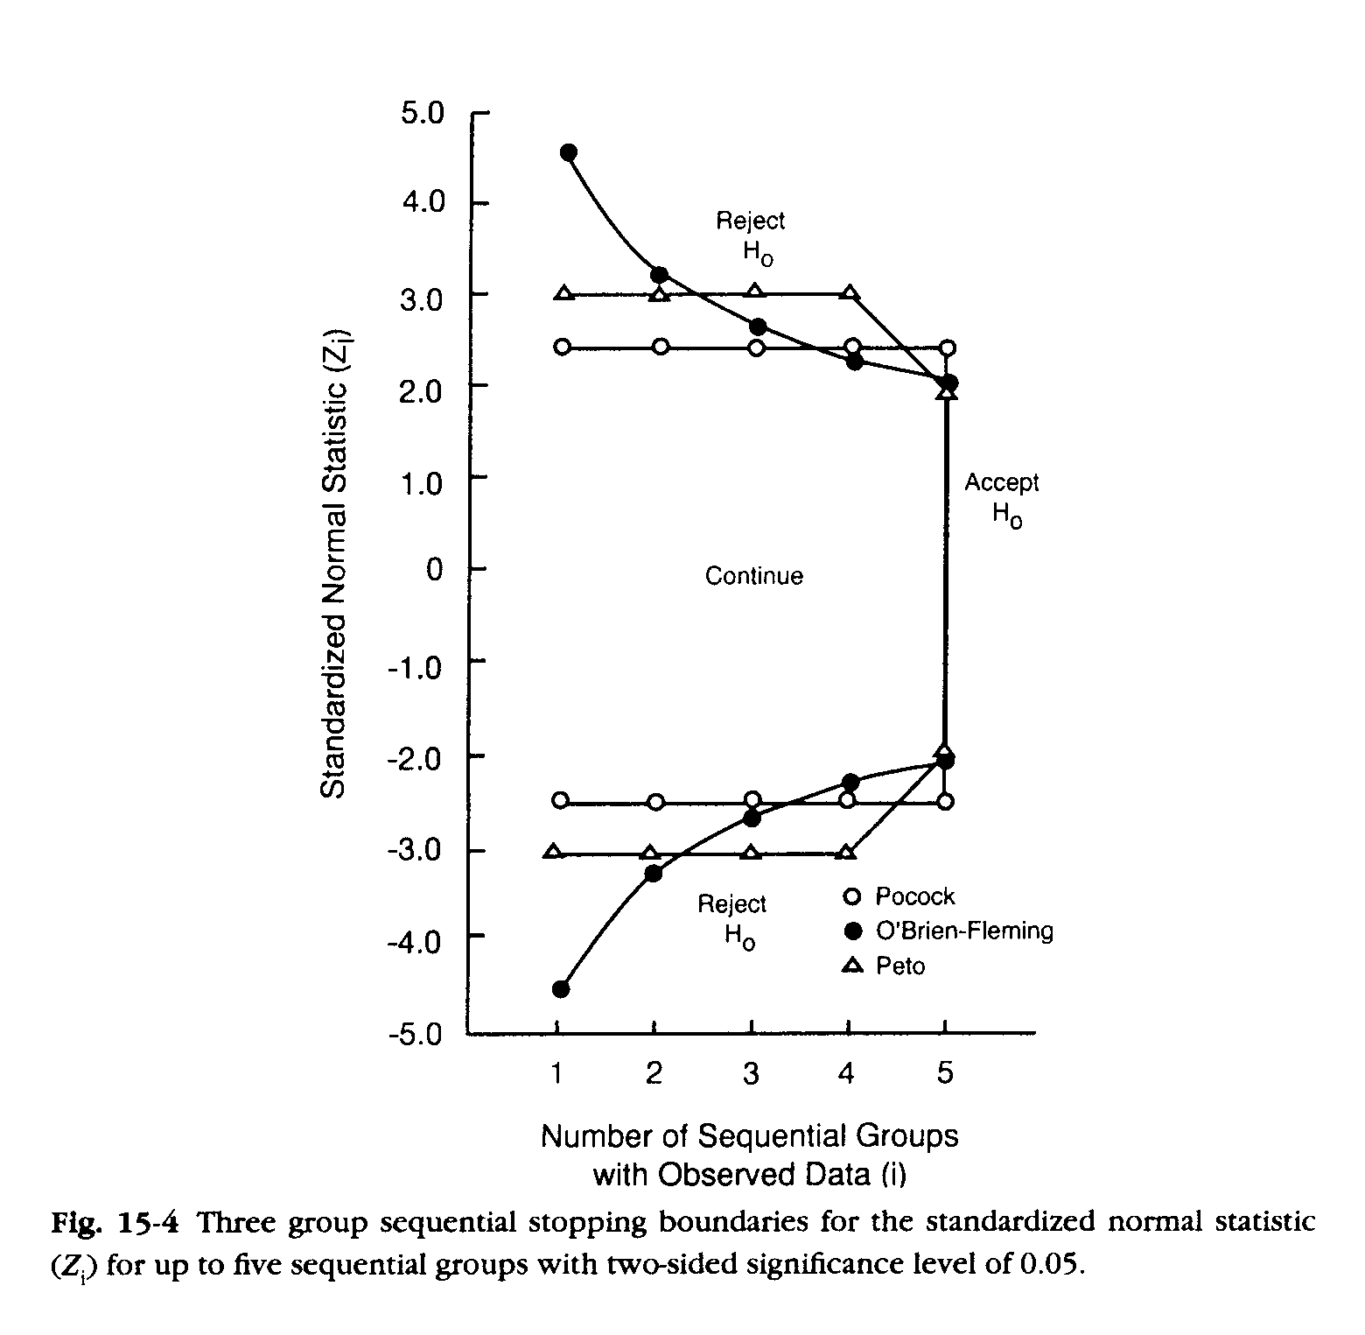
A Graphical Example
Poor use of language, should be “fail to reject H₀”
At right we see an example of different stopping boundaries for a two-sided hypothesis test (e.g., H₀: there is no difference between groups)
We’ll talk through some of the trade-offs for these boundaries…

Slide 21
Pocock Boundaries
The simplest approach to using interim boundaries
Identify a constant critical value that maintains the correct overall type I error rate
Pros: aggressive to stopping early
Cons: substantial reduction in power and relatively large increase in max sample size

Slide 22


O’Brien Fleming Boundaries
Use large critical values for boundaries early in the study and progressively reduce as the study progresses
Pros: final critical value is closer to fixed sample design, smaller max sample size than Pocock
Cons: less likely to stop early than Pocock boundaries

Slide 23


Haybittle-Peto Boundaries
Boundaries can be thought of as an in-between of Pocock and OBF
Pros: simple, critical value is close to that of fixed sample design
Cons: less likely to stop early, it may be impossible to find boundaries for certain combinations of type I error and number of interim analyses

Slide 24

Potential Sample Size Trade-Off
Sample size is now a “random variable” (it is no longer fixed when we use interim monitoring since we could stop early and therefore would need a smaller sample size)
Expected sample size is an estimate for the sample size (n) we would expect on average given our assumptions, the maximum sample size is the n we will have to observe if we do not stop early
Max Sample Size
Stopping Early
Notes:
Image: http://www.clker.com/cliparts/f/b/2/f/1238968076936815408scott_kirkwood_scales.svg.hi.png

Slide 25
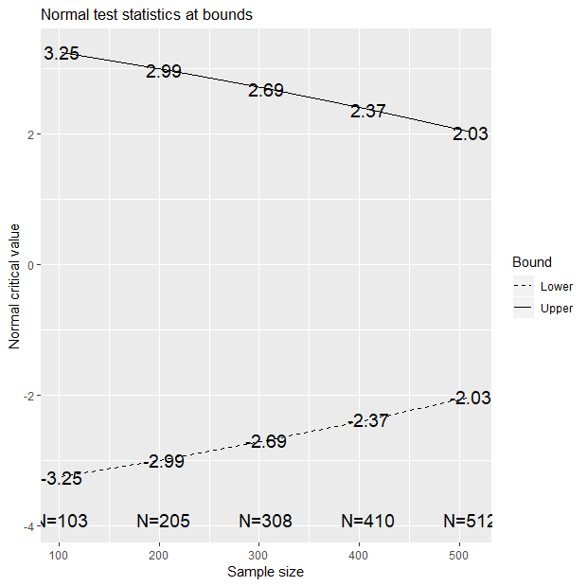
Sample Size Example
STOP, REJECT H₀
A study without interim monitoring was designed and it was determined that we would need to enroll 500 individuals to achieve 90% power with a 5% two-sided type I error rate.
If we have 5 interim analyses with OBF boundaries we would have a design like the figure here →
CONTINUE
No IM: 1.96
N=500
CONTINUE
FAIL TO REJECT H₀
CONTINUE
No IM: -1.96
STOP, REJECT H₀
Notes:
Figure (without labels) created with gsDesign in R: gsDesign(k=5, test.type=2, n.fix=500)

Slide 26
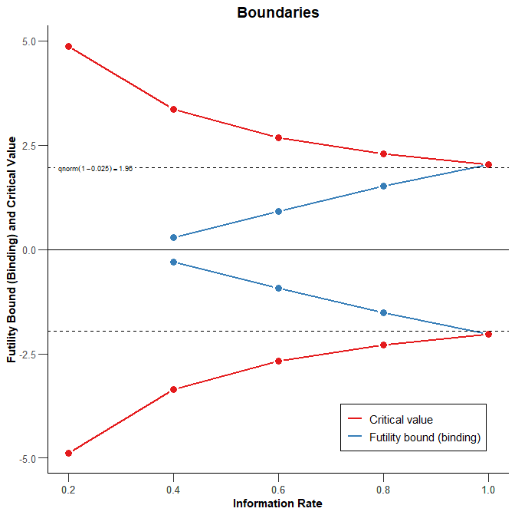
Example with Both Futility and Efficacy Bounds
Using “rpact” R package
Two-sided hypothesis test with α=0.05
O’Brien-Fleming type boundaries
Five total looks (4 interim, 1 final)
Notice, no futility stopping possible at 1st look with OBF
Stop, Reject H₀
Stop for Futility
Stop, Reject H₀
Notes:
library(rpact)
# Example: non-binding futility boundary at each interim in case
# estimated treatment effect is null or goes in "the wrong direction"
design <- getDesignGroupSequential(
sided = 2, alpha = 0.05,
informationRates = c(0.2, 0.4, 0.6, 0.8, 1), typeOfDesign = "asOF",
typeBetaSpending = "bsOF")
plot(design)

Slide 27
Case Study
Efficacy Stopping

Slide 28
Clinical Trial: Efficacy Example
Name: Thrombectomy for Stroke in the Public Health Care System of Brazil (NCT02216643)
Design: multi-center, randomized, controlled, open, blinded-endpoint trial with a sequential design
Population: stroke patients from 12 sites in Brazil with proximal intracranial occlusion
Purpose: evaluate if SOC with mechanical thrombectomy (a one-time procedure) is better than just the SOC
Notes:
Martins, Sheila O., et al. "Thrombectomy for stroke in the public health care system of Brazil." New England Journal of Medicine 382.24 (2020): 2316-2326.

Slide 29
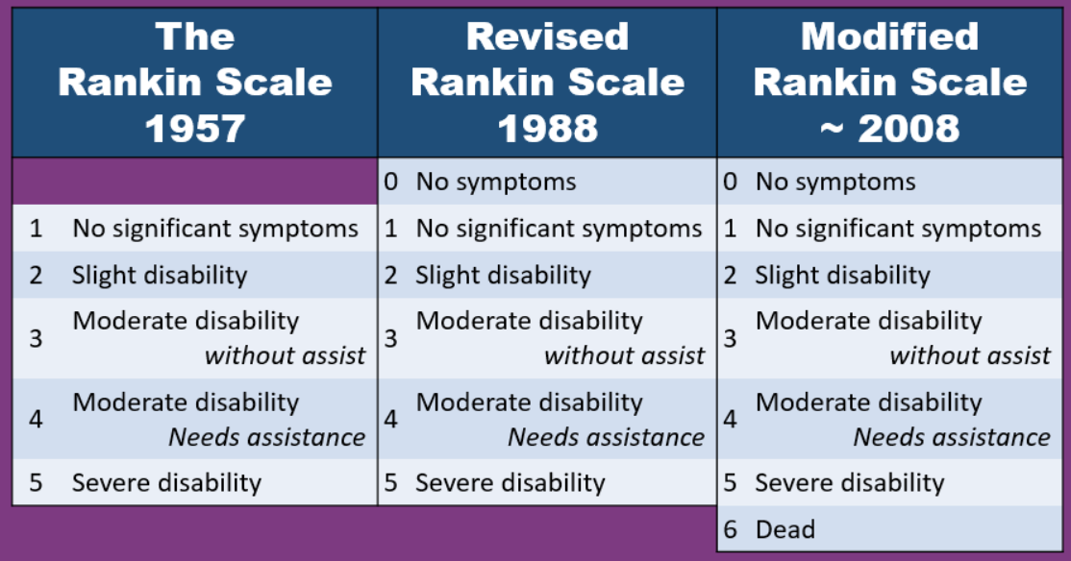
Clinical Trial: Efficacy Example
N: 690
Randomization Ratio: 1:1
Primary Outcome: modified Rankin scale, a measure of disability, at 90 days
Source: Journal of Neuroscience Nursing Facebook post
Notes:
Photo link: https://www.facebook.com/155970861157578/photos/it-has-been-about-10-years-since-the-last-change-to-the-rankin-scale-is-it-time-/2861269263961044/?_rdr

Slide 30
Clinical Trial: Efficacy Example
Interim Analysis: efficacy monitoring planned after 25%, 50%, and 75% of trial participants completed their 90-day follow-up visit
Method Used: one-sided alpha-spending (to be able to use the exact fraction of the trial available around planned interim analyses)
Identified Thresholds:
25%: p < 0.0125
50%: p < 0.0161
75%: p < 0.0203
100%: p < 0.0248 (notice, slightly less than 0.025 if used without IM)

Slide 31
Clinical Trial: Efficacy Example
First interim analysis (25%):
N=174 (25%) of 690 planned participants with completed 90-day follow-up visit
Adjusted common odds ratio of 2.24 (95% CI: 1.30, 3.88) with p=0.004 in favor of thrombectomy
DSMB recommended early termination for efficacy because p=0.004<0.0125 (the first IA threshold from previous slide)

Slide 32
Clinical Trial: Efficacy Example Conclusion
Total of 221 enrolled (32% of planned total), since those who were enrolled during the 1st interim analysis but not yet at 90-days followed for completion
Final reported adjusted common odds ratio of 2.28 (95% CI: 1.41, 3.69) with p=0.001
Trial was able to address their research question using fewer participants than planned, equating to a more efficient use of participant time and study resources

Slide 33
Case Study
Futility Stopping

Slide 34
Clinical Trial: Futility Example
Name: Stroke Hyperglycemia Insulin Network Effort (SHINE) (NCT01369069)
Design: multi-center, randomized, controlled clinical
Population: within 12 hours of stroke symptom onset and either have type 2 diabetes and glucose concentrations of over 110 mg/dL or no history of diabetes and glucose concentrations of 150 mg/dL or higher
Purpose: evaluate efficacy of intensive glucose control during acute ischemic stroke with IV insulin versus SOC control
Notes:
Johnston, Karen C., et al. "Intensive vs standard treatment of hyperglycemia and functional outcome in patients with acute ischemic stroke: the SHINE randomized clinical trial." JAMA 322.4 (2019): 326-335.

Slide 35
Clinical Trial: Futility Example
N: 1400
Randomization Ratio: 1:1
Primary Outcome: favorable modified Rankin scale at 90-days
Source: Journal of Neuroscience Nursing Facebook post
Notes:
Photo link: https://www.facebook.com/155970861157578/photos/it-has-been-about-10-years-since-the-last-change-to-the-rankin-scale-is-it-time-/2861269263961044/?_rdr

Slide 36
Clinical Trial: Futility Example
Interim Analysis: futility and efficacy monitoring planned after 500, 700, 900, and 1100 participants completed 90-day day follow-up out of up to 1400 participants
Method Used: two-sided alpha-spending
Identified Futility Thresholds:
500: p > 0.949
700: p > 0.896
900: p > 0.652
1100: p > 0.293 (notice how much closer to α=0.05 with only n=300 left)

Slide 37
Clinical Trial: Futility Example Conclusion
Final interim analysis (after n=1100):
N=1151 of 1400 planned participants with completed 90-day follow-up visit
Primary manuscript noted no significant difference in proportion with 90-day favorable outcomes (20.5% intensive versus 21.6% SOC)
Trial terminated for futility, saving resources and patient participation in a study that was unlikely to demonstrate its primary outcome

Slide 38
Case Study
Safety Stopping

Slide 39
Clinical Trial: Safety Example
Name: An Efficacy and Safety Study of Atabecestat in Participants Who Are Asymptomatic at Risk for Developing Alzheimer's Dementia (EARLY; NCT02569398)
Design: phase 2b/3 randomized, double-blind, placebo-controlled, parallel group, multi-center
Population: amyloid-positive participants who are asymptomatic at risk for developing Alzheimer's dementia (family history or genetic factors)
Purpose: explore short-term effects of atabecestat at two different doses compared to placebo in preclinical AD

Slide 40
Clinical Trial: Safety Example
N: 1650 recruited from 143 sites
Randomization Ratio: 1:1:1
Primary Outcome: change from baseline in Preclinical Alzheimer Cognitive Composite (PACC) score

Slide 41
Clinical Trial: Safety Example
Interim Analysis: futility monitoring planned for various outcomes (e.g., biomarkers and cognitive measures)
Method Used: unclear based on study protocol published with main outcome results
Identified Futility Thresholds:
At least 60 participants (20 per group) with 12-month biomarker value
At least 168 participants (56 per group) with 24-month amyloid PET
Identified Safety Thresholds: clinical expertise

Slide 42
Clinical Trial: Safety Example Conclusion
Study terminated after N=557 participants randomized (out of 1650 target) due to hepatic safety concerns relating to serious elevations of liver enzymes
Based on accumulated evidence, it was decided at an interim analysis that the benefit-to-risk assessment offered by the drug did not support continued study
Manuscript noted atabecestat would not be developed further given the safety concerns

Slide 43
Module Conclusions - I
Efficacy monitoring inflates the type I error rate, so methods (e.g., group sequential or alpha spending) are needed to preserve it
Futility monitoring without futility monitoring does NOT inflate the type I error rate, but may inflate the type II error rate (i.e., reduce the statistical power); can use GSM/ASF as well as conditional power or predictive probability of success
Safety monitoring is important for the physical well-being of participants and for ethical considerations

Slide 44
Module Conclusions - II
Interim monitoring allows for more efficient and ethical studies that better use limited study resources
DSMBs, as independent and unbiased entities, should be tasked with making recommendations on interim stopping to avoid the risk of bias from the immediate study team

Slide 45
References
Ciolino, Jody D., Alexander M. Kaizer, and Lauren Balmert Bonner. "Guidance on interim analysis methods in clinical trials." Journal of Clinical and Translational Science 7.1 (2023): e124.
Kaizer, Alexander M., et al. "Recent innovations in adaptive trial designs: a review of design opportunities in translational research." Journal of Clinical and Translational Science (2023): 1-35.
Martins, Sheila O., et al. "Thrombectomy for stroke in the public health care system of Brazil." New England Journal of Medicine 382.24 (2020): 2316-2326.
Johnston, Karen C., et al. "Intensive vs standard treatment of hyperglycemia and functional outcome in patients with acute ischemic stroke: the SHINE randomized clinical trial." JAMA 322.4 (2019): 326-335.
Sperling, Reisa, et al. "Findings of efficacy, safety, and biomarker outcomes of atabecestat in preclinical Alzheimer disease: a truncated randomized phase 2b/3 clinical trial." JAMA neurology 78.3 (2021): 293-301.
US Food and Drug Administration. Adaptive designs for clinical trials of drugs and biologics guidance for industry. https://www.fda.gov/regulatory-information/search-fda-guidance-documents/adaptive-design-clinical-trials-drugs-and-biologics-guidance-industry

Slide 46

Contact Info:
Email:
alex.kaizer@cuanschutz.edu
Website: www.alexkaizer.com
GitHub: alexbiostats

