Slide 1
Adaptive and Bayesian Methods for Clinical Trial Design Short Course
Dr. Alex Kaizer
Adaptive Enrichment
Notes:
xx

Slide 2
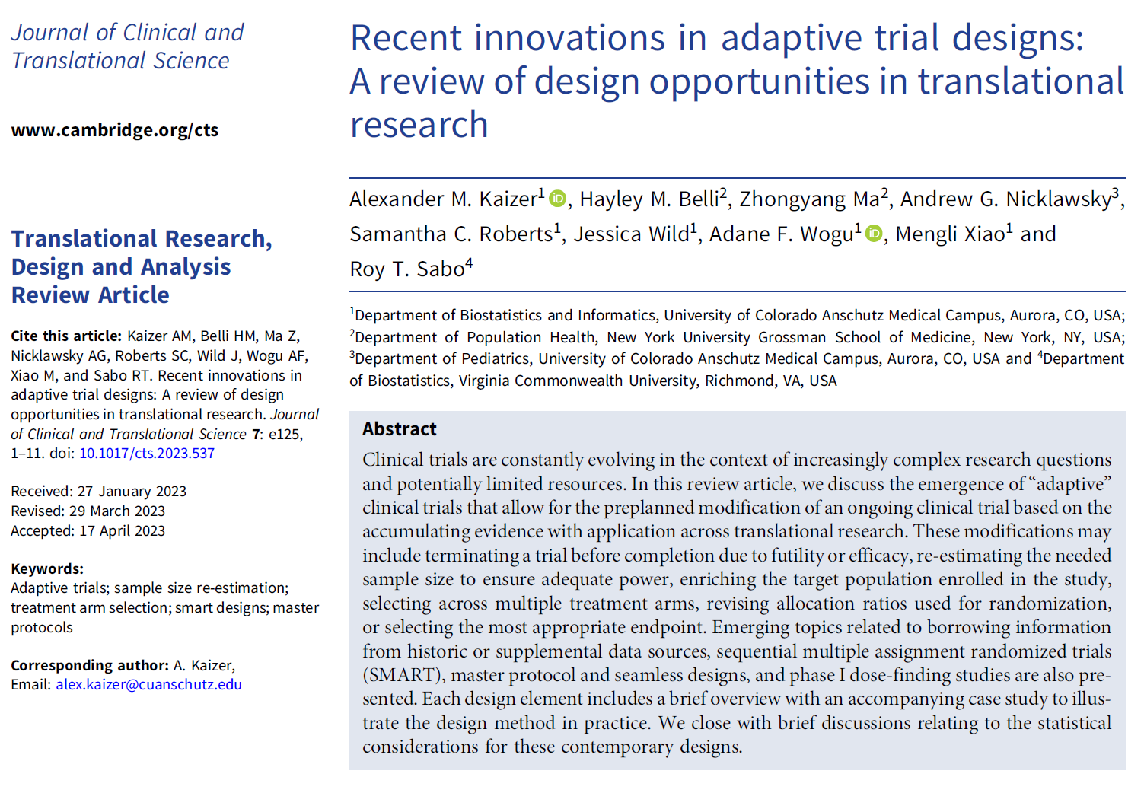
Overview Paper:

Slide 3
Background
Enriching our knowledge of statistical approaches and of prospective study designs

Slide 4
Why “Enrich” the Patient Population?
Hypothetical Scenario:
You expect the treatment effect to be greater in a certain targeted subset of the trial population: >
Do we enroll only the targeted subpopulation?

Slide 5
Simple Enrichment Example
3a. Continue enrollment of both
1. Enroll both groups at start
2. At interim analysis, determine if you continue enrollment in the overall population or restrict future enrollment to the targeted subpopulation.
3b. Restrict enrollment to subpop.

Slide 6
Adaptive Enrichment
If we believe a subgroup of the population will experience more benefit from an intervention but are uncertain of the effect, we may wish to incorporate adaptive enrichment strategies (i.e., heterogeneity of treatment effect (HTE))
These designs facilitate the revision of eligibility criteria and allow one to drop lower performing subgroups at an interim analysis, so study resources are more efficiently allocated to those with the greater chance of benefit
May result in an increased probability of a more successful trial (i.e., higher power) by refining study criteria

Slide 7
Advantages
Compared to a study designed to only enroll a targeted subgroup, adaptive enrichment allows us to evaluate for potential benefit in nontargeted subgroups
If nontargeted subgroups do not benefit from the treatment, or benefit at a much lower rate, these subgroups can be dropped, and the design focused on the targeted subgroups
Subgroups can be defined by binary, categorical, or continuous biomarkers

Slide 8
Challenges
Given the potential for multiple testing and evaluation, approaches may need to account for multiplicity:
This multiple testing may take place across repeated interim analyses, testing across multiple subgroups, or both
Multiple testing strategies may include combination tests, corrected p-values, etc.
Subgroups may be small or have very different prevalences, making it difficult to evaluate a treatment effect
Concerns about generalizability and applicability of study results

Slide 9
Categories of Enrichment Approaches
Three categories of enrichment procedures exist depending on the intended purpose:
Decreasing Variability: choosing participants with baseline measurements of a disease or biomarker in a narrow range (decreased interpatient variability) and excluding those whose disease or symptoms improve spontaneously or are highly variable (decreased intrapatient variability)
Prognostic: choose participants more likely to have the study endpoint or have worsening conditions (i.e., high-risk participants), expected to increase absolute effect difference but not alter relative effects
Predictive: identify participants with a higher chance of responding to a given treatment based on aspect related in some manner to the mechanism of the intervention, expected to increase absolute and relative effect
Notes:
US Food and Drug Administration. Enrichment Strategies for Clinical Trials to Support Approval of Human Drugs and Biological. https://www.fda.gov/regulatory-information/search-fda-guidance-documents/enrichment-strategies-clinical-trials-support-approval-human-drugs-and-biological-products

Slide 10
Decreasing Variability Strategies
Many of these methods do not require special statistical approaches and are already practiced:
Defining eligibility criteria carefully to ensure participants have disease being studied
Identifying participants likely to adhere to treatment (e.g., history of adherence, willingness to track/report use, etc.)
Use of lead-in periods before randomization to avoid spontaneous improvement
Enrolling participants with consistent baseline values
Excluding participants already taking similar drugs, drugs that may interact with a study drug, or highly likely to not tolerate the drug

Slide 11
Prognostic Strategies
Designed to increase proportion of patients likely to have an outcome
Event-based studies: enrolling participants with higher event rate to more quickly accrue events; prognostic indicators can be clinical/lab measures, medical history, genomic/proteomic signatures; if successful larger future studies can enroll those with lower risk
Progression-based studies: studies to delay progression (e.g., Alzheimer’s disease, Parkinson’s disease) could attempt to enroll those expected to more rapidly progress; prognostic indicators can be the same above but may also ultimately be predictive

Slide 12
Prognostic Strategies
Prognostic studies are expected to impact the absolute, but not relative, effects
Example from FDA Guidance on Enrichment Designs:
Reduction of mortality from 10% to 5% in a high-risk population has absolute risk reduction of 5% with a relative risk of 0.5
Reduction of mortality from 1% to 0.5% in a lower-risk population has absolute risk reduction of 0.5% with the same 0.5 relative risk
Notes:
US Food and Drug Administration. Enrichment Strategies for Clinical Trials to Support Approval of Human Drugs and Biological. https://www.fda.gov/regulatory-information/search-fda-guidance-documents/enrichment-strategies-clinical-trials-support-approval-human-drugs-and-biological-products

Slide 13
Predictive Strategies
Designed to identify patients more likely to respond to an intervention, already used in existing studies through eligibility criteria:
Congestive heart failure occurs due to systolic or diastolic dysfunction, but inotropes increase ventricular contraction and are more likely benefit those with systolic dysfunction
Antibacterial drugs evaluated among those with infected organism, but study may randomize at before specific testing is done with only those with positive result included in the primary analysis
Protein/genetic markers related to an intervention’s mechanism of action, such as HER2 overexpression in breast cancer to indicate responsiveness to trastuzumab, a monoclonal antibody targeting HER2

Slide 14
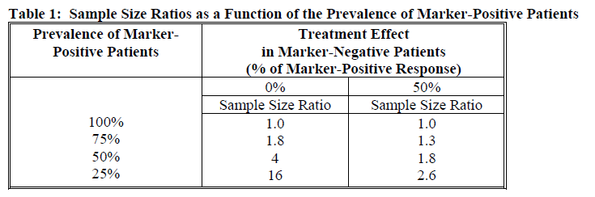
Predictive Strategies
These strategies can reduce the sample size ratio (number of subjects in unselected population versus number need for only marker-positive population), resulting in more efficient studies:
Note, scenarios assume marker-negative have either no response (0%) or half the response (50%) relative to the effect in the marker-positive participants.
Source: FDA Guidance on “Enrichment Strategies for Clinical Trials to Support Approval of Human Drugs and Biological”

Slide 15
Predictive Strategies
Predictive strategies also provide an enhanced benefit-risk relationship for a given intervention
The “risk” of potential toxicity and adverse events is rarely black and white, but rather is context-dependent upon the potential “benefit”
Enriching for those most likely to benefit avoids the challenge of enrolling participants who may have little-to-no benefit (e.g., marker-negative) but are still at risk for toxicity or adverse events
This improves the feasibility of a study and may encourage further development if a positive effect is present in some subgroup, while still providing evidence on subgroup with less or no effect

Slide 16
General Prognostic/Predictive Considerations
Prognostic and predictive indicators are most beneficial if they have both high sensitivity and specificity (i.e., correctly identifying responders and non-responders or those having the outcome)
Decision of final analysis population (e.g., including the enrichment factor subgroup only or including all participants)
Control of the type I error rate in the presence of multiple testing

Slide 17
Survey of Some Statistical Considerations to Enrichment

Slide 18
General Schematic of Enrichment Designs
Baldi Antognini, Frieri, and Zagoraiou in their 2023 review paper provide the following general schematic of an adaptive enrichment design:
Start trial with recruitment from the entire population meeting standard broad eligibility criteria
Interim analysis (one or more) to assess efficacy/safety in the entire population and in one (or more) subgroup(s)
Design the rest of the trial based on the interim analysis with pre-planned modifications
Notes:
Baldi Antognini, Alessandro, Rosamarie Frieri, and Maroussa Zagoraiou. "New insights into adaptive enrichment designs." Statistical Papers 64.4 (2023): 1305-1328.

Slide 19
General Interim Decisions
Baldi Antognini, Frieri, and Zagoraiou describe five possible actions to take at an interim analysis:
Recruitment continues from entire population (with possible sample size re-estimation)
Recruitment is restricted to one (or more) subgroups
Trial stops for futility or efficacy
Recruitment weighted towards one (or more) subgroup
Stop randomization to one or more treatments and/or start randomizing subjects to one or more new arms

Slide 20
General Selection for Enrichment
Baldi Antognini, Frieri, and Zagoraiou summarize 7 types of proposed strategies for selecting subgroup(s) for enrichment that also align with Stallard (2023):
All where the treatment effect is larger than a minimal clinically significant difference
The subgroup with the maximum treatment effect
The subgroup with a maximized test statistic
All subgroups with test statistics above some positive threshold
The subgroup that maximizes the overall benefit
All subgroups with a desired conditional power metric
Select the best “X” out of all subgroup, with X pre-specified
Notes:
Stallard, Nigel. "Adaptive enrichment designs with a continuous biomarker." Biometrics 79.1 (2023): 9-19.

Slide 21
Considerations with Continuous Biomarkers
Thresholds may be a priori identified (in which case it is really a categorical variable), but this may not reflect the prospective data or be based on limited data
Thresholds can be estimated through statistical methods:
Evaluate optimal threshold based on AUC or sensitivity/specificity metrics (e.g., Youden’s J index)
Challenges exist when biomarkers have non-monotonic relationships to select the appropriate subgroup(s)
New markers can be combined with existing markers in regression models

Slide 22
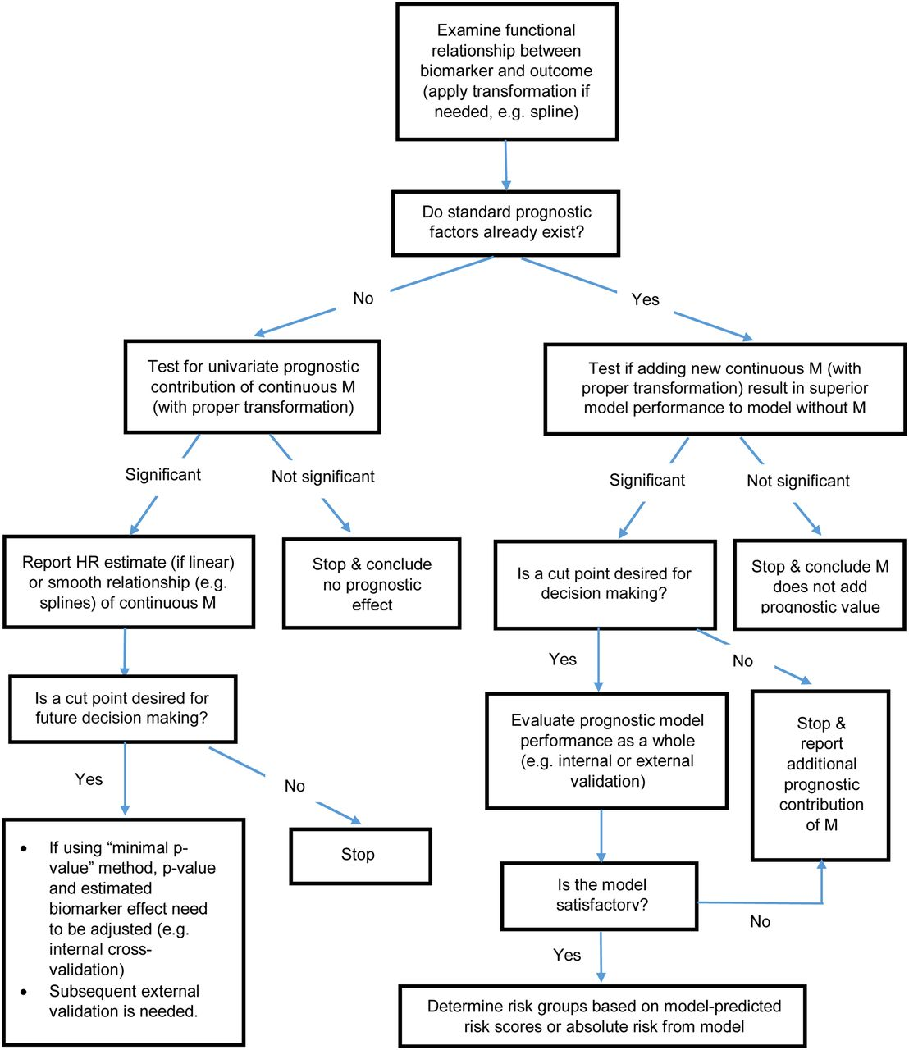
Continuous Biomarker Considerations
Polley and Dignam (2021) provided this nice flow chart to help guide some of the practices for evaluating continuous (prognostic) biomarkers (Figure 6 in paper)
Notes:
Polley, Mei-Yin C., and James J. Dignam. "Statistical considerations in the evaluation of continuous biomarkers." Journal of Nuclear Medicine 62.5 (2021): 605-611.

Slide 23
Bayesian Interim Decisions, Frequentist Final Analysis
It is possible to combine Bayesian and frequentist methods within one design, with Bayesian approaches used to determine adaptive elements and frequentist approaches used for the final analysis
Simon and Simon (2018) proposed using a Bayesian approach to simulate from the posterior at an interim analysis to find an “optimal” enrollment decision rule, then implementing the rule and continuing enrollment to either another interim analysis or completion, final analyses completed using a frequentist analysis
Notes:
Simon, Noah, and Richard Simon. "Using Bayesian modeling in frequentist adaptive enrichment designs." Biostatistics 19.1 (2018): 27-41.

Slide 24
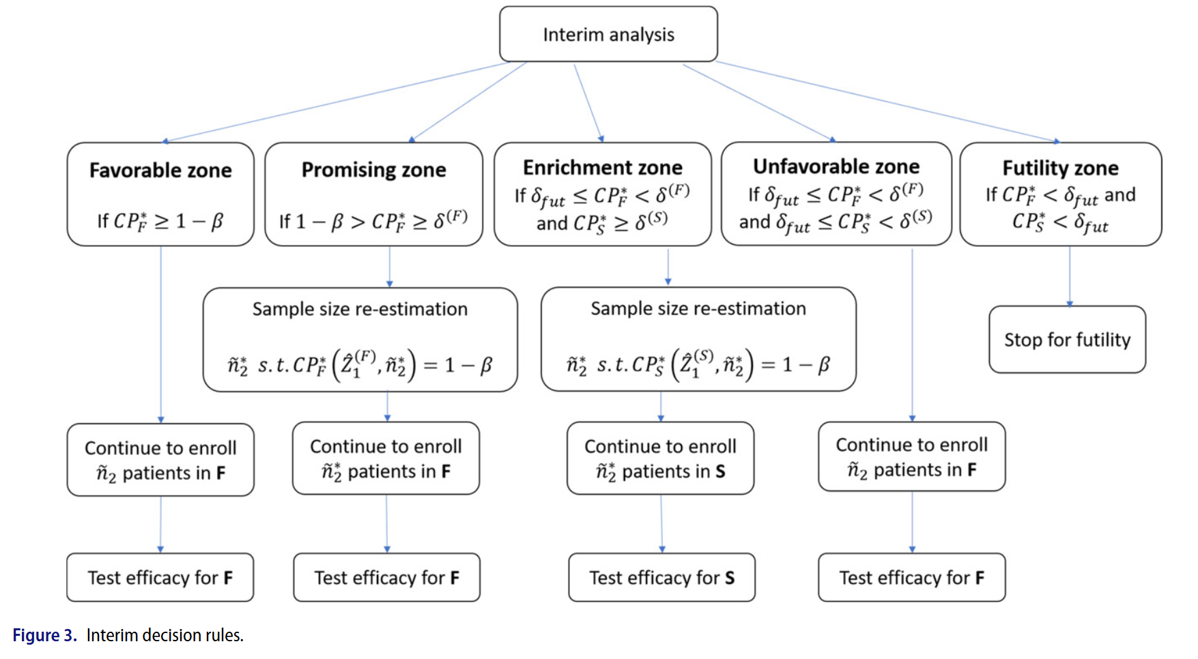
Example with Conditional Power and Binary Subgroup
This figure from Liwen et al. (2022) shows an adaptive enrichment design based on conditional power considerations (full=F, marker-positive=S)
Notice sample size re-estimation is possible, as well as stopping for futility
Notes:
Wu, Liwen, et al. "Incorporating surrogate information for adaptive subgroup enrichment design with sample size re-estimation." Statistics in Biopharmaceutical Research 14.4 (2022): 493-504.

Slide 25
Analysis at End of Study
As mentioned before, there are concerns with multiplicity and there is a desire to control the type I error rate. Multiple strategies have been proposed:
Combination tests (discussed in sample size re-estimation module)
Conditional error functions
Adaptive likelihood ratio tests
Bayesian techniques or decision-theoretic frameworks
The choice of strategy can be evaluated via simulation studies to determine trial operating characteristics

Slide 26
Other Notes
Decision rules can be based on one or multiple biomarkers
Adaptive enrichment could be used for studies with multiple arms where enrichment could be applied to some arms (e.g., dropping a subgroup from one arm but keeping in others) (Steingrimsson 2021)
Enrichment can extend the expected study duration, especially if in less prevalent subgroups (i.e., feasibility challenges)
There is some overlap with adaptive randomization methods, which could be used to modify treatment arm allocation in the study versus dropping altogether
Notes:
Steingrimsson, Jon Arni, et al. "Optimized adaptive enrichment designs for three-arm trials: learning which subpopulations benefit from different treatments." Biostatistics 22.2 (2021): 283-297.

Slide 27
Case Study

Slide 28
Clinical Trial: Adaptive Enrichment Example
Name: Phase III Trial of TRC105 and Pazopanib Versus Pazopanib Alone in Patients With Advanced Angiosarcoma (TAPPAS; ClinicalTrials.gov number: NCT02979899)
Design: multi-national, multi-center, open-label, parallel-group, phase 3 trial
Population: 18 years or older with advanced angiosarcoma, including cutaneous and non-cutaneous subgroups
Purpose: determine if carotuximab plus pazopanib is better than pazopanib alone
Notes:
Jones, Robin L., et al. "Efficacy and safety of TRC105 plus pazopanib vs pazopanib alone for treatment of patients with advanced angiosarcoma: A randomized clinical trial." JAMA oncology 8.5 (2022): 740-747.

Slide 29
Clinical Trial: Adaptive Enrichment Example
N: 190 from 31 sites in the US and EU stratified into two cohorts (120 from 1st, 70 from 2nd) based on interim analysis results, target of 95 total events (60 from 1st, 35 from 2nd)
Randomization Ratio: 1:1
Primary Outcome: progression free survival (PFS)
Adaptive Elements:
adaptive enrichment due to uncertainty of PFS among subgroups
informal futility zone for DSMB (i.e., no formal criteria but general guidance provided)
Notes:
Jones, Robin L., et al. "Efficacy and safety of TRC105 plus pazopanib vs pazopanib alone for treatment of patients with advanced angiosarcoma: A randomized clinical trial." JAMA oncology 8.5 (2022): 740-747.
Note, N pulled from study protocol Section 11 (see supplemental materials from JAMA Oncology) where it notes 120 participants in cohort 1 and 70 in cohort 2, driven by interim analysis decisions

Slide 30
Clinical Trial: Adaptive Enrichment Example
Adaptive Enrichment:
Enrichment based on conditional power after (1) 40 events observed or (2) within 30 days after enrollment of 120 participants in cohort 1
Notation: CP_{F} (full population CP), CP_{S} (cutaneous subpopulation CP)
Classified four zones based on conditional power (details on following slides):
Favorable Zone
Promising Zone
Enrichment Zone
Unfavorable Zone
Notes:
Jones, Robin L., et al. "Efficacy and safety of TRC105 plus pazopanib vs pazopanib alone for treatment of patients with advanced angiosarcoma: A randomized clinical trial." JAMA oncology 8.5 (2022): 740-747.

Slide 31
Clinical Trial: Adaptive Enrichment Example
Favorable Zone Criteria and Modifications:
CP_{F} > 95%
Continue with initially planned enrollment of 120 in cohort 1 and enroll 70 in cohort 2
Keep both subgroups
Final analysis based on the full population when 60 events are observed in cohort 1 and 35 in cohort 2, whichever comes later (i.e., could observe more events in a cohort if the other hasn’t yet met its target)
Notes:
Jones, Robin L., et al. "Efficacy and safety of TRC105 plus pazopanib vs pazopanib alone for treatment of patients with advanced angiosarcoma: A randomized clinical trial." JAMA oncology 8.5 (2022): 740-747.

Slide 32
Clinical Trial: Adaptive Enrichment Example
Promising Zone Criteria and Modifications:
CP_{F} between 30-95%
Continue enrollment of 120 in cohort 1
Increase enrollment from 70 to 220 in cohort 2
Keep both subgroups
Final analysis based on the full population when 60 events are observed in cohort 1 and 110 in cohort 2, whichever comes later
Notes:
Jones, Robin L., et al. "Efficacy and safety of TRC105 plus pazopanib vs pazopanib alone for treatment of patients with advanced angiosarcoma: A randomized clinical trial." JAMA oncology 8.5 (2022): 740-747.

Slide 33
Clinical Trial: Adaptive Enrichment Example
Enrichment Zone Criteria and Modifications:
CP_{F} < 30% and CP_{S} > 50%
Continue enrollment of 120 in cohort 1
Restrict cohort 2 to cutaneous subgroup only, increase sample size from 70 to 160
Final analysis based on subcutaneous subgroup only
Final analysis performed when 60 events are observed in cohort 1 based on full population and 110 events in cutaneous subgroup from both cohorts combined
Notes:
Jones, Robin L., et al. "Efficacy and safety of TRC105 plus pazopanib vs pazopanib alone for treatment of patients with advanced angiosarcoma: A randomized clinical trial." JAMA oncology 8.5 (2022): 740-747.

Slide 34
Clinical Trial: Adaptive Enrichment Example
Unfavorable Zone Criteria and Modifications:
CP_{F} < 30% and CP_{S} < 50%
Continue with initially planned enrollment of 120 in cohort 1 and enroll 70 in cohort 2
Keep both subgroups
Final analysis based on the full population when 60 events are observed in cohort 1 and 35 in cohort 2, whichever comes later
Note, the “modifications” are identical to the favorable zone strategy (i.e., no changes)
Notes:
Jones, Robin L., et al. "Efficacy and safety of TRC105 plus pazopanib vs pazopanib alone for treatment of patients with advanced angiosarcoma: A randomized clinical trial." JAMA oncology 8.5 (2022): 740-747.

Slide 35
Clinical Trial: Adaptive Enrichment Example
After 123 participants were enrolled, the trial terminated for futility
The study had entered the informal futility zone with a hazard ratio of 0.98 for PFS between the two groups (p=0.95)
Ultimately, no adaptive enrichment implemented
Notes:
Jones, Robin L., et al. "Efficacy and safety of TRC105 plus pazopanib vs pazopanib alone for treatment of patients with advanced angiosarcoma: A randomized clinical trial." JAMA oncology 8.5 (2022): 740-747.

Slide 36
Module Conclusions: FDA Adaptive Enrichment Considerations
Proposed enrichment should be motivated by results from previous trials and/or strong biologic plausibility
Baseline characteristics should be binary in nature, otherwise clear thresholds should be identified and justified
If using an in vitro diagnostic device, it should have adequate performance characteristics
Extent to which the trial design can characterize the complementary subpopulation depends on several factors (e.g., toxicities, distribution of biomarkers, off-label potential)
Notes:
From the Adaptive Trials FDA Guidance

Slide 37
Module Conclusions
Adaptive enrichment is an existing and common practice when considered as part of defining eligibility criteria
Newer statistical methods allow for dynamic consideration of the population to enroll, with pre-planned evaluation for potential revision to eligibility criteria
There exist different motivations (variability, predictive, prognostic) for implement adaptive enrichment
There are ongoing statistical challenges to address with future research

Slide 38
References
Kaizer, Alexander M., et al. "Recent innovations in adaptive trial designs: a review of design opportunities in translational research." Journal of Clinical and Translational Science (2023): 1-35.
US Food and Drug Administration. Adaptive designs for clinical trials of drugs and biologics guidance for industry. https://www.fda.gov/regulatory-information/search-fda-guidance-documents/adaptive-design-clinical-trials-drugs-and-biologics-guidance-industry
US Food and Drug Administration. Enrichment Strategies for Clinical Trials to Support Approval of Human Drugs and Biological. https://www.fda.gov/regulatory-information/search-fda-guidance-documents/enrichment-strategies-clinical-trials-support-approval-human-drugs-and-biological-products
Jones, Robin L., et al. "Efficacy and safety of TRC105 plus pazopanib vs pazopanib alone for treatment of patients with advanced angiosarcoma: A randomized clinical trial." JAMA oncology 8.5 (2022): 740-747.
Baldi Antognini, Alessandro, Rosamarie Frieri, and Maroussa Zagoraiou. "New insights into adaptive enrichment designs." Statistical Papers 64.4 (2023): 1305-1328.
Simon, Noah, and Richard Simon. "Using Bayesian modeling in frequentist adaptive enrichment designs." Biostatistics 19.1 (2018): 27-41.
Stallard, Nigel. "Adaptive enrichment designs with a continuous biomarker." Biometrics 79.1 (2023): 9-19.
Polley, Mei-Yin C., and James J. Dignam. "Statistical considerations in the evaluation of continuous biomarkers." Journal of Nuclear Medicine 62.5 (2021): 605-611.
Wu, Liwen, et al. "Incorporating surrogate information for adaptive subgroup enrichment design with sample size re-estimation." Statistics in Biopharmaceutical Research 14.4 (2022): 493-504.
Steingrimsson, Jon Arni, et al. "Optimized adaptive enrichment designs for three-arm trials: learning which subpopulations benefit from different treatments." Biostatistics 22.2 (2021): 283-297.

Slide 39

Contact Info:
Email:
alex.kaizer@cuanschutz.edu
Website: www.alexkaizer.com
GitHub: alexbiostats

