Slide 1
Adaptive and Bayesian Methods for Clinical Trial Design Short Course
Dr. Alex Kaizer
Treatment Arm Selection
Notes:
xx

Slide 2

Overview Paper:

Slide 3
Background
Why select only two arms when we could have N?

Slide 4
Motivation
Studies with adaptive treatment arm selection allow for the adding or dropping of treatment arms to an ongoing trial
Applications and examples (that span multiple modules*) include:
Dose-finding studies
Drop-the-losers designs
Adaptive seamless designs*
Adaptive platform designs and other master protocols*

Slide 5
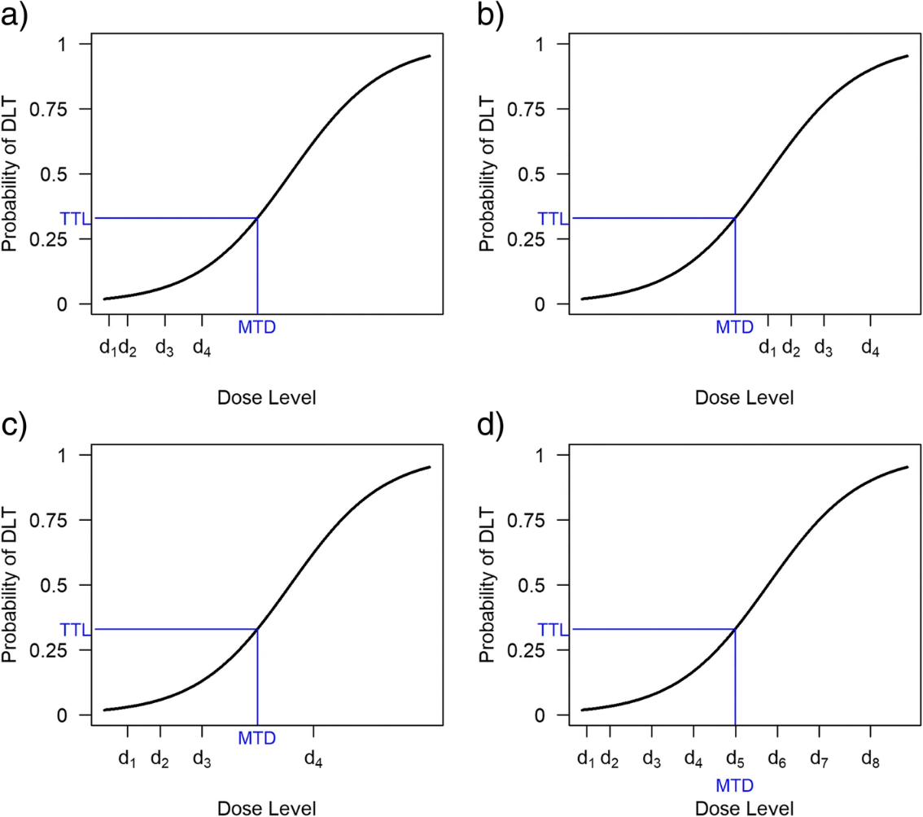
Dose Finding Studies
A natural space for treatment arm adaptation is dose finding studies
These are common in earlier phases of studies to determine the minimum effective dose or the maximum tolerable dose for the intervention to use in future studies
These studies may “drop” arms with ineffective or harmful doses, or “add” new arms with different doses based on the observed doses
Source: Figure 1 from Wheeler, Graham M., et al. "How to design a dose-finding study using the continual reassessment method." BMC medical research methodology 19 (2019): 1-15.
Notes:
Wheeler, Graham M., et al. "How to design a dose-finding study using the continual reassessment method." BMC medical research methodology 19 (2019): 1-15.
Notice, only the hypothetical design D has a chance of finding the proper dose. A only includes doses that may be too low, B only includes doses that are too high, C will likely identify d₃ but will not find the optimal dose

Slide 6
Studies with Control Arm(s)
In later phase or comparative effectiveness studies, one must consider the choice of a control arm:
Placebo-controlled
Standard of care (i.e., some existing active therapy)
No comparator arm
Often this is a shared control, but this can be modified in more complex designs (e.g., master protocols)
In practice, a placebo-controlled or standard of care arm should be maintained throughout the study; this is driven by:
Increased power assuming all interventions are better than the control arm
Better mimics a standard two-arm trial

Slide 7
General Selection for Arm Dropping/Adding
The strategy for arm selection depends on multiple considerations:
Available resources: if we are not limited by funding/eligible participants, we may wish to keep all promising arms; if we are limited, we may wish to use (potentially arbitrary) pre-specified) rules to select arms
External data: if we learn of important knowledge affecting an included arm or a potential arm, this may drive its inclusion or exclusion
Feasibility: if we expect our time to completion will be longer than expected (e.g., enrollment challenges), this may drive our desire to add or drop study arms
Notes:
Stallard, Nigel. "Adaptive enrichment designs with a continuous biomarker." Biometrics 79.1 (2023): 9-19.

Slide 8
Temporal Effects with Treatment Arm Selection
Temporal effects can introduce biases to our analyses, since we need more sophisticated statistical approaches to estimate the potential treatment effect for periods without data
This is not as problematic in studies where all arms are present at the start of the study and are dropped as we try to better apply resources to fewer study arms, but can be challenging if we have to drop arms even if not statistically different

Slide 9
Implementing Arm Dropping
Drop it like its hot…or slightly hotter than another arm

Slide 10
General Selection for Arm Dropping
Much like adaptive enrichment, there are multiple strategies that can be implemented for arm dropping (here we assume control is never dropped):
Keep active arms that meet some pre-specified statistical criteria (e.g., drop all arms that are futile based on conditional power, group sequential designs, etc.)
Keep the arm with the maximum treatment effect or test statistic
Keep all arms with responses above some threshold
Select the best “X” out of all arms, with X pre-specified
Notes:
Stallard, Nigel. "Adaptive enrichment designs with a continuous biomarker." Biometrics 79.1 (2023): 9-19.

Slide 11
Drop-the-Loser Design
A design to compare multiple study arms to a shared control arm with the goal of dropping the “loser(s)” relative to the control arm
These designs do not anticipate pairwise comparisons for finding the best treatment (i.e., a “pick-the-winner” design), so controlling the familywise type I error rate may be easier
Chen, DeMets, and Lan (2010) proposed various designs for studies with multiple dose levels
If combined with a seamless design (see module), it could involve pairwise comparisons in the later phase that need to be accounted for the in the study design
Notes:
Joshua Chen, Y. H., David L. DeMets, and K. K. Gordon Lan. "Some drop‐the‐loser designs for monitoring multiple doses." Statistics in Medicine 29.17 (2010): 1793-1807.

Slide 12
Implementing Arm Adding
Incorporating encouraging arms that were not there at the start

Slide 13
Arm Adding Considerations
Within dose finding studies, adding an arm is likely driven by the results of a previous study that demonstrated a dose was too high or too low
In comparative effectiveness trials or platform trials, the addition of arms is often motivated by practical considerations:
If another arm has dropped and sufficient resources are available, add one from a pipeline
New external information from the trial indicates a potentially important arm to add to holistically address the research question
If funds are not available or enrollment is challenging, may not be ideal to add a study arm

Slide 14
Case Study

Slide 15
Clinical Trial: Drop-the-Loser Example
Name: Citalopram for Cocaine Dependence (NCT01535573)
Design: double-blind, randomized controlled design with Bayesian adaptive treatment arm selection
Population: current cocaine dependence, between 18 and 60 years of age; exclusion includes drugs other than cocaine, marijuana, nicotine
Purpose: to determine the best dose of citalopram for a future trial
Notes:
Suchting, Robert, et al. "Citalopram for treatment of cocaine use disorder: A Bayesian drop-the-loser randomized clinical trial." Drug and alcohol dependence 228 (2021): 109054.

Slide 16
Clinical Trial: Drop-the-Loser Example
N: 108
Randomization Ratio: 1:1:1
Primary Outcome: cocaine abstinence in past 2 weeks (8-9) via drug test at final study visit
Adaptive Drop-the-Loser: Bayesian posterior probability used to drop the “worse” performing dose of citalopram
Notes:
Suchting, Robert, et al. "Citalopram for treatment of cocaine use disorder: A Bayesian drop-the-loser randomized clinical trial." Drug and alcohol dependence 228 (2021): 109054.

Slide 17
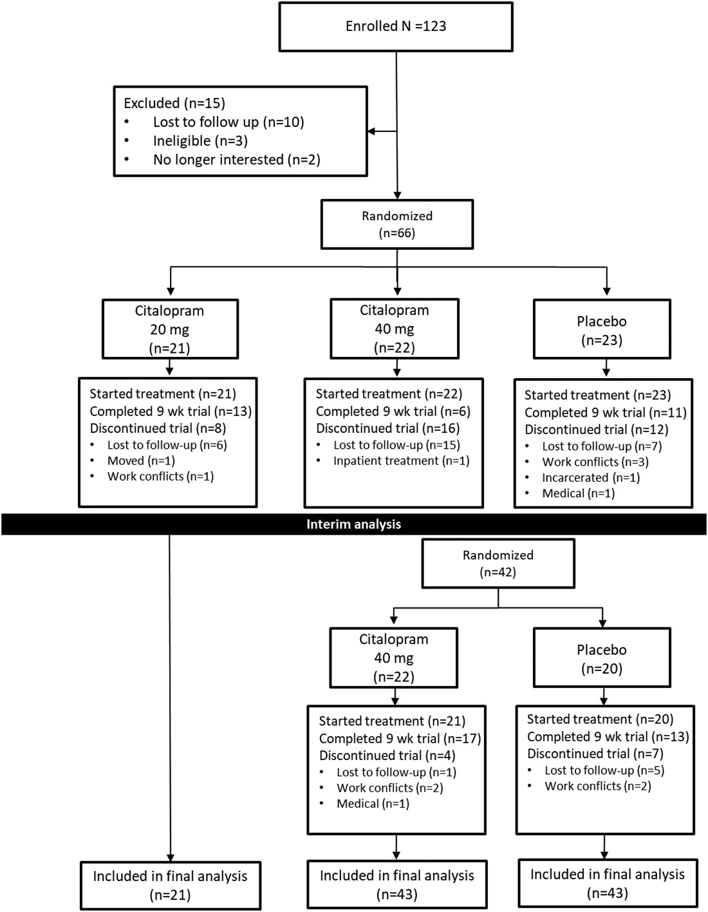
Clinical Trial: Drop-the-Loser Example
The CONSORT diagram from the trial primary results paper shows the flow of participants through the study
The lower 20 mg dose citalopram arm was dropped at the interim analysis, with 40 mg and placebo continuing for the second stage

Slide 18
Clinical Trial: Drop-the-Loser Example
As noted on the CONSORT diagram, the 20 mg dose of citalopram was dropped at the interim analysis due to appearing less favorable (although specific posterior probability not reported in manuscript)
The 40 mg/day dose was declared the “winner” of the study with an 82.1% posterior probability of increased abstinence from cocaine (although this did not meet the pre-specified 95% threshold)
Conclusion of “moderate-to-strong evidence” of positive effects at study conclusion for 40 mg/day dose, recommended for use in future studies
Notes:
Suchting, Robert, et al. "Citalopram for treatment of cocaine use disorder: A Bayesian drop-the-loser randomized clinical trial." Drug and alcohol dependence 228 (2021): 109054.

Slide 19
Module Conclusions
Treatment arm selection methods may increase flexibility to include multiple interventions or arms in a study where the “best” arm(s) continue to completion
If there is flexibility with sample size/time/budget, can keep all arms that show promise
If less flexible (e.g., can only afford N participant total), strategies to select the “best” arm, even if not statistically different from other arms, may be needed to maximize power for the best arms
Seamless designs (see other module) are a related area that may provide additional flexibility

Slide 20
References
Kaizer, Alexander M., et al. "Recent innovations in adaptive trial designs: a review of design opportunities in translational research." Journal of Clinical and Translational Science (2023): 1-35.
US Food and Drug Administration. Adaptive designs for clinical trials of drugs and biologics guidance for industry. https://www.fda.gov/regulatory-information/search-fda-guidance-documents/adaptive-design-clinical-trials-drugs-and-biologics-guidance-industry
Wheeler, Graham M., et al. "How to design a dose-finding study using the continual reassessment method." BMC medical research methodology 19 (2019): 1-15.
Joshua Chen, Y. H., David L. DeMets, and K. K. Gordon Lan. "Some drop‐the‐loser designs for monitoring multiple doses." Statistics in Medicine 29.17 (2010): 1793-1807.
Suchting, Robert, et al. "Citalopram for treatment of cocaine use disorder: A Bayesian drop-the-loser randomized clinical trial." Drug and alcohol dependence 228 (2021): 109054.

Slide 21

Contact Info:
Email:
alex.kaizer@cuanschutz.edu
Website: www.alexkaizer.com
GitHub: alexbiostats

