Slide 1
Adaptive and Bayesian Methods for Clinical Trial Design Short Course
Dr. Alex Kaizer
Adaptive Randomization
Notes:
xx

Slide 2
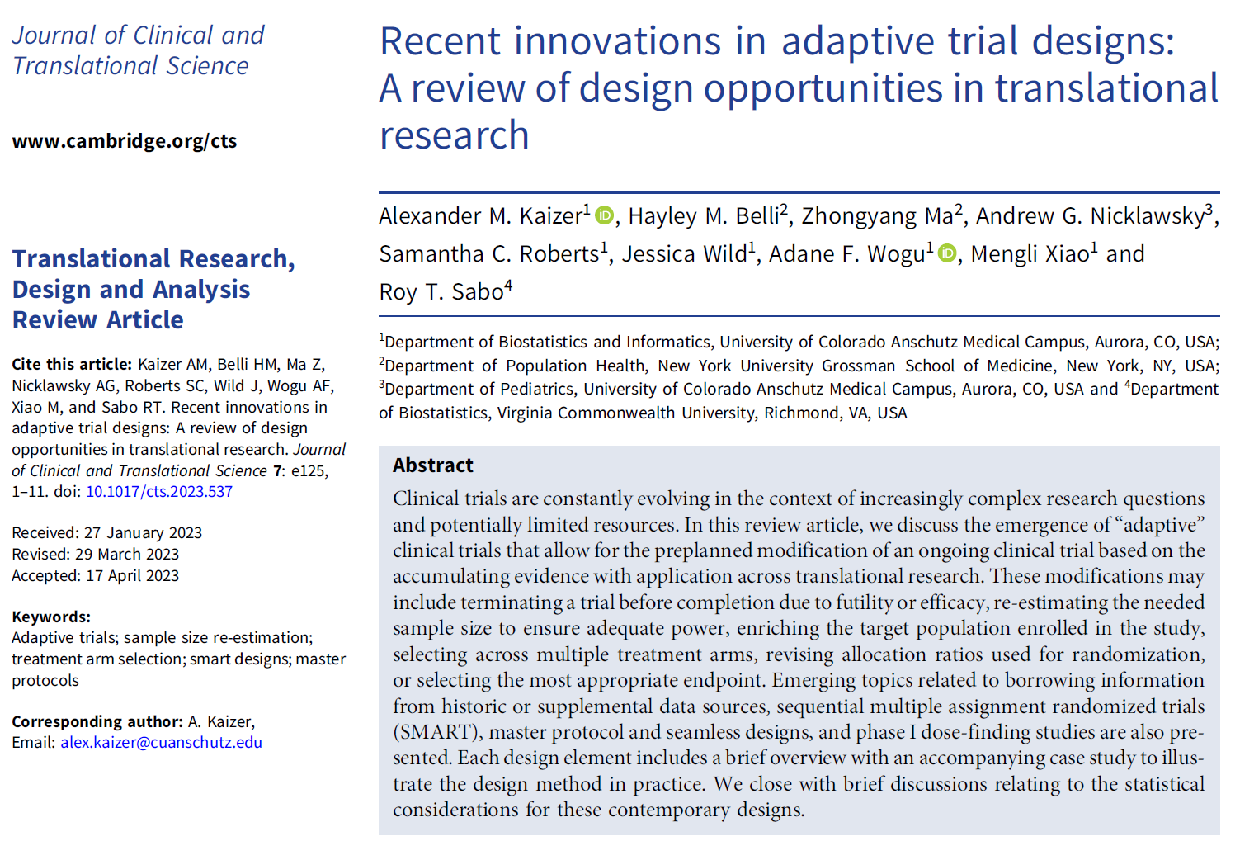
Overview Paper:

Slide 3
Background
When a coin flip or dice role isn’t enough

Slide 4

Randomization in Trials: The Key Points
We randomize to ensure that the groups only differ with respect to the interventions being compared
Treatment allocations should be concealed until time of randomization (i.e., allocation concealment)
Helps to prevent selection bias
Also referred to as “blinded randomization”
Notes:
Image: https://media.wiley.com/product_data/coverImage300/49/11187422/1118742249.jpg

Slide 5
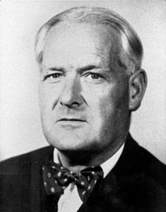
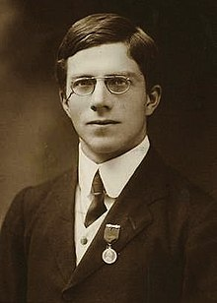
Advantages of Randomization
Sir Austin Bradford Hill (1897-1991):
Eliminates bias from treatment assignment
Balances the known and unknown differences between groups on average
May lead to a more credible study
Sir Ronald Aylmer Fisher (1890-1962):
Assures validity of statistical tests (e.g., type I error)
Notes:
Sir Austin Bradford Hill: https://upload.wikimedia.org/wikipedia/commons/thumb/e/eb/Austin_Bradford_Hill.jpg/330px-Austin_Bradford_Hill.jpg
RA Fisher:

Slide 6
Randomization Schedules
A list showing the order in which subjects are assigned to the various interventions. There are two general types of allocation:
Fixed Allocation Methods
Simple randomization
Permuted block (restricted)
Permuted block with random mixing of block sizes (restricted)
Adaptive Allocation Methods
Assignments based on probabilities that can change over the trial
Baseline adaptive
Response adaptive
Multi-source adaptive

Slide 7

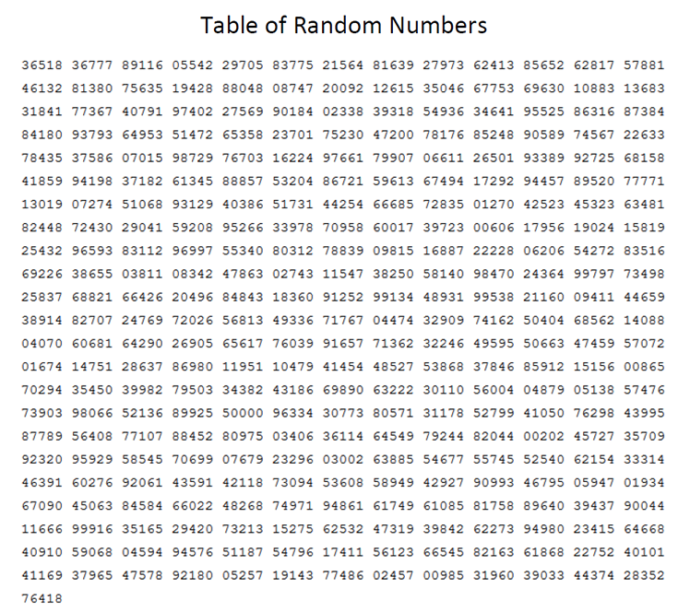
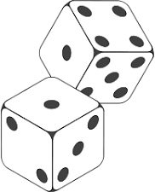
Simple Randomization
The number and order of participants receiving a treatment is determined by (pre-defined) chance
E.g., 1:1 allocation, 2:2:1 allocation, etc.
May have chance imbalance at…
End of the study
Periodic looks
Imbalance may lead to…
Logistical problems (e.g., allocation of resources)
Loss of power
Notes:
Random number table: https://mathbitsnotebook.com/Algebra2/Statistics/random%20table.png
Coin flip: https://upload.wikimedia.org/wikipedia/commons/thumb/1/15/Coin_Toss_%283635981474%29.jpg/220px-Coin_Toss_%283635981474%29.jpg
Dice: https://encrypted-tbn0.gstatic.com/images?q=tbn:ANd9GcSl-aoJSZAZnN6qBN_DOCIeuRuxi1QS7Xuj2ck0z6JK1QsoVLjq

Slide 8
Example of Simple Randomization Struggles
Binomial
Probability
Treatment A
Treatment B
0 (10) 10 (0) 0.002
1 (9) 9 (1) 0.020
2 (8) 8 (2) 0.088
3 (7) 7 (3) 0.234
4 (6) 6 (4) 0.410
5 5 0.246
0.2% chance one arm gets everyone!!
11% chance we have major imbalance.
64% chance we have minor imbalance.
Only 25% chance we have perfect balance!

Slide 9
Permuted Block Randomization
Divide patients into blocks of equal size according to the time they enter the study
Choose a block size
Write down all possible permutations
Randomly choose one
Can also choose multiple block sizes to randomly select between
Example: blocks of size 4 with equal allocation
AABB
ABAB
ABBA
BBAA
BABA
BAAB
E.g., Roll dice to determine block to use

Slide 10
Advantages of Permuted Block Randomization
1. Forces balance at end of study and (near) balance during patient accession
2. Reduces the likelihood of bias due to changing patient characteristics during course of study
3. Facilitates planning with regard to treatment administration (resource planning)

Slide 11
Stratified Randomization
B1
B2
A2
B1
A1
C1
C2
C1
C2
C1
C2
B2
C1
C2
Used when you have certain prognostic variables that you wish to maintain balance across their combinations
Within each combination we generate a randomization scheme
Can be challenging for small studies or with lots of combinations
3 strata with 2 categories each leads to 8 unique combinations (2 x 2 x 2)

Slide 12
Fixed to Adaptive Allocation
The previous methods all generated a randomization schedule before the trial even starts
What if we want to leverage information collected or observed during the trial?

Slide 13
Adaptive Randomization
We will discuss three general classes of adaptive randomization:
Baseline/Covariate (BAR): modifying allocation probabilities to achieve balance in (baseline) covariates of interest
Outcome/Response (RAR): modifying allocation probabilities to assign more participants to study arms with a higher probability of success
Information Balance: modifying allocation probabilities to balance the overall information in a trial, particularly when incorporating external or historical data

Slide 14
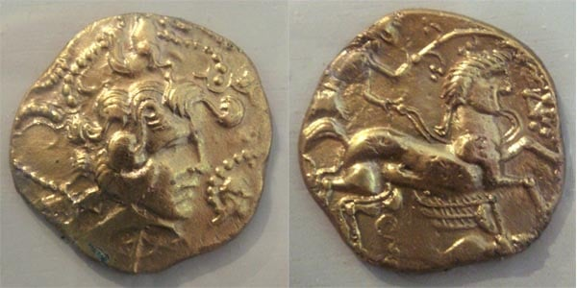
Baseline (Covariate) Adaptive Randomization
The probability of the next treatment assignment is altered on the basis of the previous assignments in order to achieve better balance (i.e., biased coin, minimization procedures).
Considerations:
How to implement (central entity vs. local entities)
Multiple treatments
What is considered a lack of balance
What covariates to use for balance
Main advantage: opportunity to balance composition of treatment groups on several characteristics without stratification
Notes:
Image: https://www.probabilisticworld.com/wp-content/uploads/2016/03/biased-coin.jpg

Slide 15
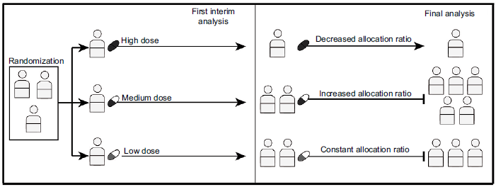
Response-Adaptive Randomization (RAR)
When the outcomes suggest better response in certain arms, we may wish to randomize more participants to those promising arms
RAR can help address ethical issues with the principle of equipoise in trials
Recent research has identified that outcome adaptive randomization may result in randomization to the inferior arm, concerns about sample size imbalance (leading to reduced power), and challenges where time effects are present
Park, Jay JH, Kristian Thorlund, and Edward J. Mills. "Critical concepts in adaptive clinical trials." Clinical epidemiology 10 (2018): 343.
Notes:
Park, Jay JH, Kristian Thorlund, and Edward J. Mills. "Critical concepts in adaptive clinical trials." Clinical epidemiology 10 (2018): 343.

Slide 16
Response/Outcome Adaptive Randomization
Assignment probabilities are modified based on observed responses or outcomes
The motivation is to allocate as many patients as possible to the “best” treatment arm
Recent research has identified that outcome adaptive randomization may result in randomization to the inferior arm, concerns about sample size imbalance (leading to reduced power), and challenges where time effects are present

Slide 17
Information Balance Adaptive Randomization
Methods exist to incorporate historic data sources into the analysis of a current trial (e.g., using Bayesian hierarchical models, power priors, commensurate priors, multi-source exchangeability models, etc.; see module)
When borrowing historic data, we may wish to adjust our allocation ratio to maintain the overall balance from historic and current data (Hobbs, Carlin, and Sargent, 2013, Clinical Trials)
Multi-Source or Information Balance AR helps to maintain the overall balance of information when incorporating historic information
Notes:
Hobbs, Brian P., Bradley P. Carlin, and Daniel J. Sargent. "Adaptive adjustment of the randomization ratio using historical control data." Clinical Trials 10.3 (2013): 430-440.

Slide 18
Practical Randomization Guidelines
Regardless of the randomization approach chosen, some best guidelines are to:
Be reproducible (e.g., setting seeds) and avoid non-reproducible methods (e.g., a coin flip or website without seed setting)
Never use deterministic schedules (e.g., day of week = study arm 1-7)
Pre-generate the schedule, send to study sites or central repository as needed through mechanisms that preserve blinding (if blinded)
Provide clear methods or assumptions in the SAP and/or protocol in case others need to extend or generate new methods

Slide 19
Methodological Overview
Strategies to adapt the allocation ratio

Slide 20
BAR: Minimization Methods
Original idea proposed by Taves (1974) and Pocock and Simon (1975)
A method for adaptive stratification which balances the marginal treatment totals for each stratification variable
Some approaches are deterministic in nature (e.g., Taves) whereas other are probabilistic (e.g., Pocock and Simon 1975)
Also known as covariate-adaptive randomization because imbalance in the distribution of the covariates are minimized
Able to more efficiently accommodate a larger number of stratifying factors, especially for studies with smaller sample sizes
Notes:
Taves, Donald R. "Minimization: a new method of assigning patients to treatment and control groups." Clinical Pharmacology & Therapeutics 15.5 (1974): 443-453.
Pocock, Stuart J., and Richard Simon. "Sequential treatment assignment with balancing for prognostic factors in the controlled clinical trial." Biometrics (1975): 103-115.

Slide 21
BAR: Minimization Example
Factor | Level | # on Trt A | # on Trt B | New Patient
Performance Status | Ambulatory | 29 | 32
 | Non-ambulatory | 10 | 9
Age | < 50 | 18 | 17
 | > 50 | 22 | 23
Disease-free interval | < 2 years | 31 | 32
 | > 2 years | 9 | 8
Dominant metastatic lesion | Visceral | 19 | 21
 | Osseous | 8 | 7
 | Soft tissue | 13 | 12
24 total strata
(2 x 2 x 2 x 3)
80 participants already enrolled
Where do we assign our 81st participant?
Modified from Pg. 85 of Pocock, Stuart J. Clinical trials: a practical approach. John Wiley & Sons, 2013.
Notes:
Pocock, Stuart J. Clinical trials: a practical approach. John Wiley & Sons, 2013.

Slide 22
BAR: Taves Minimization Example
Factor | Level | # on Trt A | # on Trt B | New Patient
Performance Status | Ambulatory | 29 | 32 | X
 | Non-ambulatory | 10 | 9
Age | < 50 | 18 | 17 | X
 | > 50 | 22 | 23
Disease-free interval | < 2 years | 31 | 32
 | > 2 years | 9 | 8 | X
Dominant metastatic lesion | Visceral | 19 | 21 | X
 | Osseous | 8 | 7
 | Soft tissue | 13 | 12
First, we look at their baseline characteristics:
35 years old, ambulatory status, disease free for over 2 years, with visceral lesion
Modified from Pg. 85 of Pocock, Stuart J. Clinical trials: a practical approach. John Wiley & Sons, 2013.
Notes:
Pocock, Stuart J. Clinical trials: a practical approach. John Wiley & Sons, 2013.

Slide 23
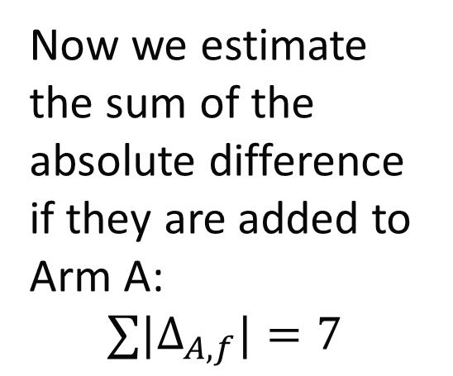
BAR: Taves Minimization Example
Factor | Level | # on Trt A | # on Trt B | 81st | |Δ_{A}|
Performance Status | Ambulatory | 29+1=30 | 32 | X | 2
 | Non-ambulatory | 10 | 9
Age | < 50 | 18+1=19 | 17 | X | 2
 | > 50 | 22 | 23
Disease-free interval | < 2 years | 31 | 32
 | > 2 years | 9+1=10 | 8 | X | 2
Dominant metastatic lesion | Visceral | 19+1=20 | 21 | X | 1
 | Osseous | 8 | 7
 | Soft tissue | 13 | 12
Now we estimate the sum of the absolute difference if they are added to Arm A:
$$∑|Δ_{A,f}|=7$$
Modified from Pg. 85 of Pocock, Stuart J. Clinical trials: a practical approach. John Wiley & Sons, 2013.
Notes:
Pocock, Stuart J. Clinical trials: a practical approach. John Wiley & Sons, 2013.
Taves would randomize to A since A=76, B=77.

Slide 24
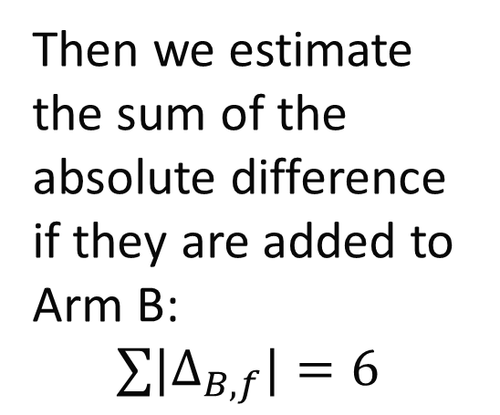
BAR: Taves Minimization Example
Factor | Level | # on Trt A | # on Trt B | 81st | |Δ_{B}|
Performance Status | Ambulatory | 29 | 32+1=33 | X | 3
 | Non-ambulatory | 10 | 9
Age | < 50 | 18 | 17+1=18 | X | 0
 | > 50 | 22 | 23
Disease-free interval | < 2 years | 31 | 32
 | > 2 years | 9 | 8+1=9 | X | 0
Dominant metastatic lesion | Visceral | 19 | 21+1=22 | X | 3
 | Osseous | 8 | 7
 | Soft tissue | 13 | 12
Then we estimate the sum of the absolute difference if they are added to Arm B:
$$∑|Δ_{B,f}|=6$$
Modified from Pg. 85 of Pocock, Stuart J. Clinical trials: a practical approach. John Wiley & Sons, 2013.
Notes:
Pocock, Stuart J. Clinical trials: a practical approach. John Wiley & Sons, 2013.
Taves would randomize to A since A=76, B=77.

Slide 25
BAR: Taves Minimization Example
Factor | Level | # on Trt A | # on Trt B | New Patient
Performance Status | Ambulatory | 29 | 32 | X
 | Non-ambulatory | 10 | 9
Age | < 50 | 18 | 17 | X
 | > 50 | 22 | 23
Disease-free interval | < 2 years | 31 | 32
 | > 2 years | 9 | 8 | X
Dominant metastatic lesion | Visceral | 19 | 21 | X
 | Osseous | 8 | 7
 | Soft tissue | 13 | 12
Since arm B “minimizes” the absolute difference, we would assigned the participant to Arm B, even though some factors have greater imbalance.
Modified from Pg. 85 of Pocock, Stuart J. Clinical trials: a practical approach. John Wiley & Sons, 2013.
Notes:
Pocock, Stuart J. Clinical trials: a practical approach. John Wiley & Sons, 2013.

Slide 26
BAR: Taves Minimization Limitation
While great for a “simpler” illustration of minimization, Taves’ approach has a potential limitation of being deterministic (i.e., there is no element of random chance unless the absolute differences are equal, then allocation is 1:1 via some random process)
This can be easily modified by adding a biased randomization based on the imbalance:
For example, randomizing with a probability of 80% to the arm that minimizes the imbalance but allowing for allocation to other arm(s)
The choice of 80% may need to be calibrated and explored via simulation studies

Slide 27
BAR: Pocock and Simon Minimization
The 1975 minimization approach by Pocock and Simon incorporate a biased randomization scheme. Let there be K arms, the allocation procedure procedures in the following general steps:
Based on some imbalance metric (e.g., the absolute difference from our last example, or the 1975 paper denotes others), the arms are ranked from 1 to K for the metric that minimizes the imbalance.
Allocation is randomly assigned based on some biased probability, where Pocock and Simon proposed 3 (detailed on next slide)

Slide 28
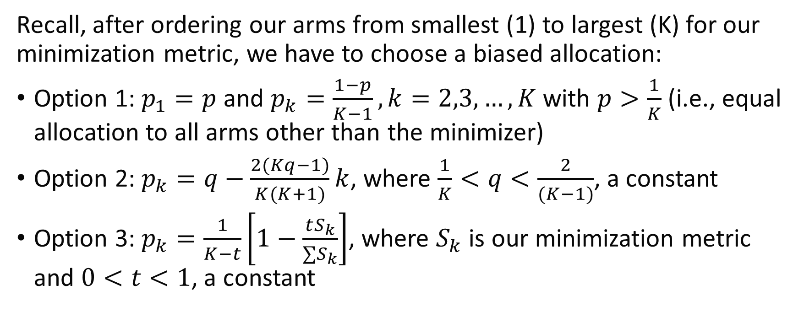
BAR: Pocock and Simon Minimization
Recall, after ordering our arms from smallest (1) to largest (K) for our minimization metric, we have to choose a biased allocation:
Option 1: $p_{1}=p$ and $p_{k}=\frac{1−p}{K−1}, k=2,3,…,K$ with $p>\frac{1}{K}$ (i.e., equal allocation to all arms other than the minimizer)
Option 2: $p_{k}=q−\frac{2(Kq−1)}{K(K+1)}k$, where $\frac{1}{K}<q<\frac{2}{(K−1)}$, a constant
Option 3: $p_{k}=\frac{1}{K−t}\left[1−\frac{tS_{k}}{∑S_{k}}\right]$, where $S_{k}$ is our minimization metric and $0<t<1$, a constant

Slide 29
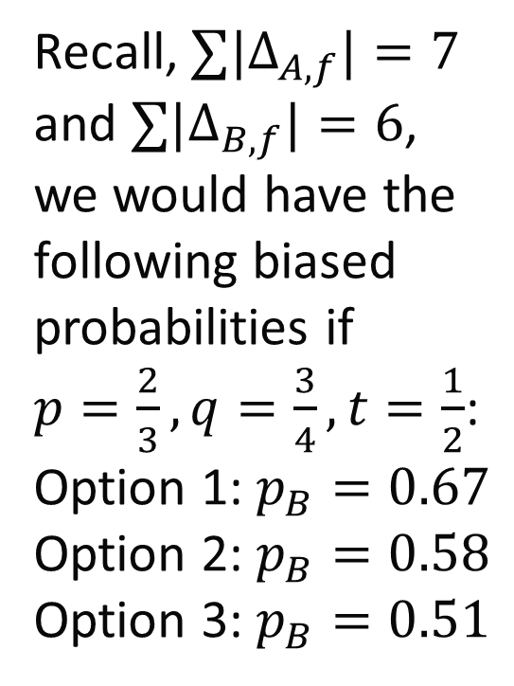
BAR: Pocock and Simon Minimization Example
Factor | Level | # on Trt A | # on Trt B | New Patient
Performance Status | Ambulatory | 29 | 32 | X
 | Non-ambulatory | 10 | 9
Age | < 50 | 18 | 17 | X
 | > 50 | 22 | 23
Disease-free interval | < 2 years | 31 | 32
 | > 2 years | 9 | 8 | X
Dominant metastatic lesion | Visceral | 19 | 21 | X
 | Osseous | 8 | 7
 | Soft tissue | 13 | 12
Recall, $∑|Δ_{A,f}|=7$
and $∑|Δ_{B,f}|=6$, we would have the following biased probabilities if $p=\frac{2}{3}, q=\frac{3}{4}, t=\frac{1}{2}$:
Option 1: $p_{B}=0.67$
Option 2: $p_{B}=0.58$
Option 3: $p_{B}=0.51$
Modified from Pg. 85 of Pocock, Stuart J. Clinical trials: a practical approach. John Wiley & Sons, 2013.
Notes:
Pocock, Stuart J. Clinical trials: a practical approach. John Wiley & Sons, 2013.
Option 1: p_B = 2/3, p_A = (1- 2/3)/(2-1) = 1/3 [or, with 2 arms, we can also simply do p_A = 1-p_B = 1-(2/3) = 1/3]
Option 2: p_B = $q−\frac{2(Kq−1)}{K(K+1)}k$ =$0.75−\frac{2\left(2×0.75−1\right)}{2\left(2+1\right)}1=0.583=\frac{7}{12}$;
p_A = $q−\frac{2(Kq−1)}{K(K+1)}k$ =$0.75−\frac{2\left(2×0.75−1\right)}{2\left(2+1\right)}2=0.417=\frac{5}{12}$
Option 3: p_B =$\frac{1}{K−t}\left[1−\frac{tS_{k}}{∑S_{k}}\right]=\frac{1}{2−0.5}\left[1−\frac{0.5×6}{13}\right]=0.513$

Slide 30
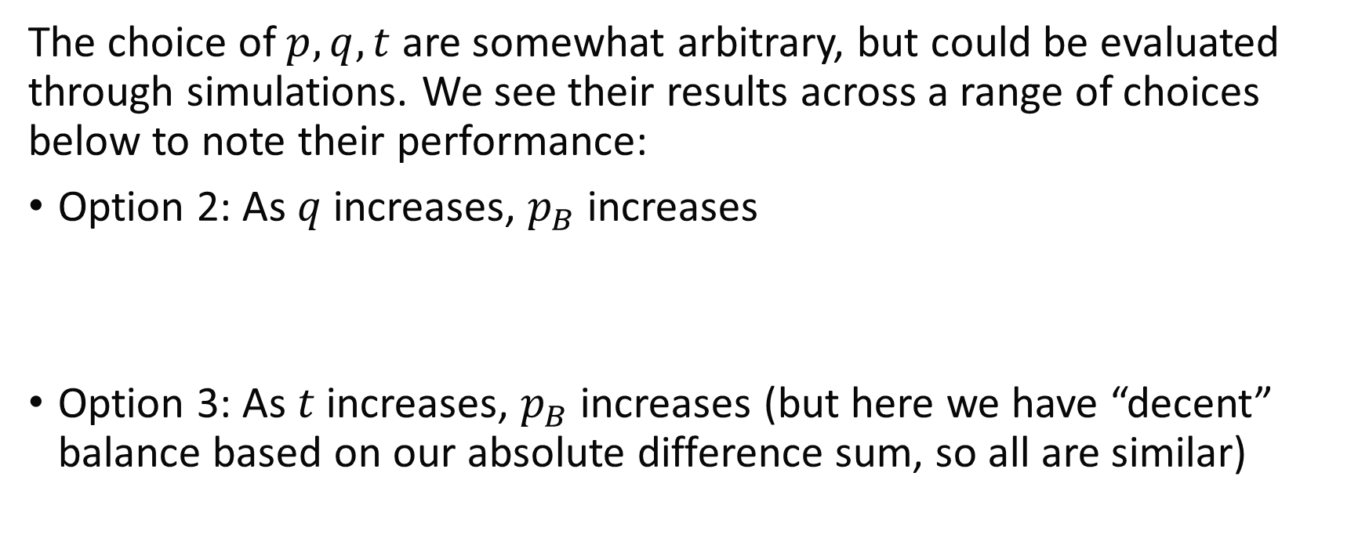
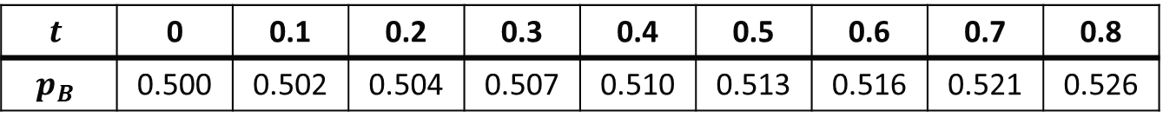
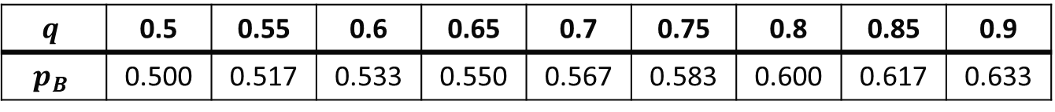
BAR: Pocock and Simon Minimization Example
The choice of $p,q,t$ are somewhat arbitrary, but could be evaluated through simulations. We see their results across a range of choices below to note their performance:
Option 2: As $q$ increases, $p_{B}$ increases
Option 3: As $t$ increases, $p_{B}$ increases (but here we have “decent” balance based on our absolute difference sum, so all are similar)
$$q$$ | 0.5 | 0.55 | 0.6 | 0.65 | 0.7 | 0.75 | 0.8 | 0.85 | 0.9
$$p_{B}$$ | 0.500 | 0.517 | 0.533 | 0.550 | 0.567 | 0.583 | 0.600 | 0.617 | 0.633
$$t$$ | 0 | 0.1 | 0.2 | 0.3 | 0.4 | 0.5 | 0.6 | 0.7 | 0.8
$$p_{B}$$ | 0.500 | 0.502 | 0.504 | 0.507 | 0.510 | 0.513 | 0.516 | 0.521 | 0.526
Notes:
# Option 2 R Code:
q <- seq(0.5,1,by=0.05)
round( q- ((2*(2*q-1)) / (2*3) )*1, 3)
# Option 3 R Code:
t <- seq(0,1,by=0.1)
round( (1/(2-t)) * (1-(t*6)/13), 3)

Slide 31
BAR: Minimization Considerations
Helps to prevent accidental bias from maldistribution of important strata
Facilitates valid subgroup analyses
Does not guarantee adequate power to make within-strata comparisons
Does not eliminate the need for covariate-adjusted analyses! Best practices are to adjust for any covariates used in stratification in your analysis.

Slide 32


RAR Designs
Many types of RAR designs exist, including two main families
Urn models:
Play-the-winner (Zelen, 1969, JASA)
Randomized play-the-winner (Wei and Durham, 1978, JASA)
Randomized Pólya Urn (Durham, Flournoy, & Li, 1998, CJS)
Double adaptive biased coin designs:
Eisele and Woodroofe (1995, Annals of Statistics)
Hu and Rosenberger (2003, JASA)
Notes:
Textbook cover: https://images.tandf.co.uk/common/jackets/amazon/978142005/9781420059830.jpg
Coin image: https://statmodeling.stat.columbia.edu/wp-content/uploads/2008/01/barker1.png
Papers:
Zelen, Marvin. "Play the winner rule and the controlled clinical trial." Journal of the American Statistical Association 64.325 (1969): 131-146.
Wei, L. J., and S. Durham. "The randomized play-the-winner rule in medical trials." Journal of the American Statistical Association 73.364 (1978): 840-843.
Durham, S. D., N. Flournoy, and W. Li. "A sequential design for maximizing the probability of a favourable response." Canadian Journal of Statistics 26.3 (1998): 479-495.
Eisele, Jeffrey R., and Michael B. Woodroofe. "Central limit theorems for doubly adaptive biased coin designs." The Annals of Statistics (1995): 234-254.
Hu, Feifang, and William F. Rosenberger. "Optimality, variability, power: evaluating response-adaptive randomization procedures for treatment comparisons." Journal of the American Statistical Association 98.463 (2003): 671-678.

Slide 33
RAR: Example with Playing the Winner
Zelen’s 1969 Play the Winner Design (2 arm study):
Assign 1st participant to either arm with equal probability
Observe success/failure in arm
Depending on outcome…
Observed success leads to a future participant receiving the same treatment (or increasing probability of same treatment)
Observed failure leads to a future participant receiving the other treatment (or decreasing probability of failed treatment)

Slide 34
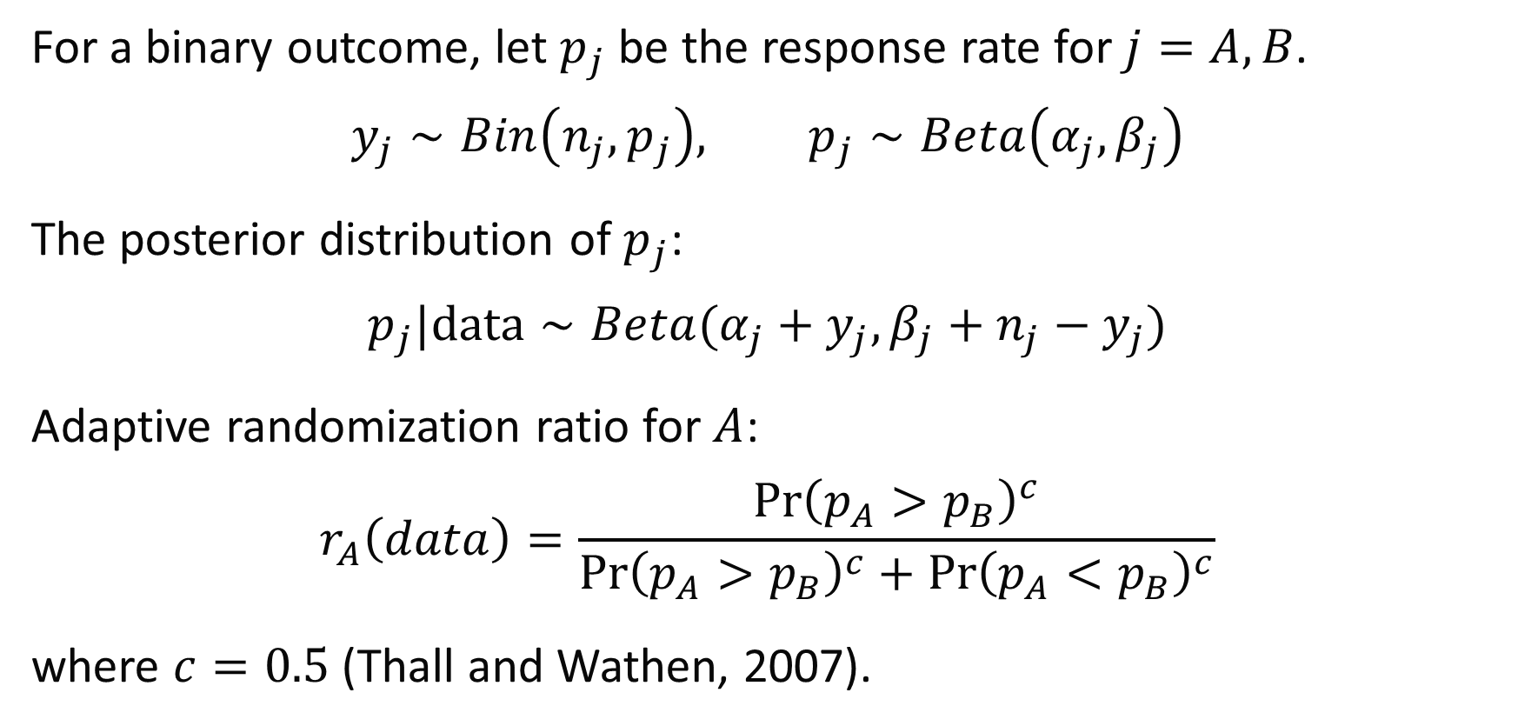
RAR: Bayesian Example
For a binary outcome, let $p_{j}$ be the response rate for $j=A,B$.
$$y_{j}∼Bin\left(n_{j},p_{j}\right), p_{j}∼Beta\left(α_{j},β_{j}\right)$$
The posterior distribution of $p_{j}$:
$$p_{j}|data∼Beta(α_{j}+y_{j},β_{j}+n_{j}−y_{j})$$
Adaptive randomization ratio for $A$:
$$r_{A}\left(data\right)=\frac{{\operatorname{Pr}\left(p_{A}>p_{B}\right)}^{c}}{{\operatorname{Pr}\left(p_{A}>p_{B}\right)}^{c}+{\operatorname{Pr}\left(p_{A}<p_{B}\right)}^{c}}$$
where $c=0.5$ (Thall and Wathen, 2007).
Notes:
Thall, Peter F., and J. Kyle Wathen. "Practical Bayesian adaptive randomisation in clinical trials." European Journal of Cancer 43.5 (2007): 859-866.

Slide 35
RAR Considerations
RAR designs can be used to identify better therapies more rapidly, and minimize the expected number of treatment failures
Number of arms (control vs. one treatment arm or multiple?)
Recent criticisms for 2 arm studies and early phase studies
Better for multi-arm studies with a shared control that maintains enrollment
Better for shorter term outcomes
Methods and approaches developed for longer term outcomes
Doesn’t ensure balance of baseline covariates like BAR designs
Notes:
D.A. Berry: Bayesian statistics and the efficiency and ethics of clinical trials, Statistical Science, 19: 175-187, 2004.
Criticisms:
Hey, Spencer Phillips, and Jonathan Kimmelman. "Are outcome-adaptive allocation trials ethical?." Clinical trials 12.2 (2015): 102-106.
Thall, P., P. Fox, and J. Wathen. "Statistical controversies in clinical research: scientific and ethical problems with adaptive randomization in comparative clinical trials." Annals of Oncology 26.8 (2015): 1621-1628.

Slide 36
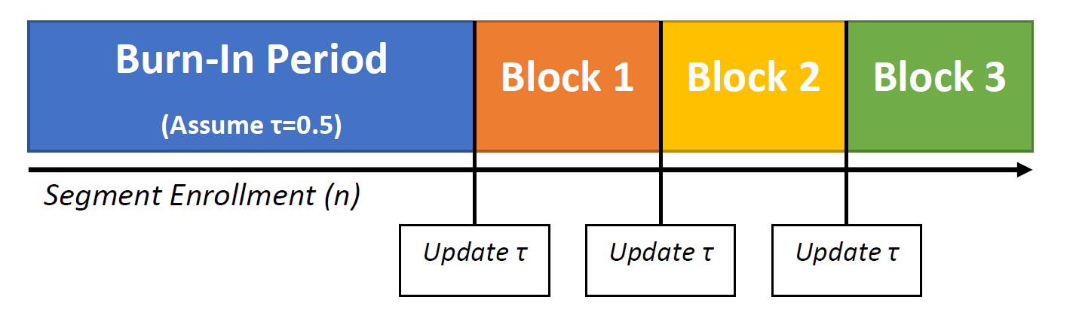
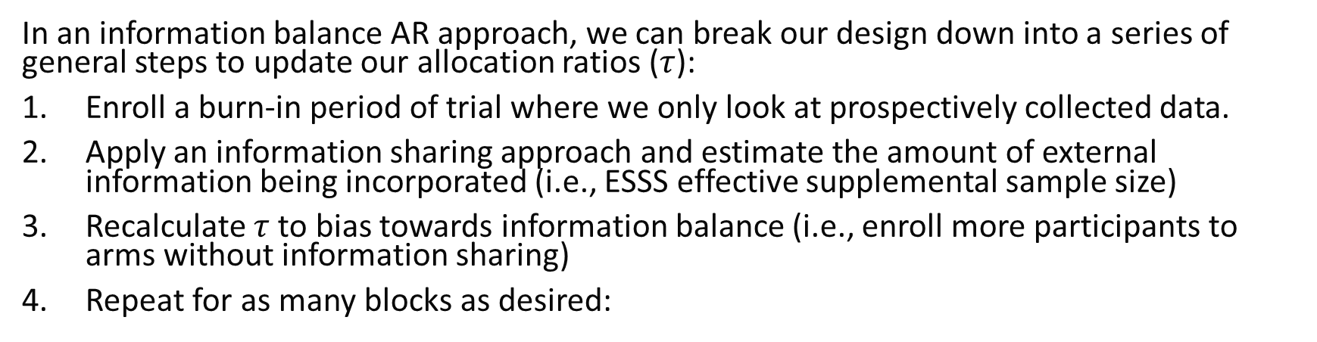
IBAR: General Steps
In an information balance AR approach, we can break our design down into a series of general steps to update our allocation ratios ($τ$):
Enroll a burn-in period of trial where we only look at prospectively collected data.
Apply an information sharing approach and estimate the amount of external information being incorporated (i.e., ESSS effective supplemental sample size)
Recalculate $τ$ to bias towards information balance (i.e., enroll more participants to arms without information sharing)
Repeat for as many blocks as desired:
Notes:
Kaizer, A. M., Hobbs, B. P., & Koopmeiners, J. S. (2018). A multi-source adaptive platform design for testing sequential combinatorial therapeutic strategies. Biometrics, 74(3), 1082-1094.

Slide 37
IBAR Example 1 (Naïve)
Assume we have a historic set of N_{H}=50 observations from a previous trial control arm and we are planning a study to enroll N=100 in a 1:1 allocation to the control and treatment arms (i.e., N_{C}=50 and N_{T}=50)
We have an interim analysis after 50 participants have been enrolled (i.e., N_{C}=N_{T}=25), and we decide to naively* incorporate all N_{H}=50 observations so that we really have N_{C}+N_{H}=25+50=75 control observations
To maintain the overall balance of control to treatment information in our 1:1 ratio, we would need to adjust our allocation ratio for the remaining 50 participants to have 100% allocation to the treatment arm (i.e., deterministic)
*Naïve pooling is generally not recommended (more discussion in information sharing module)

Slide 38
IBAR Example 2 (Bayesian Sharing Method)
Assume we have a historic set of N_{H}=50 observations from a previous trial control arm and we are planning a study to enroll N=100 in a 1:1 allocation to the control and treatment arms (i.e., N_{C}=50 and N_{T}=50)
We have an interim analysis after 50 participants have been enrolled (i.e., N_{C}=N_{T}=25), and we decide to use a Bayesian information sharing that estimates we incorporate information worth approximately N_{H}=15 observations (i.e., the effective supplemental sample size)
We can roughly think of this ashaving N_{C}+N_{H}=25+15=35 control observations (i.e., the effective sample size)
To maintain the overall balance of control to treatment information in our 1:1 ratio, we would need to adjust our allocation ratio for the remaining 50 participants to enroll 17 controls and 33 treatment participants (i.e., 1.94:1 treatment:control allocation)

Slide 39
IBAR Considerations
Having multiple blocks is useful, since methods to evaluate if or how much external data to incorporate are likely to change how aggressively they borrow data over time due to:
More prospective study data to evaluate for exchangeability
Naturally occurring random changes in observed outcomes
The interim estimate of the number of controls could change by the end of the trial, so re-evaluating in blocks allows to potentially randomize relatively more to the arm that previously incorporated external data if it is no longer warranted to do so
Notes:
Hobbs, Brian P., Bradley P. Carlin, and Daniel J. Sargent. "Adaptive adjustment of the randomization ratio using historical control data." Clinical Trials 10.3 (2013): 430-440.

Slide 40
Case Study

Slide 41
Clinical Trial: RAR Example
Name: Established Status Epilepticus Treatment Trial (ESETT; NCT01960075)
Design: multi-center, blinded, comparative effectiveness study
Population: benzodiazepine-refractory status epilepticus participants older than 2 years
Purpose: to determine the most effective treatment for epilepsy among three study drugs: fosphenytoin, levetiracetam, and valproic acid
Notes:
Kapur, Jaideep, et al. "Randomized trial of three anticonvulsant medications for status epilepticus." New England Journal of Medicine 381.22 (2019): 2103-2113.

Slide 42
Clinical Trial: RAR Example
N: 795
Randomization Ratio: 1:1:1 until 300 participants, then adaptive; stratified by age category according to targeted probabilities
Primary Outcome: absence of clinically apparent seizures and improving responsiveness at 60 minutes after start of drug infusion
Adaptive Elements:
Response adaptive randomization to allocate more participants after 300 to the most promising study arm(s)
Interim monitoring for futility or efficacy
Notes:
Kapur, Jaideep, et al. "Randomized trial of three anticonvulsant medications for status epilepticus." New England Journal of Medicine 381.22 (2019): 2103-2113.

Slide 43
Clinical Trial: RAR Example
Trial ultimately terminated for futility after 384 participants because it was determined that the probability of reaching full enrollment and detecting a significant effect was minimal
Adaptive randomization implemented: N=145 for levetiracetam, N=118 for fosphenytoin, and N=121 for valproate
Notes:
Kapur, Jaideep, et al. "Randomized trial of three anticonvulsant medications for status epilepticus." New England Journal of Medicine 381.22 (2019): 2103-2113.

Slide 44
Module Conclusions
Baseline AR may facilitate the overall balance flexibly than stratified randomization (although this is marginal balance, and particular prognostic or baseline factors of interest may have imbalance)
Response AR has the ethical appeal of allocating more participants to “better” study arms, but may inadvertently allocate more to poorer performing arms in 2 arm studies and is recommended for multi-arm designs with a fixed control allocation
Information balance AR is used when incorporating external data in an attempt to better balance the overall information from external and internal sources

Slide 45
Available Software Resources
There are many more information sharing approaches, but luckily software is plentiful for implementation!
R packages: SeqAlloc (B/RAR), randomizeR (B/RAR), miniRand (BAR), blockRAR (RAR), etc.

Slide 46
References
Kaizer, Alexander M., et al. "Recent innovations in adaptive trial designs: a review of design opportunities in translational research." Journal of Clinical and Translational Science (2023): 1-35.
US Food and Drug Administration. Adaptive designs for clinical trials of drugs and biologics guidance for industry. https://www.fda.gov/regulatory-information/search-fda-guidance-documents/adaptive-design-clinical-trials-drugs-and-biologics-guidance-industry
Taves, Donald R. "Minimization: a new method of assigning patients to treatment and control groups." Clinical Pharmacology & Therapeutics 15.5 (1974): 443-453.
Pocock, Stuart J., and Richard Simon. "Sequential treatment assignment with balancing for prognostic factors in the controlled clinical trial." Biometrics (1975): 103-115.
Pocock, Stuart J. Clinical trials: a practical approach. John Wiley & Sons, 2013.
Kaizer, A. M., Hobbs, B. P., & Koopmeiners, J. S. (2018). A multi-source adaptive platform design for testing sequential combinatorial therapeutic strategies. Biometrics, 74(3), 1082-1094.
Kapur, Jaideep, et al. "Randomized trial of three anticonvulsant medications for status epilepticus." New England Journal of Medicine 381.22 (2019): 2103-2113.

Slide 47

Contact Info:
Email:
alex.kaizer@cuanschutz.edu
Website: www.alexkaizer.com
GitHub: alexbiostats

