Slide 1
Adaptive and Bayesian Methods for Clinical Trial Design Short Course
Dr. Alex Kaizer
Bayesian Methods for Information Sharing
Notes:
xx

Slide 2

Overview Paper:

Slide 3
Background
Why reinvent the wheel if you already have so much data?

Slide 4










A Continuum of Options (Mixing Apples and Oranges)
THE MIDDLE GROUND
NAÏVE POOLING
SEPARATE
The more appropriate middle ground based on “exchangeability”:
Only prospectively collected Honeycrisp apples.
?
Mixing apples and oranges?!

Slide 5
Some Terminology
I will interchangeably use historic, supplemental, and external to indicate “sources” of data to incorporate into a trial
A Phase III trial may have previously completed historic Phase II studies to borrow data from that were conducted as part of the development process
A basket trial may wish to share information across baskets as “supplemental” sharing that is internal to the trial
A study may wish to borrow from registry or observational data, past trials, etc. that are external to the trial and study team
Exchangeability implies we could swap individuals between any two data sources and observe the same results (i.e., outcomes are similar)
This serves as an assumption for many of the methods for borrowing information

Slide 6
Some Terminology
Dynamic vs. Static Borrowing
Static indicates a priori decision where current data doesn’t inform borrowing
Effective sample size (ESS)
Part of an analysis is knowledge of the actual sample size (n)
With Bayesian methods, priors and methods of dynamic borrowing can incorporate “effective” knowledge to our analysis (n becomes n+something from priors and/or external data for the sake of our analysis)
Effective Supplemental/Historic Sample Size (ESSS or EHSS)
The amount of data incorporated from the historic data, incorporating the influence of choice of priors on the historic pieces

Slide 7
Why borrow?
Clinical trials do not often occur out of nowhere
They are generally the result of many prior studies
Many times, we have historic information for a control arm
Sometimes for the treatment arm(s) as well, but this may be seen as less stable depending on how the studies have evolved
Including historic data in the analysis can improve the precision of our estimates, leading to
Increased power and reduced type I error
Potential for reducing our needed sample size (or randomizing more to the treatment arm)

Slide 8
Concerns with borrowing
If the supplemental sources are not exchangeable, we may
Introduce bias
Reduce our power, inflate our type I error rate
Different methods have different trade-offs
Some may struggle to simultaneously account for multiple sources with varying levels of exchangeability
Others may be increasingly complex and challenging to implement without specialization in the methods

Slide 9
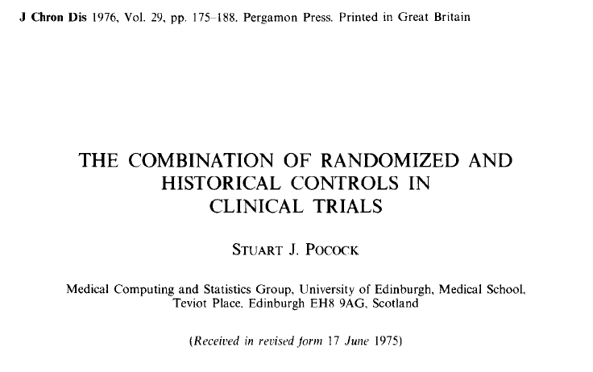
Initial Idea

Slide 10
Pocock’s Criteria for Acceptable Historic Controls
Received a precisely defined treatment which is the same as the randomized controls in the current study
Part of a recent study with identical eligibility requirements
Methods of treatment evaluation must be the same
Distribution of important patient characteristics should be comparable
Previous study performed by the same organization with the same clinical investigators
No indications leading one to expect different results between groups

Slide 11
Many Approaches Exist to Incorporating Supplemental Information
Separate
(Naïve) Pooling
Single arm trial
Test-then-pool
Power priors
Hierarchical modeling

Slide 12
Separate, Pooling, Single Arm, Test-then-Pool

Slide 13
Separate Approach
In this approach we ignore the historical data (except perhaps for power calculations to the design a study)
In other words, this approach is how we traditionally conduct most trials and do most analyses
No gain in efficiency from the historic data
Represents one extreme along the continuum of borrowing data

Slide 14
(Naïve) Pooling Approach
In this approach we combine all data without any real evaluation of exchangeability or the appropriateness
We are making an implicit assumption about the exchangeability of all data (i.e., assuming it all comes from the same distribution)
If exchangeability assumption is violated, we may have extremely biased results
Represents the other extreme of borrowing

Slide 15
Single Arm Trial Approach
Utilizing historic data, we can estimate a benchmark to compare a prospective cohort of individuals on a treatment
Advantageous in that we can assign all prospective participants to the proposed intervention
May be challenging to identify which historic sources are exchangeable and should be combined
We may also be concerned with temporal changes

Slide 16
Test-then-Pool Approach
Before determining if we should naively pool or ignore historic data, we first test a hypothesis that the current control group is equal to the historic control estimate
If we fail to reject, then we pool
If we reject, we analyze the data without incorporating the historic controls
Works to control the inflation of the type I error introduced by naïve pooling or single arm trials
One of the most basic examples of dynamic borrowing
Depends on the power at the evaluation of historic and contemporaneous controls (can choose different α-levels)

Slide 17
Power Prior Type Approaches

Slide 18

Original Power Prior
Originally proposed by Ibrahim and Chen (2000)
The power prior is motivated to incorporate historic data by downweighting the likelihood of the historic data as the prior (more details on the next slide)

Slide 19
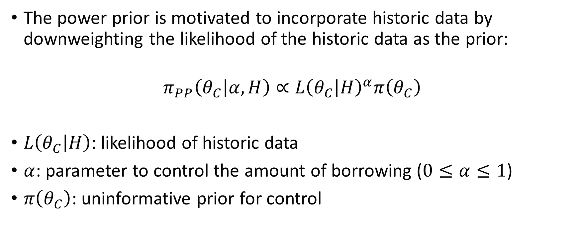
Original Power Prior
The power prior is motivated to incorporate historic data by downweighting the likelihood of the historic data as the prior:
$$π_{PP}\left(θ_{C} | α, H\right)∝L{\left(θ_{C} | H\right)}^{α}π\left(θ_{C}\right)$$
$L\left(θ_{C} | H\right)$: likelihood of historic data
$α$: parameter to control the amount of borrowing ($0≤α≤1$)
$π\left(θ_{C}\right)$: uninformative prior for control

Slide 20
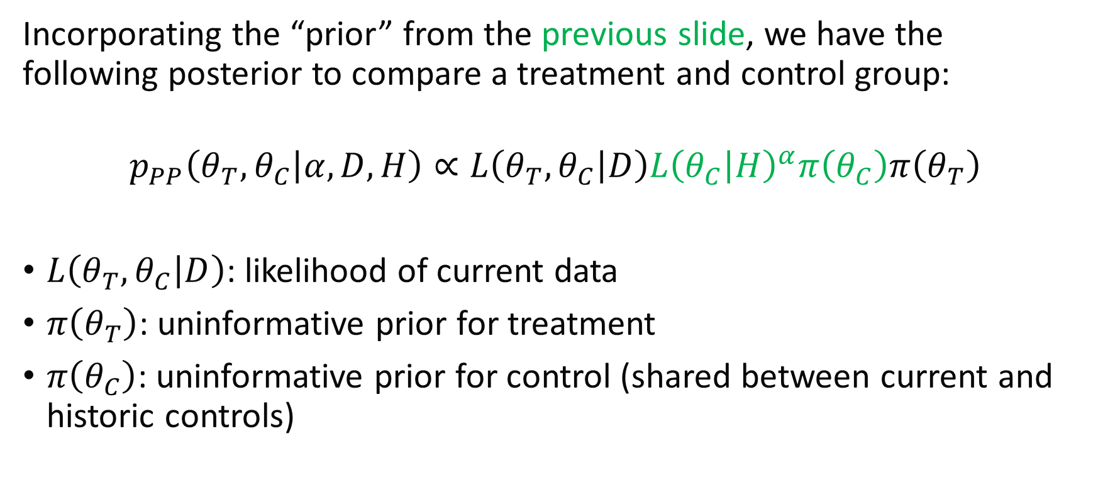
Original PP Posterior
Incorporating the “prior” from the previous slide, we have the following posterior to compare a treatment and control group:
$$p_{PP}\left(θ_{T},θ_{C} | α, D, H\right)∝L\left(θ_{T},θ_{C} | D\right)L{\left(θ_{C} | H\right)}^{α}π\left(θ_{C}\right)π\left(θ_{T}\right)$$
$L\left(θ_{T},θ_{C} | D\right)$: likelihood of current data
$π\left(θ_{T}\right)$: uninformative prior for treatment
$π\left(θ_{C}\right)$: uninformative prior for control (shared between current and historic controls)

Slide 21
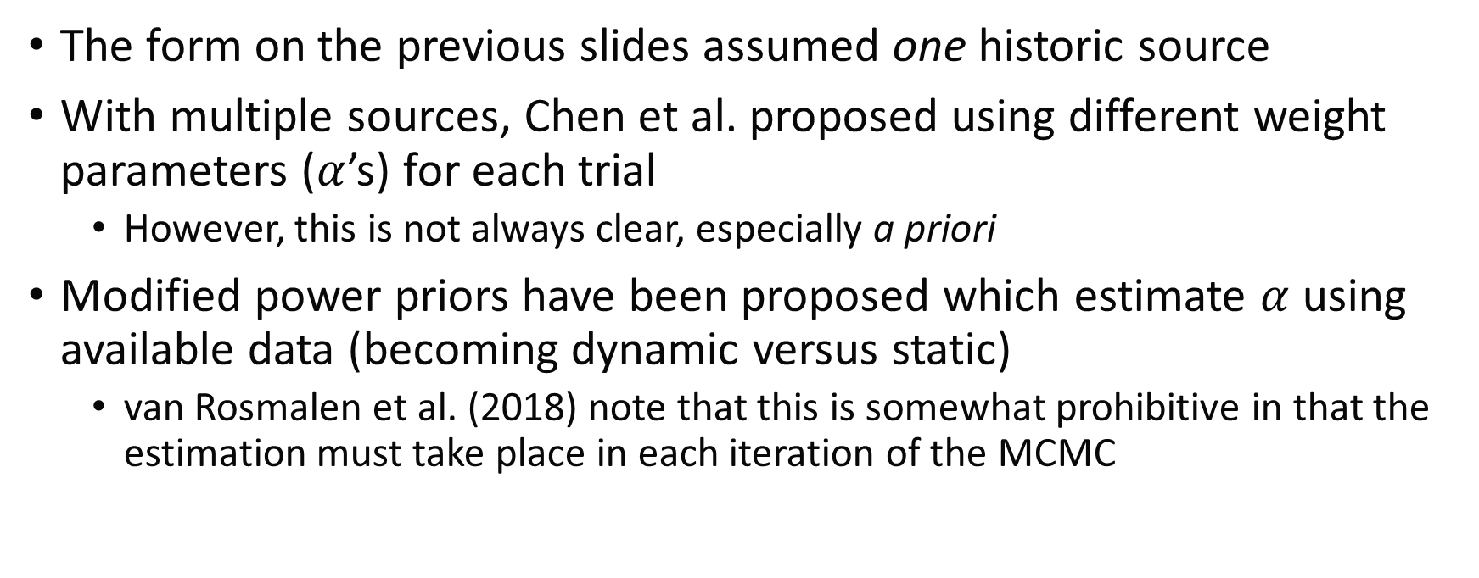
Some Original PP Considerations
The form on the previous slides assumed one historic source
With multiple sources, Chen et al. proposed using different weight parameters ($α$’s) for each trial
However, this is not always clear, especially a priori
Modified power priors have been proposed which estimate $α$ using available data (becoming dynamic versus static)
van Rosmalen et al. (2018) note that this is somewhat prohibitive in that the estimation must take place in each iteration of the MCMC

Slide 22
Hierarchical Methods: Multi-Source Exchangeability Models (MEMs)

Slide 23
Motivation Refresher
When supplementary information related to a primary data source is available, we may want to consider incorporating it into our primary source
Goal is for improved efficiency compared to the standard analysis without borrowing
Conventional approaches assuming exchangeable data sampling models may struggle to account for between-study heterogeneity

Slide 24
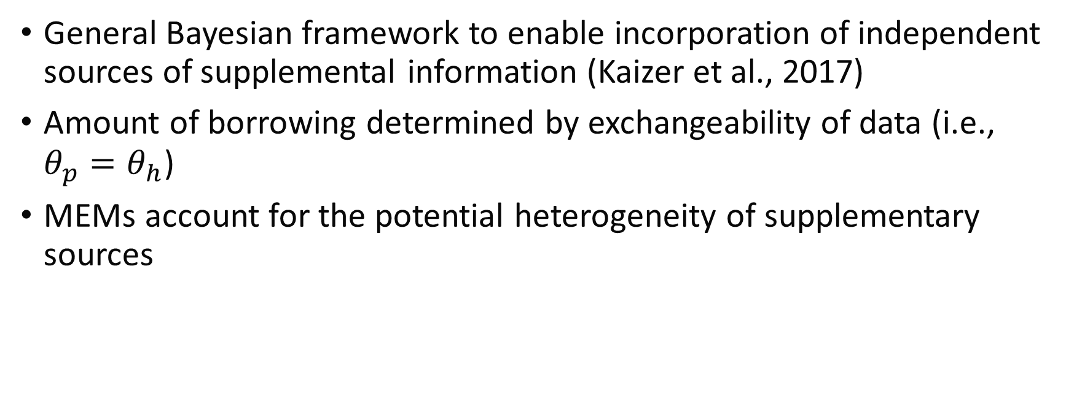
MEMs
General Bayesian framework to enable incorporation of independent sources of supplemental information (Kaizer et al., 2017)
Amount of borrowing determined by exchangeability of data (i.e., $θ_{p}=θ_{h}$)
MEMs account for the potential heterogeneity of supplementary sources

Slide 25
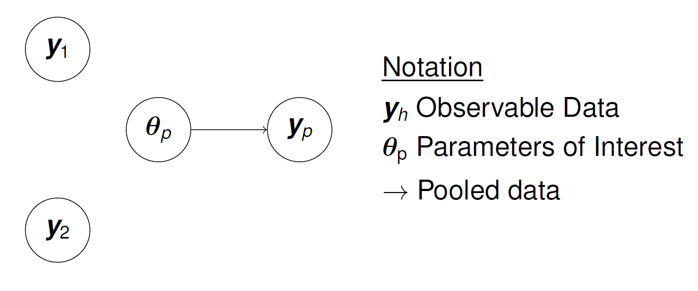
Standard Analysis without Borrowing

Slide 26
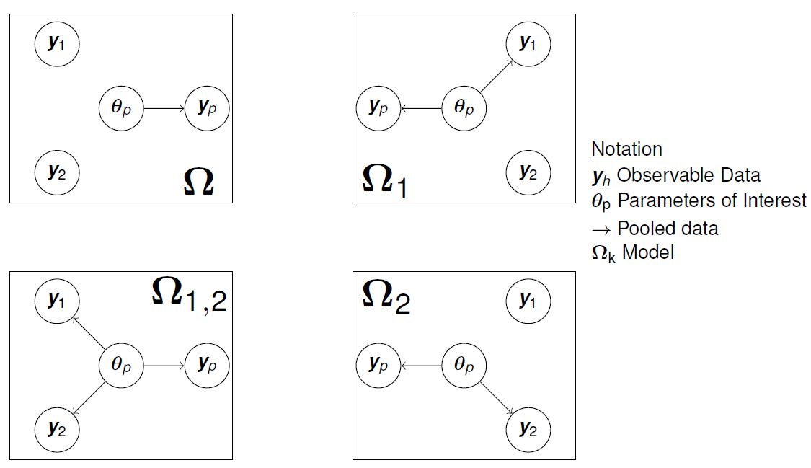
MEM Framework with 2 Supplemental Sources

Slide 27
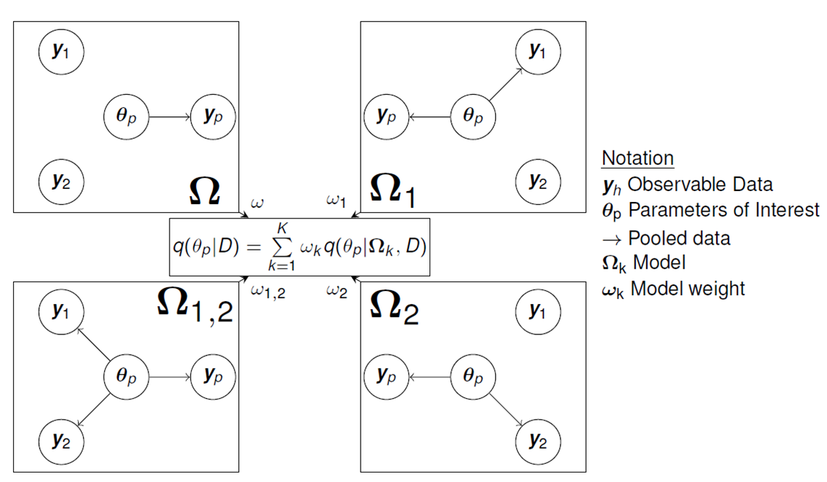
MEM Framework with 2 Supplemental Sources

Slide 28

The Big Picture
MEMs represent all potential assumptions of exchangeability of the supplemental sources: $K=2^{H}$ possible combinations
The primary goal is still to estimate $θ_{p}$

Slide 29
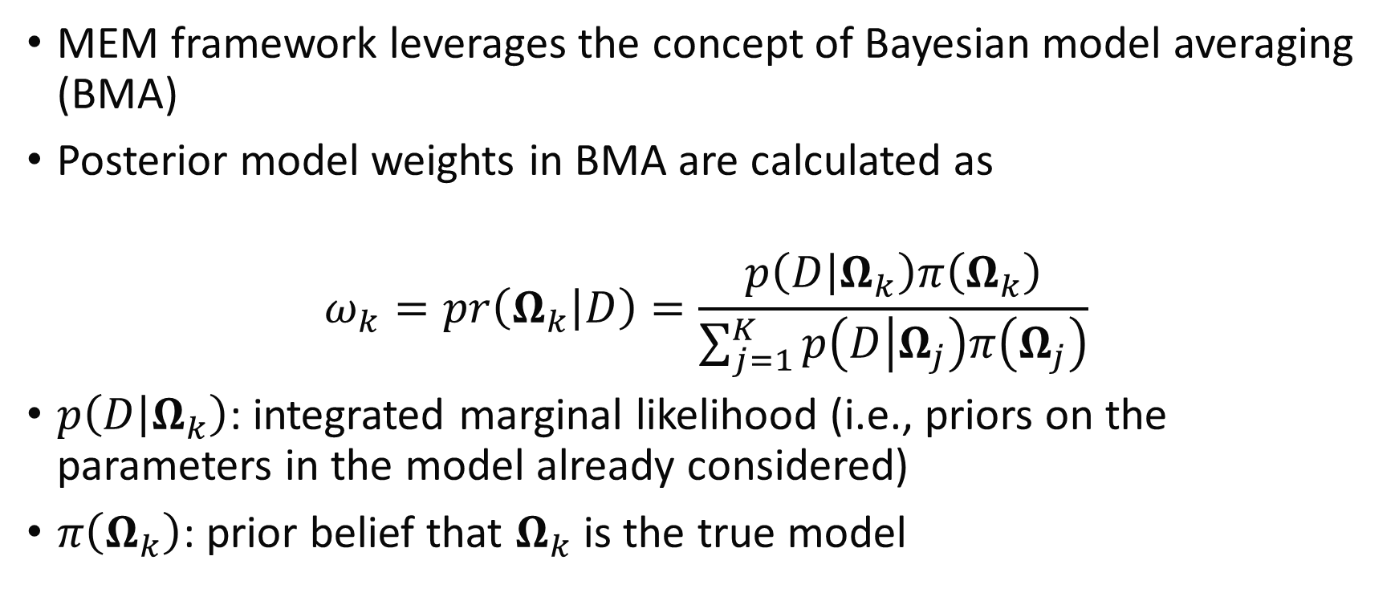
Building the MEM Framework
MEM framework leverages the concept of Bayesian model averaging (BMA)
Posterior model weights in BMA are calculated as
$$ω_{k}=pr\left(Ω_{k} | D\right)=\frac{p\left(D | Ω_{k}\right)π\left(Ω_{k}\right)}{\sum_{j=1}^{K}{p\left(D | Ω_{j}\right)π\left(Ω_{j}\right)}}$$
$p\left(D | Ω_{k}\right)$: integrated marginal likelihood (i.e., priors on the parameters in the model already considered)
$π\left(Ω_{k}\right)$: prior belief that $Ω_{k}$ is the true model

Slide 30
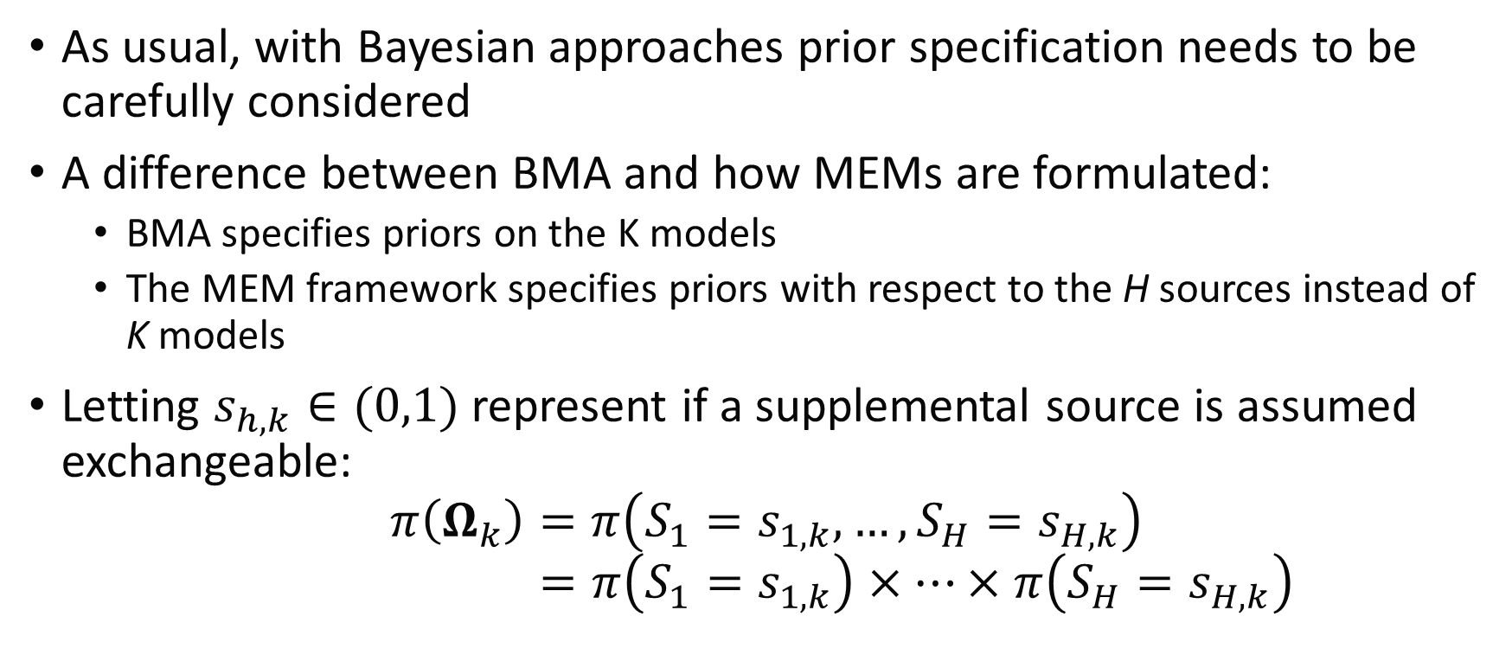

Specifying Model Priors: $π\left(Ω_{k}\right)$
As usual, with Bayesian approaches prior specification needs to be carefully considered
A difference between BMA and how MEMs are formulated:
BMA specifies priors on the K models
The MEM framework specifies priors with respect to the H sources instead of K models
Letting $s_{h,k}∈(0,1)$ represent if a supplemental source is assumed exchangeable:
$$π\left(Ω_{k}\right)=π\left(S_{1}=s_{1,k},…,S_{H}=s_{H,k}\right)$$
$$=π\left(S_{1}=s_{1,k}\right)×…×π\left(S_{H}=s_{H,k}\right)$$

Slide 31
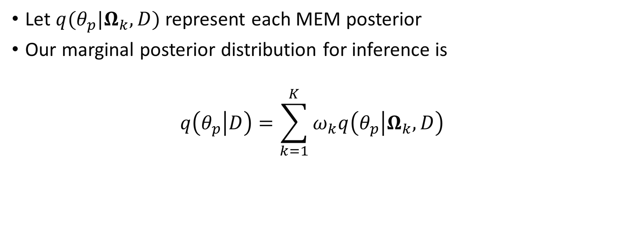
Posterior Inference with MEMs
Let $q(θ_{p}|Ω_{k},D)$ represent each MEM posterior
Our marginal posterior distribution for inference is
$$q\left(θ_{p} | D\right)=\sum_{k=1}^{K}{ω_{k}q\left(θ_{p} | Ω_{k},D\right)}$$

Slide 32
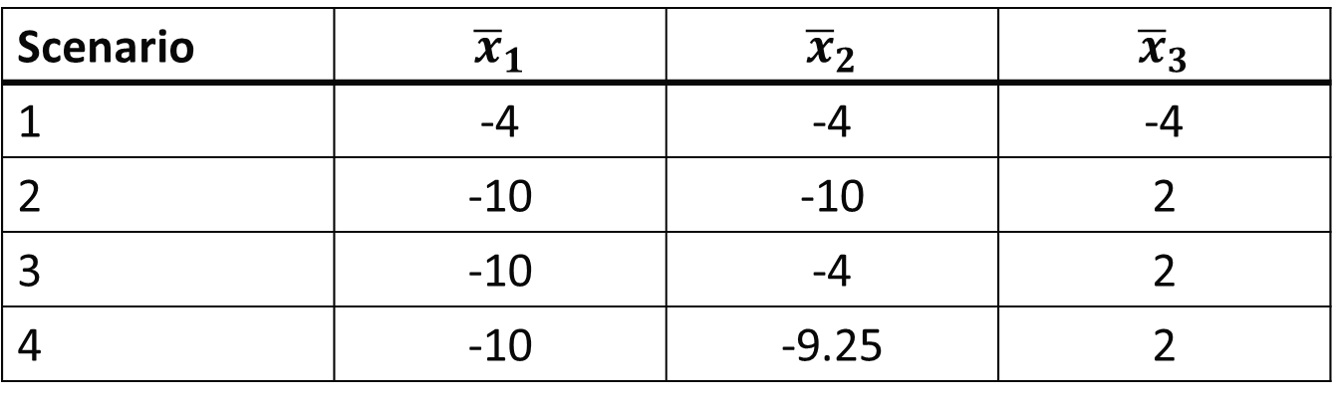
Illustration with 3 Supplemental Sources
On the following slides we highlight the performance of MEMs with respect to simulation results from Kaizer et al. (2018)
Consider 2 MEM priors and compare with commensurate priors (power prior-type approach) and a standard hierarchical model
The context is a normally distributed outcome under 4 scenarios:
Scenario | $${\overline{x}}_{1}$$ | $${\overline{x}}_{2}$$ | $${\overline{x}}_{3}$$
1 | -4 | -4 | -4
2 | -10 | -10 | 2
3 | -10 | -4 | 2
4 | -10 | -9.25 | 2

Slide 33
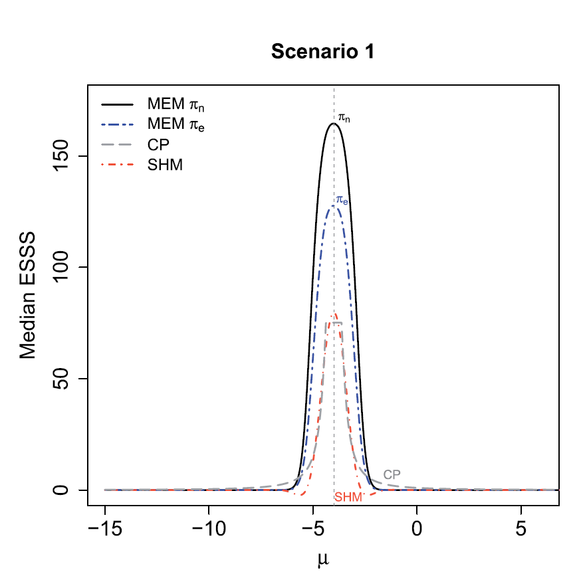

Slide 34
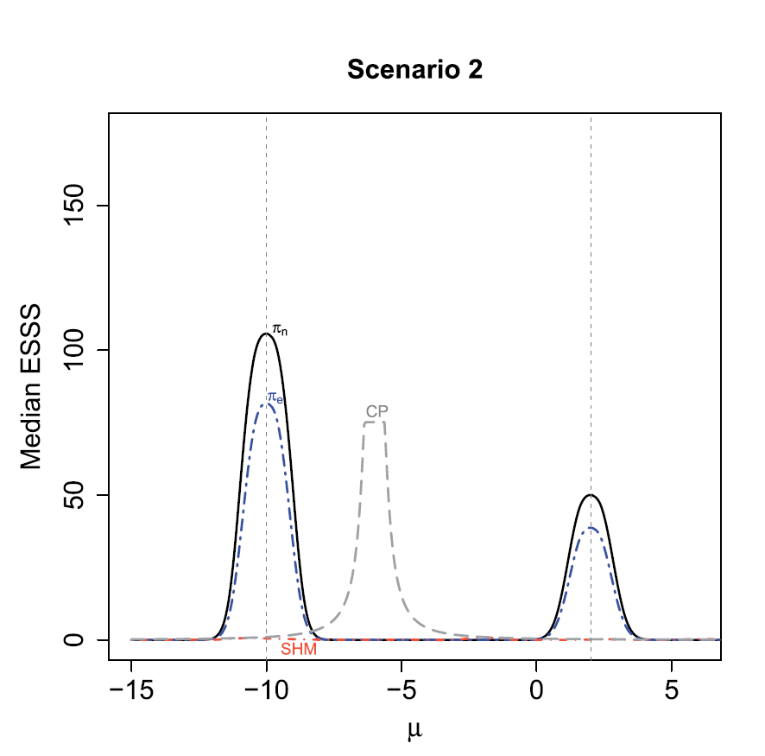

Slide 35
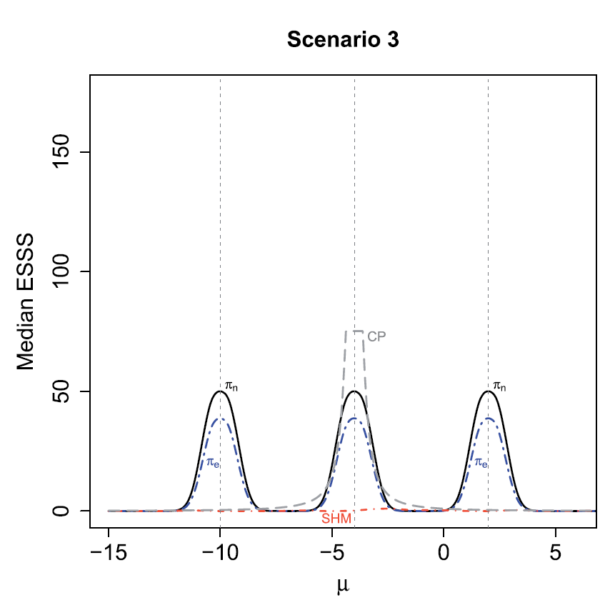

Slide 36
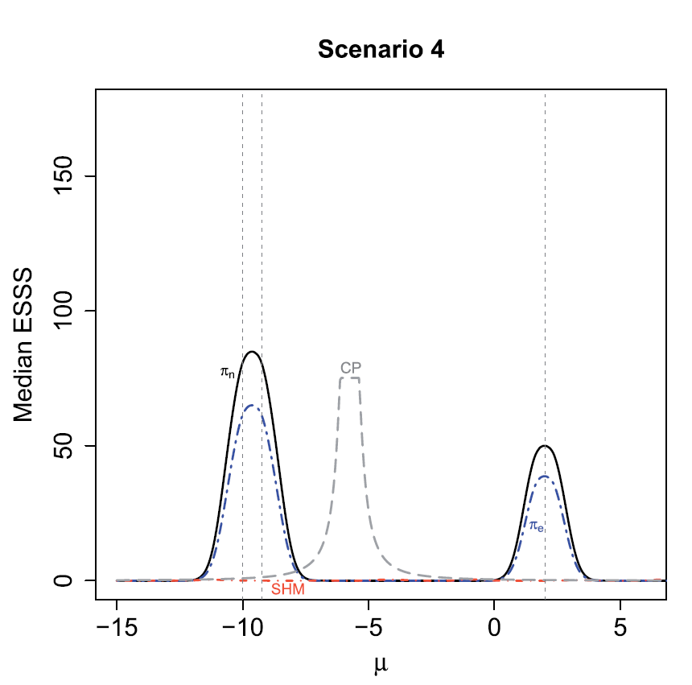

Slide 37
Seminal MEM Paper Conclusions
MEMs have desirable asymptotic properties for the posterior model weights (not shown)
In simulation studies, MEMs achieved up to 56% reduction in bias when there is heterogeneity among the supplemental sources, compared to competing Bayesian hierarchical modeling strategies
In application, MEMs resulted in a 30% improvement in efficiency compared to a standard analysis without borrowing (not shown)

Slide 38
Can I use MEMs now?
R package functionality is in development
An extension of MEMs for use in basket trials is available in the “basket” package
Uses symmetric versus asymmetric borrowing (i.e., no one source is considered as “primary” compared to all other sources)
MEMs have been extended to regression contexts (Kotalik 2022) and other settings are in development

Slide 39
Hierarchical Methods: Meta-Analytic-Predictive (MAP) Priors

Slide 40
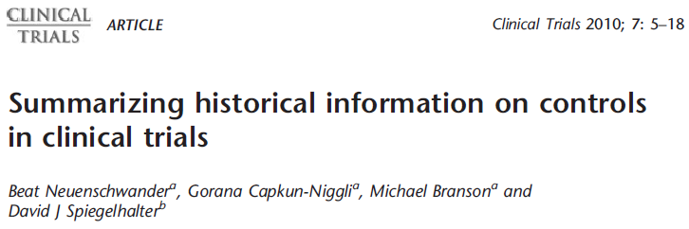
MAP Approach
Proposed by Neuenschwander et al. (2010)
Motivating by meta-analytic techniques and methods

Slide 41
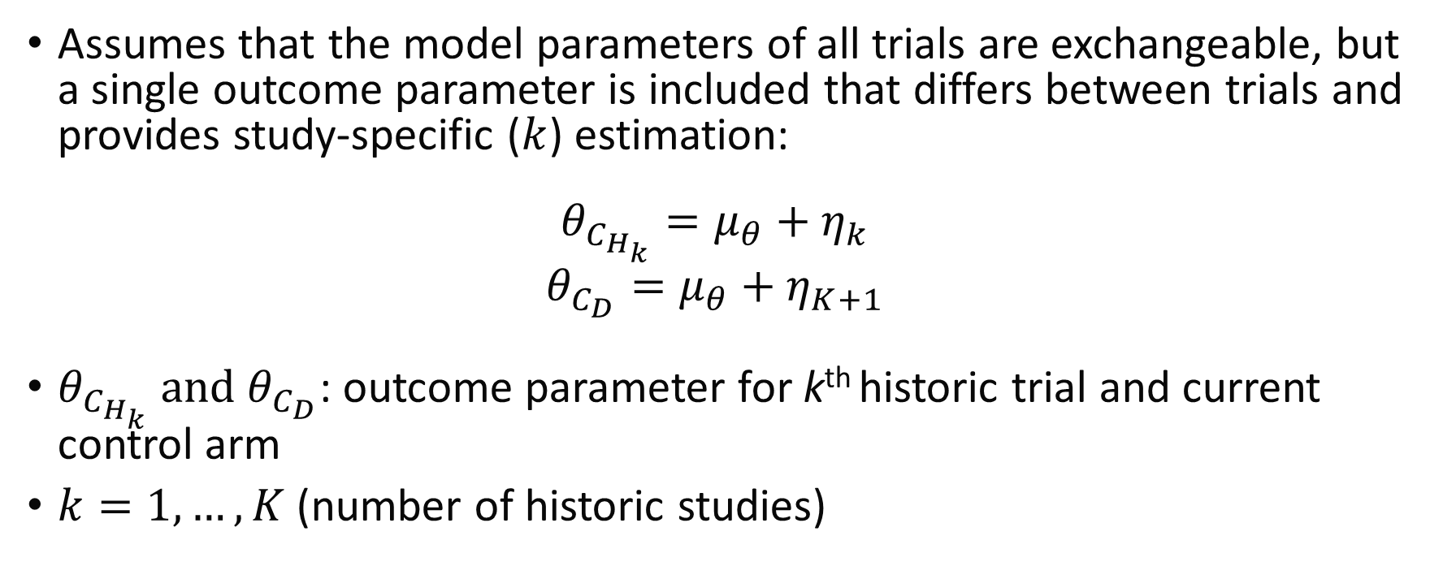
MAP Details
Assumes that the model parameters of all trials are exchangeable, but a single outcome parameter is included that differs between trials and provides study-specific ($k$) estimation:
$$θ_{C_{H_{k}}}=μ_{θ}+η_{k}$$
$$θ_{C_{D}}=μ_{θ}+η_{K+1}$$
$θ_{C_{H_{k}}}$ and $θ_{C_{D}}$: outcome parameter for k^{th} historic trial and current control arm
$k=1,…,K$ (number of historic studies)

Slide 42
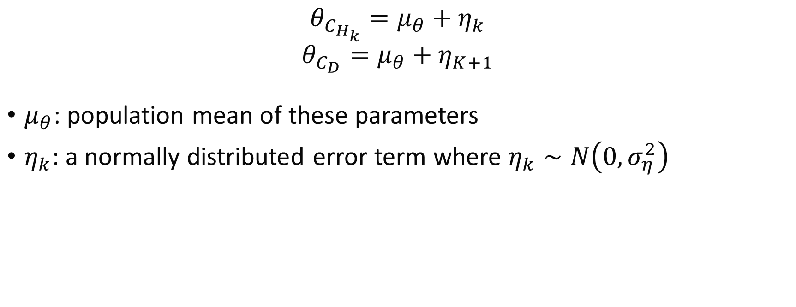
MAP Details cont.
$$θ_{C_{H_{k}}}=μ_{θ}+η_{k}$$
$$θ_{C_{D}}=μ_{θ}+η_{K+1}$$
$μ_{θ}$: population mean of these parameters
$η_{k}$: a normally distributed error term where $η_{k}∼N\left(0,σ_{η}^{2}\right)$

Slide 43
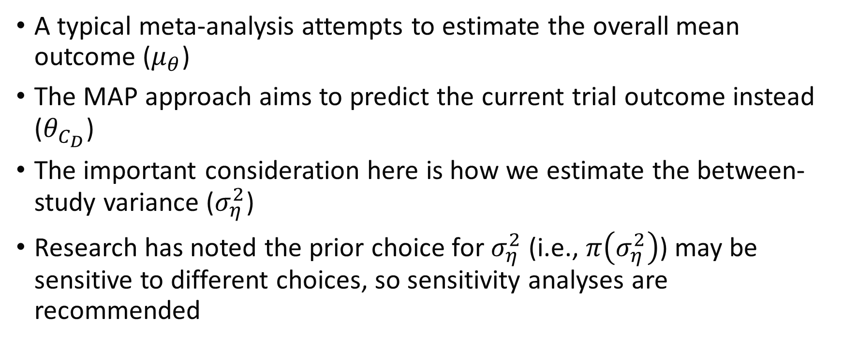
MAP Difference with Meta-Analysis
A typical meta-analysis attempts to estimate the overall mean outcome ($μ_{θ}$)
The MAP approach aims to predict the current trial outcome instead ($θ_{C_{D}}$)
The important consideration here is how we estimate the between-study variance ($σ_{η}^{2}$)
Research has noted the prior choice for $σ_{η}^{2}$ (i.e., $π\left(σ_{η}^{2}\right)$) may be sensitive to different choices, so sensitivity analyses are recommended

Slide 44
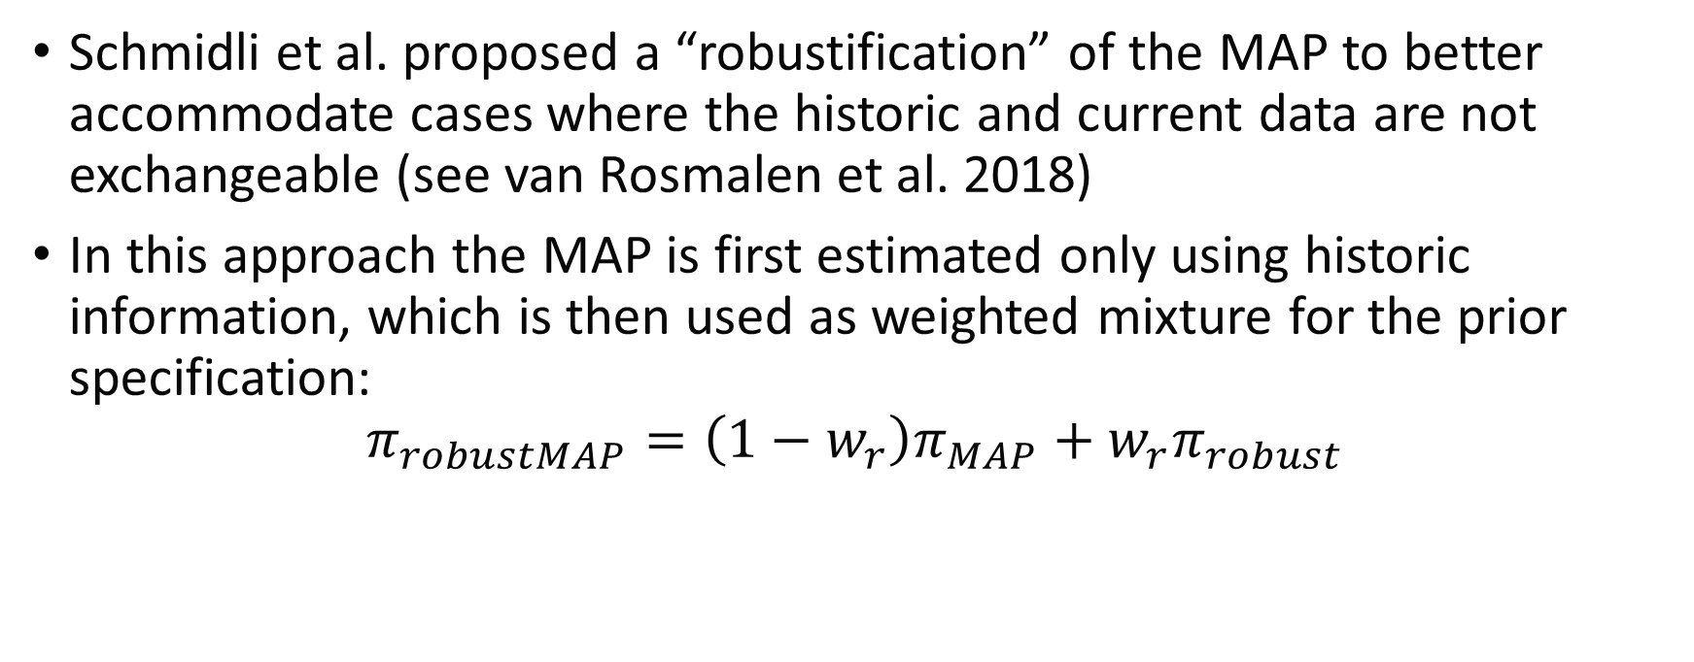
MAP Extension
Schmidli et al. proposed a “robustification” of the MAP to better accommodate cases where the historic and current data are not exchangeable (see van Rosmalen et al. 2018)
In this approach the MAP is first estimated only using historic information, which is then used as weighted mixture for the prior specification:
$$π_{robustMAP}=\left(1−w_{r}\right)π_{MAP}+w_{r}π_{robust}$$

Slide 45
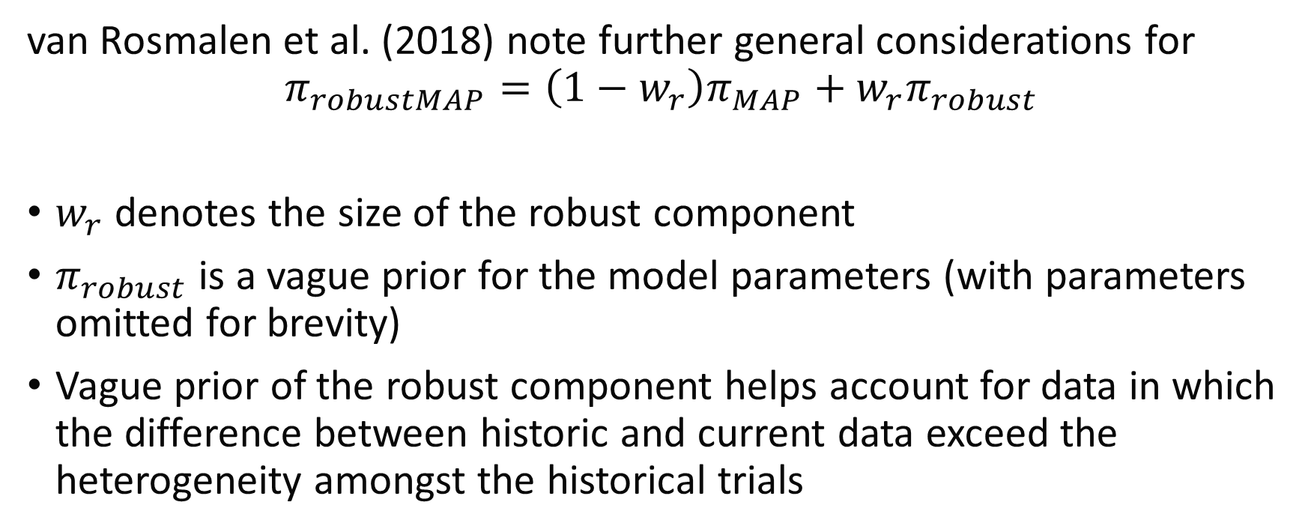
Robust MAP Considerations
van Rosmalen et al. (2018) note further general considerations for
$$π_{robustMAP}=\left(1−w_{r}\right)π_{MAP}+w_{r}π_{robust}$$
$w_{r}$ denotes the size of the robust component
$π_{robust}$ is a vague prior for the model parameters (with parameters omitted for brevity)
Vague prior of the robust component helps account for data in which the difference between historic and current data exceed the heterogeneity amongst the historical trials

Slide 46
Case Study

Slide 47
Clinical Trial: Information Sharing Example
Trial Name 1: Evaluation of the Safety and Effectiveness of the OPTIMIZER System in Subjects With Heart Failure: FIX-HF-5 (FIX-HF-5; NCT00112125)
Trial Name 2: Evaluate Safety and Efficacy of the OPTIMIZER® System in Subjects With Moderate-to-Severe Heart Failure: FIX-HF-5C (FIX-HF-5C; NCT01381172)
Design 1 and 2: multi-center, randomized, open-labeled
Population 1: age 18 or older, class III/IV NYHA (New York Heart Association) heart failure with LVEF up to 45%
Population 2: age 18 or older, class III NYHA HF, 25% < LVEF < 45%
Notes:
Saville, Benjamin R., Daniel Burkhoff, and William T. Abraham. "Streamlining Randomized Clinical Trials for Device Therapies in Heart Failure: Bayesian Borrowing of External Data." Journal of the American Heart Association 13.3 (2024): e033255.

Slide 48
Clinical Trial: Information Sharing Example
Purpose 1: compare effectiveness of CCM (cardiac contractility modulation) plus SOC versus SOC alone in heart failure
Purpose 2: designed to confirm benefit in peak VO₂ of CCM therapy in more narrowly defined population
N: 428 in FIX-HF-5, 160 in FIX-HF-5C
Randomization Ratio 1 and 2: 1:1 in both trials
Primary Outcome 1 and 2: peak VO₂ at 24 weeks measured during exercise stress testing
Notes:
Saville, Benjamin R., Daniel Burkhoff, and William T. Abraham. "Streamlining Randomized Clinical Trials for Device Therapies in Heart Failure: Bayesian Borrowing of External Data." Journal of the American Heart Association 13.3 (2024): e033255.

Slide 49
Clinical Trial: Information Sharing Example
Reasons for information sharing:
Positive results in subgroup from FIX-HF-5, but FDA required further study in a second pivotal trial
Sponsor and FDA agreed that FIX-HF-5C could incorporate Bayesian information sharing based on positive results of FIX-HF-5 subgroup analysis
Helped to reduce necessary sample size from >230 to 160
Notes:
Saville, Benjamin R., Daniel Burkhoff, and William T. Abraham. "Streamlining Randomized Clinical Trials for Device Therapies in Heart Failure: Bayesian Borrowing of External Data." Journal of the American Heart Association 13.3 (2024): e033255.

Slide 50
Clinical Trial: Information Sharing Example
Reasons for information sharing:
Positive results in subgroup from FIX-HF-5 (n=229 in subgroup), but FDA required further study in a second pivotal trial
Sponsor and FDA agreed that FIX-HF-5C could incorporate Bayesian information sharing based on positive results of FIX-HF-5 subgroup analysis
Helped to reduce necessary sample size from >230 to 160
Primary analysis specified the Bayesian prior to downweight n=229 by 70% to represent approximately 69 participants worth of information (i.e., avoid overwhelming the prospective study with the historic results)
Notes:
Saville, Benjamin R., Daniel Burkhoff, and William T. Abraham. "Streamlining Randomized Clinical Trials for Device Therapies in Heart Failure: Bayesian Borrowing of External Data." Journal of the American Heart Association 13.3 (2024): e033255.

Slide 51
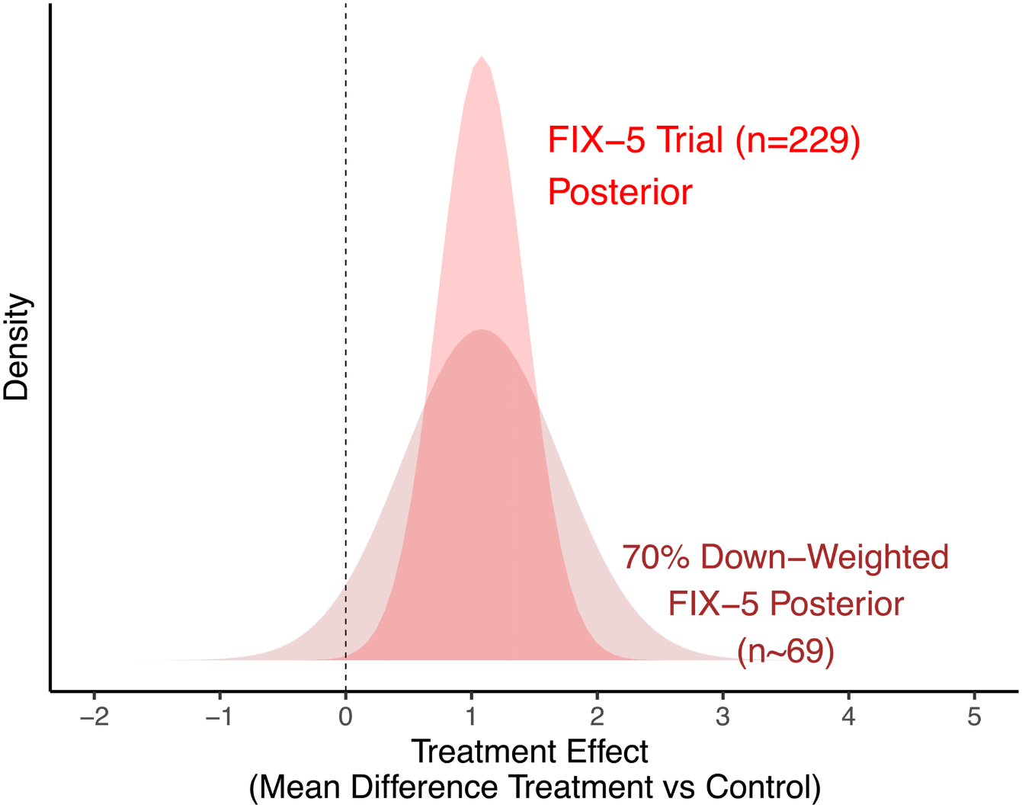
Clinical Trial: Information Sharing Example
Example of downweighting from Saville (2024) are shown in Figure 2.
70% downweighting chosen to control type I error rate at 10%, which the FDA deemed an acceptable risk for the disease and patient population.

Slide 52
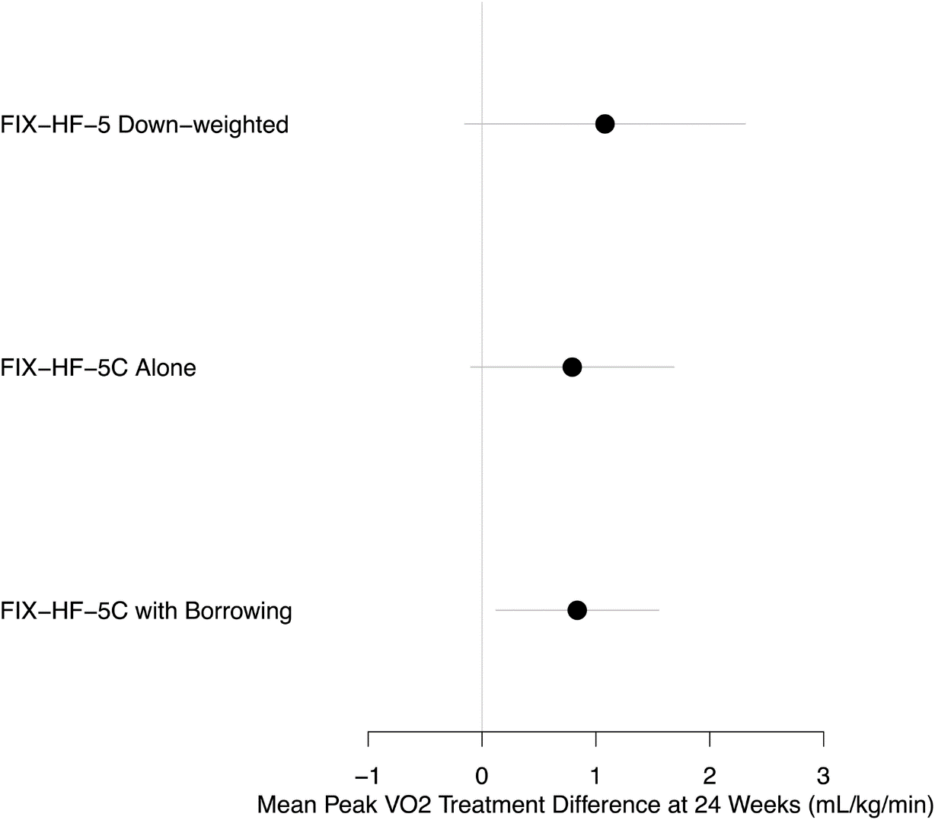
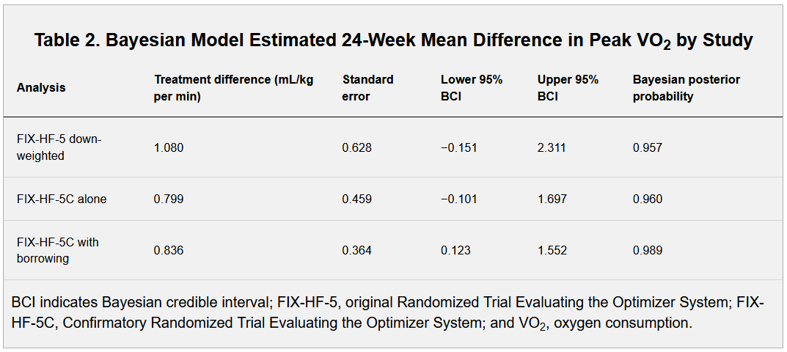
Clinical Trial: Information Sharing Example
Results from Saville (2024) in Figure 4 present the original subgroup estimate, the trial on its own, and the result with borrowing

Slide 53
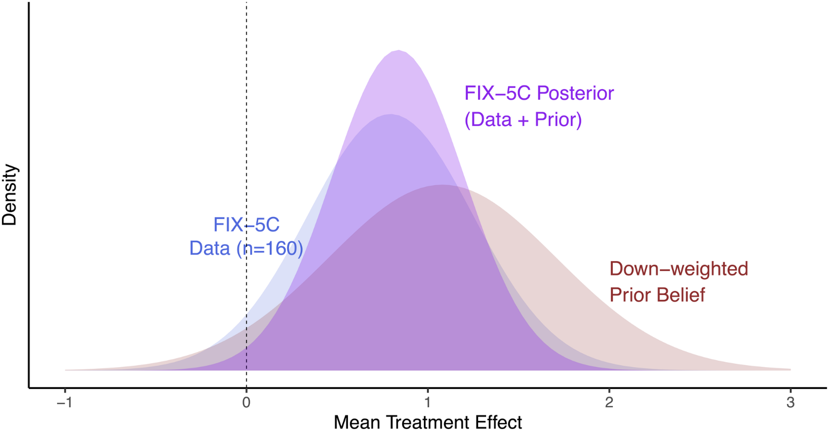
Clinical Trial: Information Sharing Example
Figure 5 from Saville (2024) shows the Bayesian triplot of the prior, likelihood, and posterior.
We can see how the prior and likelihood combined to show the posterior in between the two distributions.

Slide 54
Clinical Trial: Information Sharing Example
Conclusion from Saville (2024) was that Bayesian information sharing was necessary for the success of the second pivotal trial (FIX-HF-5C)
Without information sharing, a larger sample size would have been needed (>230 noted)
Analyzing just the observed N=160 showed a statistically insignificant result based on a posterior probability threshold of 0.975 since PP=0.960
Notes:
Saville, Benjamin R., Daniel Burkhoff, and William T. Abraham. "Streamlining Randomized Clinical Trials for Device Therapies in Heart Failure: Bayesian Borrowing of External Data." Journal of the American Heart Association 13.3 (2024): e033255.

Slide 55
Module Conclusions
Information sharing methods can improve the efficiency of clinical trials by incorporating historic/external/supplemental information in the analysis
There may be challenges with temporal trends or trying to borrow data from potentially non-exchangeable sources that could introduce bias into analyses
In practice, many trials propose information sharing as a sensitivity or secondary analysis; but concerns with information sharing methods lead to primary analyses focusing on the observed data

Slide 56
Module Conclusions
While not discussed in this module methods have been proposed that incorporate data selection steps to identify subgroups that may be better representative (i.e., more exchangeable) than borrowing for the whole population:
Wang, Chenguang, et al. "Propensity score-integrated power prior approach for incorporating real-world evidence in single-arm clinical studies." Journal of biopharmaceutical statistics 29.5 (2019): 731-748.
Liu, Meizi, et al. "Propensity‐score‐based meta‐analytic predictive prior for incorporating real‐world and historical data." Statistics in medicine 40.22 (2021): 4794-4808.
Wang, Jixian, Hongtao Zhang, and Ram Tiwari. "A propensity-score integrated approach to Bayesian dynamic power prior borrowing." Statistics in Biopharmaceutical Research 16.2 (2024): 182-191.
Alt, Ethan M., et al. "LEAP: The latent exchangeability prior for borrowing information from historical data." arXiv preprint arXiv:2303.05223 (2023).

Slide 57
References
Kaizer, Alexander M., et al. "Recent innovations in adaptive trial designs: a review of design opportunities in translational research." Journal of Clinical and Translational Science (2023): 1-35.
Pocock, Stuart J. "The combination of randomized and historical controls in clinical trials." Journal of chronic diseases 29.3 (1976): 175-188.
Ibrahim, Joseph G., and Ming-Hui Chen. "Power prior distributions for regression models." Statistical Science (2000): 46-60.
Kaizer, Alexander M., Joseph S. Koopmeiners, and Brian P. Hobbs. "Bayesian hierarchical modeling based on multisource exchangeability." Biostatistics 19.2 (2018): 169-184.
Kotalik, Ales, et al. "A group‐sequential randomized trial design utilizing supplemental trial data." Statistics in Medicine 41.4 (2022): 698-718.
Neuenschwander, Beat, et al. "Summarizing historical information on controls in clinical trials." Clinical Trials 7.1 (2010): 5-18.
Schmidli, Heinz, et al. "Robust meta-analytic-predictive priors in clinical trials with historical control information." Biometrics 70.4 (2014): 1023-1032.
van Rosmalen, Joost, et al. "Including historical data in the analysis of clinical trials: Is it worth the effort?." Statistical methods in medical research 27.10 (2018): 3167-3182.
Saville, Benjamin R., Daniel Burkhoff, and William T. Abraham. "Streamlining Randomized Clinical Trials for Device Therapies in Heart Failure: Bayesian Borrowing of External Data." Journal of the American Heart Association 13.3 (2024): e033255.

Slide 58

Contact Info:
Email:
alex.kaizer@cuanschutz.edu
Website: www.alexkaizer.com
GitHub: alexbiostats

