Slide 1
Proper Orthogonal Decomposition
Made possible by SVD☺

Slide 2
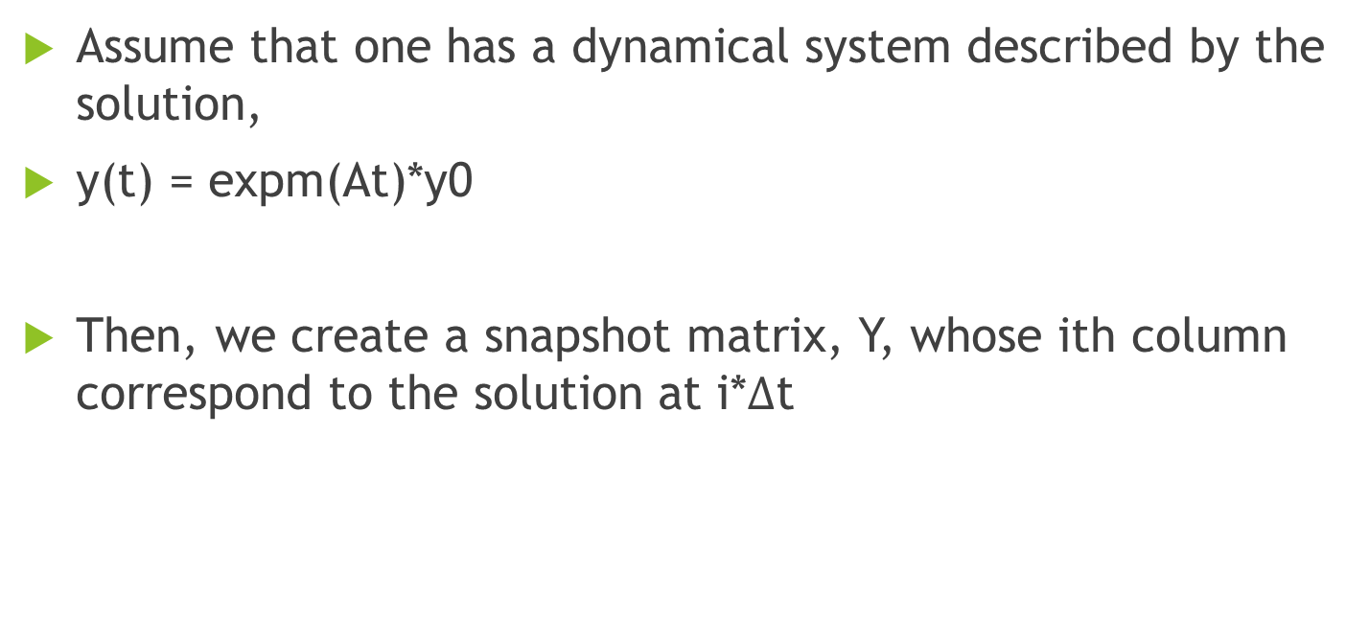
Starting Point
Assume that one has a dynamical system described by the solution,
y(t) = expm(At)*y0
Then, we create a snapshot matrix, Y, whose ith column correspond to the solution at i*$Δ$t

Slide 3
Adjust Y by the mean
Next we apply the SVD to a version of the snapshot matrix, Y.
First find the mean of all the columns. = y_mean
Then multiply y_mean by a vector of all ones (transposed)
Subtract that matrix from Y, leaving us with Y_mean
Purpose = ?

Slide 4

Singular Value Decomposition
Now let’s take the SVD of Y_mean (but let’s just refer to it as Y from now on)
We truncate Y by keeping only the first k columns corresponding to the largest singular values of Y
R(Y)≈R(Uk)

Slide 5

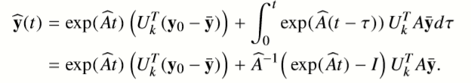
Algebraic Manipulation Time!
Rewriting the columns leads to
So in general
Plugging this into y’(t) = Ay(t) and multiplying on the left by (Uk)’ gives
If we let (Uk)’*A*Uk = A_hat ,
y_hat’(t) = A_hat* y_hat(t) + f(t) with f(t) =
And now the solution is given by

Slide 6
Why do this?
For small sytems there is limited upside to reducing the system. In a dynamical system with only one spatial dimension, the computational upside is not worth the extra time and loss of accuracy.
In the example I am about to show on Jupyter Notebooks, we reduce from 100x100 to 5x5
But some systems (like example 2) are larger, like 900x900. It becomes worth the time and computation to reduce this system.

Slide 7
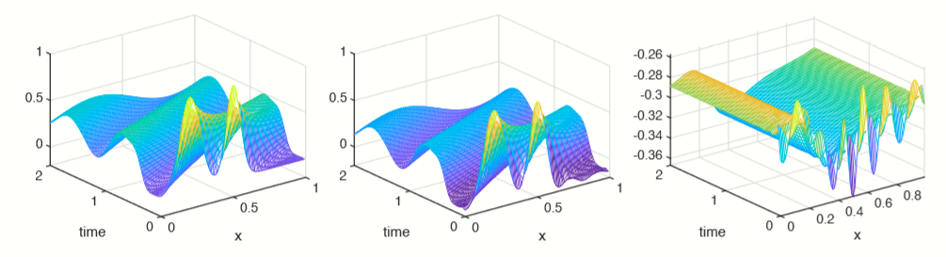
Any Downsides?
Yes. In the case that the initial condition, y0, is not well contained in R(Uk), solutions are inaccurate.
As seen from the error plot, the POD reduced model is inaccurate, making this technique useless with this choice of initial condition
Left: actual solution
Middle: POD with k=10
Right: Error plot

