Slide 1
Daily Songs
Robert Guglielmino

Slide 2
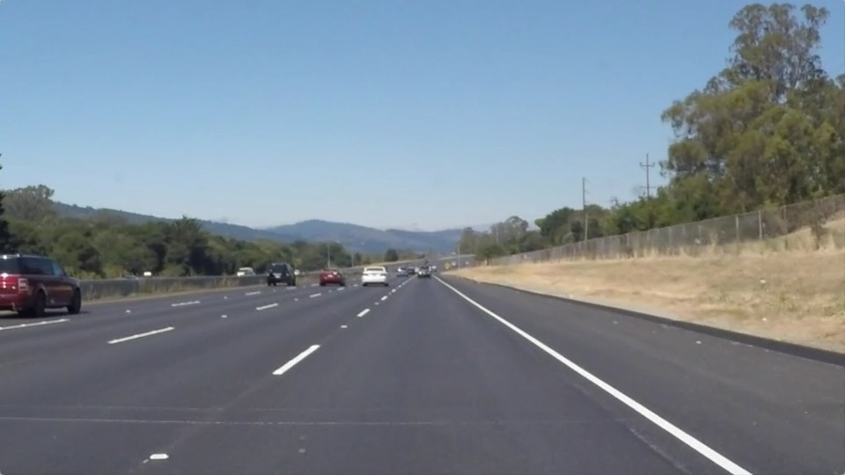
Inspiration

Slide 3
How to make a song personalized to an experience?

Slide 4
Daily Songs (name tbd)
Data driven song generation

Slide 5
Algorithmic song generation from:
Twitter feed
Your afternoon run
How well you slept last night
The weather
And more!

Slide 6
Personalized to YOU
You choose what metrics you want the song to come from

Slide 7
Lots of options
Song Creation vs. Song Choice
How the algorithms would work
Providing user with customization

Slide 8
Necessary Skills
API/Data Collection
Algorithmic Processing – Data into Music
Music skills to make not bad music

Slide 9
Scaling Up
Songs of friends
Songs of regions
Songs of countries

Slide 10
Theme
Personalized Day
Large scale mapping
Putting feelings into a song

