Slide 1
Project Delivery
SIT 782
Workshop 1 : when life gives you lemons

Slide 2
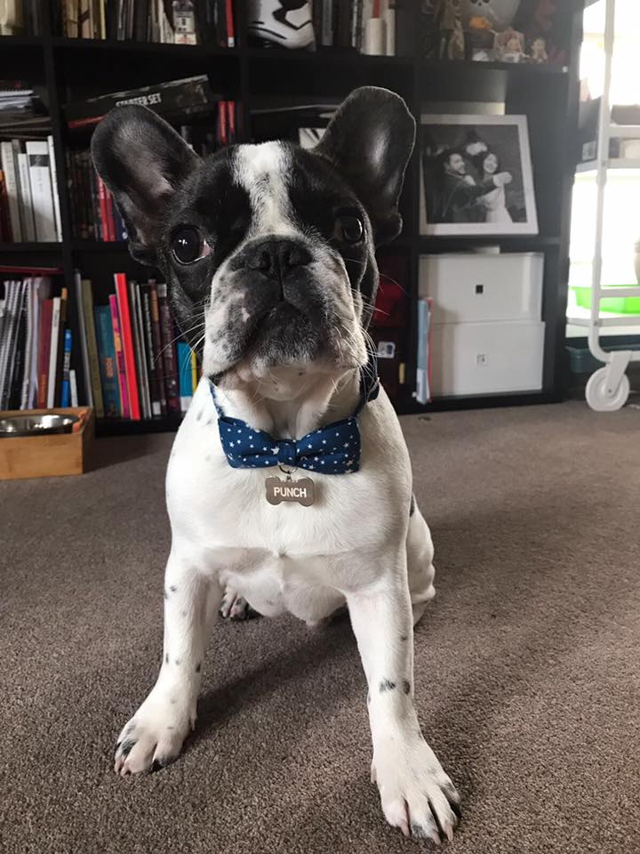
Good Morning !
Do you know the name of the person sitting next to you?
In my opinion, a good outcome is the result of being happy and professional

Slide 3

You would be surprised to find out how many mistakes which translate into hours and hours, of work, would have been solved if communication was effective.
Communication! When working in a real environment, nothing is more important that communication.

Slide 4
Welcome to SIT 782!
Who are you and why are you here?

Slide 5
We will look at …
Agile and Scrum
Lean Management and User-Centred Design
What Practitioners say
And transition from student to professionals

Slide 6
Complete the tasks weekly, do not leave everything to the last minute! Weekly announcements will happen https://www.futurelearn.com
Step 1 : Future Learn

Slide 7
How this Unit works How you get your Grades Week 1 Quiz
FutureLearn Week 1

Slide 8
Complete the tasks weekly, do not leave everything to the last minute! https://ontrack.deakin.edu.au
Step 2 : OnTrack

Slide 9
Individual Retrospective SWOT Analysis + Skillset + Project Preference Grading Agreement + (FutureLearn Week 1 Quiz)
OnTrack week 1

Slide 10
We share documents with you that way Join the public group to get alerts
Step 3 : Deakin365

Slide 11
Project Briefs (All of them are listed) Document Templates to complete your OnTrack Tasks (All of them are listed) Project Preference Form (Check Announcements for URL)
Deakin365

Slide 12
Forums are up there for discussion Ask your questions there too
Step 4 : Cloud Deakin Discussion Board

Slide 13
Student Discussion – for you to share info Questions about Assessments Questions about Unit Structure Do you want us to create more? Email the unit chair!
Cloud Deakin Discussion Board

Slide 14
Where are you going?

