Slide 1

Team 4 - Next Gen System Sustainability
Team Members: Cole Goodnight, Kyle Manahan, Matt Murdoch, Josh Roddy, Colin Szatkowski & Justin Wald
Sponsors: John Carter, Cathy Cooper, Eric Estes, Carl Jeeter

Slide 2
Presentation Agenda
Problem Statement
Project Migration
Documentation Walkthrough
Demo
DPR Training Calendar
Documentation Walkthrough
Demo
Action Steps and Conclusion

Slide 3
Problem Statement
System Problems
Outdated internal applications
Ad-hoc development
Minimal documentation
No version control or testing
No development environment
DPR Calendar Problems
Unsupported language(PHP 5)
Difficult to use
Long forms where users timeout and data is lost
Hard coded values
(Such as server ip)
Confusing DB Structure

Slide 4
Proposed Solution
Migrate existing application stack
Containers
Multiple environments
Version Control
Rewrite existing application: Training calendar (DPRCal)
Modern tools (Slim/JS)
Design in mind
Model for future rewrites

Slide 5
Migration

Slide 6
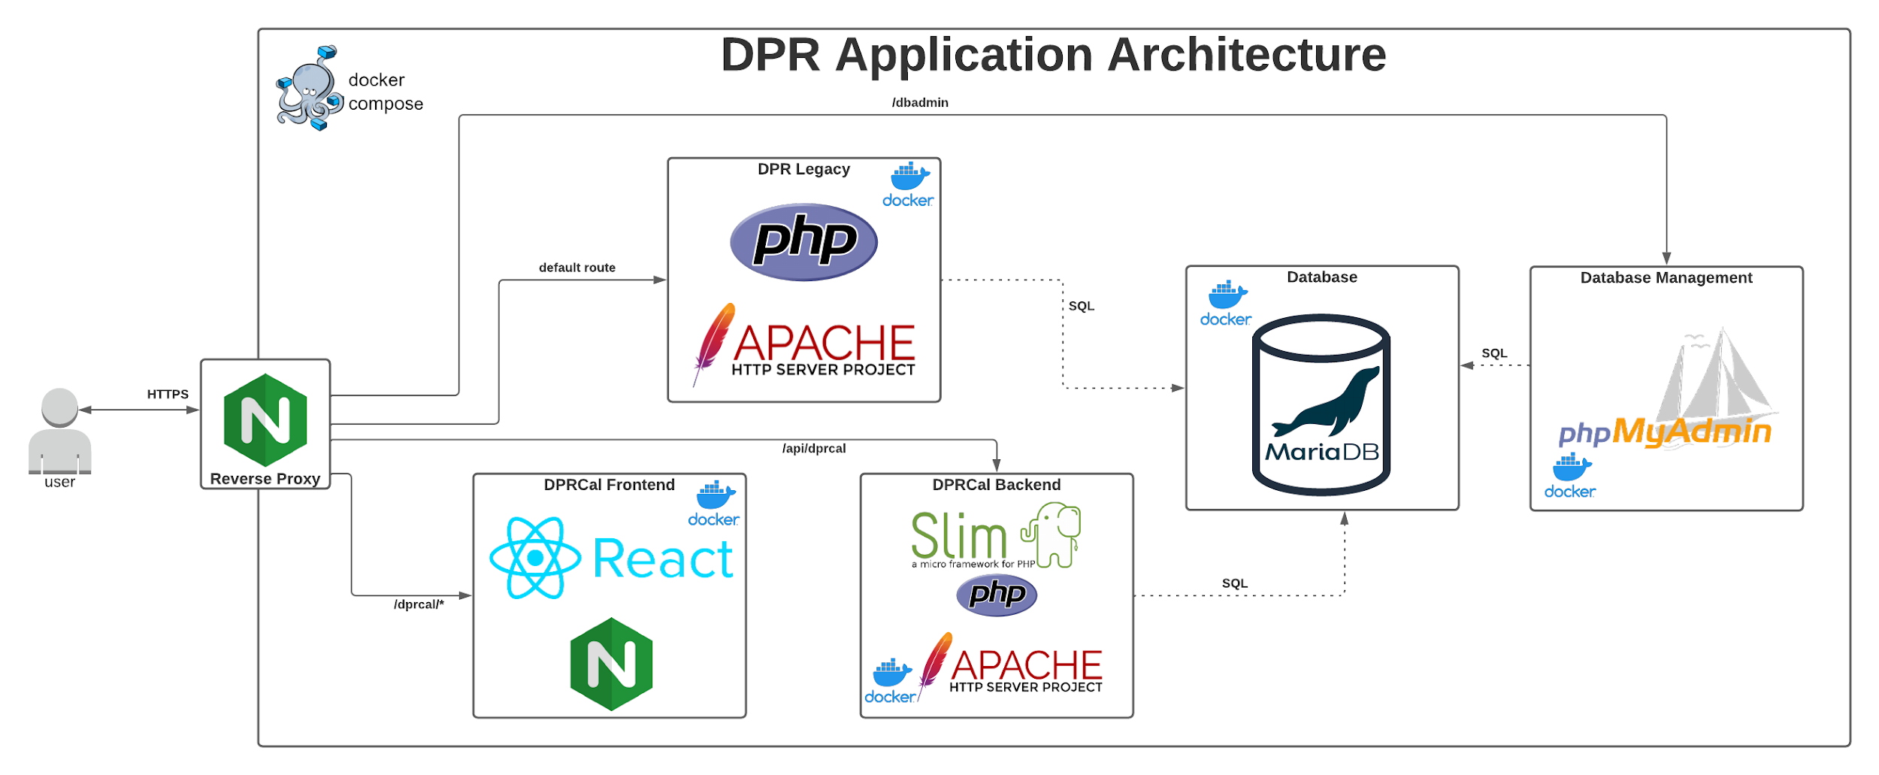
System Overview
Migration
JW
Notes:
Since our previous report, we have made changes to the system design. Kubernetes -> docker compose. Frontend and backend containers for flexibility. Nginx reverse proxy. The new DPRCal application is deployed as a separate frontend and backend container
Secrets are read in from the host system and mounted in containers with minimal permissions
An Nginx reverse proxy routes traffic to the appropriate container by uri
Legacy monolith is still fully supported

Slide 7
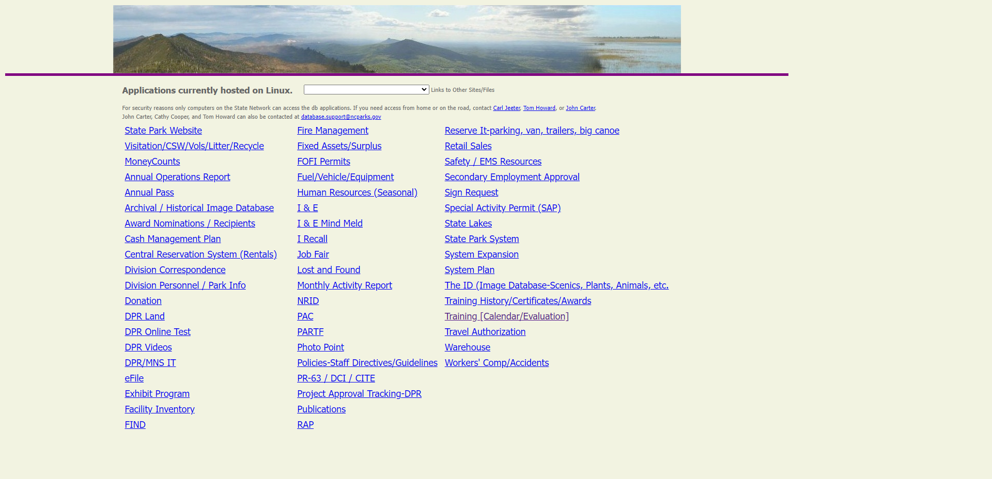
Installation Quick Start
Pre-Requisites
Docker=20.10.12
Docker-Compose=2.2.3
Steps
Clone the project using git
Copy the project’s secrets into the root directory
Start compose with docker compose --env-file envs/prod.env up
Notes:
Throw to Justin

Slide 8
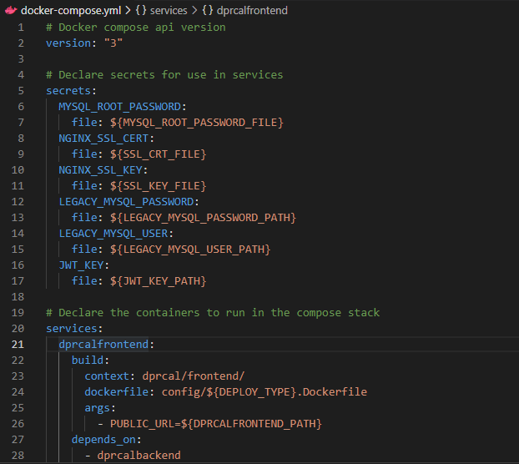
Development Overview
Functionality is split into services
Each service is built with a Dockerfile and deployed (with runtime parameters) using Docker Compose
Configuration variables are set using environment variables (optionally stored in a .env file)
Secrets are stored in a directory in plain text before being loaded by compose at runtime

Slide 9
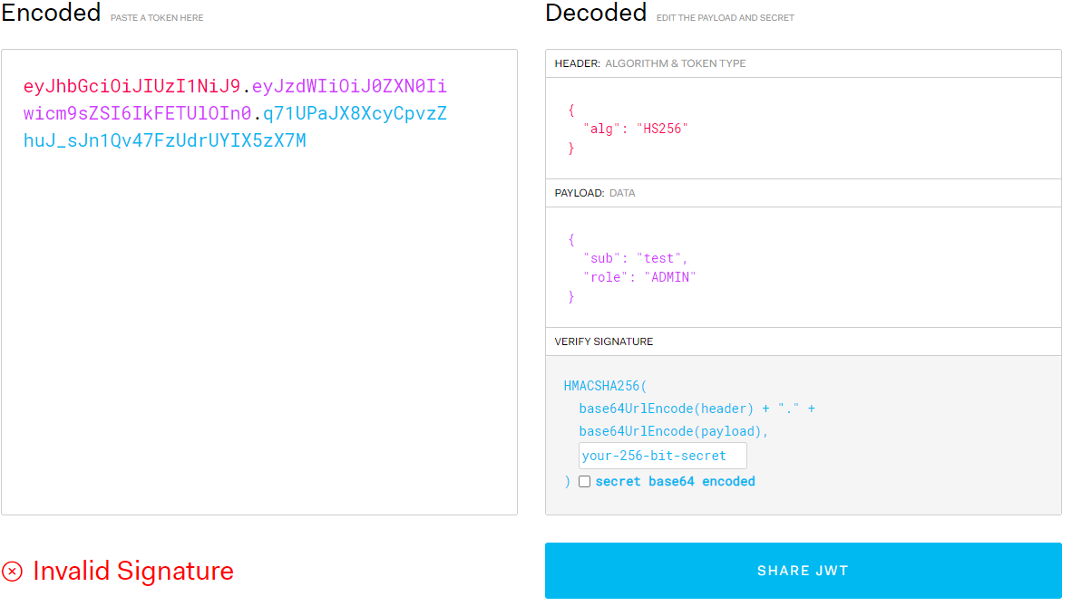
DPRCal New Security Brief
Based on a simple JSON Web Token (JWT) scheme
Users login against a BCRYPT password hash stored in the user DB
Users have a JWT generated for them, split into parts, then stored in the browser’s cookies to auth requests
The JWT contains “claims” with user id and role.
The JWT is signed by the backend to prevent anyone from modifying the JWT (e.g. changing their role)
Currently, the JWT does not expire (this is a security flaw and requires a TTL or other expiration scheme)

Slide 10
DPR Calendar
Notes:
Back to Josh

Slide 11
DPRCal

Slide 12
DPR Cal
Backend
API Docs
Frontend
Demo
Notes:
Matt
Title Slide
Title of project
Team number & member names
Introduction to Presentation
Project Recap (i.e., review of Problem Statement/Proposed Solution & summary of work presented in OPRs 1 & 2 to refresh the audience about your project) – this information can be placed throughout the presentation, as appropriate
Overall Requirements
Overall Design
Requirements related to your team’s most current iteration
Design (low level) related to Requirements, above
Briefly show & summarize code, as appropriate
Testing related to team’s most current iteration
Each team member’s contribution to project
Risks & How to Minimize, if any
Action Steps / Conclusion
Q&A

Slide 13
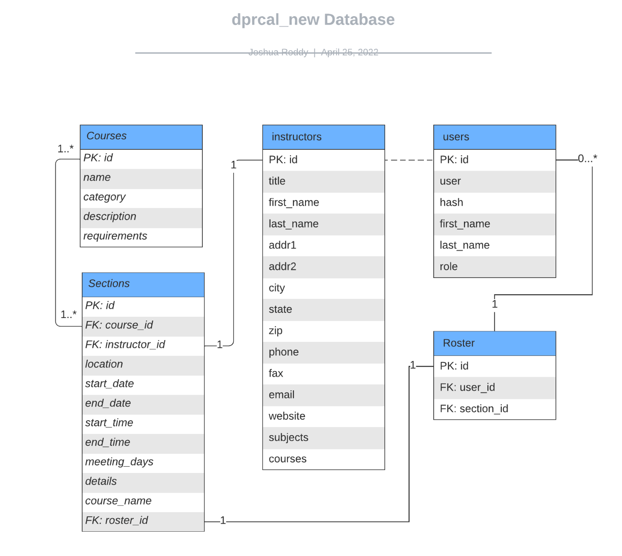
Backend
Database Design
Dev Guide

Slide 14
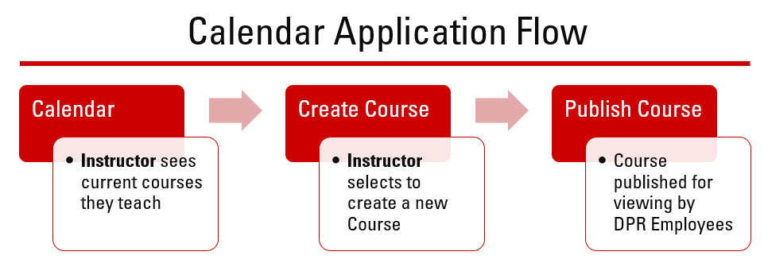
Backend
Control Flow
Dev Guide
Instructor View

Slide 15
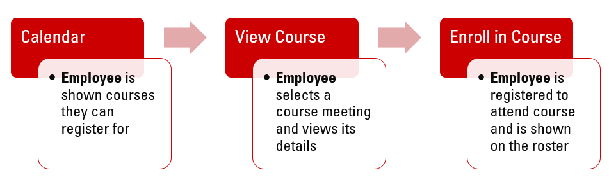
Backend
Control Flow
Dev Guide
Attendee/Employee View

Slide 16
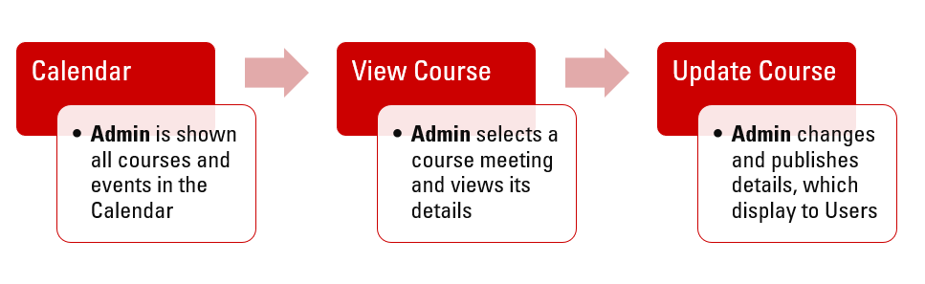
Backend
Control Flow
Dev Guide
Admin View

Slide 17
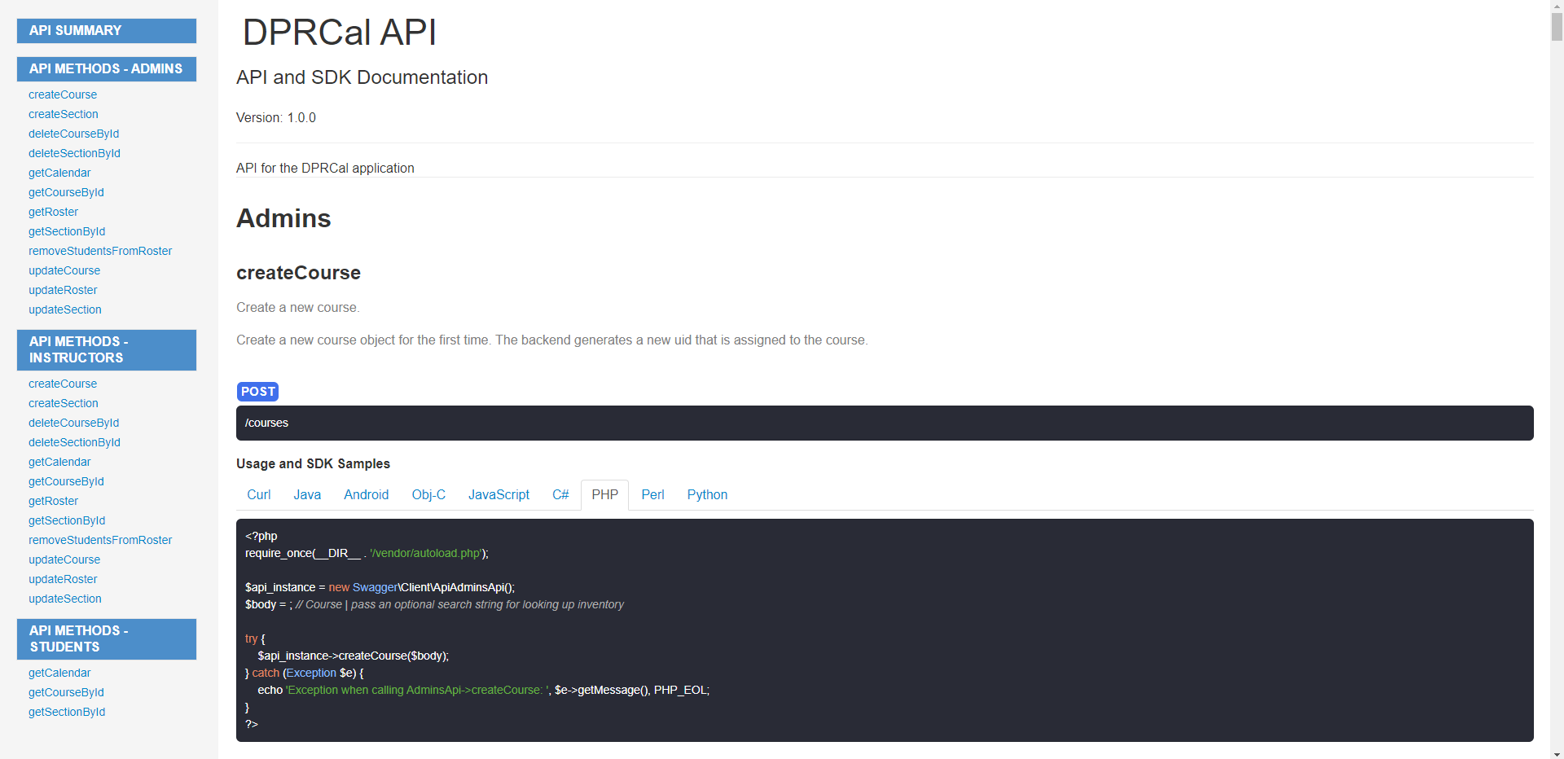
API
Doc Index - Dev Guide

Slide 18
API
Walk through index.php and sections.php if time
Notes:
Did not have time in presentation to look through code

Slide 19

Frontend
React
Javascript library for UI creation
MaterialUI
Provides styled components for React
FullCalendar
Plugin used to display calendar information
Notes:
Throw to Matt

Slide 20
Demo

Slide 21
Action Steps and Conclusion
Test newer API Functions
Roster Updates
Finalize Documentation
Installation Guide
Developer’s Guide
Formalize User’s Guide
Notes:
Back to Josh for closing remarks

