Slide 1

eFile (Electronic Filing Information Links Environment)
A How-to guide for storing data electronically.
By: Cara Hadfield
10/01/2013
Notes:
http://www.treehugger.com/gadgets/saving-energy-in-data-centers-with-smart-sensors-and-algorithms.html photo credit: Michael Graham Richard

Slide 2

What is eFile?
The eFile database is designed to store important documents, articles, web links and just about any other data for use by the staff of North Carolina State Parks.
By storing some of these important items on a server, we free up space in the office for required paper files .
Electronic filing does not replace all documents, but for documents that do not require lock and key, we should make them easily available to staff working across the State.
By using a keyword search setup like that of Google or Yahoo, staff are able to type in just a few words and are able to pull out any records pertaining to that keyword.
You can also perform more isolated searches by selecting a category or park code to look for more specific documents.
Notes:
https://www.dc801.org/ image credit

Slide 3

Pros
Easily find documents
Remotely access files when we are not at our desks.
Allow for more space within paper file cabinets/desktop memory.
Create an archive of information for and about State Parks.

Slide 4
Cons
Human Error (data entry or choosing the wrong file)
Too many hands in the cookie jar (security)
Incomplete scanning of documents can result in lost files.
Potential damage to Original Copy during scanning process.

Slide 5
Reducing the Risk…
Keeping an electronic back-up of the files assures that documents placed on the server can be uploaded again in the event of a failure.
We should all be careful of what materials we put up using this new system, anything with sensitive information should not be uploaded and revisions to any document found therein should be first brought to the attention of the originating archivist.
Great care should be taken when scanning in documents for upload. Some may be so old they won’t scan well, we should do everything in our power to help restore/preserve the information contained in those documents.
Do not destroy any document until being instructed to by the proper authority.

Slide 6
How to eFile….

Slide 7
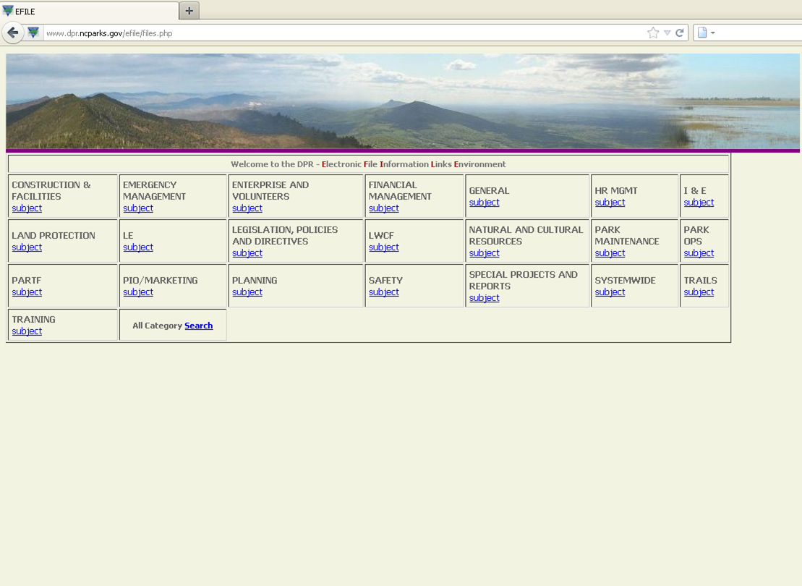
eFile sorts documents by category and sub-category, and also by park code.
Notes:
http://www.dpr.ncparks.gov/efile/files.php

Slide 8
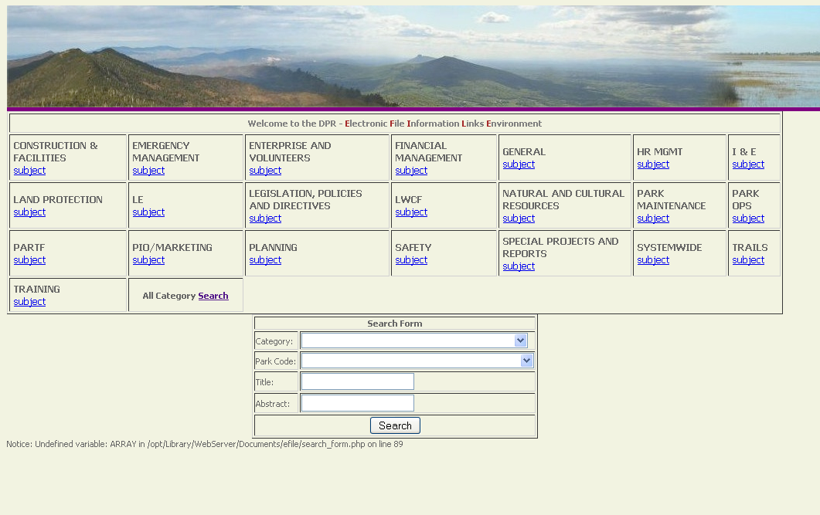
How to search for something using eFile…
Searches can be filtered by Park Code or Category.
To perform a general “Google” type search you would use the ‘Title’ or ‘Abstract’ search blocks to type in any key words pertaining to the document.
Notes:
http://www.dpr.ncparks.gov/efile/files.php

Slide 9
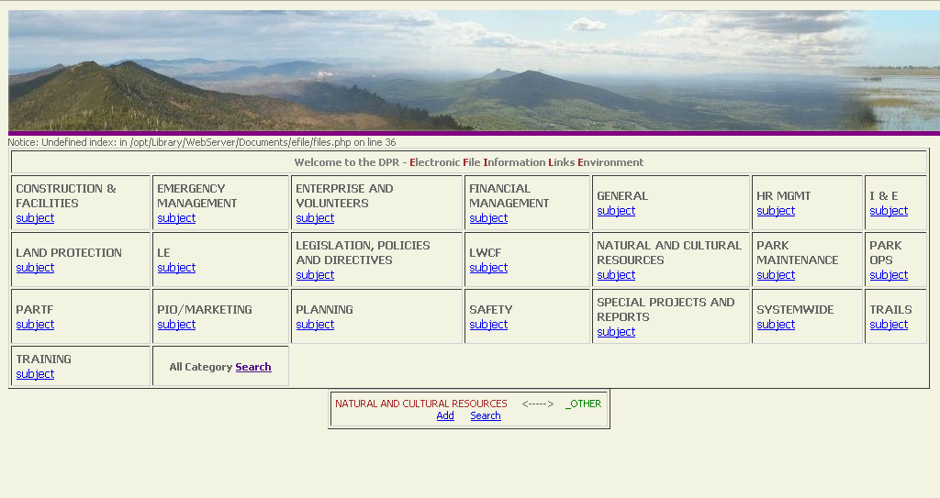
How to add a document using the eFile database…
Before you start:
Scan Document (Convert if needed)
Give the file a name on Desktop CPU
Save any other web links related to the document for easy access.
To Enter/Add:
First select the category you want it to go in. Then the sub-category, and Hit Add.

Slide 10
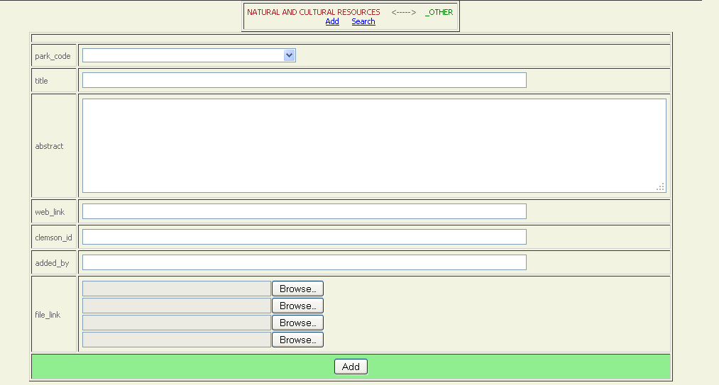
Enter Park Code
Enter a Title
Cut and paste keywords into this
section, making the document
easier to find.
Insert Web Links
*Added by field will self-populate
Attach Scanned Copy of File
Then Hit ADD

Slide 11
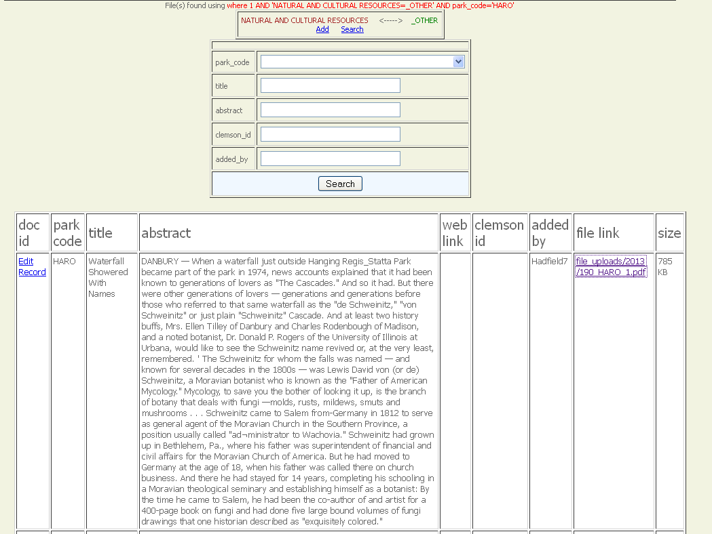

Here is what your file looks like when it’s finished.
Any words in this column will be searchable. This is a good tool for searching proper names/places.
Any pertinent information about the article/document should be entered into the abstract section. The server will search all documents to those key words making it easier to narrow down the document you’re looking for.
If you find you’ve made a mistake and need to edit the file, simply hit edit record and you can revise any of the information.

Slide 12

Do y’all have any questions about eFile?

Slide 13
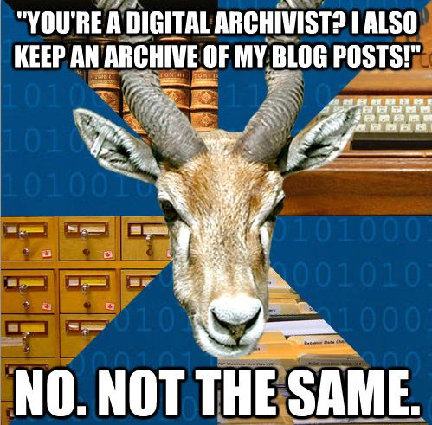
Just Kidding around…

Slide 14
“Nobody cares how much you know, until they know how much you care.”
~Theodore Roosevelt

