Slide 1
TIW project #4: “Trasferimento denaro”
Group 10: Alexandru Gabriel Bradatan

Slide 2
Project structure
3 maven modules:
  api: shared between the two frontends, it provides a highlevel interface to common business logic
    Additional dependencies: mockito, junit
  static: HTML-only frontend
  ria: HTML+JS frontend
Dependencies:
  GSON and javax-servlet (obviously)

Slide 3
Package structure
templated
ria
api
api.dbaccess
api.beans
api.functional

Slide 4
api module: monads
Use of Haskell-like monadic structures:
  ApiResult<T>: represents the result of a backend function that can fail. Contains either:
    Operation result
    ApiError: easily JSON-able record detailing an error
  Most monadic operators are available (flatMap, then, peek, match)

Slide 5
api module: DAOs
Implementers of DataAccessObject<T> do the heavy lifting
  Base queries (byId, ofUser…)
  Updates (insert, update, newTransfer...)
Not all objects implement all operations
  Contacts do not have IDs
  Transfers cannot be updated once inserted

Slide 6
api module: facades
Frontends interact with Facade objects that implement higher level operations
Facades take/return beans from api.beans

Slide 7
api module: connections
All api objects (except beans) expect a java.sql.Connection
Connection objects are retrieved using a ConnectionRetriever
  Its main implementer fetches a JDBC pooled connection from a JNDI path registered by each frontend

Slide 8
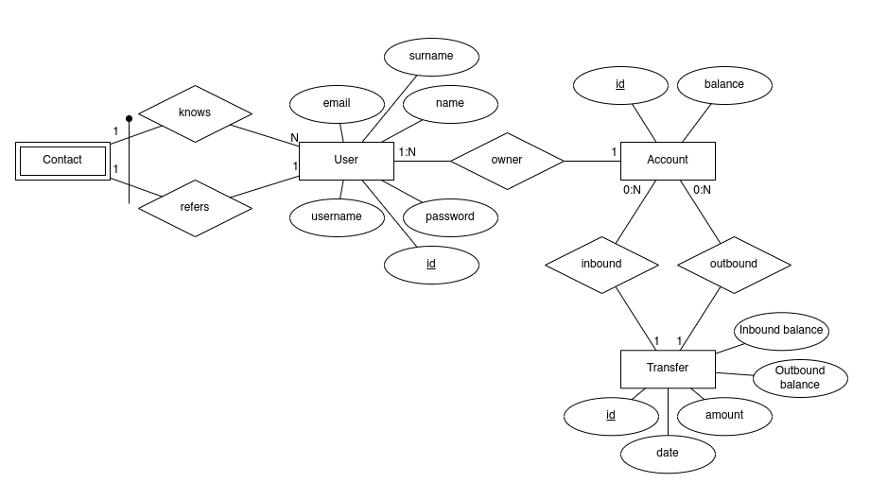
Database: ER

Slide 9
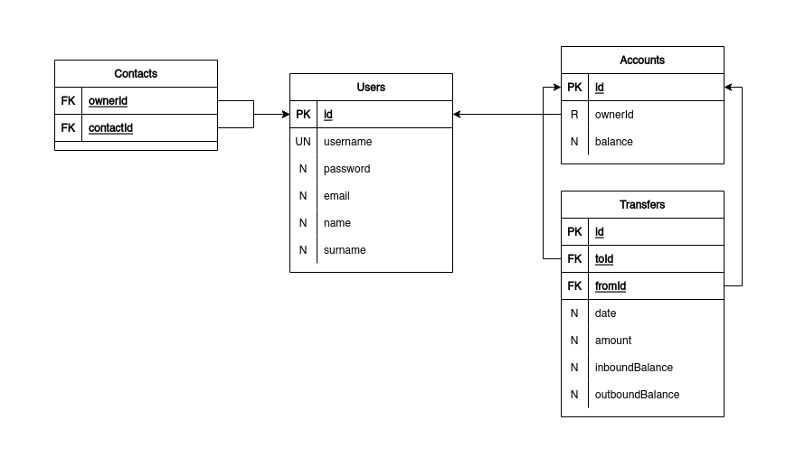
Database: logic

Slide 10
Frontends
Static
RIA

Slide 11
HTML-only frontend
RIA version
RIA version
Exit

Slide 12
Pages
/index.html: Account list page
/details.html: Account detail page + transfer form
/login.html: Login page
/register.html: Registration page
/confirmTransfer.html: Successful transfer summary
/rejectTransfer.html: Rejected transfer summary

Slide 13
HtmlPageServlet
Most important servlet
Templates any *.html with Thymeleaf
Page specific data is injected in the template via HttpServletRequest attributes by filters

Slide 14
Filters
Filters act as middleware (see Express from node land)
Request is processed in a pipeline-like manner
  Order matters (a little bit)
Main filters:
  HistoryFilter: handles the back button
  LoginFilter: ensures that the user is currently logged in
  AccountDetailsFilter: adds an account and its details (if the currently logged user has access to said account)
  AccountListFilter: adds the list of accounts of the currently logged in user
  TransferFilter: adds a transfer with the given id (if the currently logged user has access to said account)

Slide 15
Example: handling /details.html
Data is fetched and added
GET
HistoryFilter
LoginFilter
Logged in?
AccountDetailsFilter
HtmlPageServlet
302 /login.html
200

Slide 16
POSTable endpoints
/registerUser: registers a new user
/loginUser: logins a user
/logout: logs out the current user
/newAccount: creates a new Account for the currently logged in user
/newTransfer: creates a new Transfer

Slide 17
Generic error reporting
Throughout the application a convention for communicating errors is used
  sendError page is ugly and sending stacktraces is not good practice
The “e” parameter describes the type of error (e.g.)
  server: server problem
  user: user inserted wrong data
  conflict: user inserted data that doesn’t align with what is stored on the server
Filters can instead set the “error” attribute to an ApiError if they encounter problems (e.g. unauthorized access)

Slide 18
Login-logout mechanism
POST to /loginUser with the correct data
The retrieved user data is stored in a HttpSession
A redirect to /index.html is sent as response
On logout said object is removed from the session

Slide 19
History mechanism
A History object is stored in the HttpSession
  History is basically a stack of URLs with some helper methods
On a GET the URL + query string is pushed on the stack
If the GET has a ret parameter, the last viewed URL is sent as a redirect

Slide 20
Architecture limitations and issues
Use of in-memory session store
Disorganized endpoints names
  Fixed in the RIA version
The servlet API does not have an easy way of declaring a filter order
  We need to give filter alphanumerically sorted names

Slide 21
HTML+JS frontend
HTML version
Exit

Slide 22
Pages and views
/login.html: Login and registration
  Login view: Login form
  Register view: Register form
/index.html: Main application page
  Summary view: account list
  Details view: account details + transfer form

Slide 23
A small liberty
The spec says that “each page should provide a link to the previous”
However this is almost a SPA
  What page? Login?
The back button has been removed in favor of “view” controls:
  Back arrow: previous view (detail view ⇒ summary view)
  Refresh button: reloads current view

Slide 24
Communication with the server
The communication between frontend and server is fully JSON
  More consistent than sending JSON or
  x-www-form-urlencoded and replying with JSON
  Easier for JS to work with JSON
API calls are sent to /api/* endpoints
  REST-like semantics

Slide 25
API endpoints
/api/users: POST a new user
/api/user/{byId,byUsername}: check if user exists
/api/auth/{login,logout,refresh}: session management
/api/accounts: POST new accounts
  /api/accounts/transfers: query transfers linked to an account
  /api/accounts/ofUser: query accounts of a given user
/api/contacts: POST new contacts
  /api/contacts/ofUser: query accounts of a given user

Slide 26
Ajax object
Wrapper around XMLHttpRequest and central node of the communication
Exposes a simpler interface:
  get(): sends a GET
  post(): sends a POST
  authenticatedPost(): sends a POST with authentication, handling an eventual refresh

Slide 27
Authentication
Fully client-side and stateless: JWT tokens
Symmetric encryption (secrets passed as context init parameters)
Main token (expiry 15min):
  Stored in session storage
  Is sent via JSON with each authenticated request
Refresh token (expiry 1gg):
  Stored as HttpOnly cookie
If the main token expires, a new one can be retrieved from /api/auth/refresh
If refreshing fails, then user must re-login

Slide 28
Authentication flow
On login, both token are sent through their respective channels
If in a subsequent request the main token expires or is invalid, the server will respond with a 401
On logout:
  the server will clear the refresh token
  the client will clear its storage

Slide 29
Modules
loginManagement.js
  LoginManager and LogoutButtonManager
  Session management functions
ajax.js (requires loginManagement.js)
  Ajax object and related utilities
index.js and login.js (require both aforementioned modules)
  Page logic

Slide 30
Server side
The server works much less in this implementation
No filters, servlets follow a repeatable pattern:
  Parse JSON into an equivalent java object
  Check parameters
  Check permissions
  Execute action
  Format response JSON

Slide 31
Login page
submit()
Login form
LoginFormValidator
post()/get()
ViewManager
login()
Ajax
Server
switchView()
LoginManager
Register form
RegisterFormValidator
post()/get()
submit()

Slide 32
Index page
If user is not logged in, redirect to login page
  If refreshing fails on a request a modal is shown and the user is redirected
Each object handles part of the page:
  Dispatcher: sends requests and returns Promises containing the result
  ModalManager: displays the modal window
  AccountListManager: handles the account list view
  AccountDetailsManager: handles the transfer list
  NewTransferFormManager: handles the “New transfer” form
ViewOrchestrator rules them all

Slide 33
Index page
Account
summary
view
AccountListManager
show()
show()/hide()
Transfer
list
ModalManager
Modal dialog
ViewOrchestrator
AccountDetailsManager
fetch*()
New transfer
form
Dispatcher
Server
NewTransferFormManager
fetch*()
LogoutButtonManager

Slide 34
Autocomplete
The contact autocomplete is handled via HTML5 datalists
  On focus of the relevant form input contacts are fetched
  Each contact is inserted into the datalist
BONUS: autocomplete is present also for the payee’s accounts (if a payee is specified)
  Same mechanism

Slide 35
Architecture limitations and issues
JS’s dynamic typing gets a bit in the way
  No true object orientation (in the java sense)
    I chose to ignore ES6 features and stick to what we discussed during lectures (notable exceptions are Promises)
Module subdivision could be improved
  index.js is 700+ lines atm
Working with low-level web APIs can be a pain
  Especially the Validation API (no wonder people write frameworks)

