Slide 1
CLASSIFICATION AND PREDICTION OF DIADETES RISK AND HEART DISEASES USING MACHINE LEARNING TECNIQUES

Slide 2
Guide: Mr. I. Solomon M.Tech.,
Batch Members:
T. Jaideep
A. Alex Britto
S. Arun Rajaseelan

Slide 3
Domain Name: Python , Machine Learning

Slide 4
Abstract:
Accurate detection of heart and diabetes diseases in all cases and consultation of a patient for 24 hours by a doctor is not available since it requires more sapience, time and expertise.
In this study, a tentative design of a cloud-based heart and diabets diseases prediction system had been proposed to detect impending heart and diabets diseases using Machine learning techniques.
In addition we also predicting the diseases the machine learning. Algorithms like Random Forest, Support Vector Machine, Naïve Bayes and etc., are used to build a machine learning model.

Slide 5
Introduction…..
Heart and diabets disease predictor is a platform designed and developed to explore the path of machine learning.
The goal is to predict the health of a patient from collective data, so as to able to detect configurations at risk for the patient, in case requiring emergency medical assistance, alert the appropriate medical staff of the situation of the latter.

Slide 6
We initially have a dataset collecting information of many patients with which we are able to conclude the results into a complete form and can predict data precisely.
The results of the predictions, derived from the predictive models generated by machine learning, will be presented through several distinct graphical interface according to the datasets considered.
Macine learning algorithms can also be helpful in providing advanced analytics of the patient’s heart and diabets diseases to docters.

Slide 7
Literature survey
YEAR | AUTHOR | PURPOSE | TECHNIQUE BASED | ACCURACY
2019 | Avinash golande | Heart disease prediction using effective machine learning technique. | 1)Decision tree 2)K-means clustering | Decision tree provide 86.60% accuracy K-means clustering 79.10 accuracy
2019 | Senthilkumar Mohan | Effective heart disease prediction using hybrid machine learning technique | 1)Decision tree 2)Language model 3)Support vector | HRFLM(88.4 accuracy)
2020 | A.Lakshamanarao | Machine learning technique for heart disease prdiction | 1)Random over sampling 2)Synthatic minority oversampling | For random sampling provide 83.4% accuracy

Slide 8
YEAR | AUTHOR | PURPOSE | TECHNIQUE BASED | ACCURACY
2020 | Rahul Katarya, and Srinivas Polipireddy | Classified and prediction of heart disease | 1)Decision tree 2)KNN 3)Adaboost | KNN provide 84.01 accuracy Adaboost given the bst accuracy of 90.10%

Slide 9
Existing System:
In existing system, the medical teams from the patient’s medical history, symptom , physical test. It’s not possible to physical test.
Existing system they use only machine techniques to patient having heart and diabetics diseases or not in implement model single data mining and web application.

Slide 10
Disadvantage:
Uses single trained mode.
only able to run in python platform.
less accuracy with machine learning model.

Slide 11
Proposed System:
In proposed system, we adopted artifical intelligent concept as machine learning defined patient heart diseaeses or not.
The heart diseases input smoking ,diabetes rate, Bp , etc …
There is no need doctor after physical test ,because it’s machine learning outcome one of main advantages.
We develop the machine learning model and embedded web application so its they real time application.

Slide 12
Advantages:
Increasingly Accurate Dataset and Model.
Separate Model for each stage. Initial stage and final stage.
Interactive Model and Interfaced with Web Application.
Recommending Hospitals and Doctors.
Able to run in mobile.

Slide 13
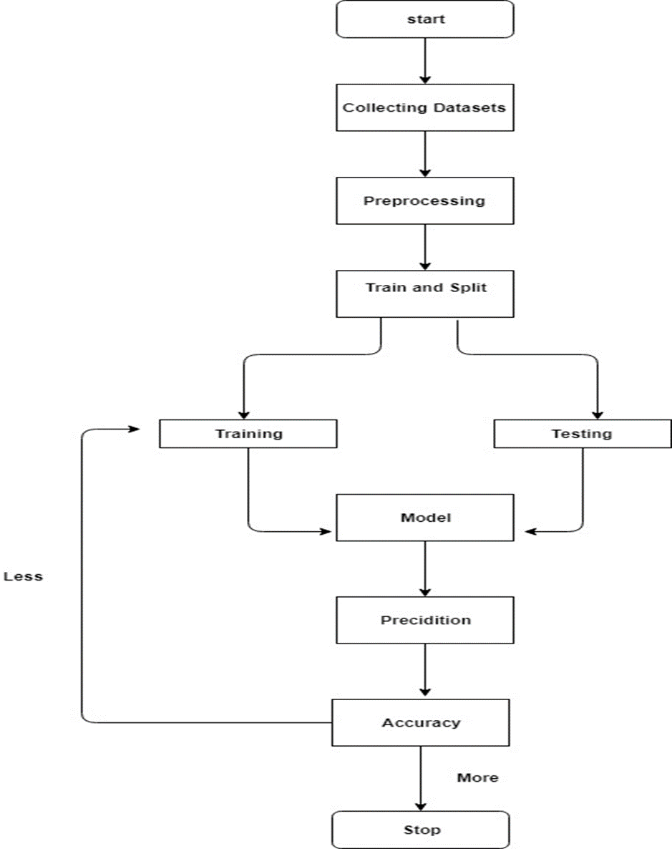
Data Flow Diagram:

Slide 14
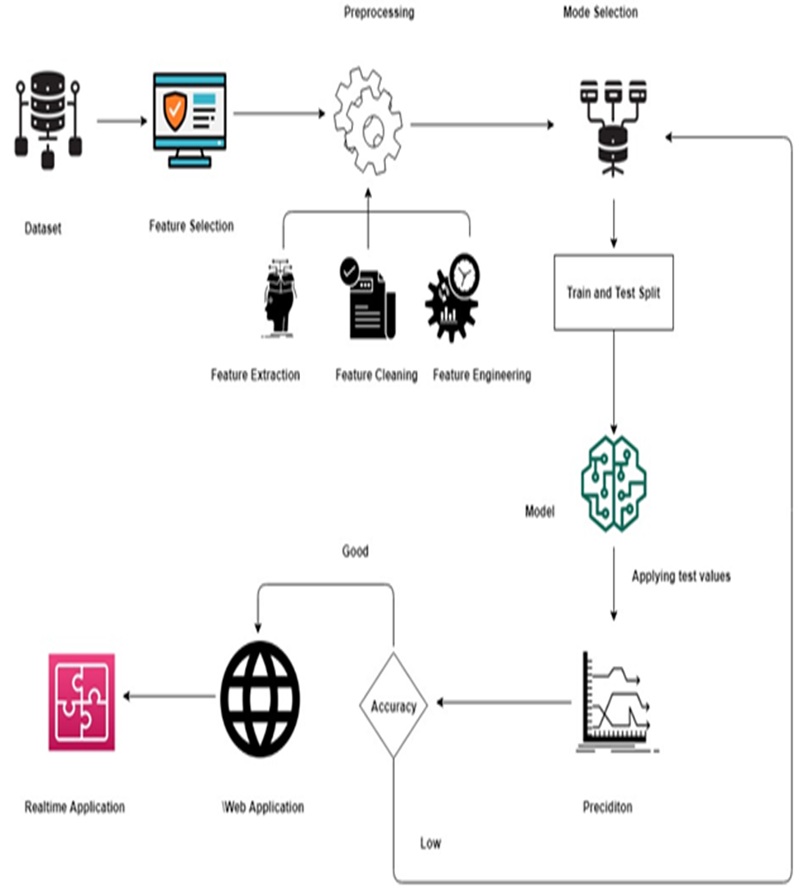
Architecture Diagram:

Slide 15
Web Developement Modules:
1.Login and Registration for Diabetes disease predication.
2.BMI calculator:
3.Heart diseases module:
4.Doctor Suggestion:

Slide 16
1.Login and Registration for Diabetes disease predication.
In this module, authenticated user can login and predict the heart diseases. Otherwise the invalid user should signup with necessary details and create a account, after creating the account the user will be provide with username and password.

Slide 17


Slide 18


2.BMI calculator

Slide 19
3.Heart diseases module:
In this is module, the user can predict the heart diseases by providing the results of model and with other symptoms like (sex, cigarette per day ,prevalent stoke, cholesterol, Diabetes rate, etc…) in order to predict heart diseases.

Slide 20
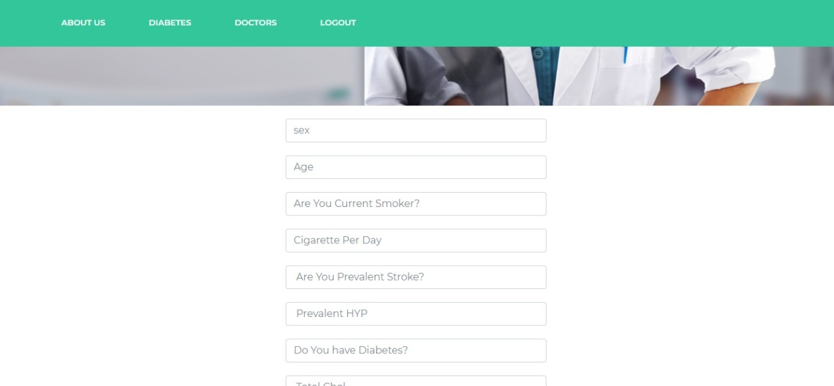

Slide 21
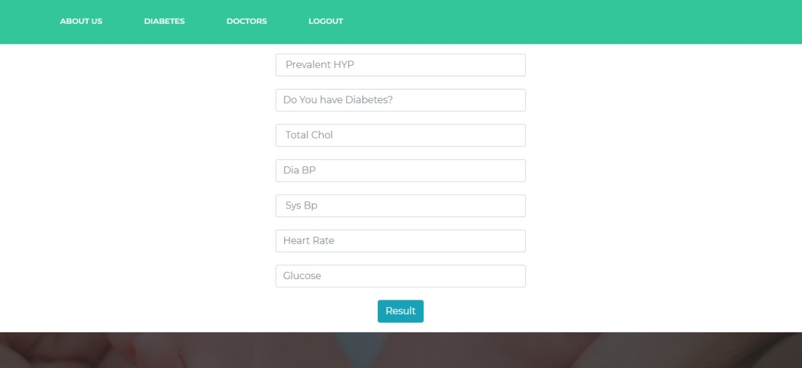
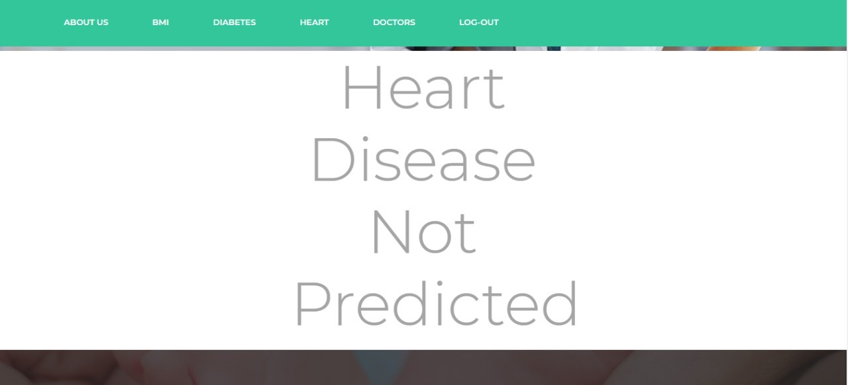

Slide 22
4.Doctor Suggestion:
Above predictions can show the patient/person has been affected by the Diabetes disease according to its severe category. This module will display the suggestion of hospitals.

Slide 23



Slide 24
REFERENCES:
1.H. Ashouri and O. T. Inan, “Automatic detection of seismocardiogramsensor misplacement for robust pre-ejection period estimation in unsu-pervised settings,” IEEE Sensors Journal, vol. 17, no. 12, pp. 3805–3813, June 2017.
2. M. D. Zink, C. Bruser, B.-O. St ̈ uben, A. Napp, R. St ̈ ohr, S. Leonhardt, ̈ N. Marx, K. Mischke, J. B. Schulz, and J. Schiefer, “Unobtrusive nocturnal heartbeat monitoring by a ballistocardiographic sensor in patients with sleep disordered breathing,” Scientific Reports, vol. 7, no. 1, p. 13175, 2017.

Slide 25
3. M. Di Rienzo, E. Vaini, and P. Lombardi, “An algorithm for the beat-to-beat assessment of cardiac mechanics during sleep on earth and in microgravity from the seismocardiogram,” Scientific Reports, vol. 7, no. 1, p. 15634, 2017.
4.T. Hurnanen, M. Kaisti, M. J. Tadi, M. Vah ̈ a-Heikkil ̈ a, S. Nieminen, ̈Z. Iftikhar, M. Paukkunen, M. Pank ̈ a ̈al ̈ a, and T. Koivisto, ̈ Heartbeat Detection Using Multidimensional Cardiac Motion Signals and DynamicBalancing. Singapore: Springer Singapore, 2018, pp. 896–899.
5. M. Kaisti, J. Leppanen, O. Lahdenoja, P. Kostiainen, M. Pank ̈ a ̈al ̈ a, ̈U. Meriheina, and T.Koivisto, “Wearable pressure sensor array for health monitoring,” in Computing in Cardiology 2017 (CinC), Rennes,

