Slide 1

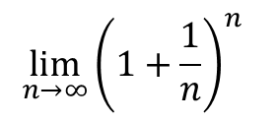
$$\lim_{n→∞}{{\left(1+\frac{1}{n}\right)}^{n}}$$
$$x_{y^{2}}$$

