Slide 1
Zhongan Hackathon AI Model
Alex Bui - PIDL

Slide 2

Modules Structure
Data
Spark
Prediction

Slide 3
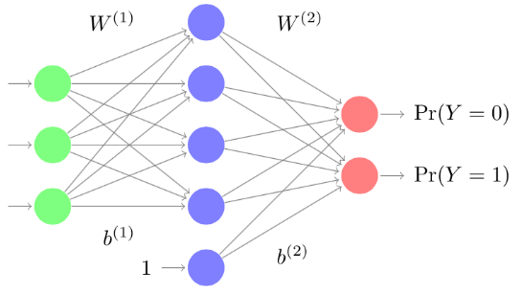
Learning Model
Attention model is appropriate
Claim 1
p₁
⨂
Claim 1
Claim 2
Softmax
p₂
⨂
Claim 2
…
…
⨂
…
Policy Vector
Claim n
p_{n}
⨂
Claim n
⨁
Claim Attention
Customer 1
p₁
⨂
Customer 1
Customer 2
⨁
Softmax
p₂
⨂
Customer 2
Customer Attention
…
…
⨂
…
Customer n
p_{n}
⨂
Customer n

