Slide 1
Machine-Learning Prediction of Stability and Band Gap in ABX₃ Perovskites
Project Midpoint Presentation
Alex Burg / Alex Greck · 29 June 2026
Atomistic Modeling — M.Sc. project

Slide 2
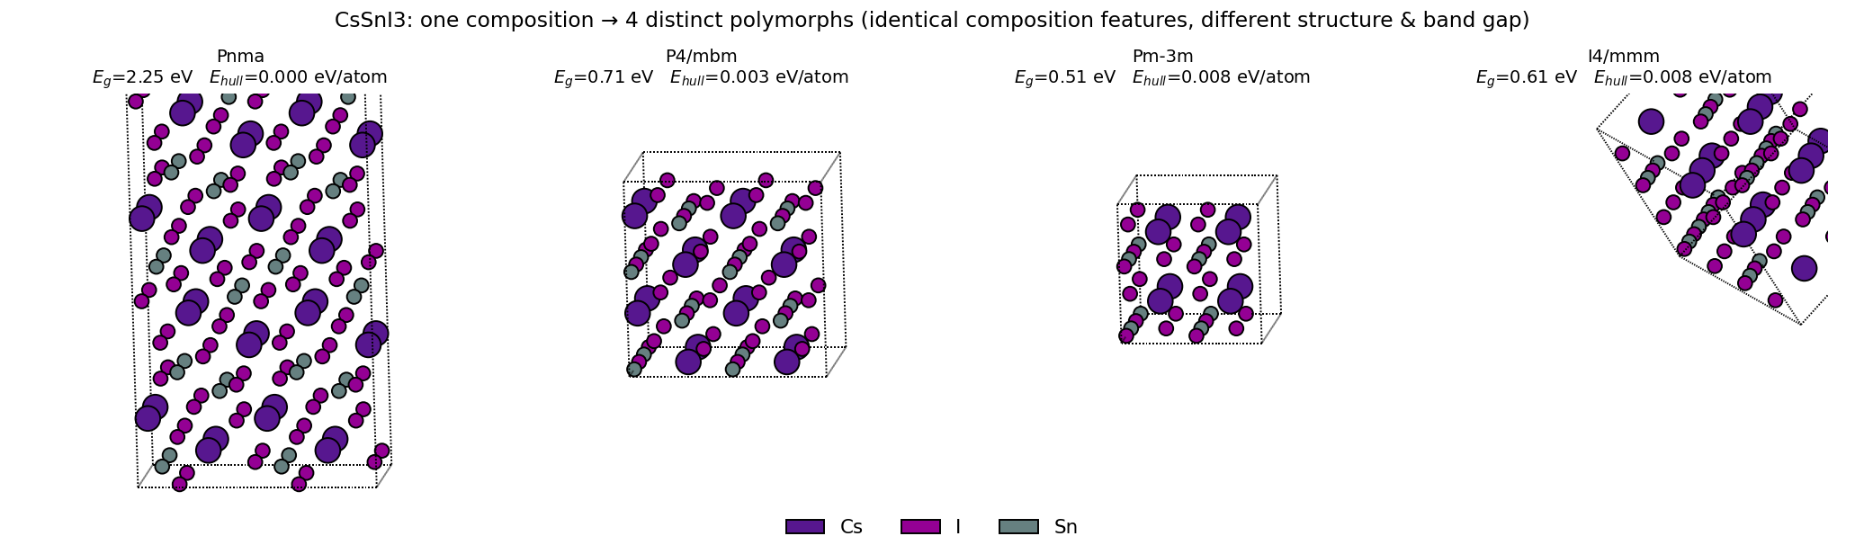
Introduction & Research Question
• ABX₃ perovskites: key materials for solar cells, LEDs, catalysis — but their properties usually come from expensive DFT calculations.
• Goal: predict the two decisive properties directly from composition/structure, bypassing DFT:
thermodynamic stability — energy above the convex hull (synthesizability)
electronic structure — band gap (metal vs. semiconductor)
• Constraint: favour synthesizable chemistries — exclude toxic / rare-earth / radioactive elements.
• Research question:
Can structural ML descriptors predict perovskite stability and band gap well enough to screen novel candidates?
One composition (CsSnI₃) → several polymorphs with different band gaps & stability: structural, not just compositional, descriptors are needed.

Slide 3
Data: Dataset & Descriptors
• Source: OQMD-derived ABX₃ perovskite dataset (Chenebuah & Chenebuah 2023) — 16,323 compounds.
• Relaxed atomic structures fetched from the OQMD API: 16,316 / 16,323 (99.96%).
• Targets per structure: band gap E_g, energy above hull (stability), formation energy.
• Reduced set (remove rare-earth / radioactive): ~8,000 structures; matrix descriptors also cap ≤30 atoms ⇒ 7,875.
• Structural descriptors (DScribe):
SOAP — 48,870 dimensions (local atomic environments)
Coulomb matrix — 900 dimensions
Ewald sum matrix — 900 dimensions (periodicity-aware)

Slide 4
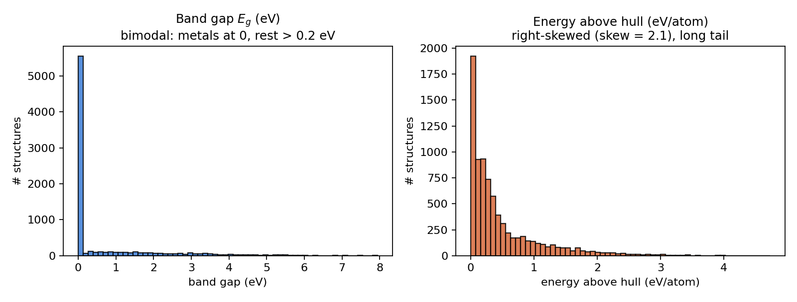
Data Analysis: Target Distributions
• Band gap is bimodal — a large spike at 0 eV (metals, ~69%) and the rest above 0.2 eV; almost nothing in between.
• Energy above hull is strongly right-skewed (skew = 2.1): median 0.26, long tail to 4.7 eV/atom.
• Further EDA: element frequencies (84 elements), A/B/X site occupancy, atoms-per-cell (→ n_atoms_max = 30 cutoff).

Slide 5
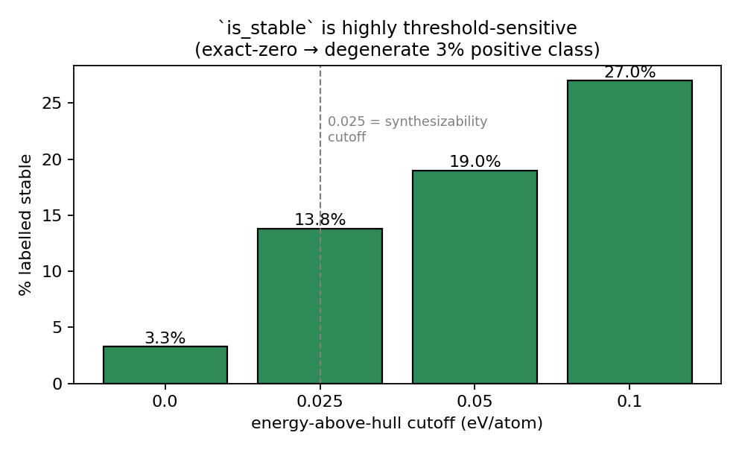
Data Analysis: Label Definition & Sensitivity
• Continuous targets must be thresholded into classes — the cutoff is a modelling choice.
• is_metal = band_gap ≤ t : robust (gaps bimodal) — ~69% metal regardless of t.
• is_stable = E_hull ≤ t : highly sensitive.
exact-zero ⇒ only 3.3% positive (degenerate task)
0.025 eV/atom (synthesizability cutoff) ⇒ 13.8%

Slide 6
Preliminary Tests: Setup
• Two tasks: is_metal classification and energy-above-hull regression.
• Three descriptors compared: SOAP, Coulomb matrix, Ewald sum matrix.
• Models tried: Decision Tree, Random Forest, HistGradientBoosting.
• Class imbalance handled with class_weight = balanced.
• Evaluation: cross-validation (not a single split); balanced accuracy + F1 for classification, R² + MAE for regression.
• All wired through a small shared package (config / data / descriptors / evaluation / labels).

Slide 7
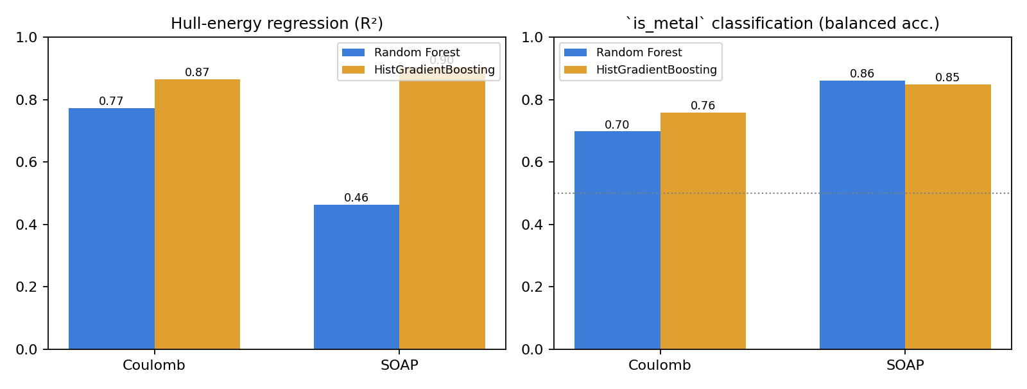
Preliminary Tests: Results
• Regression — best: SOAP + HistGradientBoosting → R² = 0.90, MAE = 0.11 eV/atom.
• Classification — best: SOAP + Random Forest → balanced accuracy = 0.86 (Coulomb only 0.70).
• HistGB is more accurate for regression but 15–35× slower than RF; descriptor choice (SOAP) matters more than model choice for is_metal.

Slide 8
Does Performance Track the Data Distributions? Yes.
• is_metal: clean bimodal band gap ⇒ well-separated classes ⇒ high, threshold-robust accuracy (0.86).
• is_stable: extreme imbalance (3% positive at exact-zero)
The 0.025 cutoff rebalances it (→14% positive); balanced accuracy improves with the threshold (e.g. Ewald 0.53→0.66), though it stays modest
• Hull energy: right-skewed with outliers ⇒ RMSE ≫ MAE; max error ≈ 4.5 eV/atom on rare ultra-unstable phases — the tail is the hard part.
• Dimensionality: SOAP's hull signal is diffuse across 48k dims — RF with max_features=sqrt collapses R² 0.90 → 0.46; the is_metal signal is concentrated (sqrt is fine).

Slide 9
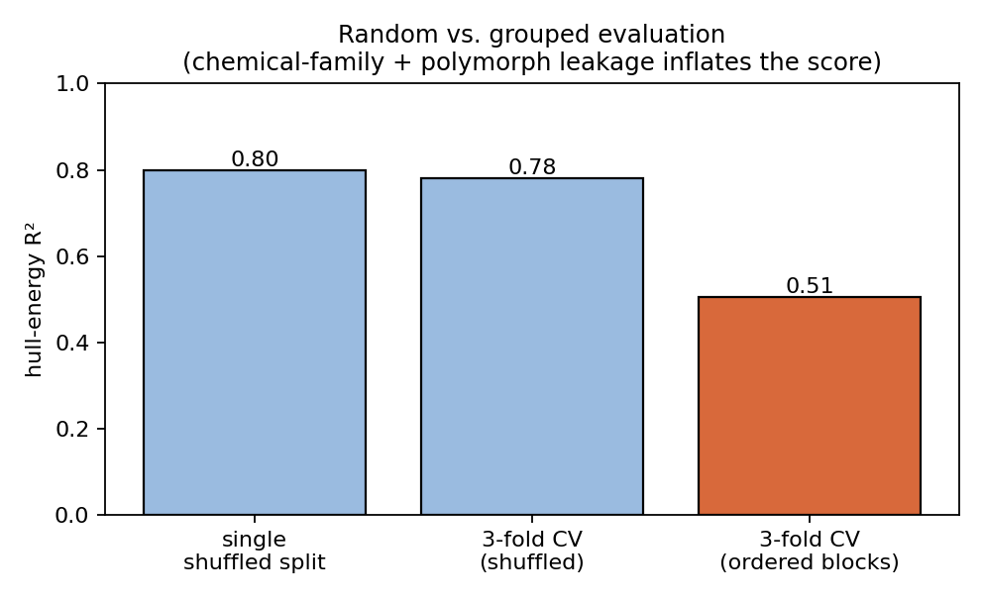
Key Caveat: Honest Evaluation
• A random (shuffled) train/test split inflates scores here:
chemical-family leakage — data is clustered by chemistry
polymorph leakage — same-composition structures split across train/test
• Holding out grouped/ordered blocks instead:
hull-energy R²: 0.80 (shuffled) → 0.51 (grouped)
• ⇒ realistic screening estimates need composition-grouped splits.

Slide 10
Next Steps
• Honest evaluation: GroupKFold by composition / scaffold splits to remove leakage.
• Dimensionality reduction: PCA(SOAP) → fast and accurate; makes gradient boosting practical at scale.

Slide 11
References
• Dataset — E. T. Chenebuah & D. T. Chenebuah, “An inorganic ABX₃ perovskite materials dataset for ML,” arXiv:2312.11335 (2023). https://doi.org/10.48550/arXiv.2312.11335 · github.com/chenebuah/ML_abx3_dataset

