Slide 1
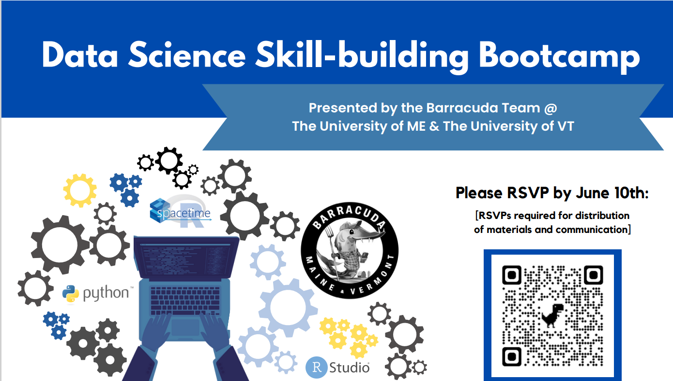

Session:
Python 101 - Intro to Python, scipy, numpy and more
----------
Tuesday June 15, 2023
9AM-12PM

Slide 2
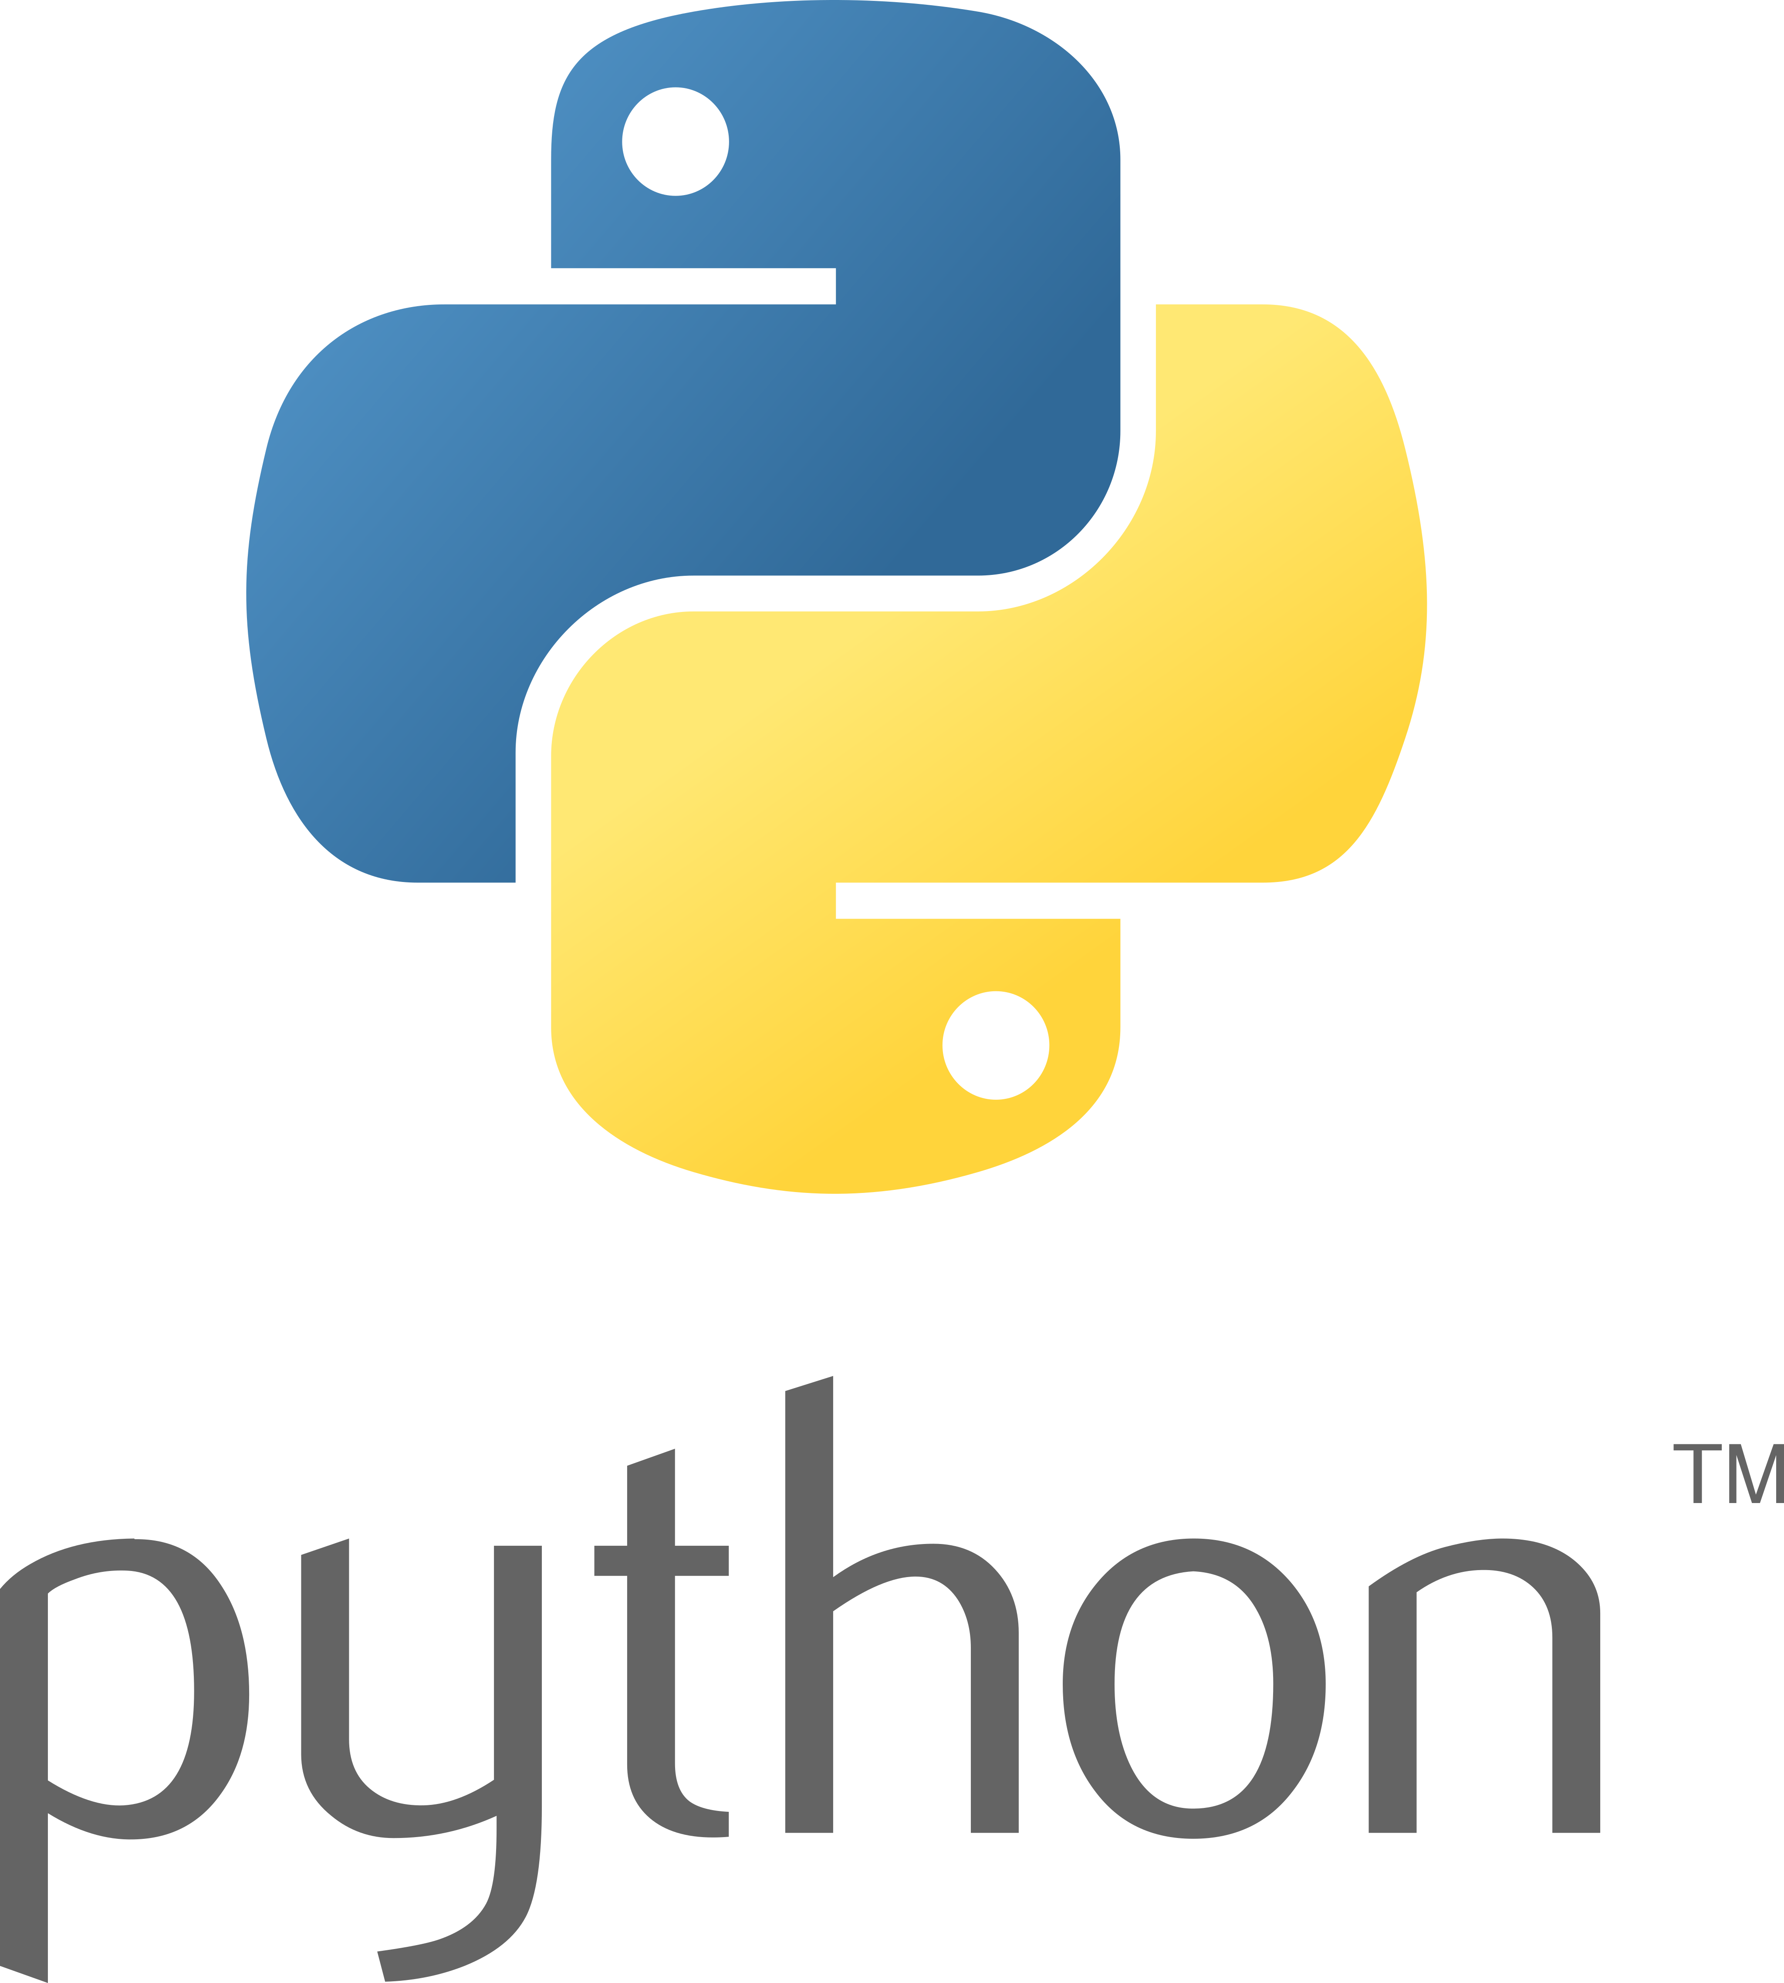
What are we doing today?
Looking at a few slides (history and syntax)
Installing reticulate, python, packages etc.
Working though some code of increasing complexity.
Question checkpoints throughout the script.
Two 10 minute breaks

Slide 3
What is Python?
Python is a general programming language
It is high-level object-oriented language
It has a focus on simplicity/readability
A very versatile/powerful open source language
Highly favored by developers and data scientists

Slide 4
Python History
Developed by Guido van Rossum in 1989
Written in C
Python 2.0 launched in 2000
Python 3.0 launched in 2008
Most notable for its design philosphy

Slide 5
Python Culture
Beautiful is better than ugly.
Explicit is better than implicit.
Simple is better than complex.
Complex is better than complicated.
Readability counts.
Zen of Python,PEP20

Slide 6
What is it good for?
Web/software development
Machine Learning
Mathematical Modeling
Network science
Data analysis and visualization

Slide 7
What sites/apps use it?
Google
Spotify
youtube
Dropbox
Instagram
Uber
Netflix

Slide 8
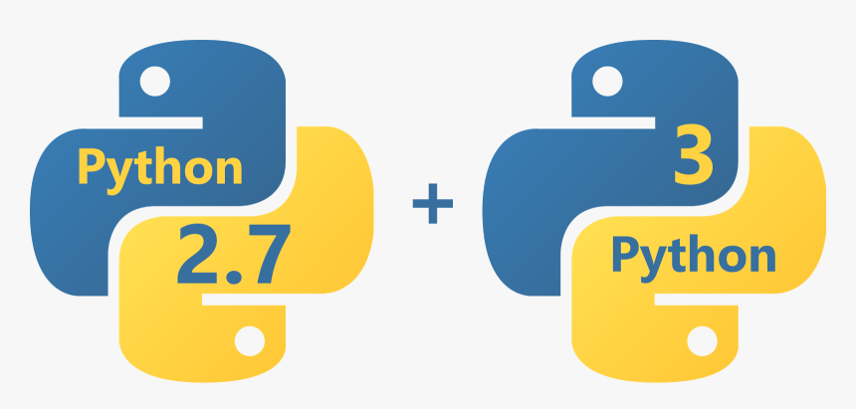
Python Versions
VS

Slide 9

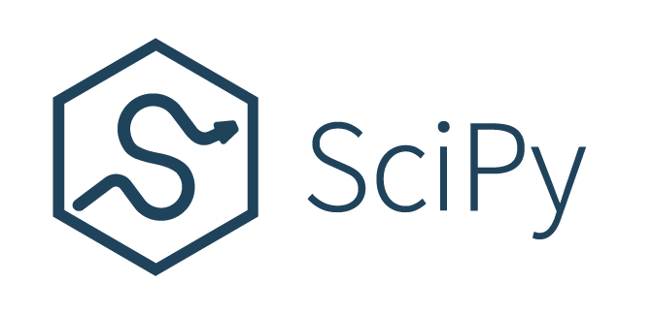
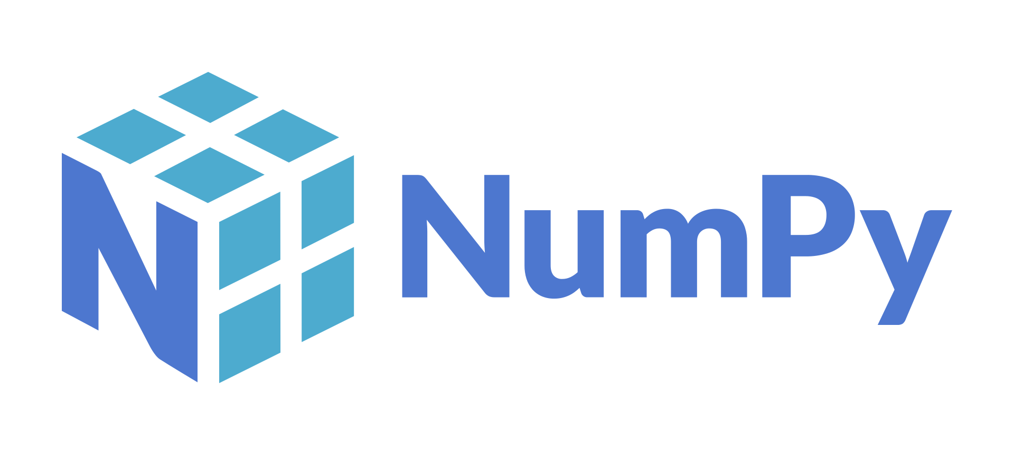
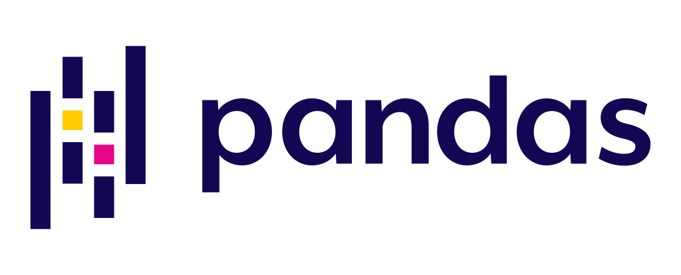
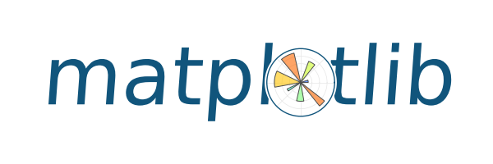
A focus on community modules

Slide 10
Using python as an R User
Python can be tricky to install:
Lots of versions, package installers IDEs etc.
As a scripting language, setting the interpreter and debugging is different than the way R functions

Slide 11
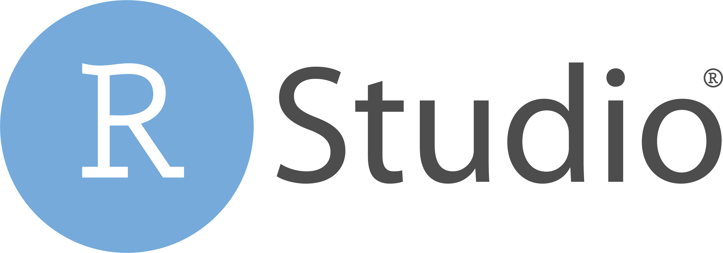
R Studio with Reticulate
IDE for R
Supports Python through Reticulate
Can run code line by line as in R
Familiar to R users and language switching

Slide 12
Python Syntax
Anatomy of a python function:
object = function(data = ds, method = ”mean", num = 10)
Object name
Function name
Arguments

Slide 13
Python Syntax
Anatomy of a python function:
object = function(data = ds, method = ”mean", num = 10)
Pass a dataset
Pass a setting to the function
Or a numeric value

Slide 14
Python Syntax
Anatomy of a python function:
object = function(data = ds, method = ”mean", num = 10)
Python objects have methods:
print(object.python_method(method = ”mean", num = 10)
Object name
Method name
Methods can take arguments

Slide 15
Python Syntax
Anatomy of a python function:
object = function(data = ds, method = ”mean", num = 10)
Python objects have methods:
print(object.python_method(method = ”mean", num = 10)
This result could be stored as a new object
Pri. newObj = object.python_method(method = ”mean”))

Slide 16
Python Syntax
Anatomy of a python function:
object = function(data = ds, method = ”mean", num = 10)
Python objects have methods:
print(object.python_method(method = ”mean", num = 10)
Or printed directly to the console
Pri. print(object.python_method(method = ”mean”))

Slide 17
Script Roadmap
Installation of python and libraries
Objects, Methods and Functions
Data Structures and indexing
Numpy
Logic Structures
Loops
Pandas
Functions
Data analysis – statsmodels
Scipy
Graphics - seaborn

Slide 18
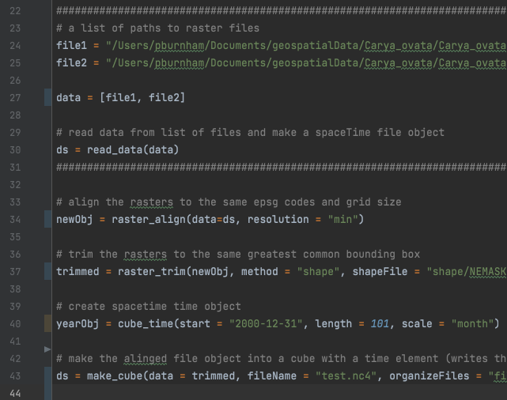
Jumping into some code

