Slide 1


Planar Languages and
Learnability
Alexander Clark, Christophe Costa Florêncio,
Chris Watkins, Mariette Serayet
Department of Computer Science,
Royal Holloway,
University of London
Département Informatique, Université de St Etienne

Slide 2
Planar langauges: motivation
Efficient unsupervised learning of mildly context-sensitive grammars

Slide 3
Planar languages: simple example
Parikh map: maps a string to a vector of counts
Parikhs theorem
  image of a CF language is semilinear

Slide 4
CF language

Slide 5
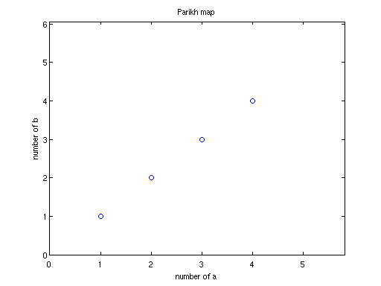
L lies on a line
baababba
bbbaaa
aabb
baba
ba
ab

Slide 6
We can learn languages from positive data
Project data into feature space
Find lowest dimensional hyperplane that contains all the data
Given unknown string w
  measure perpendicular distance to plane
  if this is zero (or very small), w in L
  if it is big, w is not in L

Slide 7
Outline
What, why, wherefore of kernels
String kernels
Planar languages
Theoretical results: expressive power, learnability, injectivity
Experimental results
Future research
Conclusion

Slide 8
Kernel functions 1
Map from data points to points in feature space
Function must be positive semi-definite
Can be used with any linear pattern learning algorithm

Slide 9
Kernel functions 2
Computational problem: feature space generally high/infinite dimension
Solution: compute just inner product, feature vector remains implicit:

Slide 10
String kernels
Map strings to points in feature space
All-k-subsequences, k-subsequences: based on counts of subsequences of length (up to) k
k = 1: Parikh kernel
Gap-weighted: based on counts of subsequences of length (up to) k, weighted by , n = size of gap
p-Spectrum: based on counts of contiguous subsequences of length p

Slide 11
Planar languages
Informally: κ-planar language is set of strings corresponding to hyperplane in κ's feature space
intuitively learnable from positive data
Formally:

Slide 12
Expressive power
Depends on kernel
Generally, planar languages do not conform to Chomsky hierarchy
All-k-subsequences contains non-mildly context sensitive languages
k-testable languages are planar for p-Spectrum kernel

Slide 13
Closure properties
Generally, planar languages do not fit into Chomsky hierarchy
Not closed under:
  concatenation, union, homomorphism...
Closed under:
  reversal
  intersection

Slide 14
Injectivity
k-subsequences not injective: for k = 2, “abba” and “baab” map to same point
But: length of such strings grows exponentially in k?
Gap-weighted is injective when decay factor transcendental number

Slide 15
Learnability
Paradigm: identification in the limit
Characteristic set has polynomial size
Polynomial computation time
Polynomial number of mind changes
Learner exists that is consistent, monotone increasing and incremental

Slide 16
Proof of learnability
Based on properties of learning algorithm SPAN:
  loop over input data
  if current datapoint does not correspond to point in hyperplane spanned by base, add to base

Slide 17
Finite elasticity
In case that feature space defined by κ has finite dimension, class of κ-planar languages has finite elasticity
True for GapWeighted(+) kernels
Finite unions of such classes also have finite elasticity

Slide 18
Computation
function [Representation, Residuals] = learn(train, kernel, param)
% Computes a representation of the training data
% and the residuals of the data which should be close to zero.
% Arguments are a cell array of training data, a function handle,
% kernel hyperparameter.
% Written by Alex Clark but heavily based on
% John Shawe-Taylor and Nello Cristianini's code
% Jan 11 2006.
n = size(train,1);
for i = 1:n
for j = i:n
v = kernel(train{i},train{j},param);
K(j,i) = v;
K(i,j) = v;
end
end
% K is the Gram matrix
D = sum(K)/n;
E = sum(D)/n;
J = ones(n,1) * D;
K2 = K - J - J' + E * ones(n,n);
% K2 is the translated kernel.
k = rank(K2)
[V,L] = eigs(K2,k,'LM');
% Debugging
fullEigenvalues = eig(K2);
invL = diag(1./diag(L));
sqrtL = diag(sqrt(diag(L)));
invsqrtL = diag(1./diag(sqrtL));
Knew = K2' * V * invL * V' * K2;
% lengths of translated vectors
mahalanobis = sqrt(diag(K2' * V * invL * invL * V' * K2))
Representation.V = V;
Representation.L = L;
Representation.D = D;
Representation.E = E;
Representation.eigs = fullEigenvalues;
Representation.rank = k;
Representation.train = train;
Representation.Knew = Knew;
Representation.kernel = kernel;
Representation.kernelParams = param;
Residuals = diag(K2) - diag(Knew);

Slide 19
Experimental results
Planar language learner, implemented in Matlab
  computes eigendecomposition of translated Gram matrix
Synthetic datasets:
  palindromes
  MIX language
  AnBmCnDm
  Crossing serial dependencies
  ...

Slide 20
PCFG vs HMM vs GapWeighted

Slide 21
Future directions
Reducing noise sensitivity
Kernels customized for natural language
Preimage problem
Work with real corpora: very high dimensionality (large alphabets), high sample complexity
Solution: projections/distribution kernels?

Slide 22
Conclusion
Planar languages constitute a new approach to GI
Inherently efficiently learnable
Right expressive power
Potential for use in NLP

