Slide 1

SCJP SUN CERTIFIED
PROGRAMMER FOR
JAVA 6

Slide 2
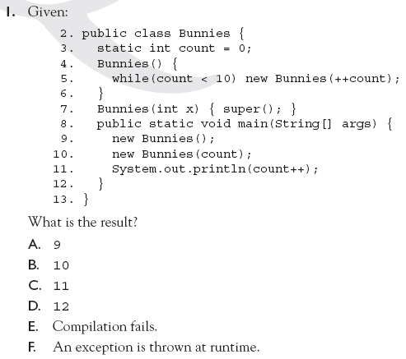

Slide 3
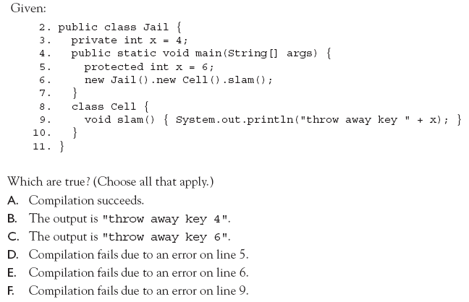

Slide 4
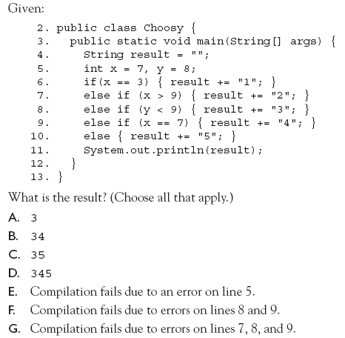

Slide 5
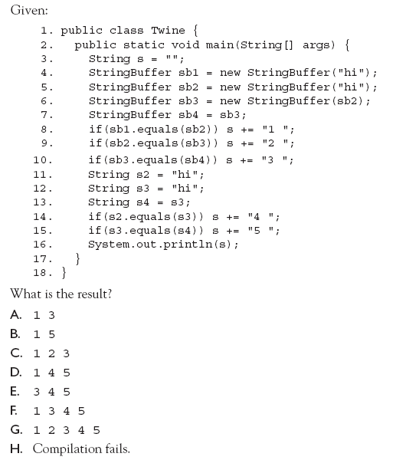

Slide 6
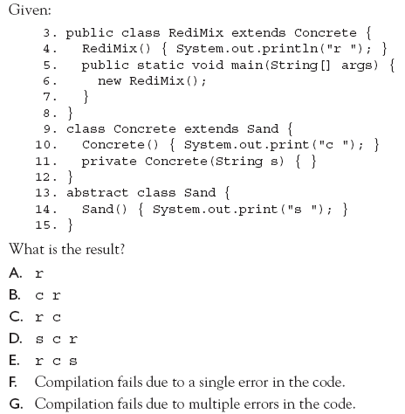

Slide 7
