Slide 1
Sockets

Slide 2
Client-server model

Slide 3
Client-server model
The client-server model is a computing model which consists of service providers (servers) and service requesters (clients)
Often clients and servers communicate over a computer network on separate hardware, but both client and server may reside in the same computer
The client-server model can be used on the Internet as well as local area networks (LANs).

Slide 4
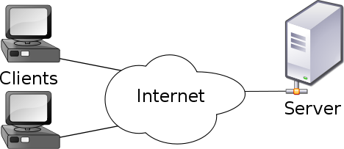
Client-server model
The client-server model distinguishes between applications as well as devices.
Network clients make requests to a server by sending messages, and servers respond to their clients by acting on each request and returning results.
One server generally supports numerous clients, and multiple servers can be networked together in a pool to handle the increased processing load as the number of clients grows.

Slide 5
Client-server model
Some of the most popular applications on the Internet follow the client-server model including email, FTP and Web services.
Each of these clients features a user interface and a client application that allows the user to connect to servers.
In the case of email and FTP, users enter a computer name (or IP address) into the interface to set up connections to the server.

Slide 6
Network programming
Computer network programming involves writing programs that enable processes to communicate with each other across a computer network.
Interprocess communication (IPC) cannot be implemented in a perfectly symmetric way: to establish a communication channel between two processes, one process must take the initiative, while the other is waiting for it. Therefore, network programming assumes a client server model
The client and server processes together form a distributed system

Slide 7
Socket programming
The endpoint in an interprocess communication is called a socket
Network socket, internet socket
The data transmission between two sockets is organized by communication protocols, usually implemented in the operating system of the participating computers.
Application programs write to and read from these sockets.
The reference API for socket programming is the Berkeley sockets API (BSD)

Slide 8
Interprocess communication (IPC)
The following IPC mechanisms are supported by Windows:
Clipboard
COM
Data Copy
DDE
File Mapping
Mailslots
Pipes
RPC
Windows Sockets
http://msdn.microsoft.com/en-us/library/windows/desktop/aa365574(v=vs.85).aspx#base.using_dde_for_ipc
See also
http://en.wikipedia.org/wiki/Inter-process_communication

Slide 9
.NET Interprocess communication
The following technologies relates to the IPC in .NET
Socket programming
HTTP
Named pipes
ASP.NET
.NET Remoting
Web Services
Windows Communication Foundation (WCF)

Slide 10
TCP/IP

Slide 11
TCP/IP Introduction
Read
http://www.w3schools.com/tcpip/tcpip_intro.asp

Slide 12
TCP/IP Addressing
Read
http://www.w3schools.com/tcpip/tcpip_addressing.asp

Slide 13
TCP/IP Protocols
Read
http://www.w3schools.com/tcpip/tcpip_protocols.asp

Slide 14
TCP/IP
Read also
http://en.wikipedia.org/wiki/Internet_protocol_suite

Slide 15
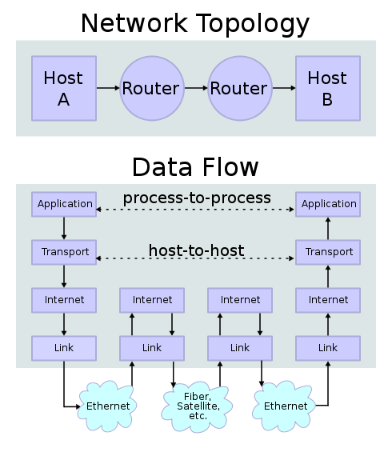
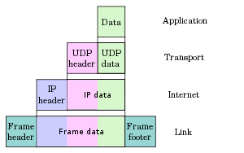
TCP/IP
Explain the following figures (from wikipedia)

Slide 16
TCP/IP Sockets

Slide 17
TCP/IP Sockets in Windows
Windows Sockets 2 (Winsock) is based on Berkeley Software Distribution (BSD) UNIX sockets
C/C++ programming
Also .NET provides a socket programming interface
http://msdn.microsoft.com/en-us/library/system.net.sockets.socket.aspx

Slide 18
TCP/IP Socket
A socket represents a single connection between two network applications.
These two applications nominally run on different computers, but sockets can also be used for interprocess communication on a single computer. Applications can create multiple sockets for communicating with each other.
Sockets are bidirectional, meaning that either side of the connection is capable of both sending and receiving data.

Slide 19
IP address and port
A socket address is the combination of IP address and port number.
The ports are used by TCP and UDP to deliver the data to the right application
Typically a server process listens a certain port. The clients send requests to this server process by specifying the IP address of the server and port number of the application
Some of the ports are well-known ports (reserved)
A computer can refer to itself with address 127.0.0.1 (localhost)

Slide 20


Socket programming
C# has the following classes for TCP/IP socket programming
TcpListener (for server)
TcpClient
Socket

Slide 21


Socket programming
Client-side:
Client chooses a free port and connects to the known port at server (request)
Server responses to the client request
Server gets a new socket bound to the same local port and also has its remote endpoint set to the address and port of the client
It needs a new socket so that it can continue to listen to the original socket for connection requests while tending to the needs of the connected client
http://docs.oracle.com/javase/tutorial/networking/sockets/definition.html

Slide 22
Client-side
The client knows the hostname of the machine on which the server is running and the port number on which the server is listening
The socket connection is opened as follows
TcpClient client = new TcpClient("localhost", port);
Next we can open input and output streams through this socket
NetworkStream ns = client.GetStream();
StreamWriter streamWriter = new StreamWriter(ns);
StreamReader streamReader = new StreamReader(ns);

Slide 23
Client-side
Read from input stream and write the output stream with application specific protocol
streamWriter.AutoFlush = true;
streamWriter.WriteLine(”time");
string response= streamReader.ReadLine();
Close streams when not needed any more
streamWriter.Close();
streamReader.Close();
Close also the socket-connection
client.Close();

Slide 24
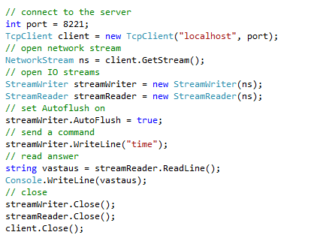
Client-side

Slide 25
Server-side
Server application listens its port and opens connections to the clients. Class TcpListener is used for that (Server socket)
TcpListener is created and started as follows
IPAddress localAddr = IPAddress.Parse("127.0.0.1");
TcpListener tcpListener = new TcpListener(localAddr, 8221);
tcpListener.Start();
After the initialization the server waits at infinite loop requests from clients. Upon request a new socket is created
TcpClient client = tcpListener.AcceptTcpClient();
The original socket (tcpListener) is released

Slide 26
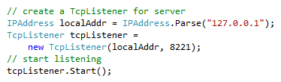
Server-side
Initialization

Slide 27
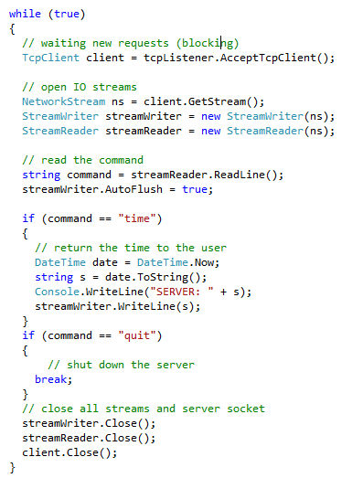
Server-side
Wait a new request from a client
Upon request create a socket
Open streams
Read command
Response
Close streams and socket

Slide 28
Exercise
Make a server, which has the following functions
Time: returns the current day and time as string
Count: returns the number of requests after the server startup
Make console client
Y:\Makela_Petteri\KLTITE10\Network Programming\Sockets\SocketTest1ThreadLoop
Make Windows Forms client

Slide 29
Server-side threads
Multiple client requests can come into the same port and, consequently, into the same server-side socket (TcpListener).
Client connection requests are queued at the port, so the server must accept the connections sequentially.
However, the server can service them simultaneously through the use of threads - one thread per each client connection.
Even in the case of single processor server use of multiple threads is beneficial. Other clients can be served on the same time as results of database query are waited for one client

Slide 30
Server-side threads
The basic flow of logic in such a server is this:
while (true) { accept a connection ; create a thread to deal with the client ; }
In other words, the main thread waits new requests from the clients. A separate thread is created on the server for each client.
The main thread and the threads to serve clients are shown in the next page

Slide 31
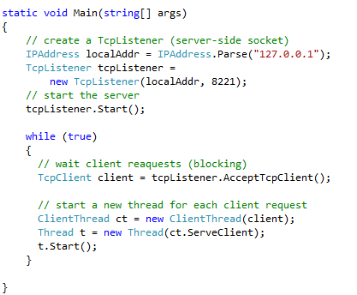
Server-side threads – Main thread
The main thread of the server waits new requests on the AcceptTcpClient thread
New socket is created for the client after the request
In addition, new thread is created for the client
The thread serving the client is shown in the next page
\Network Programming\Sockets\SocketTest1Threads

Slide 32
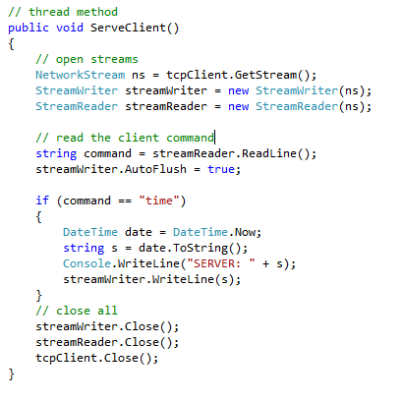
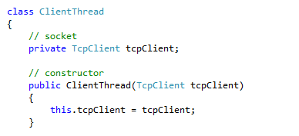
Server-side threads – Thread serving the client
Each client is served in its own thread
\Network Programming\Sockets\SocketTest1Threads

Slide 33
Server-side threads – Thread serving the client
In the previous example the thread was stopped after the response was sent to the client
Sometimes the connection between the client and server is made for a longer time. In this case the server’s thread, which serves the client has a while loop
See the example on the next page

Slide 34
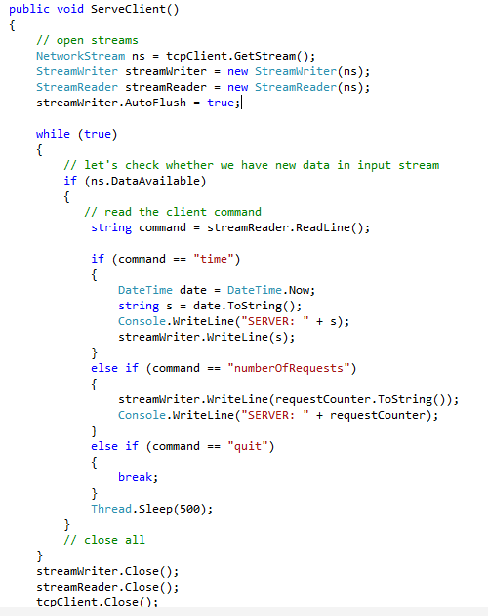
The server and client have now a connection
They can send and receive data to each other a longer time
Exercise: how to stop this thread if the client disappears without sending a “quit”-command
Network Programming\Sockets\SocketTest1ThreadLoop

Slide 35
Measurement device and server
Figure in the next page shows a diagram of a system which consists of embedded measurement device, server and several clients
The server reads measurements (e.g., temperatures, pressures etc.) from the embedded device through serial connection
The measurements are read on a separate thread on the server (Measurement thread)
Each client is served on its own thread on the server
The data is sent from the measurement thread to the client threads through FIFO
Note the thread synchronization (Lock, Monitor.Pulse, Monitor.Wait)

Slide 36
Measurement device and server
Embedded measurement device
Server
Client
Main Thread
port
port
Measurement Thread
RS port
port
Thread serving
client
RS232
Client
port
port
Thread serving
client
FIFO

Slide 37
Measurement device and server
The solution in the previous slide is probably the correct approach, but it is rather complex
There is a lot of book keeping with the client threads
Perhaps too complex for an exercise
A simpler approach is shown in the next slide
The measurements are done still in a separate thread
All of the clients are served in a single thread (“Thread for all clients”)
This thread has a list of clients
Measurements are sent to this thread through FIFO
Clients are added to the list in the main thread

Slide 38
A simpler approach
Embedded measurement device
Server
Client
Main Thread
port
port
Measurement Thread
RS port
port
Thread serving all
clients
RS232
Client
FIFO
port
port
List of clients

Slide 39
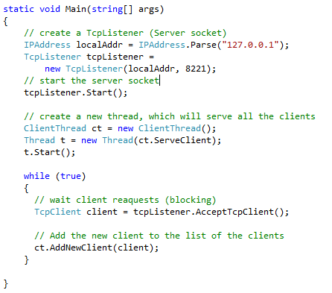
Server main thread
Server creates a TcpListener
A new thread, which serves all the clients is created and started
Upon client request the client is added to the list

Slide 40
A new class for client socket and streams
The server needs a list of clients.
Each element (client) of this list contains the following information:
TcpClient
NetworkStream
StreamWriter
StreamReader
Let’s define a new class called NetworkStreams which can be used for communication between the server and client

Slide 41
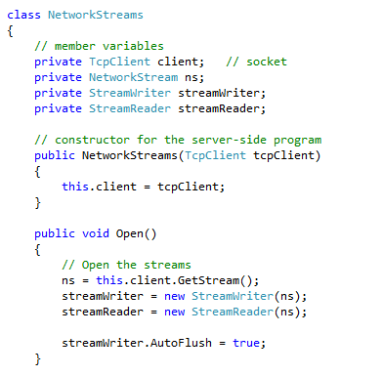
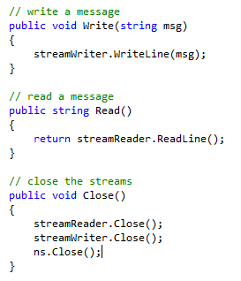
Class NetworkStreams

Slide 42
Class NetworkStreams
The class NetworkStream can be used for reading and writing the data. It has also methods to open and close the streams
Note that this same class can be used both in the server-side and the client-side
To use the class NetworkStreams in the client-side an additional constructor is needed
public NetworkStreams(string ipAddress, int port)
Implementation of this constructor is left as an exercise

Slide 43
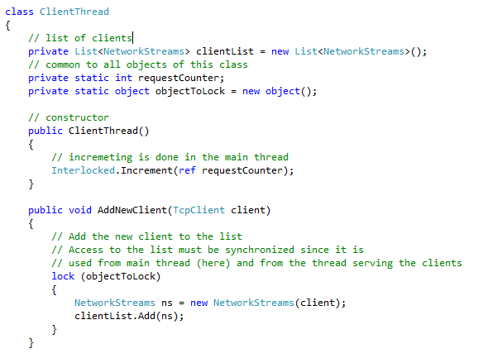
List of clients in server (List of NetworkStreams objects)
Class ClientThread contains a list of NetworkStreams objects

Slide 44
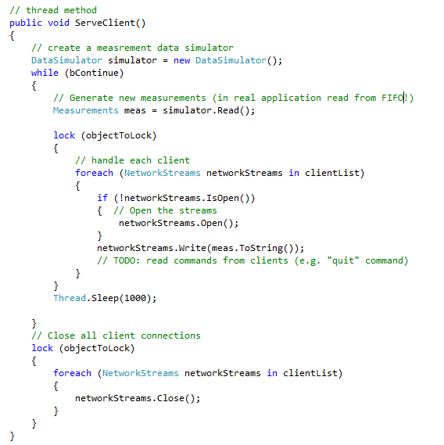
Thread serving the clients
Note the synchronization (lock)
In a real application the measurements are read in a separate thread and sent to this thread through a FIFO
Removing clients from the list is left as an exercise

Slide 45
Client application for the Measurement application
Let’s create two versions of client applications
1. Console application
Single thread
Measurement data is read continuously in a while loop (e.g. 100 times)
2. Windows Forms application
Data is shown in a ListView
Worker thread opens a socket connection to the server
Utilize the NetworkStreams object designed previously for server side

Slide 46
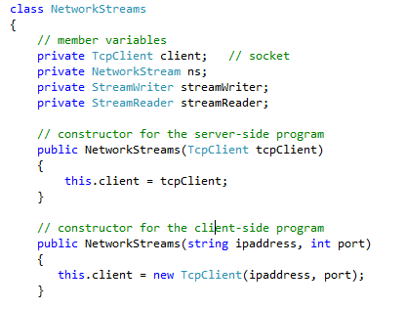
Console Client
Class NetworkStreams is utilized also in the client side
A new constructor is needed, which creates a new TcpClient object
Problem:
We have two versions of this class (and file) now
Solution: DLL
Let’s see this later on…

Slide 47
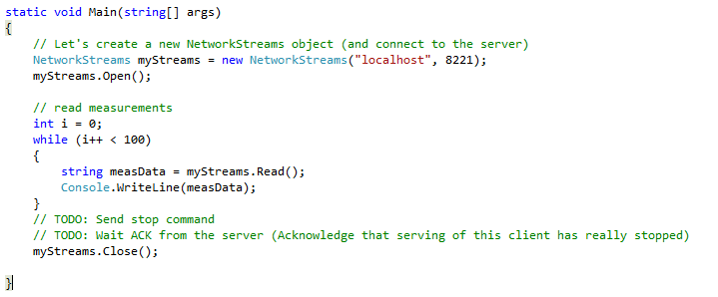
Console Client
Console client is shown below
Some issues has to be still solved
Send the “quit”-command to the server so that the server will stop data to this client
Data is in text format. Binary or XML would be better
Exception handling is missing

Slide 48
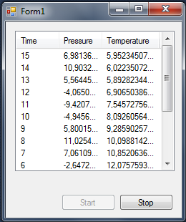
Exercise 1
Make a graphical user interface (Windows Form)
Ota pohjaksi ListViewTestiExample
Tee socket-yhteys worker-threadiin kirjastoa käyttäen
Server
Client
Worker
Thread

Slide 49
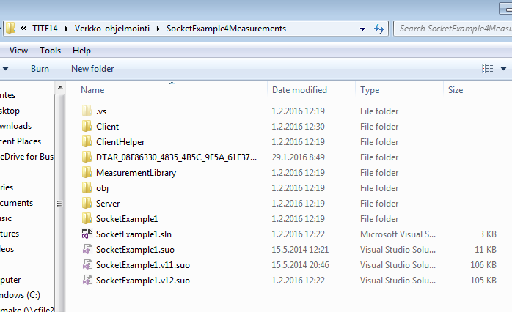
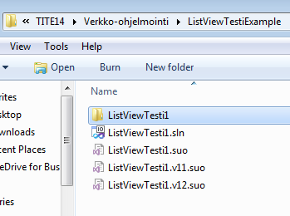
Ohjeita
Kopioi hakemisto
Y:\Makela_Petteri\TITE14\Verkko-ohjelmointi\ListViewTestiExample
hakemistoon
Y:\Makela_Petteri\TITE14\Verkko-ohjelmointi\SocketExample4Measurements
Lisää uusi Client-ohjelma SocketExample4Measurements Solutionin alle

Slide 50
Exercise 2
Modify the client and server so that stopping the client is handled properly

Slide 51
Exercise 3
Modify the server so that the measerements are handled in a separate thread
Use FIFO
Measurement options
Simulation
Read data from GPS
Read data from your own embedded device

Slide 52
Links
http://www.devarticles.com/c/a/C-Sharp/Socket-Programming-in-C-Part-I/1/
http://www.devarticles.com/c/a/C-Sharp/Socket-Programming-in-C-sharp-Part-II/

Slide 53
Examples in Java
http://docs.oracle.com/javase/tutorial/networking/sockets/definition.html
http://docs.oracle.com/javase/tutorial/networking/sockets/readingWriting.html
http://docs.oracle.com/javase/tutorial/networking/sockets/clientServer.html
Java examples are explained well. Recommended reading also for C# programmers

