Slide 1
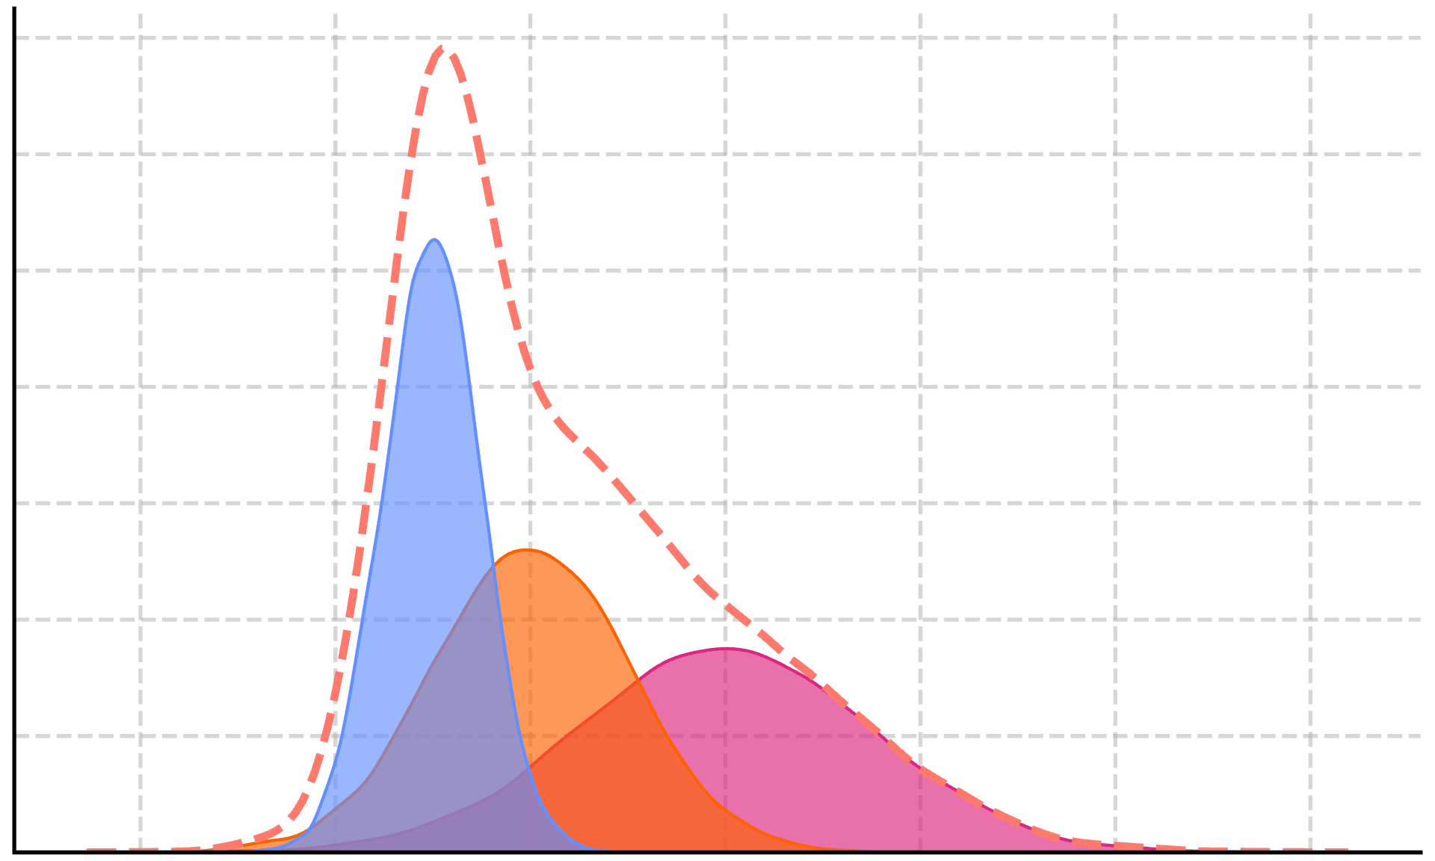
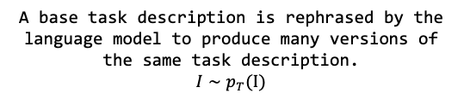


Inputs
Language Model
The language model outputs a Gaussian prior for each task description, which we use to build a mixture.
Rephrased task descriptions
$$θ∼p_{T}(Θ)$$
A base task description is rephrased by the language model to produce many versions of the same task description.
$$I∼p_{T}(Ι)$$
Data points
Calculate posterior
Data points are used to update the prior and produce the posterior.
$$p\left(θ\right|D)∝p\left(D | θ\right) p( θ)$$
Make predictions

