Slide 1
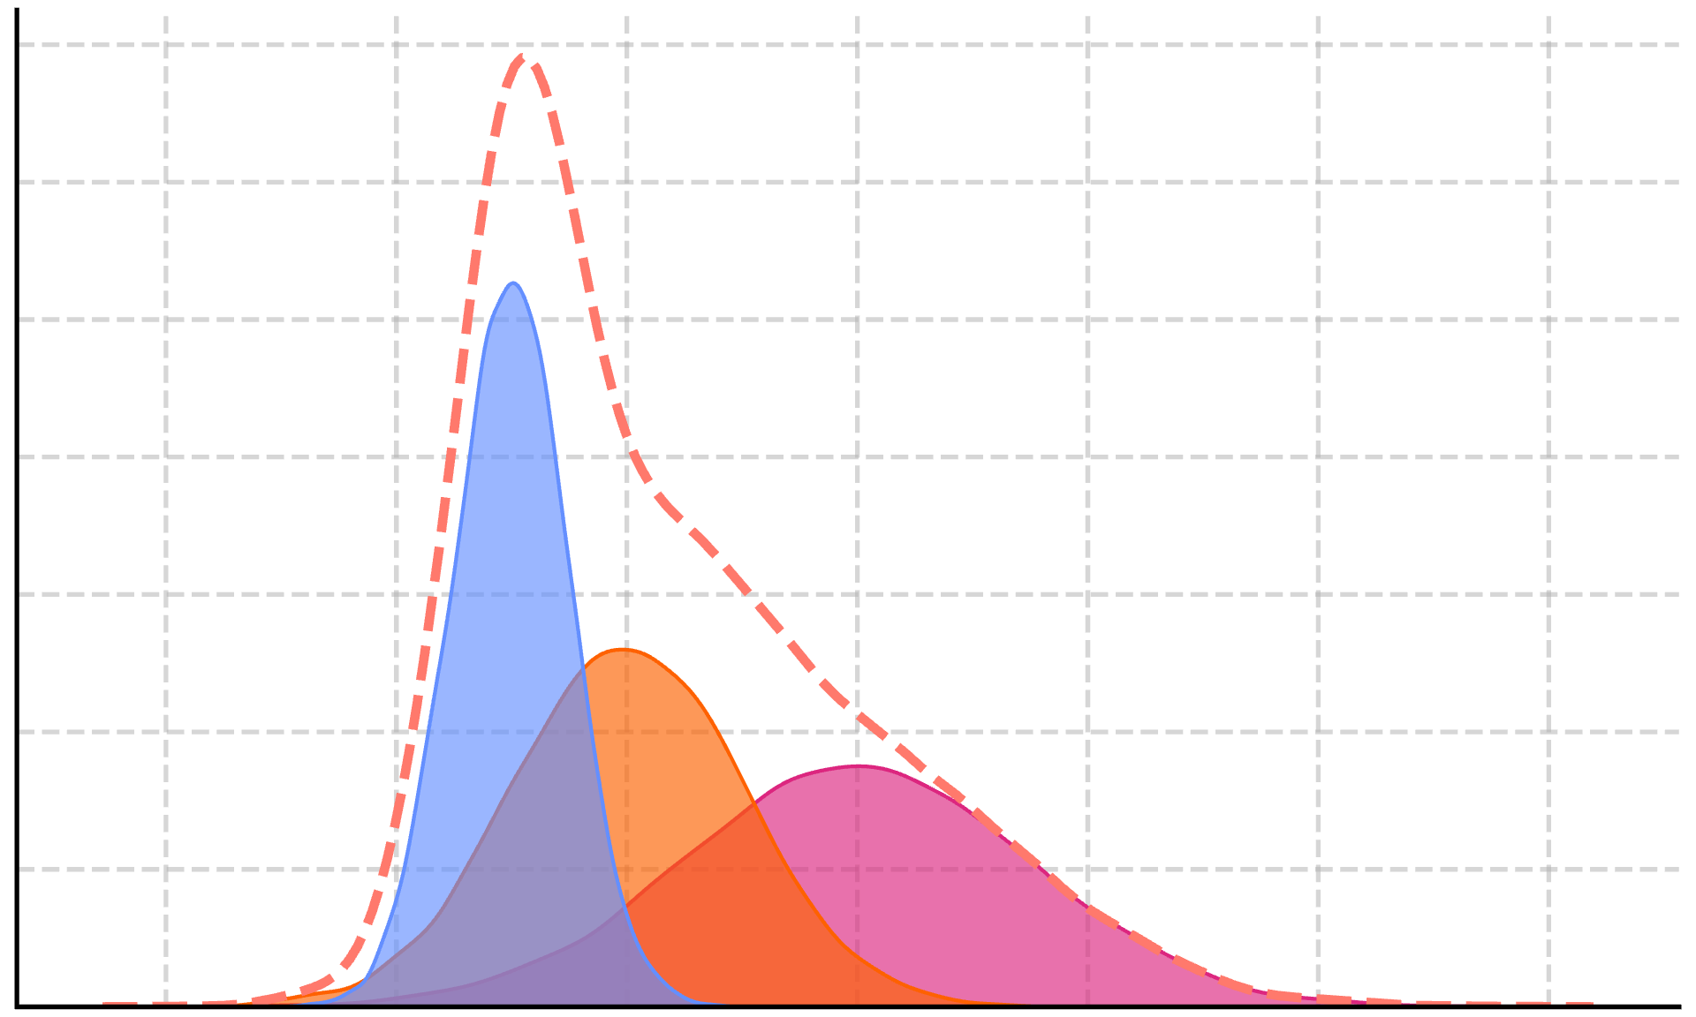


Task Descriptions
Language Model
The language model outputs a Gaussian prior for each task description, which we use to build a mixture.
Rephrased task descriptions
$$θ∼p_{T}(Θ)$$
[You can predict TARGET based on FEATURES. Please provide a mean and standard deviation for a Gaussian prior for a linear model...]
A base task description is rephrased by a language model many times to produce a distribution over relevant task descriptions.
Data
Data points
Calculate posterior
$$p\left(θ\right|D)∝p\left(D | θ\right) p( θ)$$
Data points are used to update the prior to produce the posterior with Monte Carlo methods.
Make predictions

