Slide 1
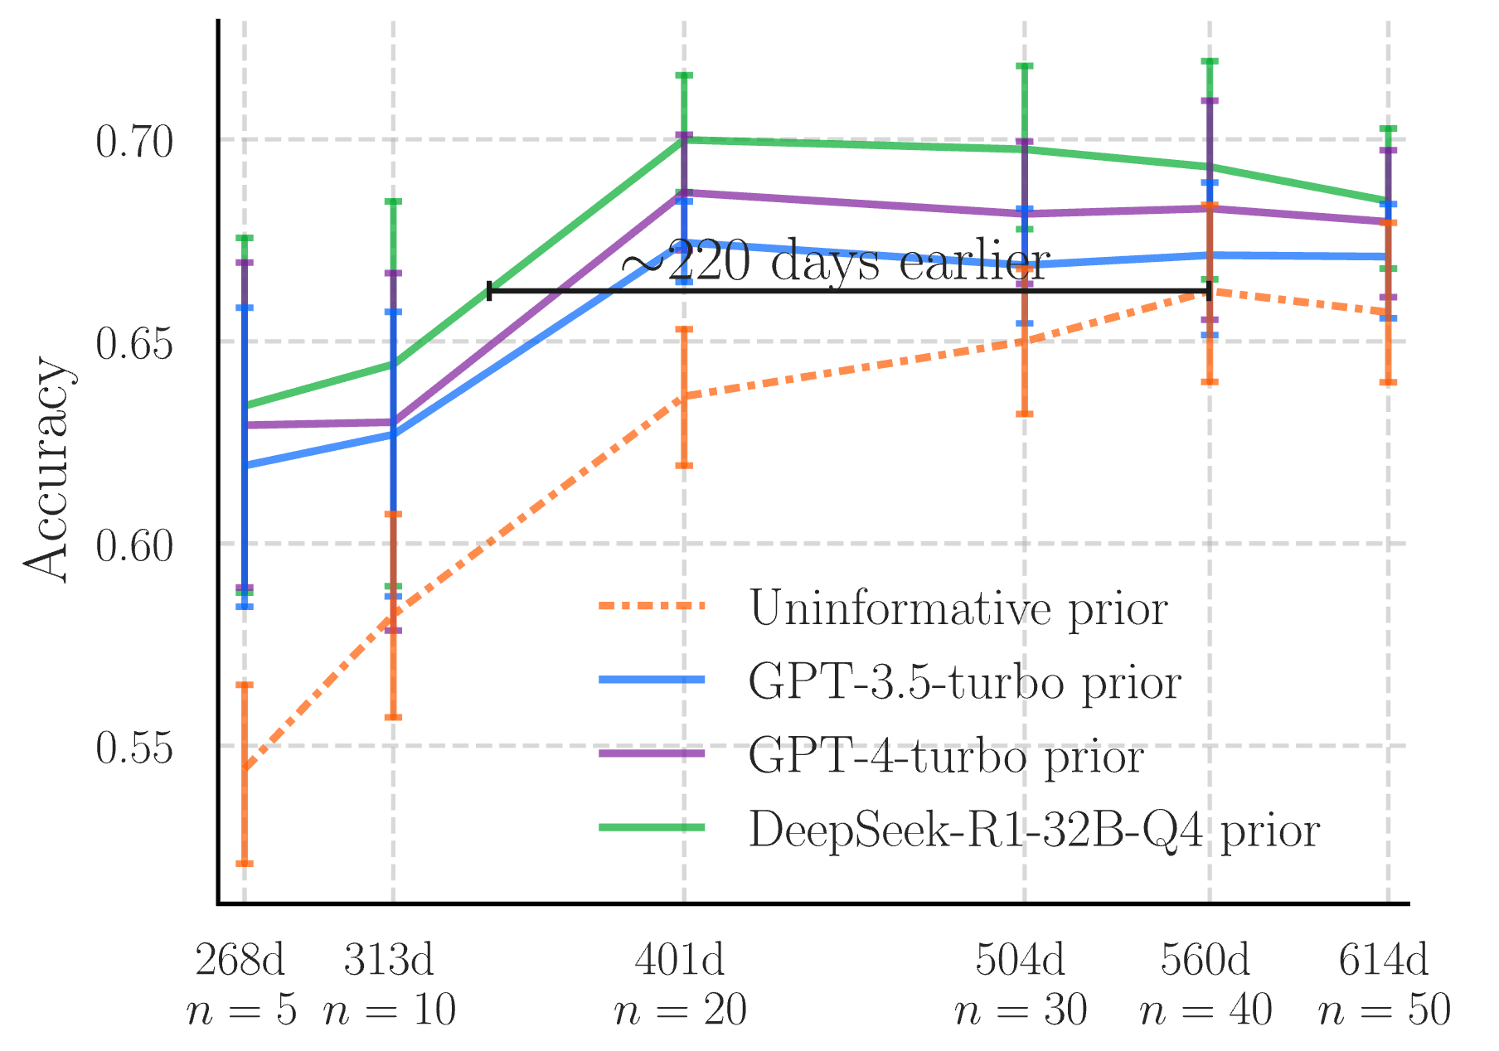
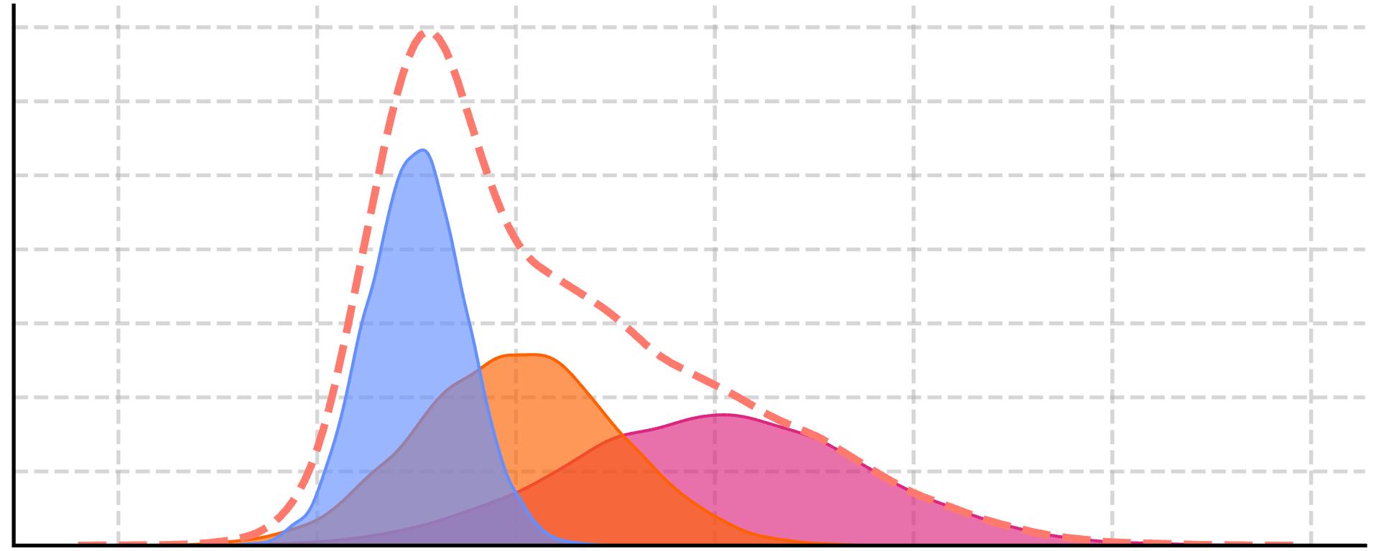


Task Descriptions
LLM-Elicited Priors
Data
[You can predict TARGET based on FEATURES. Please provide a mean and standard deviation for a Gaussian prior for a linear model...]
The LLM outputs a Gaussian prior for each task description and feature, which we use to build a mixture model.
Data points are used to update the prior to produce the posterior with Monte Carlo methods.
$$θ∼p_{T}(Θ)$$
Calculate posterior
$$p\left(θ\right|D)∝p\left(D | θ\right) p( θ)$$
A base task description is rephrased by an LLM many times to produce a distribution over relevant task descriptions.
Make predictions

